Slide 1
He seguido esta implementación en PyTorch
https://github.com/Derpimort/VGGVox-PyTorch

Slide 2
Primero entender bien la teoría:
https://github.com/a-nagrani/VGGVox
[1] A. Nagrani*, J. S. Chung*, A. Zisserman, VoxCeleb: a large-scale speaker identification dataset, INTERSPEECH, 2017
[2] J. S. Chung*, A. Nagrani*, A. Zisserman, VoxCeleb2: Deep Speaker Recognition, INTERSPEECH, 2018
The models trained for verification map voice spectrograms to a compact Euclidean space where distances directly correspond to a measure of speaker similarity.
Such embeddings can be used for tasks such as speaker verification, clustering and diarisation

Slide 3
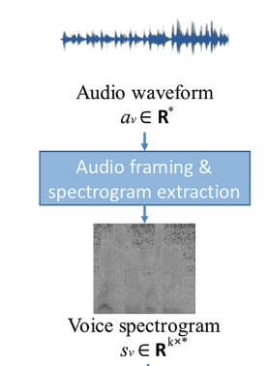
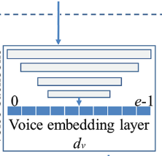
The models trained for verification map voice spectrograms to a compact Euclidean space where distances directly correspond to a measure of speaker similarity.
VGGVox

Slide 4

The system is trained on short-term magnitude spectrograms extracted directly from raw audio segments, with no other pre-processing.
A deep neural network trunk architecture is used to extract frame level features,
which are pooled to obtain utterance-level speaker embeddings.
VGGVox
CNN
VGGVox
CNN
VGGVox
CNN
frame level features
X₁ X₂ X_{N}
Pooling (promediar las X_{i} )
pooled to obtain utterance-level speaker embeddings
Y embedding vector representing the utterance

Slide 5
The entire model is then trained:
Pre-training using a softmax layer and cross-entropy over a fixed list of speakers improves
model performance; hence we pre-train the trunk architecture
model for the task of identification first.
Then TRAININ using contrastive loss.
We employ a contrastive loss [39, 40] on paired embeddings,
which seeks to minimise the distance between the embeddings
of positive pairs and penalises the negative pair distances for
being smaller than a margin parameter

Slide 6
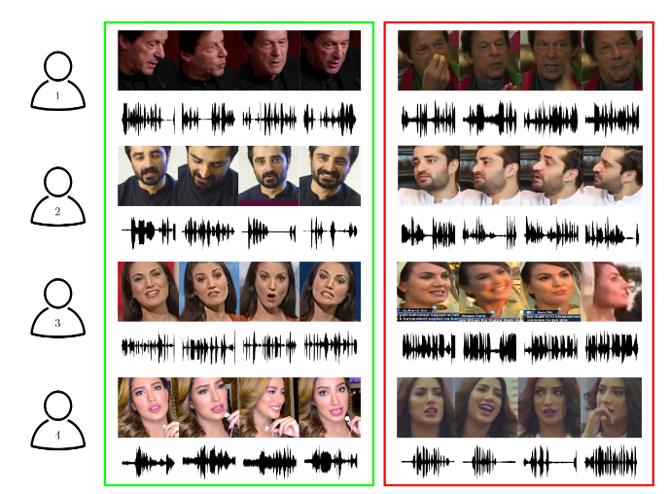
VGGVox trained for Speaker Identification in VoxCeleb

Slide 7
[2] J. S. Chung*, A. Nagrani*, A. Zisserman, VoxCeleb2: Deep Speaker Recognition, INTERSPEECH, 2018
In this paper, we present a deep CNN based neural speaker embedding system, named VGGVox,
trained to map voice spectrograms to a compact Eu-clidean space where distances directly correspond to a measureof speaker similarity.
Once such a space has been produced, other tasks such as speaker verification, clustering and diarisa-tion can be straightforwardly implemented using standard tech-niques, with our embeddings as features. Lo que se estudia en el TFM

Slide 8
Such embeddings can be used for tasks such as speaker verification, clustering and diarisation
Y₁ embedding vector representing the utterance of speaker 1
Y₂ embedding vector representing the utterance of speaker 1
Y₃ embedding vector representing the utterance of speaker 1
Y₄ embedding vector representing the utterance of speaker 1

Slide 9
Using cosine distance between Y_{i} and Y_{j} we can see if they are the same speaker
Y₁ embedding vector representing the utterance of speaker 1
Y₂ embedding vector representing the utterance of speaker 1
Y₃ embedding vector representing the utterance of speaker 1
Y₄ embedding vector representing the utterance of speaker 1

Slide 10
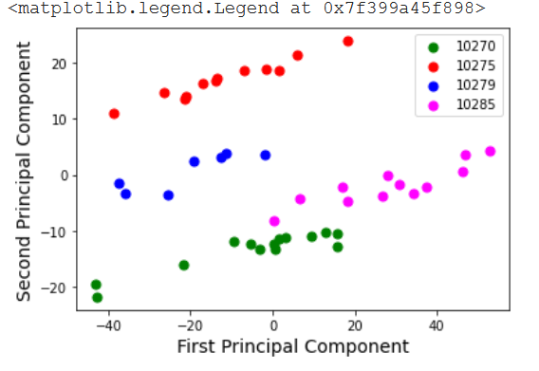
…or we can represent in 2D several embeddings from speaker 1, 2, 3,4 and see if they are in different regions…

Slide 11
Notebooks

Slide 12
VGGVox_1.ipynb
Simple Example to test a pre-trained VGGVox for speaker identification using a small VoxCeleb1 dataset
Se basa en el github: VGGVox PyTorch
El código se puede ver en https://github.com/Derpimort/VGGVox-PyTorch
La idea sería tratar de explicarlo lo más posible en el TFM:
La primera cosa a ver es cómo procesa los audios (los ficheros .wav)
Datasets={
"test":AudioDataset(df_10270, DATA_DIR, is_train=False)}

Slide 13
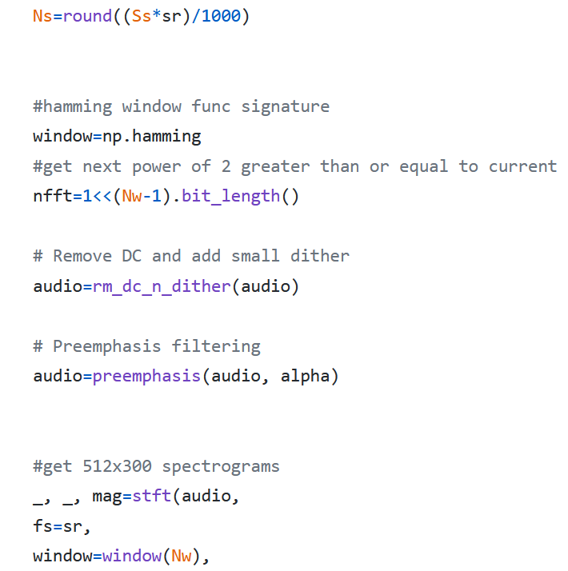
AudioDataset
Ver : https://github.com/Derpimort/VGGVox-PyTorch/blob/master/train.py
def __getitem__(self, idx):
label=self.y[idx]
sr, audio=wavfile.read(os.path.join(self.data_dir,self.X[idx]))
if(self.is_train):
start=np.random.randint(0,audio.shape[0]-self.croplen+1)
audio=audio[start:start+self.croplen]
audio=sig.preprocess(audio).astype(np.float32)
audio=np.expand_dims(audio, 2)
return transformers(audio), label
import signal_utils as sig
https://github.com/Derpimort/VGGVox-PyTorch/blob/master/signal_utils.py

Slide 14
Sería bueno entender de Pytorch: Dataset, DataLoader ya que se usan para pasar los datos a la red
from torch.utils.data import Subset, Dataset, DataLoader
class AudioDataset(Dataset):
https://pytorch.org/tutorials/beginner/data_loading_tutorial.html
Datasets={
"test":AudioDataset(df_10270, DATA_DIR, is_train=False)}
Dataloaders={i:DataLoader(Datasets[i], batch_size=1, shuffle=False, num_workers=2) for i in Datasets}

Slide 15
https://github.com/Derpimort/VGGVox-PyTorch/blob/master/vggm.py
Luego entender y explicar el VGGM model:
model=VGGM(1251)
#model.load_state_dict(torch.load(DATA_DIR+"/VGGMVAL_BEST_149_80.84.pth", map_location=device))
model.load_state_dict(torch.load(MODEL_DIR+"VGGM300_BEST_140_81.99.pth", map_location=device))
model.to(device)
model.eval()
…y el bucle para procesar los audio usando Dataloaders
for audio, labels in Dataloaders:
audio = audio.to(device)
labels = labels.to(device)
outputs = model(audio)

Slide 16
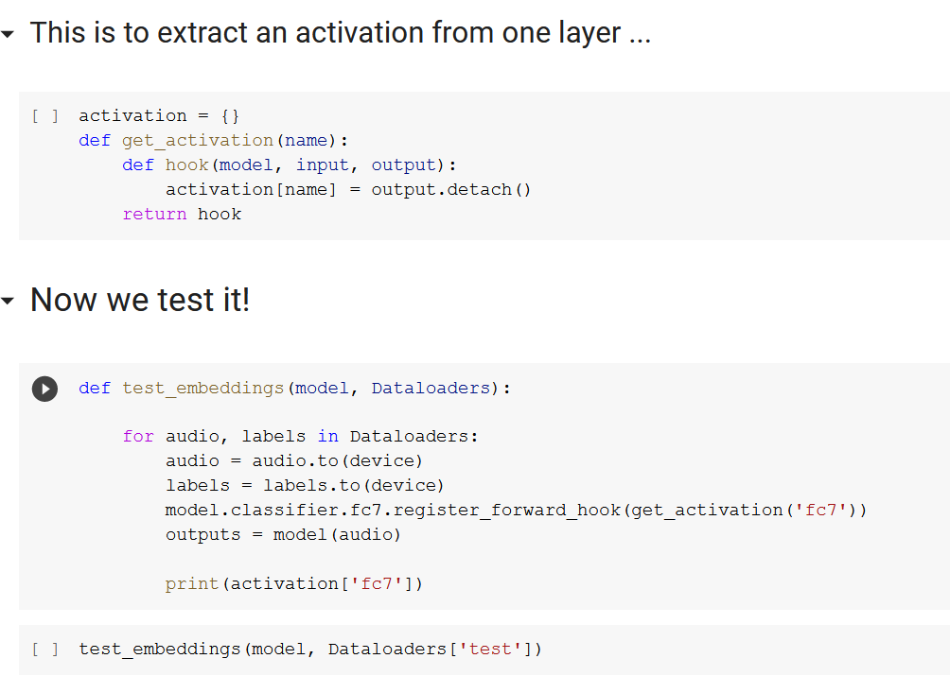
Por ultimo ver cómo extraer los embeddings antes de la capa softmax…

Slide 17
NUEVO 17 de diciembre

Slide 18
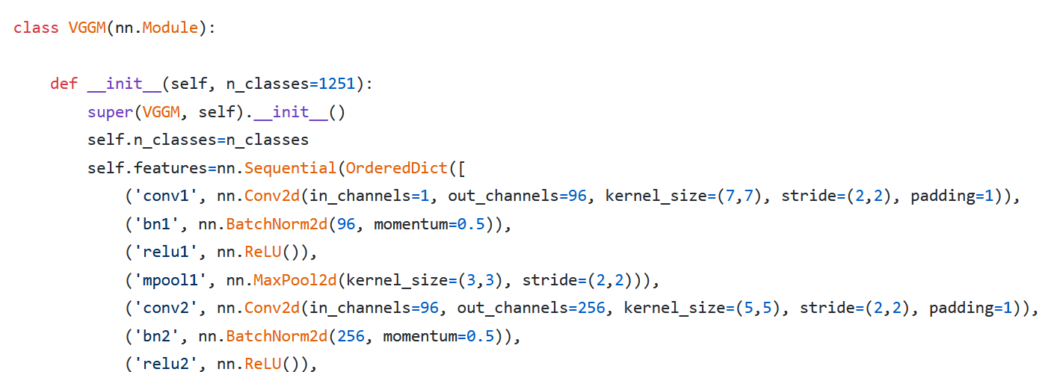
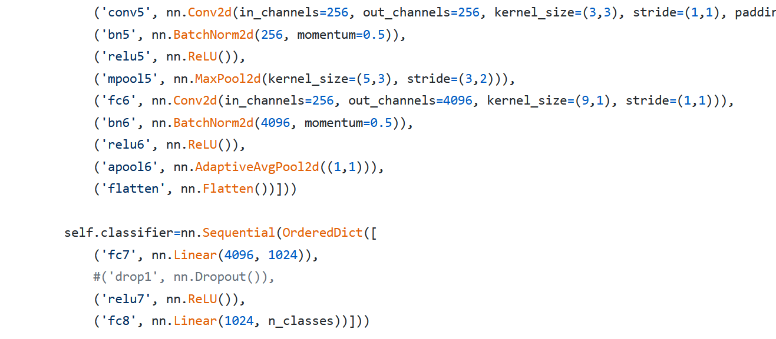
Entender y explicar el VGGM model:
… ….

Slide 19
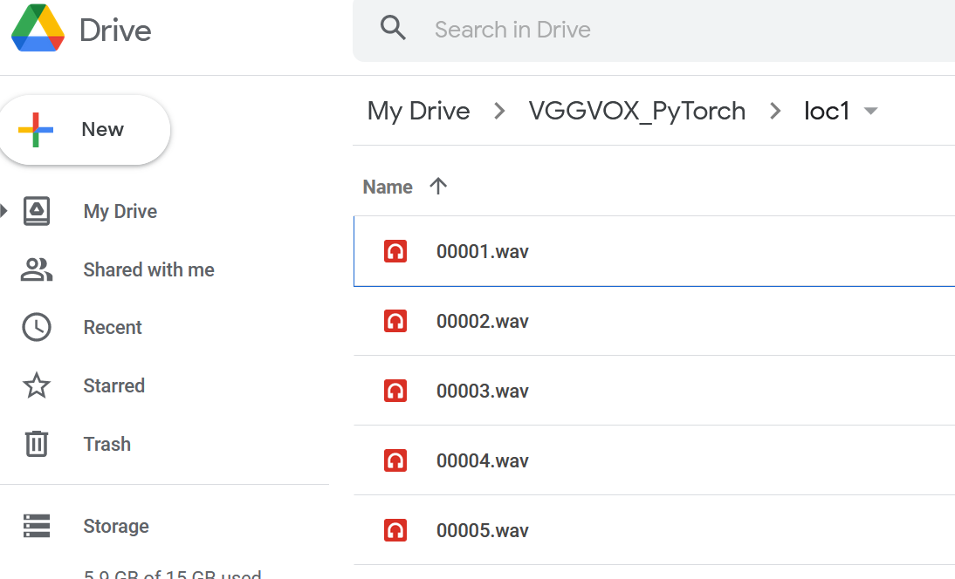

VGGVox_Embeddings_Simple.ipynb
Simple Example to EXTRACT EMBEDDING Vector from a wav file using a pre-trained VGGVox for model
PRIMERO:
Tener un directorio “loc1” en
Google Drive con varios audios
En el Notebook verás que:
Copiamos los audios de un locutor "loc1" que está en Google Drive en el directorio local de Google Colab
/VGGVOX_PyTorch/loc1 /content/VGGVox-PyTorch/data/wav/

Slide 20
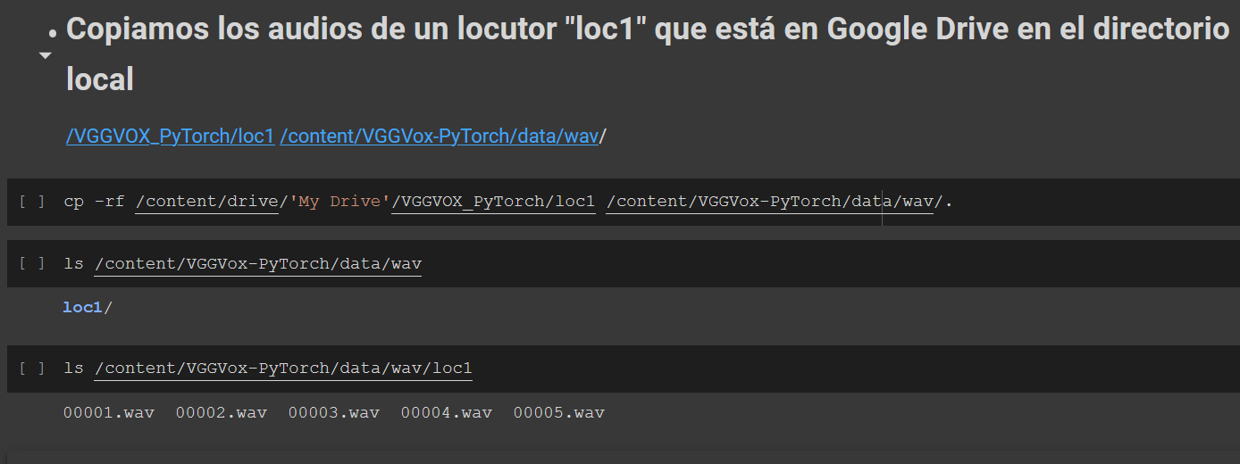

Slide 21
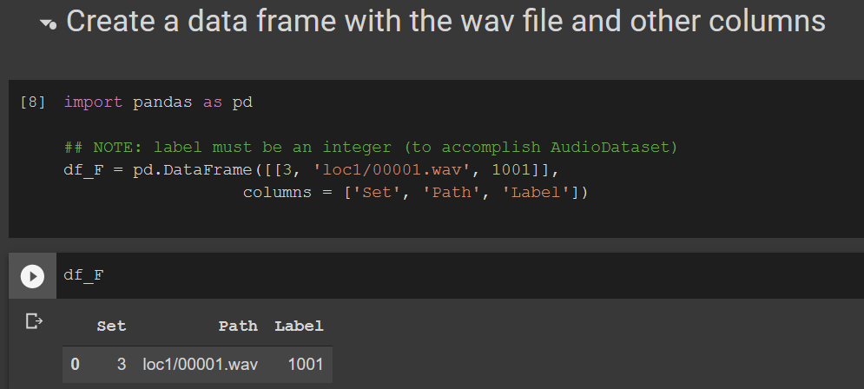
Creamos un Data Frame con la misma estructura que el Notebook original que usaba VoxCeleb PERO para sólo un wav (Es para hacer un ejemplo de cómo sacar los embeddings de un wav que tenemos en un directorio)
Set Path Label
Set es 3 para datos de test (1 es train, 2 validación, 3 test)
Path es el path del audio PERO desde el DATA_DIR = '/content/VGGVox-PyTorch/data/wav/’ !!!
Label es la etiqueta del audio: tiene que ser un entero, y en este caso es el código del locutor, pero puede ser el código de la emoción, del rango de edad, etc…

Slide 22
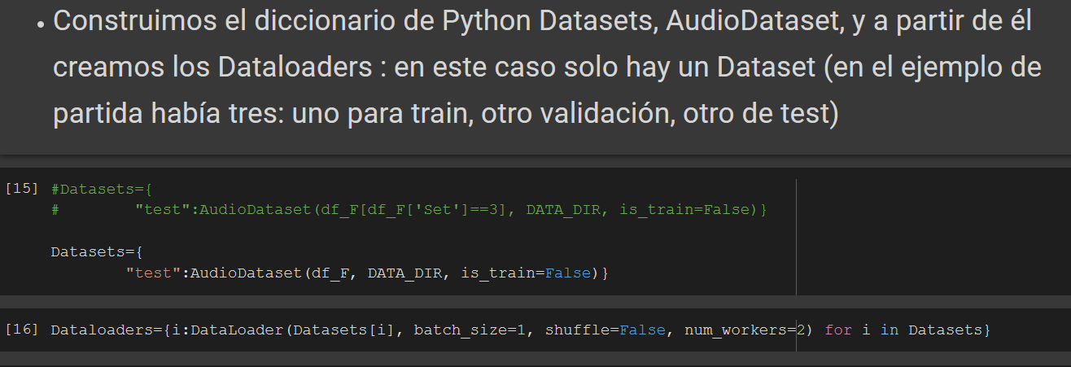
A partir del Data Frame, df_F, aunque sólo tiene un audio, definimos:
Un AudioDataset `para test (por eso is_train = False)
Y creamos los Dataloaders, sólo habrá UNO!

Slide 23
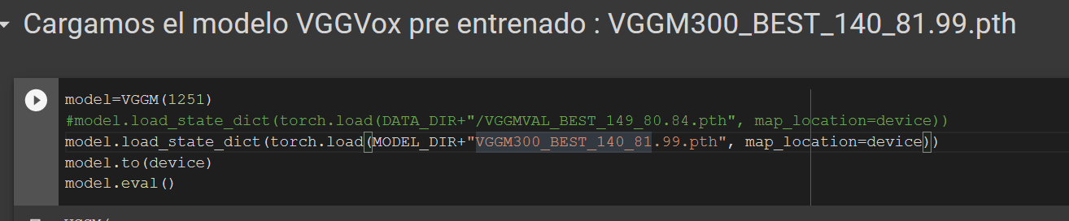

Slide 24
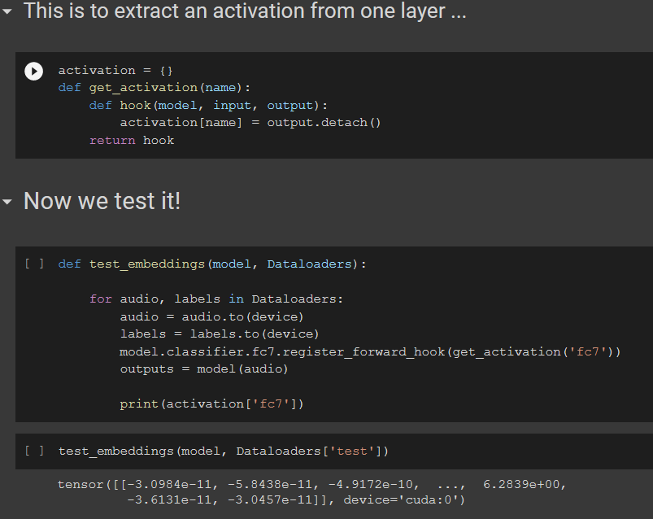

Slide 25
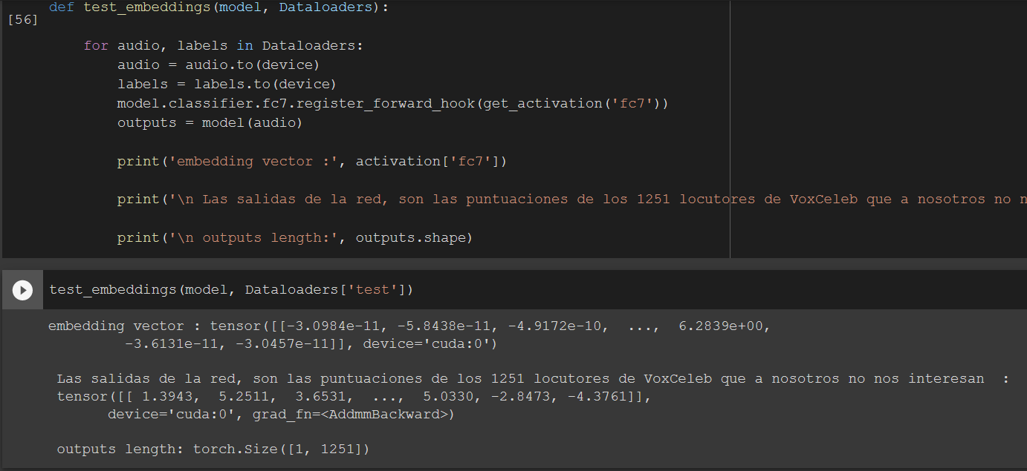
He añadido imprimir “solo para verlo” la salida de la VGGVox que sería la puntución para cada uno de los 1251 locutores usados para entrenar VGGVox

Slide 26
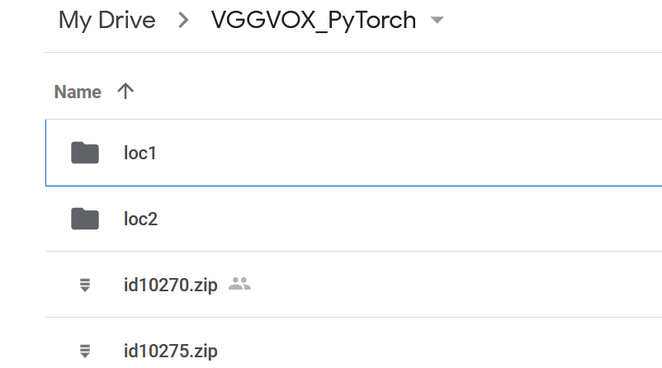
VGGVox_Distance_Embedding.ipynb
EXTRACT EMBEDDINGS from TWO wav files using a pre-trained VGGVox for model
Obtain the cosine distance between them
In this example we use some audios from two speakers from VoxCeleb
id10270, will be loc1 and
id10275 will be loc 2

Slide 27
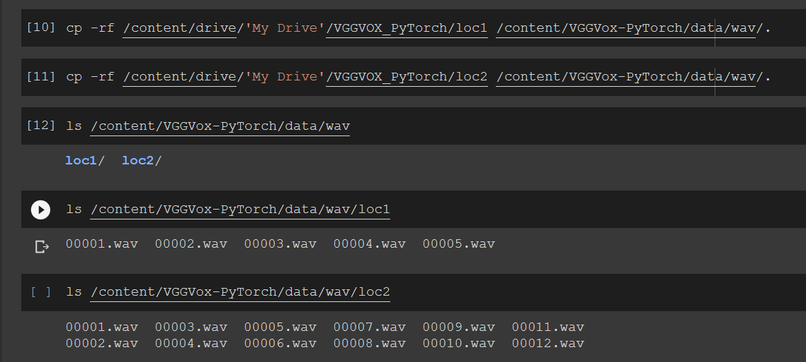
THE DIFFERENCE FROM Previous Notebook: Now we copy wav files from TWO different speakers in VoxCeleb

Slide 28
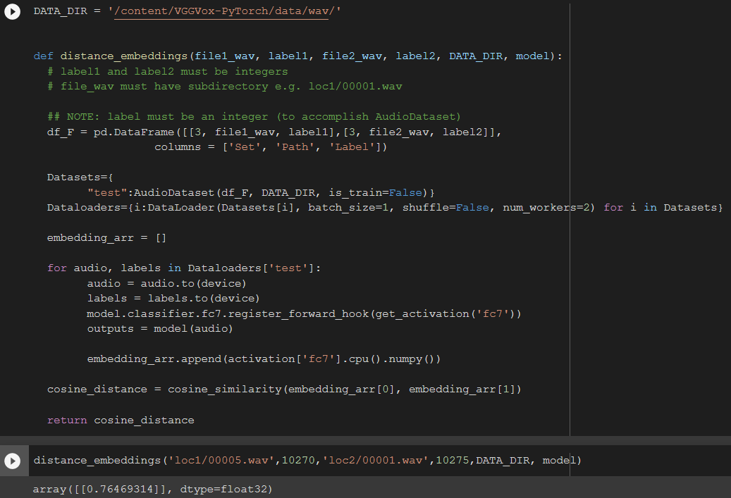
Note: now the DataFrame df_F contains TWO files :
file1_wav and file2_wav
The embeddings are appended in one array: embedding_arr
We obtain and return the cosine distance between:
the embedding_arr[0] of file1_wav
embedding_arr[1] of file2_wav

Slide 29
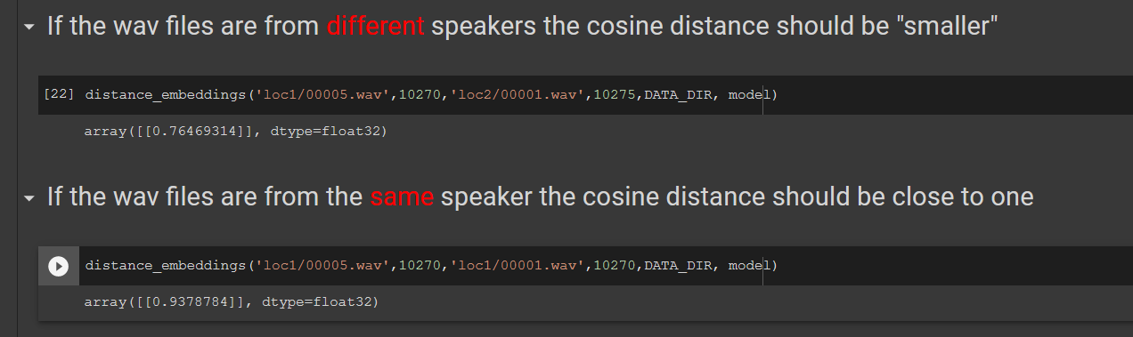
You can “play” obtaining distances between loc1 and loc2 audios….

Slide 30
VGGVox_Embeddings_wavDir.ipynb
EXTRACT EMBEDDINGS from Directory of wav files using a pre-trained VGGVox for model
Store the embeddings in a Pandas Dada Frame with labels so we can then Obtain the distance between them
Visualize 2D projections of embeddings of different speakers using PCA and tSNE

Slide 31
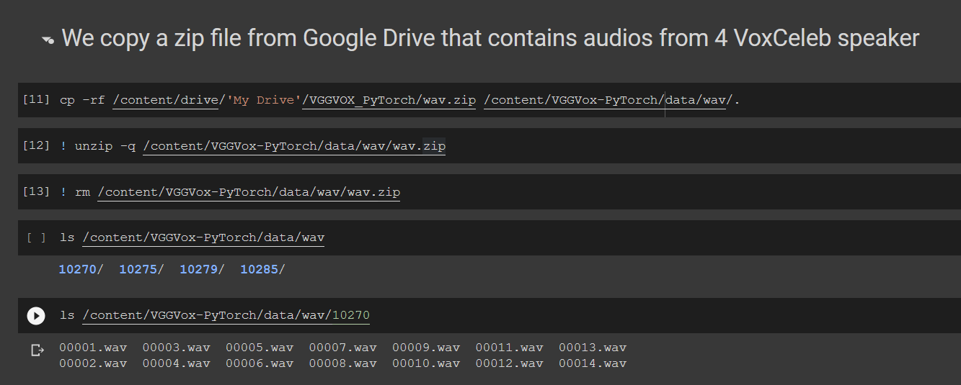
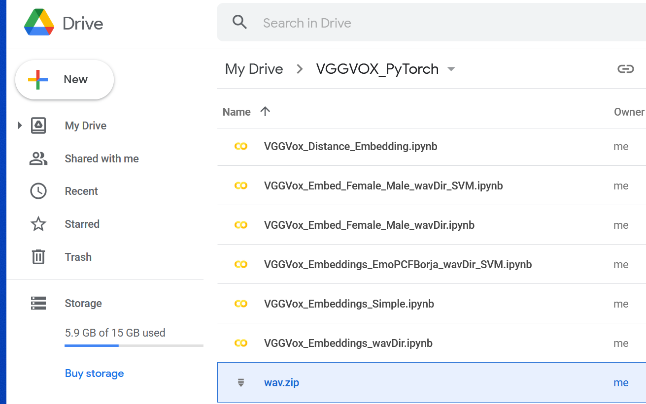
We need the wav.zip that contains 4 subdirectories with audios from 4 VoxCeleb speakers

Slide 32
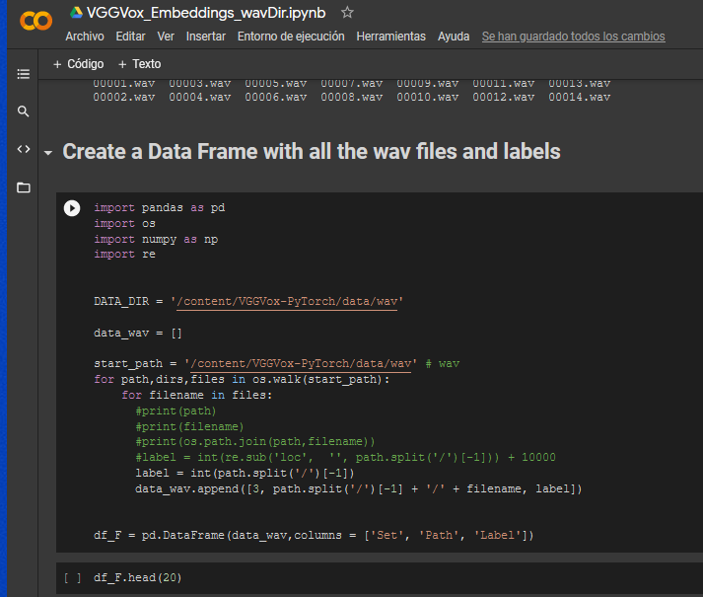
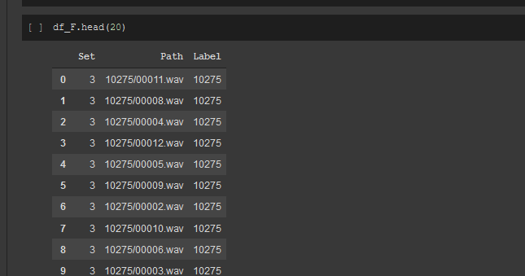

Slide 33
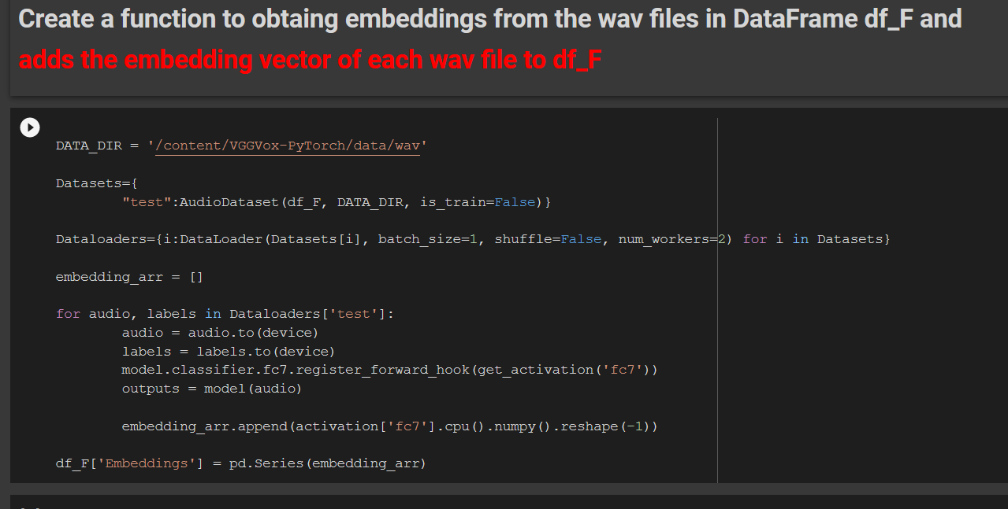
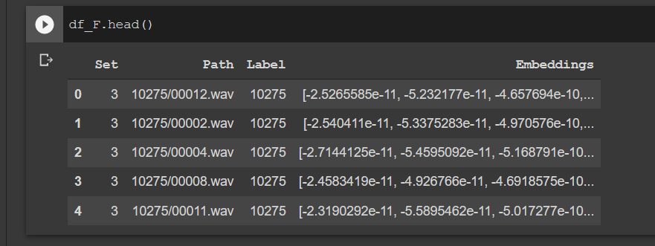

Slide 34
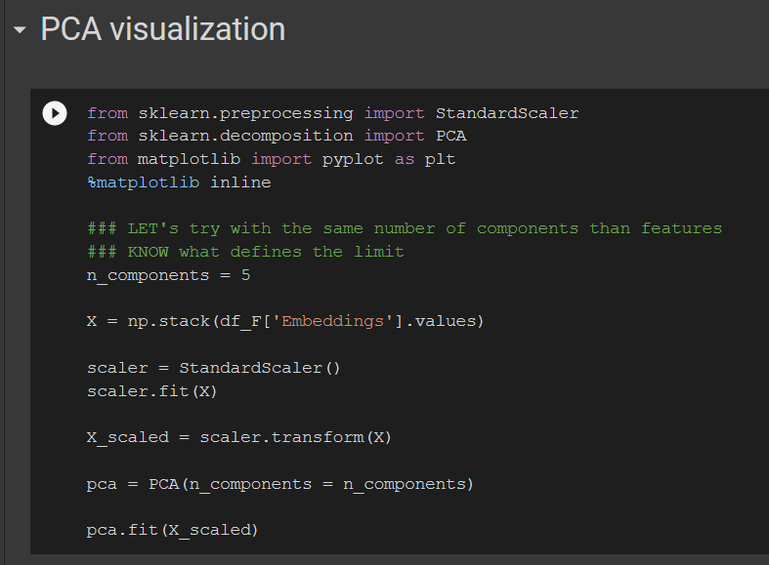
Visualize 2D projections of embeddings of different speakers using PCA and tSNE
We stack the embeddings of the wav files into a Numpy Array X
We project in 2D using PCA and visualize…

Slide 35
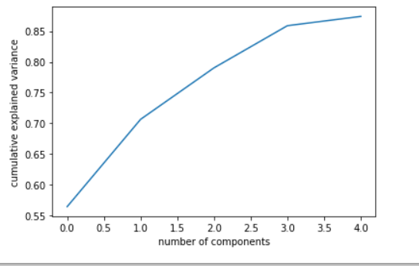
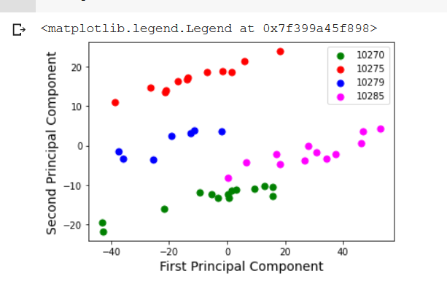
Cumulative variance explained
Visualize 2D projections of embeddings using PCA
… we can see that different speakers are in different spaces

Slide 36
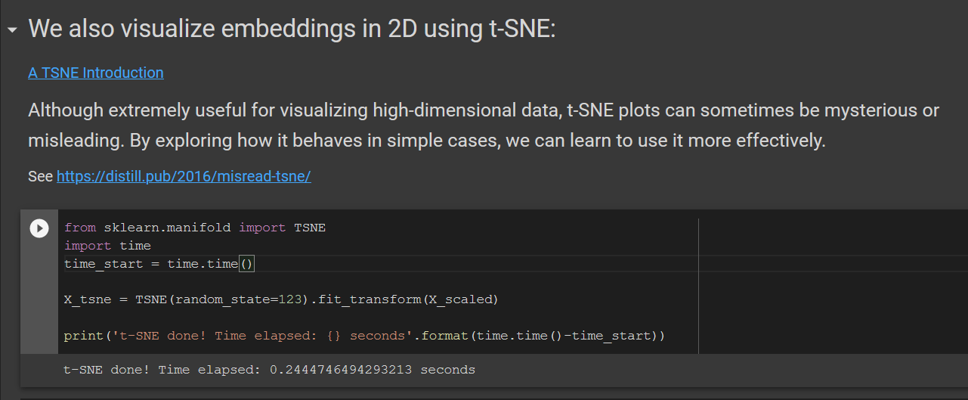
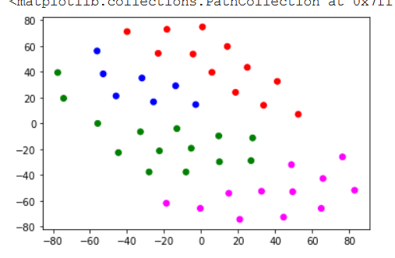

Slide 37
Pasos y Notebooks siguientes:
Extraer embeddings de audios de diferentes tipos de voces , por ejemplo, mujeres/hombres (2 clases), jovenes/mayores, … 4 emociones ….
Y visualizar 2D para ver clusters
Extraer embeddings de audios de diferentes clases y luego usar los embeddings como vector de entrada de un clasificador

Slide 38
Extraer embeddings de audios de diferentes clases y luego usar los embeddings como vector de entrada de un clasificador
VGGVox
Embeddings
extractor
SVM
Voice classifier
Voice characteristics
audio
Embedding vector
Some examples:
Female/male voice
Young/old
Obese/non-obese
Angry, Happy, Neutral, sad,
…

