Slide 1
Housing Repairs Performance
1,350
repairs analysed
Data Quality, Operational Insight
and Resident Impact
Practical Assessment Presentation
Senior Management Analytical Briefing
Presenter: Mujeeb Sonibare
Repairs • Residents • Complaints

Slide 2
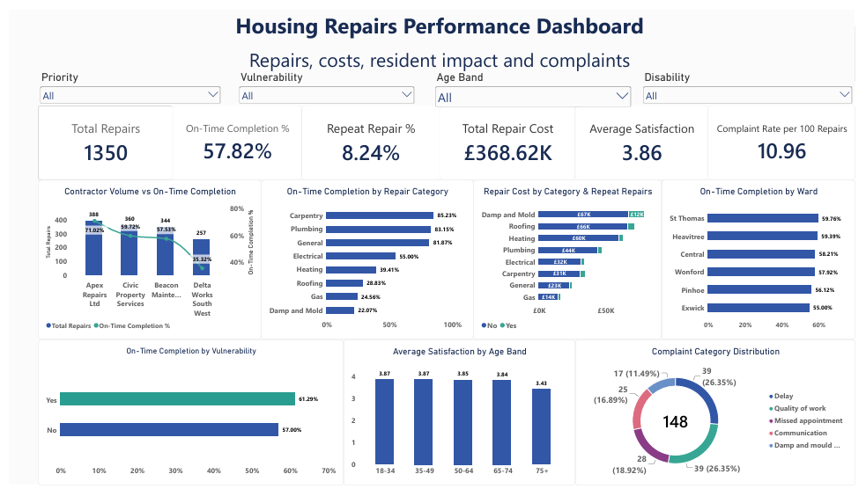
Dashboard Overview
Management view of repairs, costs, resident impact and complaints
Housing Repairs Performance | Practical Assessment
2

Slide 3
1. Business Objective & Questions
The analysis was designed around the decisions senior managers need to make.
BUSINESS OBJECTIVE
DELIVERABLES
Assess repairs performance, understand resident outcomes and complaints, identify significant service risks, and provide evidence-based recommendations for improvement.
Validated data
Profiling, quality checks and documented treatment decisions
Analytical model
KEY QUESTIONS
Relationships structured for reliable filtering and analysis
How effectively are repairs being completed against their applicable target times?
Where do repair type, priority and contractor results differ?
How do repair outcomes and satisfaction vary across resident characteristics?
What do complaints reveal about service quality and resident experience?
Where could earlier operational intervention reduce service problems?
Management KPIs
Six consistent measures for performance and resident outcomes
Dashboard
Concise Power BI view for senior-management discussion
Findings & actions
Evidence-based interpretation, risks, limitations and recommendations
Housing Repairs Performance | Practical Assessment
3

Slide 4
2. Data Quality & Validation Approach
Quality checks were performed before relying on relationships, KPIs or dashboard findings.
WHAT WE FOUND
HOW WE VALIDATED AND TREATED IT
Duplicate primary IDs: P-0119, RES-0244, C003, R-00502 and COMP-0012. No full-row duplicates.
Orphan references: invalid Property, Tenancy, Resident, Contractor, Repair Type and Complaint links were identified after duplicate correction.
Missing values: 1 vulnerability flag; 500 tenancy end dates; 28 completed-date gaps plus 319 missing satisfaction scores; 12 complaint close dates.
Date exceptions: one completion before raised; one completion before first attendance; one completed repair without completion date; one complaint closed before opened; one tenancy ended before it started.
490 Target_Date values did not equal Raised_Date + Default_Target_Days; source Target_Date retained because intended SLA rule was undocumented.
71 repairs had Priority different from Default_Priority; recorded actual Priority retained.
Gas-safety RT08: Default_Target_Days = 0, while observed targets followed other time patterns — an SLA inconsistency to clarify.
Confirmed negative financial values were nulled: weekly rent -£124.50, repair cost -£85 and compensation -£50.
Missing satisfaction treated as missing response, not zero; open repairs/complaints were not automatically treated as errors.
1
Profile
Checked row counts, grain, types, nulls, distinct IDs and value ranges.
2
Test keys
Checked uniqueness of primary keys and whether foreign keys existed in parent tables.
3
Test business rules
Compared dates, priorities, status and target-day logic rather than trusting flags.
4
Correct where justified
Corrected duplicate identifiers and nulled confirmed invalid orphan/negative values and invalid date fields.
5
Retain where uncertain
Kept source Target_Date, actual Priority and ambiguous SLA patterns rather than inventing rules.
6
Control analytical impact
Handled affected records in measures where necessary while retaining rows for traceability.
7
Document limitations
Recorded unresolved rules and exceptions so management can distinguish data issues from service findings.
Housing Repairs Performance | Practical Assessment
4

Slide 5
3. Analytical Data Model
The model was kept simple: descriptive tables provide context around the main repair activity.
Think of the centre as the service activity; the surrounding tables answer “where, who, what type, when and what happened afterwards?”
PROPERTIES
REPAIR TYPES
Ward • type • tenure
REPAIRS
Category • priority • target
Primary fact • 1,350 repairs
cost • dates • status • satisfaction
RESIDENTS
CONTRACTORS
Age • vulnerability • disability
Provider • trade • quality
COMPLAINTS
Secondary event fact • 148 complaints
DIMDATE
Calendar / date analysis
TENANCIES
Resident ↔ Property context
WHY THESE RELATIONSHIPS
Single-direction filtering avoids ambiguous paths. Direct Properties→Repairs and Tenancies→Complaints links were avoided because context already flows through Tenancies/Repairs. Complaints were linked to Repairs using Repair_ID.
Housing Repairs Performance | Practical Assessment
5

Slide 6
4. KPI Framework
Six headline measures turn the validated data into a consistent management view.
TOTAL REPAIRS
ON-TIME COMPLETION
REPEAT REPAIR
1,350
57.82%
8.24%
Distinct repair IDs
Completed repairs marked On-Time ÷ completed repairs
Completed repairs marked repeat within 90 days ÷ completed repairs
TOTAL REPAIR COST
AVERAGE SATISFACTION
COMPLAINT RATE
£368.62K
3.86
10.96
Sum of valid repair costs
Average recorded satisfaction; missing responses excluded
Complaints per 100 repairs
Validation check: for completed repairs, the recorded On-Time flag was consistent with the independent completion-date comparison.
Housing Repairs Performance | Practical Assessment
6

Slide 7
5. Repairs Performance — What It Means
The dashboard identifies where management investigation should start; it does not establish causation.
OVERALL ON-TIME
HIGHEST CONTRACTOR RATE
LOWEST CONTRACTOR RATE
57.82%
71.02%
35.22%
A substantial share of completed repairs were outside the recorded target.
Apex Repairs Ltd has the highest observed on-time rate.
Delta Works South has the lowest observed on-time rate; an investigation signal, not proof of cause.
CATEGORY SIGNALS
MANAGEMENT INTERPRETATION
Damp & Mold
22.1%
Damp & Mold, Gas and Roofing are the three weakest repair categories, all below 30% on-time completion.
Carpentry and Plumbing are above 80%, showing performance is not uniform across the portfolio.
The contractors’ on-time completion range is wide (35.22%–71.02%). Review work mix, priority, trade and target rules before attributing the difference to provider performance.
The 8.24% repeat-repair rate indicates some completed jobs are followed by another repair within 90 days, creating additional service demand and cost.
Gas
24.6%
Roofing
28.8%
Heating
39.4%
Electrical
55.0%
General
82.0%
Plumbing
83.2%
Carpentry
85.2%
Housing Repairs Performance | Practical Assessment
7

Slide 8
6. Resident Impact & Complaints — What It Means
Resident outcomes do not all point in the same direction, which makes careful interpretation important.
VULNERABLE RESIDENTS
AGE 75+ SATISFACTION
UPHELD COMPLAINTS
62.20%
3.43
60.8%
Observed on-time completion is higher than the 57.00% comparison group.
Lowest observed average satisfaction across the five age bands.
90 of 148 complaints are marked upheld, a material service-quality signal.
WHAT THIS MEANS FOR MANAGEMENT
WHAT COMPLAINTS ARE TELLING US
The vulnerable group is not showing poorer on-time performance in this dataset; it is higher. That is a positive service signal and should be maintained.
Because vulnerability can carry regulatory and reputational implications, management should still monitor this group rather than assume the result will persist.
The 75+ group has the lowest satisfaction score, making older residents a useful segment for deeper investigation into service experience.
Delay and Quality of Work are joint largest categories: 39 complaints each (26.4%).
Missed appointments account for 28 complaints (18.9%), pointing to an avoidable service-experience issue.
131 complaints are Stage 1 (88.5%), so most complaints remain at the first stage of the process.
Complaints provide a second lens on service quality and should be reviewed alongside repair performance.
Housing Repairs Performance | Practical Assessment
8

Slide 9
7. Business Risks Identified from the Analysis
The risks translate observed service patterns into potential business consequences.
Resident safety & wellbeing
Financial impact
Poor or delayed repairs—particularly gas, heating and damp/mould—can potentially expose residents to accidents, injury or other serious harm if issues are not resolved appropriately.
Repeat repairs create additional demand and cost. Repair expenditure and compensation payments can reduce financial efficiency and recurring failures may increase the cost of serving the same issue.
Customer retention & tenancy stability
Reputation & trust
Persistent poor service may reduce resident trust and satisfaction and could contribute to residents ending a tenancy, seeking redress or pursuing compensation.
High levels of complaints, upheld cases, delays and quality-of-work concerns can damage confidence in the service and increase reputational pressure.
Operational capacity
Compliance / regulatory exposure
Missed appointments, repeat repairs and unresolved work consume staff and contractor capacity, reducing resources available for new repairs.
Where repairs involve vulnerable residents, safety issues or housing-condition concerns, prolonged service failures could increase risk of regulatory scrutiny, complaint escalation or legal challenge.
These are potential business risks indicated by the analysis—not claims that these outcomes have occurred in the supplied dataset.
Housing Repairs Performance | Practical Assessment
9

Slide 10
8. Limitations, Assumptions & Project Deliverables
The limitations define how confidently the findings should be used; they do not replace the business recommendations.
DATA LIMITATIONS
ANALYTICAL LIMITATIONS
WHAT THE PROJECT DELIVERS
• Synthetic dataset; results should not be treated as live organisational performance.
• Some business rules could not be confirmed with an operational data owner.
• Missing satisfaction responses limit interpretation of resident experience.
• One complaint, one tenancy and several repair records contained date/field exceptions.
• Some complaints cannot be fully linked to repair context because of invalid/missing Repair_ID links.
• Contractor comparisons may reflect different repair mix, priority or target rules.
• Associations do not establish causation.
• The 490 Target_Date differences require business-rule clarification.
• RT08 gas-safety target behaviour requires SLA clarification.
• Current sample structure may not represent longer-term trends.
• Structured data-quality assessment
• Defensible analytical model
• Six management KPIs
• Focused repairs, resident and complaints insight
• Identified business risks
• Evidence-based service recommendations
• Clear assumptions and limitations
Housing Repairs Performance | Practical Assessment
10

Slide 11
9. Recommendations for Senior Management
Actions are based on the service patterns and risks identified in the analysis.
01
Improve on-time repair outcomes
Target the repair categories with the lowest observed on-time performance—especially Damp & Mold, Gas and Roofing—and review root causes, materials, diagnosis and contractor capacity.
02
Reduce repeat repairs
Introduce structured review of repairs that recur within 90 days, focusing on diagnosis, workmanship, parts and follow-up.
03
Strengthen appointment reliability
Investigate missed appointments as a distinct service issue and improve appointment confirmation, scheduling and escalation processes.
04
Use complaints as an early signal
Use Delay and Quality of Work complaints as warning indicators and connect complaint themes back to repair categories and operational teams.
05
Protect resident experience
Maintain the stronger on-time performance observed for vulnerable residents while using the lower satisfaction among the 75+ group to explore whether communication, accessibility or service experience can improve.
06
Monitor cost and compensation with performance
Review repeat-repair costs and compensation alongside operational KPIs to identify where service failures may also be creating avoidable financial pressure.
Focus on safer, more reliable repairs, fewer repeat failures, stronger resident experience and better cost control.
Housing Repairs Performance | Practical Assessment
11

