Slide 1
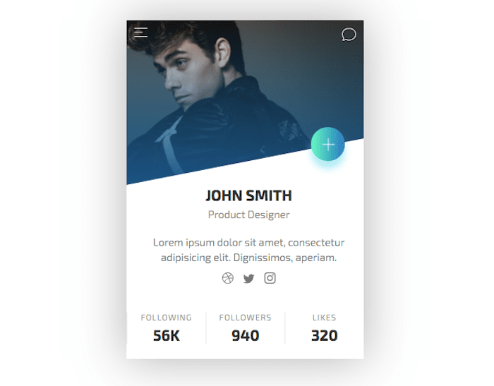
Slanted Edge Profile Card

Slide 2
body
card

Slide 3
HTML
body
<body>
<card>
</card>
</body>
card

Slide 4
HTML
<card>
<slanted-edge>
</slanted-edge>
<prof-details>
</prof-details>
<prof-desc>
</prof-desc>
<prof-icons>
</prof-icons>
<prof-stats>
</prof-stats>
</card>
Slanted-edge
Prof-details
Prof-desc
prof-icons
Prof-stats

Slide 5
HTML
<card>
<slanted-edge>
<top-icons>
<icon></icon>
<icon></icon>
</top-icons>
<button>icon<button>
</slanted-edge>
</card>
Slanted-edge
Note: The Image can go in HTML or in the CSS, the choice is yours

Slide 6
2 MAJOR CONCEPTS
Slanted Edge
Background Image with a gradient
Slanted-edge

Slide 7
(0% 0%)
(100% 0%)
Slanted Edge
We use Clip Path
(100% 80%)
(0% 100%)
(100% 100%)
clip-path: polygon(0% 0%, 100% 0%, 100% 80%, 0% 100%);

Slide 8
Background-image
Background Image with a gradient
Slanted-edge
background-image: linear-gradient(rgba(255, 0, 0, 0.7),rgba(255, 255, 0, 0.7)),url("./jb.png");

