Slide 1


K.RAMAKRISHNAN COLLEGE OF TECHNOLOGY (AUTONOMOUS), TRICHY
ANALYSING AND PLOTING EXAM RESULTS FOR A COLLEGE CLASS
PRESENTED BY
MUKILAN K - ADB23072

Slide 2
PRESENTATION OVERVIEW
Problem Identification and Analysis
Objective
Proposed Work Architecture & Module Design
Block diagram of proposed system
Module Description
Module Implementation
R Programming Implementation
Source Code
Output Snapshots
Conclusion

Slide 3
PROBLEM IDENTIFICATION
Problem Identification
-Manual result analysis is time-consuming and error-prone.
-Teachers and institutions lack interactive tools for visualizing student performance.
-Difficulty in identifying weak and strong subjects across a class.
-Limited insights for academic improvement using traditional methods.
Problem Analysis
-A need exists for a user-friendly, data-driven portal to analyze exam results.
-Real-time visualization and subject-wise insights can improve decision-making.
-Predictive suggestions can help students focus on weak areas.

Slide 4
OBJECTIVE
Develop an interactive web portal using R Shiny.
Enable upload and processing of exam results in CSV format.
Visualize pass/fail rates, average scores, and grade distribution dynamically.
Provide subject-wise performance predictions and recommendations.

Slide 5
Proposed Work Architecture & Module Design
Frontend:
- Built with R Shiny & shinydashboard for interactive UI.
Backend:
- Uses R functions to process data and manage user sessions.
- Data handling with dplyr for cleaning and summarizing.
Visualization:
- Interactive graphs with plotly for pass/fail rates, grades, averages.
Modules:
- Home, Login, Dashboard, Upload Results, Prediction.
Security:
- Basic login/logout using reactive session management.

Slide 6
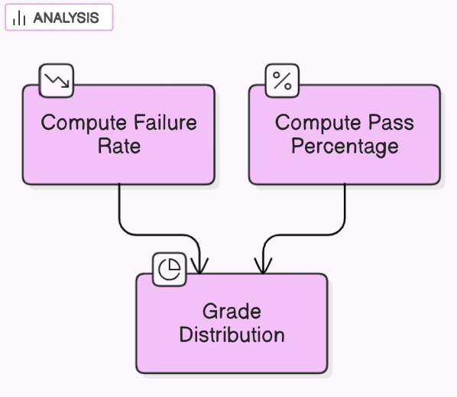
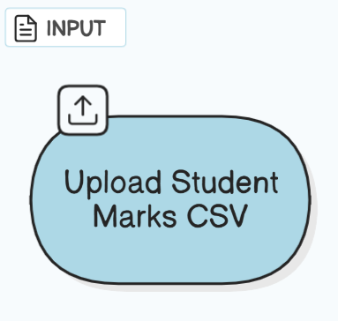
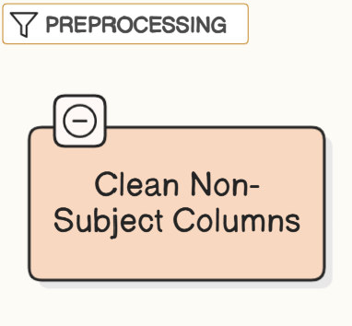
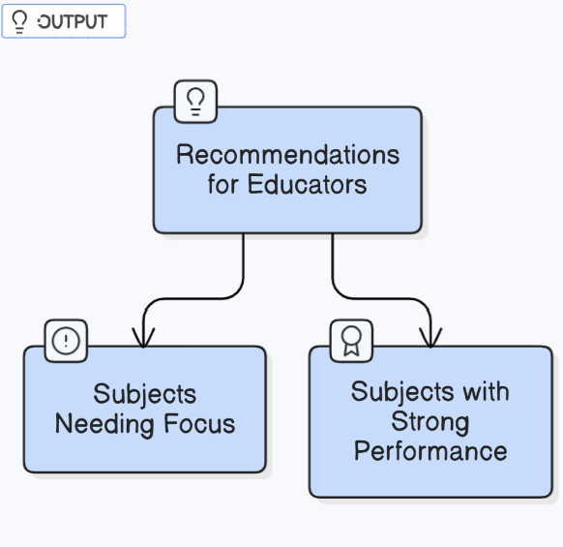
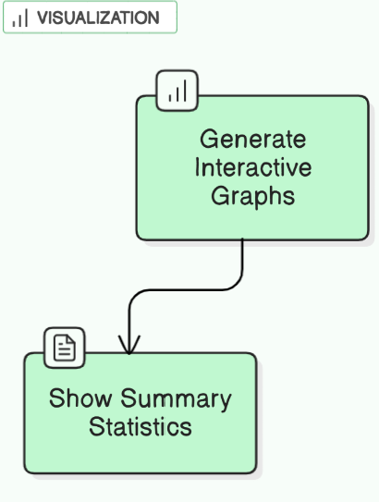
BLOCK DIAGRAM

Slide 7
MODULES DESCRIPTION
1. Data Import
2. Data Processing
3. Graphical Representation
4. Performance Analysis
5. Login & Navigation:

Slide 8
MODULE IMPLEMENTATION
1. Data Import – Reading student marks from CSV
Users upload a CSV file containing student marks.
The file is read and processed, removing non-subject columns.
The cleaned data is stored for analysis.
2. Data Processing – Calculating total marks and percentage
Total marks and percentage are calculated for each student.
Pass percentage and failure rates are determined.
Data is prepared for visualization.

Slide 9
MODULE IMPLEMENTATION
3. Visualization Representation
Bar plot of pass percentage per subject.
Bar plot showing failure rate.
Pie chart for grade distribution.
Average score bar chart for all subjects.
4. Performance Analysis
Identifies top-performing and weak subjects.
Categorizes students into grades (A+, A, B, C, D, F).
Helps educators improve student performance.

Slide 10
MODULE IMPLEMENTATION
5. Login & Navigation:
Only authenticated users can access the analysis and prediction features.
The UI follows a real website structure with tabs for Home, Login, Dashboard, Upload, and Logout.

Slide 11
R PROGRAMMING IMPLEMENTATION
The system is built using R Shiny with a dashboard layout styled using bslib, shinydashboard, and shinyjs.
Data processing is handled using dplyr.
Visuals are built using plotly for interactivity and clarity.
The app includes:
- Login panel with basic authentication
- Dashboard for analysis
- Upload panel for CSV files
- Prediction page with recommendation logic

Slide 12
SOURCE CODE
library(shiny)
library(shinydashboard)
library(plotly)
library(DT)
library(dplyr)
library(shinyjs)
library(bslib)
custom_theme <- bs_theme(
bootswatch = "minty",
base_font = font_google("Poppins"),
version = 5,
bg = "#f8f9fa",
fg = "#343a40"
)
ui <- dashboardPage(
title = "LAN - Student Performance Portal",
header = dashboardHeader(
title = span("Student Performance Portal", style = "font-family: 'Poppins', sans-serif; font-weight: bold;"),
tags$li(class = "dropdown",
actionButton("logout_btn", "Logout", class = "btn btn-danger", style = "margin-top: 10px;") )),
sidebar = dashboardSidebar(
width = 250,
sidebarMenu(id = "tabs",
menuItem("Home", tabName = "home", icon = icon("home")),
menuItem("Login", tabName = "login", icon = icon("sign-in-alt")),
menuItem("Dashboard", tabName = "dashboard", icon = icon("chart-bar")),
menuItem("Upload Results", tabName = "upload", icon = icon("upload")),
menuItem("Prediction", tabName = "prediction", icon = icon("magic")),
menuItem("Logout", tabName = "logout", icon = icon("sign-out-alt"))
)
),
body = dashboardBody(
useShinyjs(),
tags$head(
tags$style(HTML("
.main-header { background-color: #28a745 !important; }
.sidebar-menu > li > a { font-size: 14px; font-family: 'Poppins', sans-serif; }

Slide 13
SOURCE CODE
.content-wrapper { background-color: #f8f9fa; padding: 20px; }
.well { background-color: #ffffff; border-radius: 10px; box-shadow: 0 4px 6px rgba(0,0,0,0.1); }
.btn-primary { background-color: #28a745; border-color: #28a745; }
.btn-primary:hover { background-color: #218838; border-color: #1e7e34; }
.btn-danger { background-color: #dc3545; border-color: #dc3545; }
.btn-danger:hover { background-color: #c82333; border-color: #bd2130; }
h3 { font-family: 'Poppins', sans-serif; color: #343a40; }
p { font-family: 'Poppins', sans-serif; color: #6c757d; }
.shiny-plotly { border-radius: 10px; box-shadow: 0 4px 6px rgba(0,0,0,0.1); }
")) ),
tabItems(
tabItem(tabName = "home",
fluidRow(
column(12,
br(),
h2("Welcome to the Student Exam Dashboard", align = "center"),
p("Analyze, visualize, and get recommendations on student performance in just a few clicks!",
align = "center", style = "font-size: 16px;"),
br(),
img(
src = "https://res.cloudinary.com/dpdz5uwvf/image/upload/v1745511056/ac2cb122-7c0a-49f7-8465-fccb71377fc0_wsbcxb.png",
height = "300px",
style = "display:block; margin:auto;"
) ) )
),
tabItem(tabName = "login",
fluidRow(
column(4, offset = 4,
br(),
wellPanel(
h3("🔐 Login"),
textInput("username", "Username"),
passwordInput("password", "Password"),
actionButton("login_btn", "Login", class = "btn btn-primary w-100"),

Slide 14
SOURCE CODE
column(12,
h4("🔮 Subject Recommendations"),
verbatimTextOutput("prediction"),
plotlyOutput("focus_plot"))))),
tabItem(tabName = "logout",
fluidRow(
column(12,
h4("You have been logged out."),
actionLink("go_home", "Return to Home", class = "btn btn-secondary"))))))
server <- function(input, output, session) {
credentials <- list(username = "student", password = "123")
user_logged_in <- reactiveVal(FALSE)
output$loggedIn <- reactive({ user_logged_in() })
outputOptions(output, "loggedIn", suspendWhenHidden = FALSE)
observeEvent(input$login_btn, {
if (input$username == credentials$username && input$password == credentials$password)
div(style = "color:red;", textOutput("login_status")) )))),
tabItem(tabName = "dashboard",
conditionalPanel(
condition = "output.loggedIn == true",
fluidRow(column(12, h3("📊 Dashboard Overview", align = "center"))),
fluidRow(
column(6, plotlyOutput("pass_plot")),
column(6, plotlyOutput("fail_plot"))),
fluidRow(
column(6, plotlyOutput("grade_plot")),
column(6, plotlyOutput("average_plot")))),
tabItem(tabName = "upload",
conditionalPanel(
condition = "output.loggedIn == true",
fluidRow(
column(6, fileInput("file", "Upload CSV File",
accept = ".csv"))))),
tabItem(tabName = "prediction",
conditionalPanel(
condition = "output.loggedIn == true",
fluidRow(

Slide 15
SOURCE CODE
output$fail_plot <- renderPlotly({
df <- dataset()
fail_rate <- colMeans(df < 40, na.rm = TRUE) * 100
plot_ly(x = names(fail_rate), y = fail_rate, type = 'bar', name = 'Fail %') %>%
layout(title = "Failure Rate per Subject")
})
output$grade_plot <- renderPlotly({
df <- dataset()
grades <- cut(rowMeans(df), breaks = c(0, 40, 50, 60, 70, 80, 100), labels = c("F", "D", "C", "B", "A", "A+"))
grade_data <- table(grades)
plot_ly(labels = names(grade_data), values = as.numeric(grade_data), type = 'pie') %>%
layout(title = "Grade Distribution")
})
{
user_logged_in(TRUE)
updateTabItems(session, "tabs", selected = "dashboard")
} else {
output$login_status <- renderText("❌ Invalid username or password.") }})
observeEvent(input$logout_btn, {
user_logged_in(FALSE)
updateTabItems(session, "tabs", selected = "home")
})
dataset <- reactive({
req(input$file)
df <- read.csv(input$file$datapath)
df <- df %>% select(-c(Student_ID, Total))
return(df) })
output$pass_plot <- renderPlotly({
df <- dataset()
pass_rate <- colMeans(df >= 40, na.rm = TRUE) * 100
plot_ly(x = names(pass_rate), y = pass_rate, type = 'bar', name = 'Pass %') %>%
layout(title = "Pass Percentage per Subject")
})

Slide 16
SOURCE CODE
output$average_plot <- renderPlotly({
df <- dataset()
avg_scores <- colMeans(df, na.rm = TRUE)
plot_ly(x = names(avg_scores), y = avg_scores, type = 'bar') %>%
layout(title = "Average Score per Subject")
})
output$prediction <- renderPrint({
df <- dataset()
avg <- colMeans(df, na.rm = TRUE)
cat("📌 Subjects that need focus (avg < 40):\n")
print(names(avg[avg < 40]))
cat("\n🏆 Strong Subjects (avg > 70):\n")
print(names(avg[avg > 70]))
})
output$focus_plot <- renderPlotly({
df <- dataset()
avg_scores <- colMeans(df, na.rm = TRUE)
plot_ly(x = names(avg_scores), y = avg_scores, type = 'bar', marker = list(color = avg_scores)) %>%
layout(title = "📊 Subject Performance Overview")
})
}
# Run the application
shinyApp(ui = ui, server = server)

Slide 17
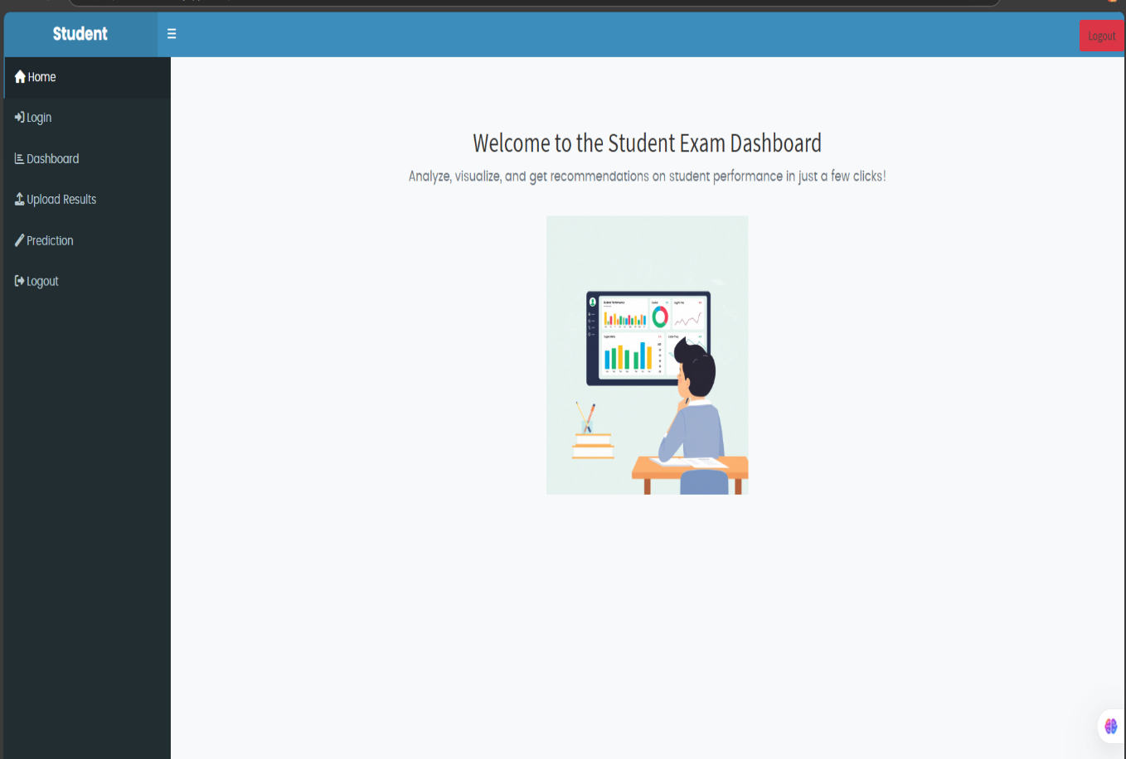
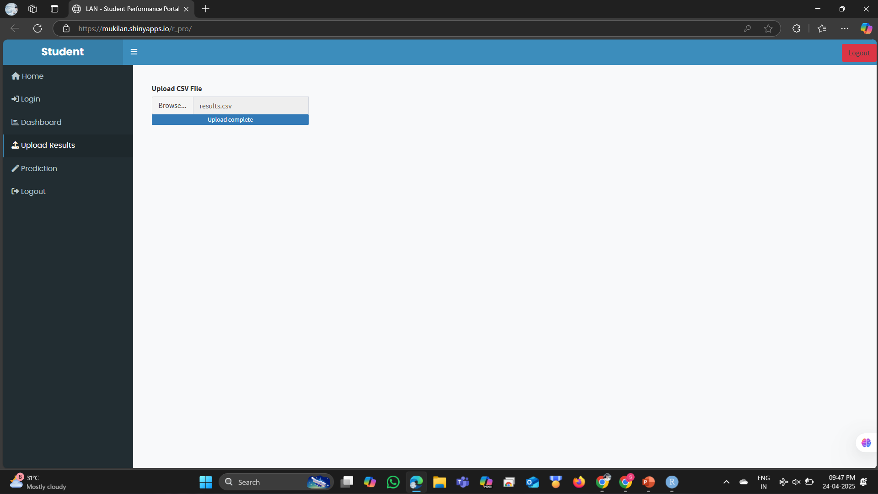
Output Snapshots

Slide 18
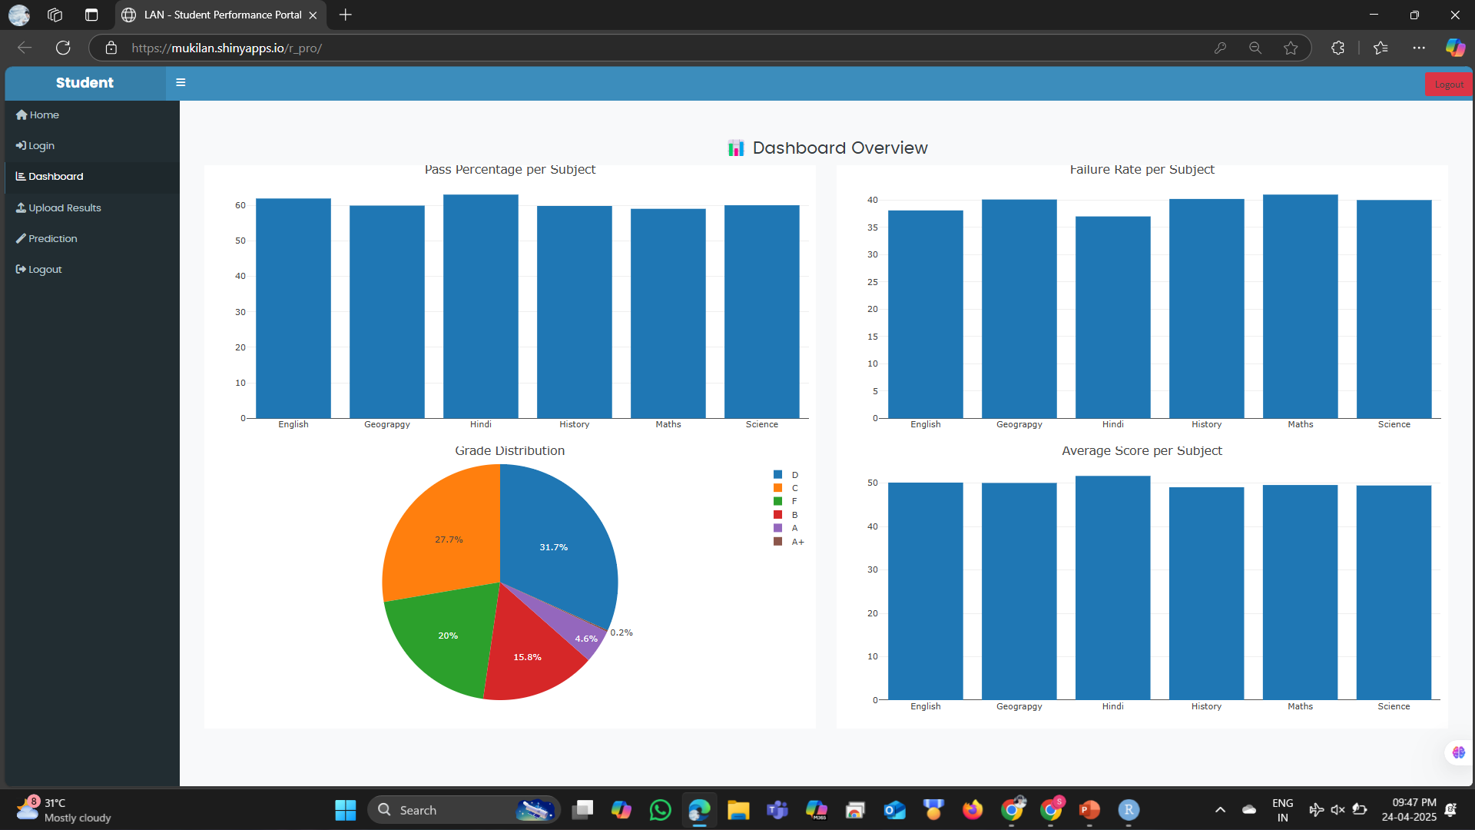
Output Snapshots

Slide 19
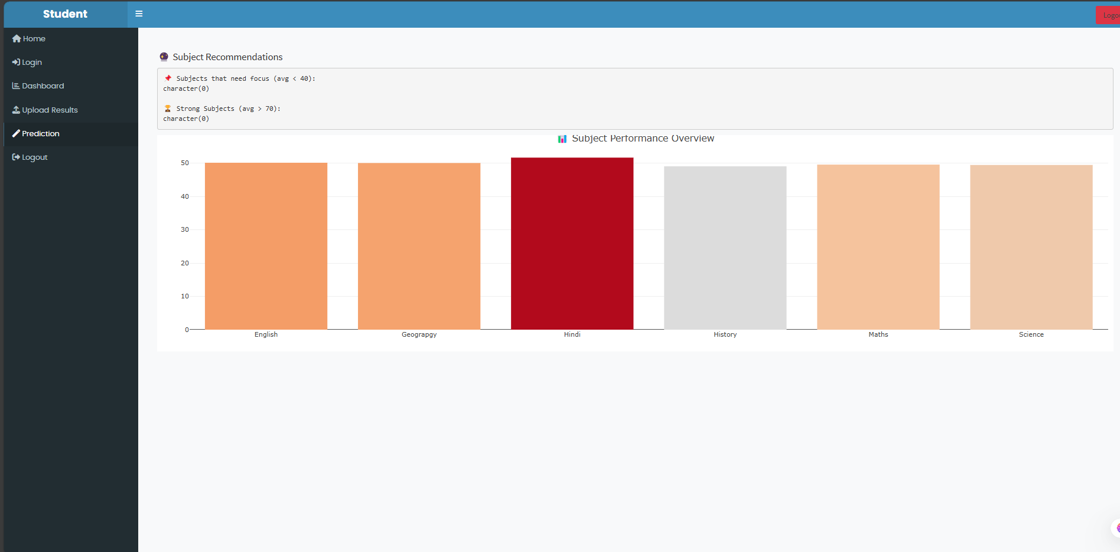
Output Snapshots

Slide 20
CONCLUSION
This project provides a web-like dashboard for colleges to analyze student marks efficiently.
It eliminates manual processing and provides data-driven recommendations.
The app is scalable, easy to use, and visually rich.
Future scope includes:
Role-based login system
Exportable performance reports

Slide 21
THANK YOU

