Slide 1
CGB1201 – JAVA PROGRAMMING
Department of Artificial Intelligence and Data Science
Academic Year: 2024 – 2025 (Odd Semester)
Register Number : 2303811724321072
Name : Mukilan K
Year : II Year
Semester : III
Section : B
Date : 25-11-2024

Slide 2
Pharmacy Management System

Slide 3
Problem Identification
Inventory Management Issues : Difficulty in maintaining accurate and up-to-date records of medicines. Inefficient tracking of stock levels, leading to overstocking or stockouts.
Expiry Monitoring : Lack of automated alerts for nearing or expired medicines, resulting in financial losses and risks to patient safety.
Prescription Handling: Managing detailed prescription records manually, leading to errors and delays in serving customers.

Slide 4
Objective
1. Inventory Management: Accurate tracking of medicine stock levels.
2. Expiry Alerts: Notifications for nearing or expired medicines.
3. Prescription Handling: Efficient management of customer prescriptions.
4. Billing Process: Generate accurate bills for faster transactions.
5. Operational Efficiency: Streamlined pharmacy operations with automation.

Slide 5
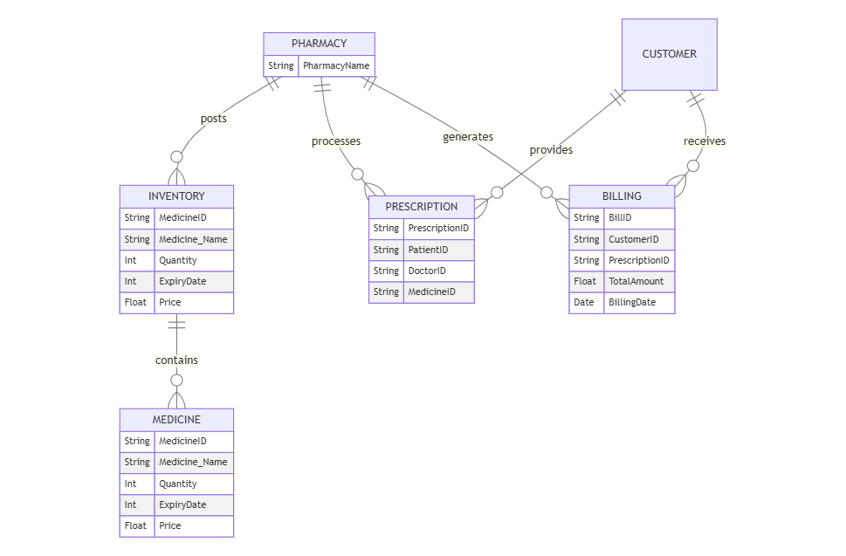
Proposed Architecture

Slide 6
Java Programming - Concepts Used
Classes and Objects: Encapsulating functionalities like Inventory, Medicine, and Prescription.
Collections Framework: Using ArrayList for dynamic storage of data.
Control Structures: Implementing navigation and workflows.
Event Handling: Button actions for system operations.
AWT Components: UI elements such as buttons, text areas, and panels.

Slide 7
List of Modules
Inventory Module
Prescription Module
Billing Module
Alert System
User Interface

Slide 8
Module Description
1. Inventory Module
Description: Manages medicine details and stock efficiently.
Features:
Add medicines with ID, name, quantity, expiry date, and price.
View a comprehensive list of medicines in stock.
Automatically alert for low stock and expired medicines.
2. Prescription Module
Description: Handles prescription management for patients.
Features:
Create and manage prescriptions by linking patients, doctors, and medicines.
Provide a searchable list of all prescriptions for reference.

Slide 9
Module Description (Cont..)
3. Billing Module
Description: Simplifies bill generation for purchases.
Features:
Generate detailed bills based on prescription details.
Automatically calculate and display the total cost for purchases.
4. Alert System
Description: Provides notifications to ensure efficient pharmacy management.
Features:
Display alerts for medicines nearing expiration dates.
Notify low stock levels for timely replenishment.

Slide 10
Module Description (Cont..)
5. User Interface
Description: Ensures user-friendly interaction with the system.
Features:
Provide labeled buttons for accessing each module.
Display outputs, alerts, and other notifications in a centralized area.

Slide 11
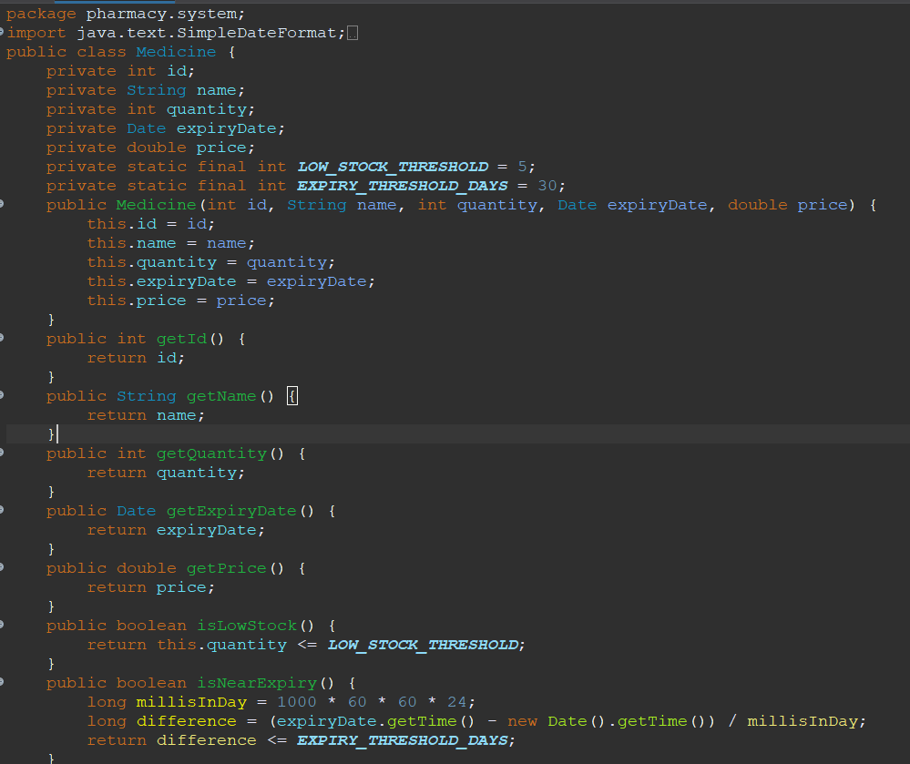
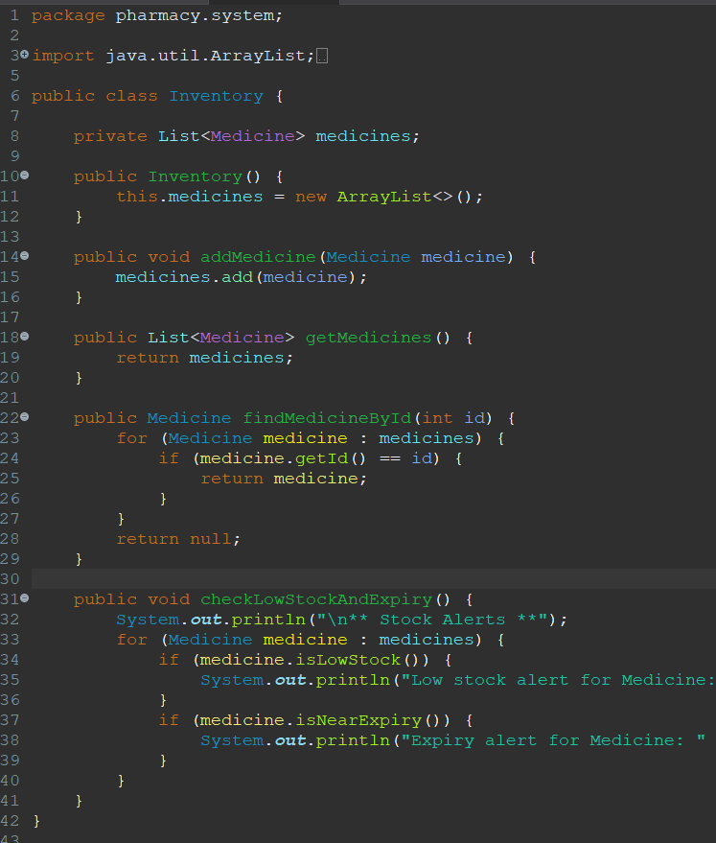
Source Code

Slide 12
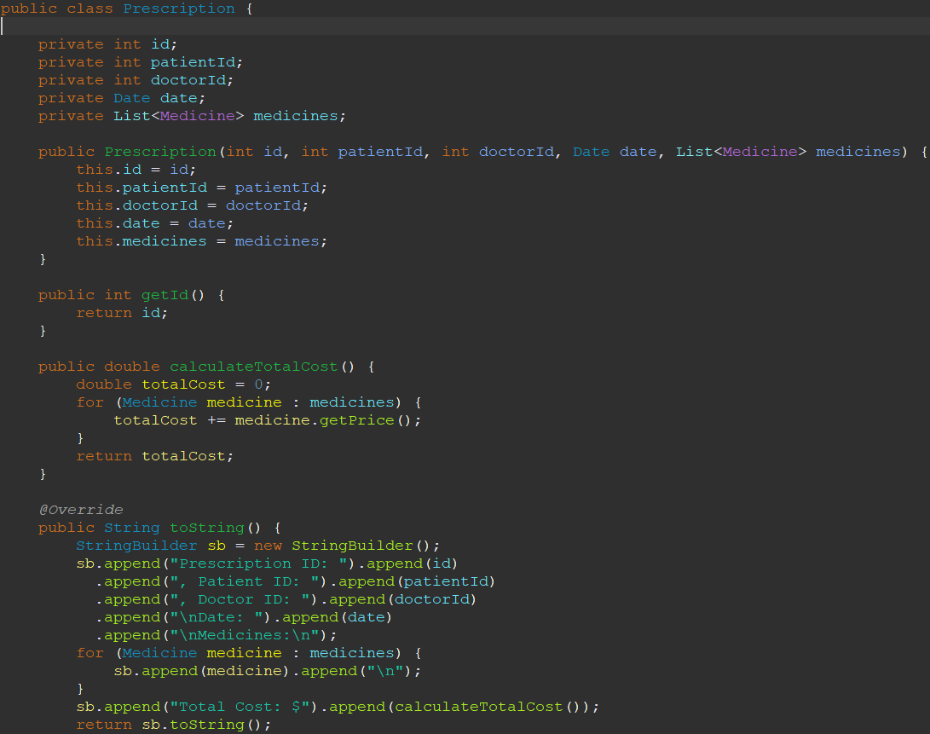
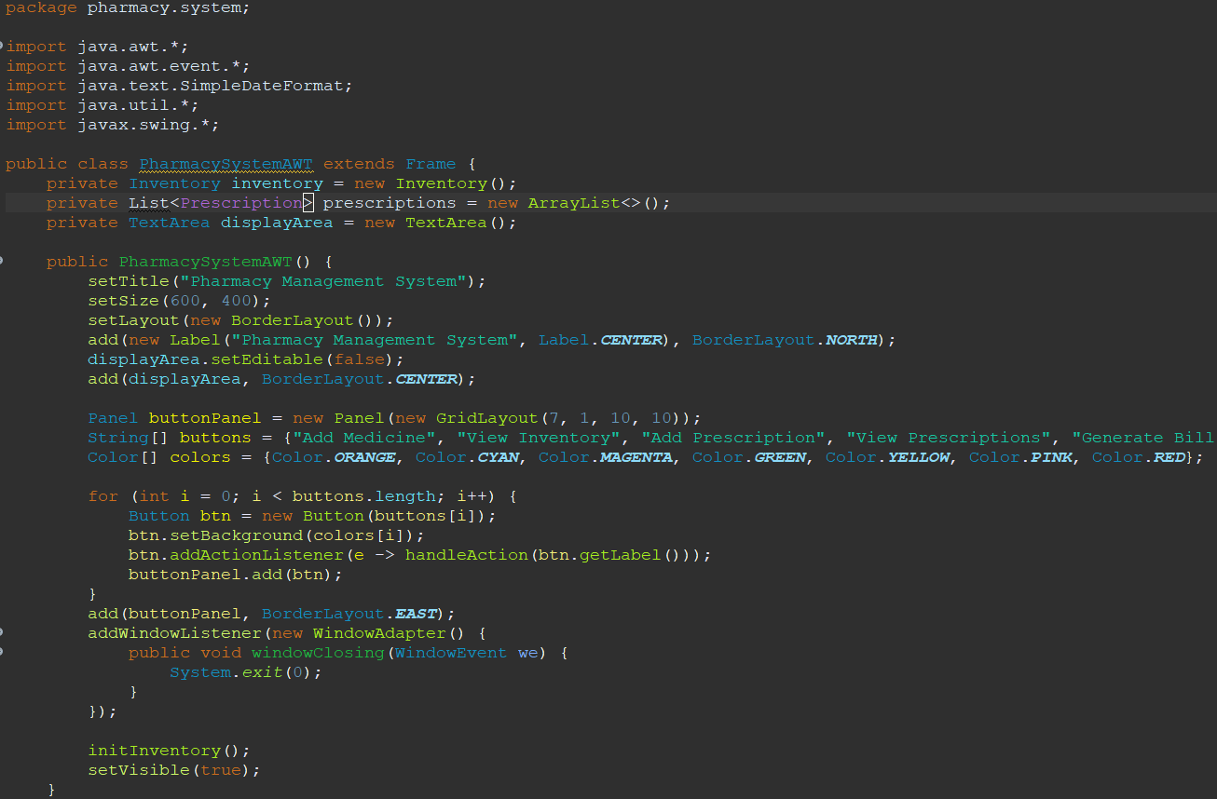
Source Code

Slide 13
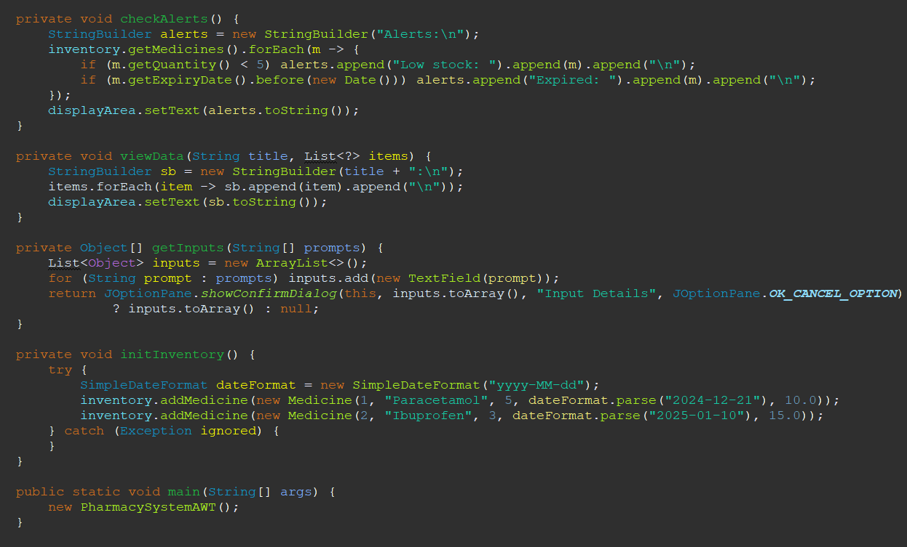
Source Code

Slide 14
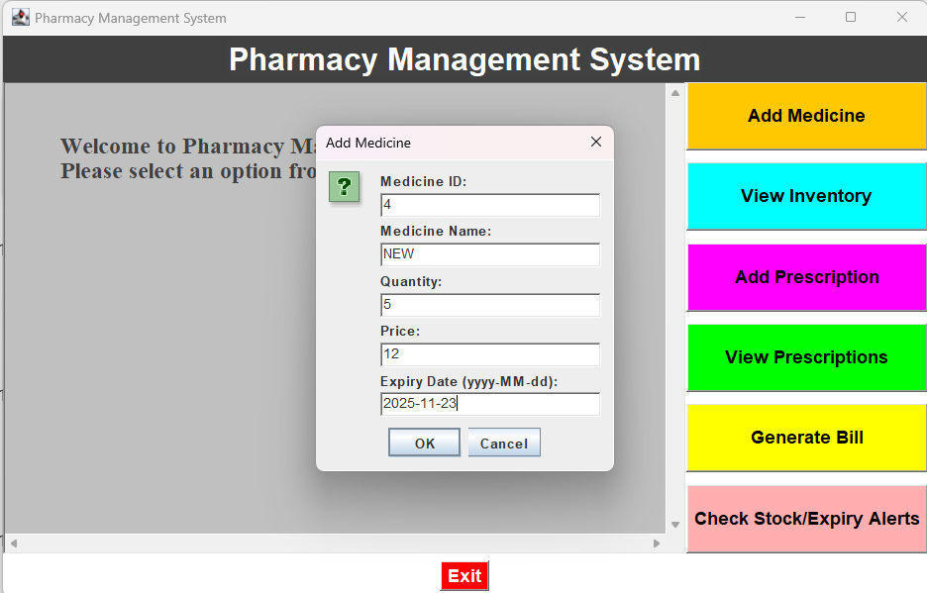
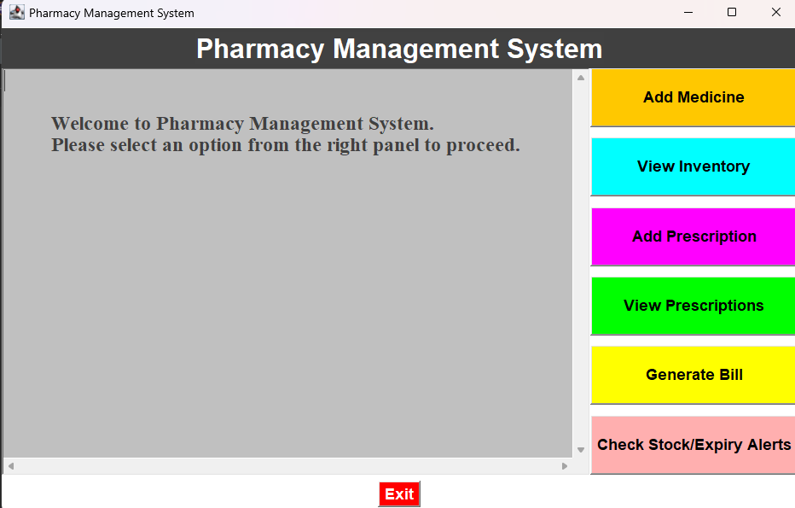
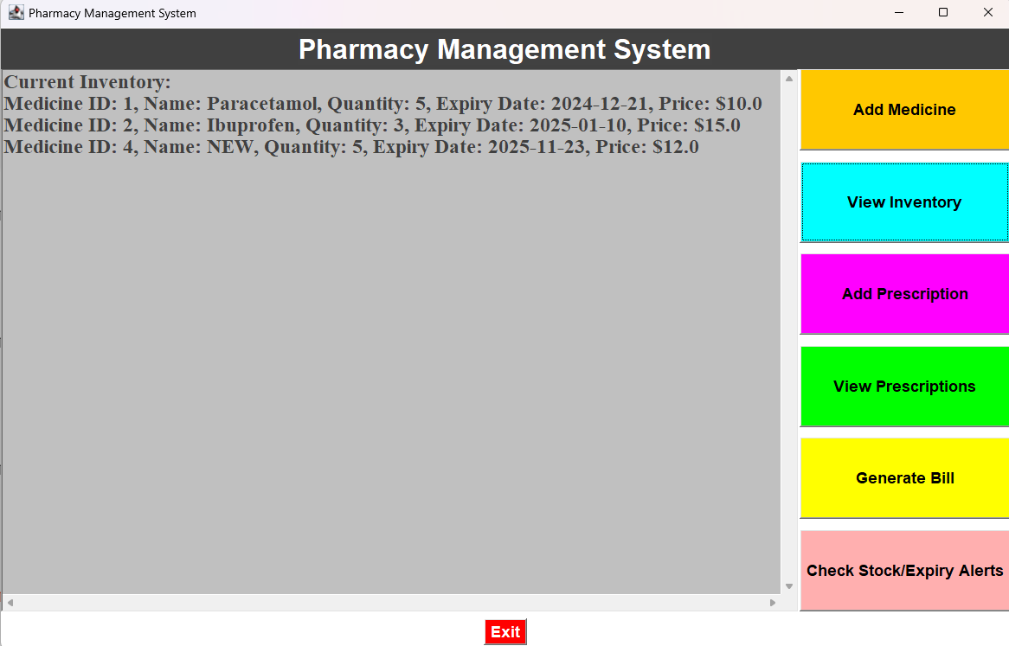
Results

Slide 15
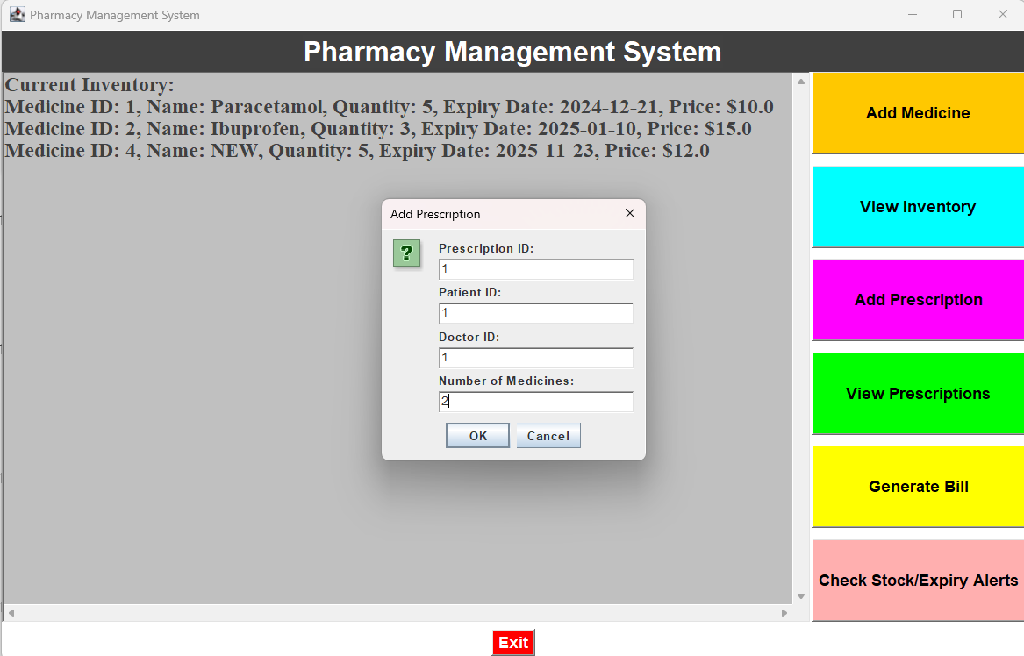
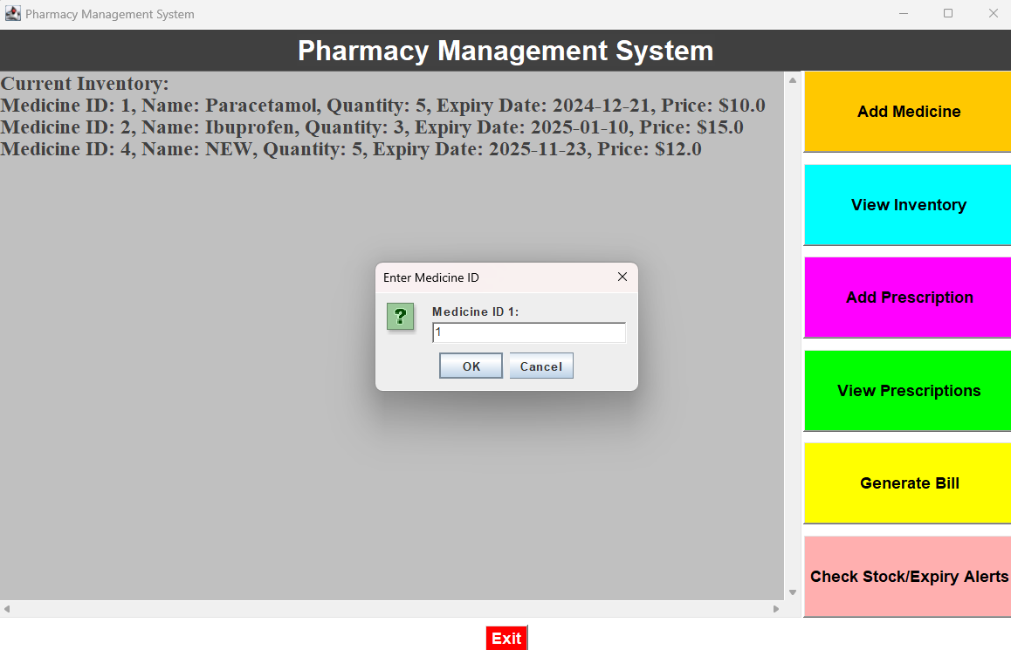
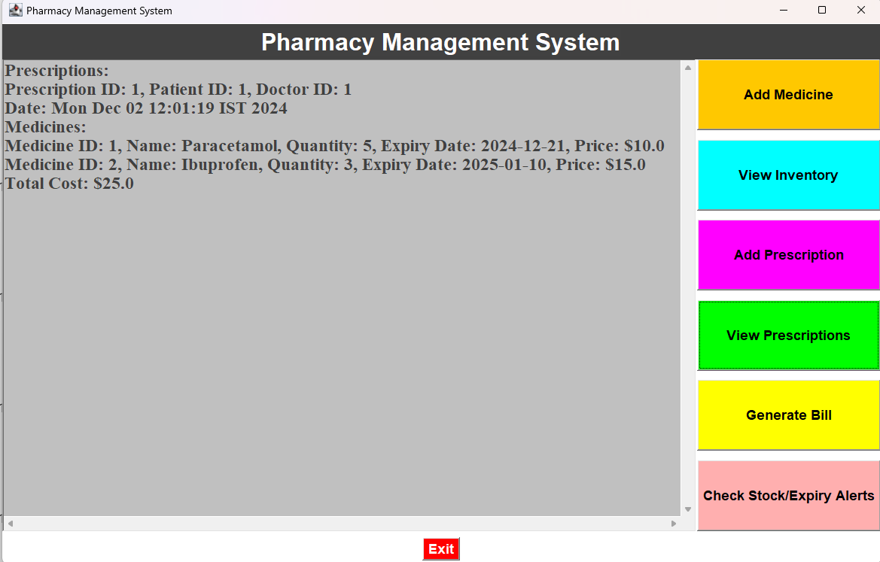
Results

Slide 16
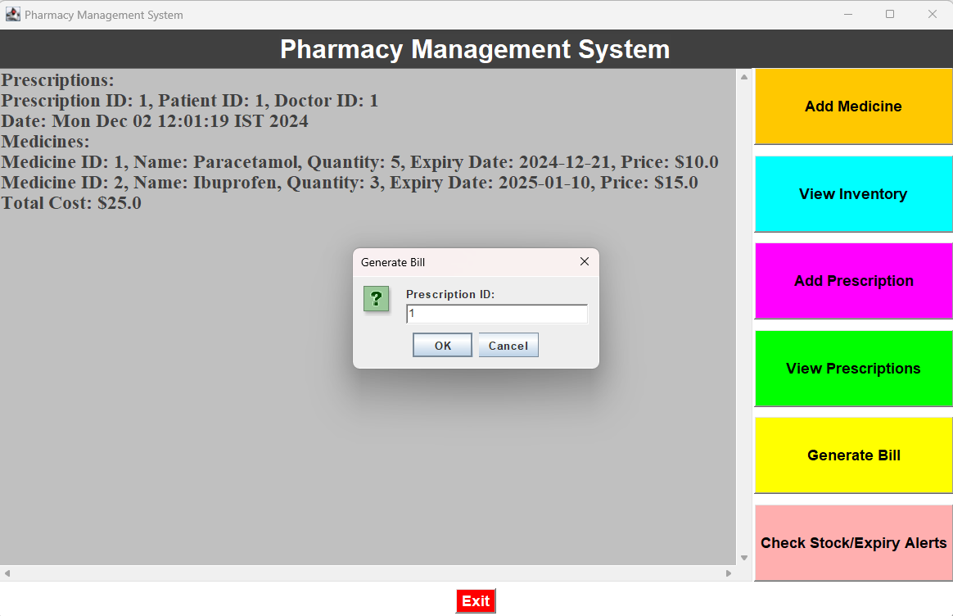
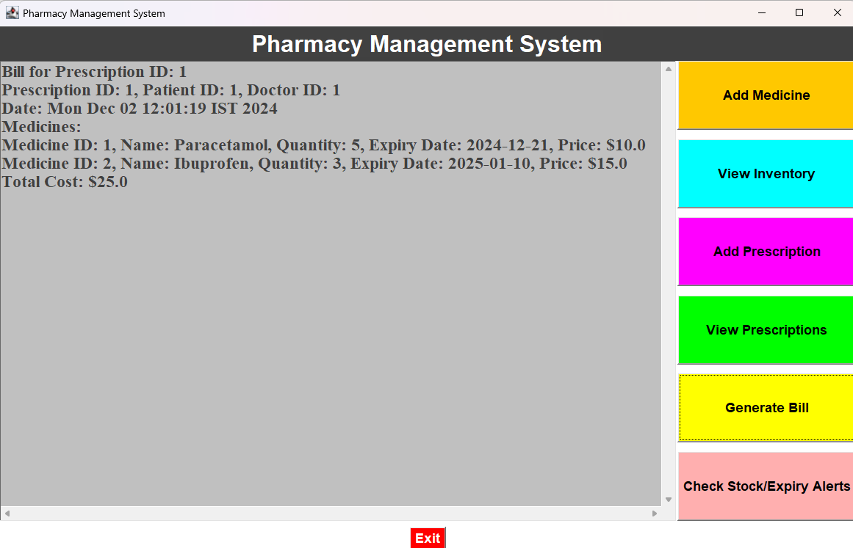
Results

Slide 17
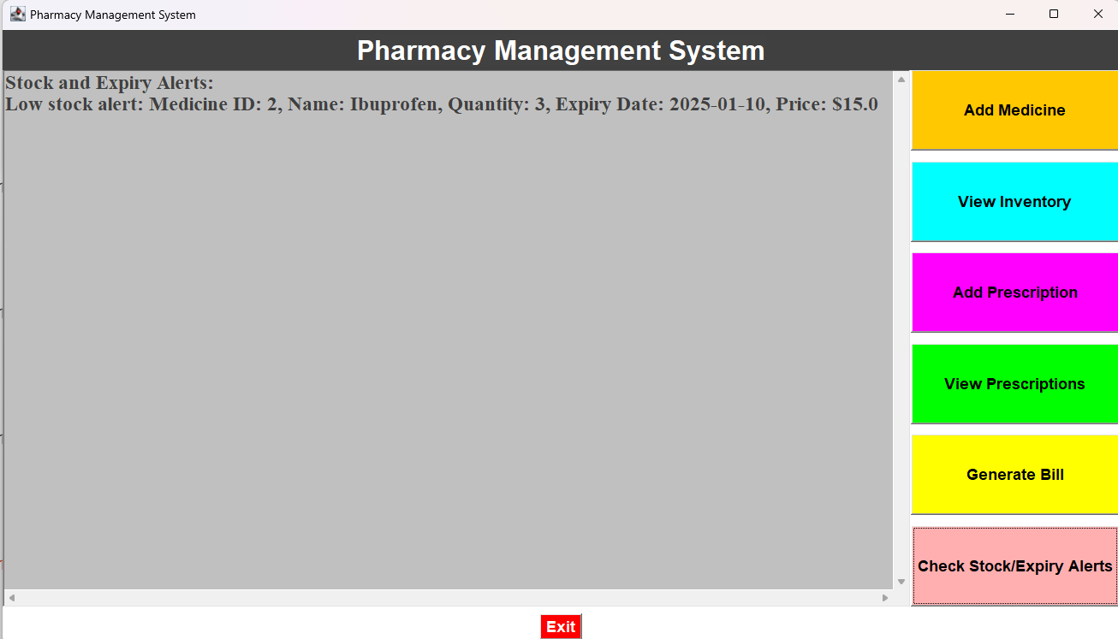
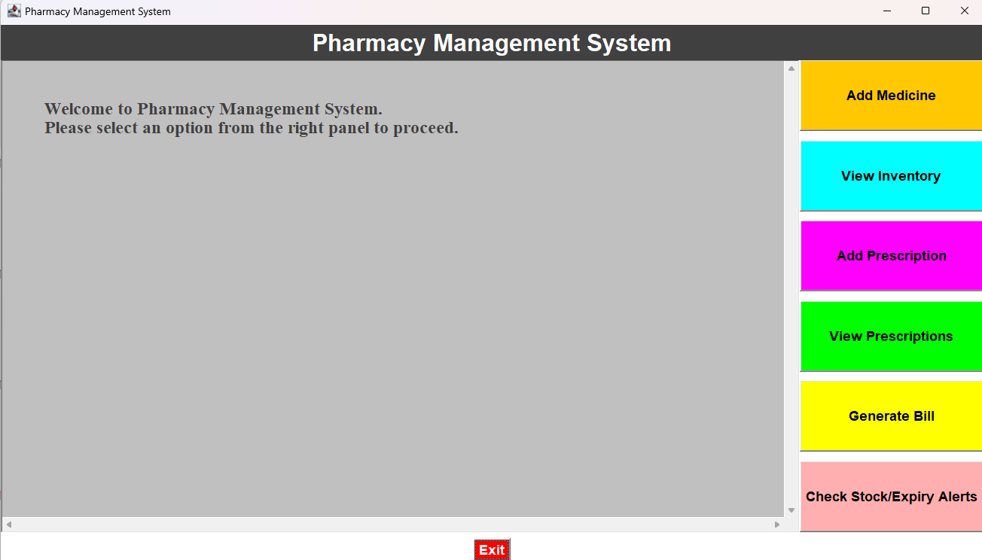
Results

Slide 18
Conclusion
This project demonstrates the practical application of Java's core features to develop a real-world solution. The modular architecture and user-friendly interface make it a scalable and reliable choice for pharmacy management.

Slide 19
Thank You
ANY QUERIES???

