Slide 1
Bernstein–Vazirani Algorithm
Point 1 of 36
Bernstein-Vazirani algorithm is a foundational quantum algorithm that finds a hidden secret binary string (encoded inside a black-box function using just one single query. Classically, this requires n queries for an n-bit string.
Real-World Applications & Where It Is Used:
Quantum Processor Benchmarking :
Quantum hardware companies (like IBM via Qiskit) use the algorithm as a standard "hello world" or validation test to check if a multi-qubit processor can accurately execute superposition, entanglement, and interference without excessive noise.
Cryptographic Oracle Analysis: It models how an attacker might query a black-box cipher or protocol to extract hidden keys or linear masks in fewer steps than classical brute-forcing allows.
Fault Diagnosis & Troubleshooting: Conceptual frameworks adapt the algorithm to trace hidden faults in complex networks or logic gates by mapping functional dependencies to a single query pass.

Slide 2
Bernstein–Vazirani Algorithm
Point 1 of 36
Realistic application: discovering a hidden XOR / linear dependency
Black-box circuit
Hidden relation
Goal
Inputs x₁, x₂, x₃ produce one parity/security bit f(x).
Unknown rule:
f(x) = s · x (mod 2)
Recover the mask s = 101
Problem Statement
given a function: f(x) = s · x (mod 2) , Where: s is a hidden binary string of length n (e.g., s = 101) ,x is an n-bit binary input ,· is the bitwise dot product modulo 2
Goal: Determine the hidden string s with the minimum number of queries.
Classical Approach: Requires n queries to the function f.
Quantum Advantage: Only 1 query is needed , Exponential speedup!

Slide 3
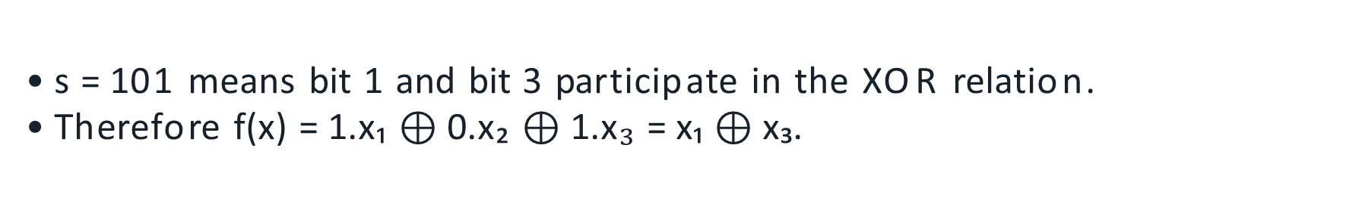
What Are We Trying to Find?
Point 2 of 36
Unknown secret mask: s = ?
Actual hidden mask: s = 101
f(x) = s · x (mod 2)
s = 101 means bit 1 and bit 3 participate in the XOR relation.
Therefore f(x) = 1.x₁ $⊕$ 0.x₂ $⊕$ 1.x₃ = x₁ $⊕$ x₃.

Slide 4
Algorithm Steps
1. Initialization Start with n qubits in the |0⟩ state and 1 ancilla qubit in the |1⟩ state: |0⟩^⊗n ⊗ |1⟩
2. Apply Hadamard Gates Apply Hadamard gates to all n+1 qubits to create a uniform superposition:(1/√2^n) ∑_x |x⟩ ⊗ (|0⟩ - |1⟩)/√2
3. Apply Oracle Uf The oracle flips the phase of the state depending on the value of f(x): Uf: |x⟩|y⟩ → |x⟩|y ⊕ f(x)⟩
Due to the ancilla being in the (|0⟩ - |1⟩) state, this results in a phase flip if f(x) = 1.
4. Apply Hadamard Gates Again Hadamards are applied to the first n qubits again. This causes quantum interference that isolates the hidden string s.
5. Measurement Measure the first n qubits. The result will be the hidden string s with 100% probability.

Slide 5
Quantum Solution Overview
Point 4 of 36
Example (n = 3, s = 101)
Initialize state: |000⟩|1⟩
Hadamard: Superposition of all inputs
Oracle flips phase based on s · x
Second Hadamard: Interference pattern collapses to |101⟩
Measure: Output is 101 — the hidden string
Quantum query complexity for the promised BV problem: 1 oracle query

Slide 6
Classical Solution
Point 3 of 36
f(x) = s · x (mod 2), S = 101
Query x = 100 → f(100) = s₁= 1
Query x = 010 → f(010) = s₂ = 0
Query x = 001 → f(001) = s₃ = 1
Result: s = 101
For an n-bit string: deterministic classical method needs n oracle queries.

Slide 7
Hadamard Gate: The Key Ingredient
Point 5 of 36
H = (1/√2) [ [1, 1], [1, −1] ]
A Hadamard changes computational-basis information into phase/superposition information.
It is also its own inverse: H² = I.
In BV, the first H layer creates superposition; the final H layer decodes phase into bits.

Slide 8
Hadamard Acting on |1⟩
Point 6 of 36
|1⟩ = [0, 1]ᵀ
H|1⟩ = (1/√2)[1, −1]ᵀ
H|1⟩ = (|0⟩ − |1⟩)/√2 = |−⟩
This |−⟩ state is essential because X|−⟩ = −|−⟩.
That minus sign is what allows phase kickback.

Slide 9
Initialize the BV Circuit
Point 7 of 36
Initial state: |000⟩|1⟩
q₁ = |0⟩
q₂ = |0⟩
q₃ = |0⟩
ancilla qₐ = |1⟩
The data register starts at |000⟩; the ancilla starts at |1⟩ so that H creates |−⟩.

Slide 10
Apply Hadamard to All Four Qubits
Point 8 of 36
|0⟩ —H→ |+⟩
|1⟩ —H→ |−⟩
|000⟩|1⟩ —H⊗4→ |+++⟩|−⟩
The first three qubits become an equal superposition.
The ancilla becomes |−⟩ and is ready for phase kickback.

Slide 11
Expand the Three-Qubit Superposition
Point 9 of 36
|+⟩⊗3 = 1/√8 (|000⟩+|001⟩+|010⟩+|011⟩+|100⟩+|101⟩+|110⟩+|111⟩)
Three qubits represent amplitudes over 2³ = 8 computational-basis states.
This is quantum parallelism—but the eight values cannot simply be read out independently.
The oracle must encode useful global information into phase.

Slide 12

Oracle for the Secret s = 101
Point 10 of 36
f(x) = x₁ $⊕$ x₃
Oracle s = 101
q1 |0⟩
H
H
q2 |0⟩
H
H
q3 |0⟩
H
H
qa |1⟩
H
Because s₂ = 0, q₂ does not control the ancilla. CNOTs are used from q₁ and q₃.

Slide 13
Phase Kickback: Core Calculation
Point 11 of 36
|−⟩ = (|0⟩ − |1⟩)/√2
X|−⟩ = (|1⟩ − |0⟩)/√2
X|−⟩ = −(|0⟩ − |1⟩)/√2 = −|−⟩
The ancilla returns to the same physical state, but the input branch acquires a minus phase.

Slide 14
Why Phase Kickback Matters
Point 12 of 36
U_f |x⟩|−⟩ = (−1)^{f(x)} |x⟩|−⟩
If f(x) = 0 → phase factor is +1.
If f(x) = 1 → phase factor is −1
The oracle output has been converted into a relative phase on the input register.

Slide 15
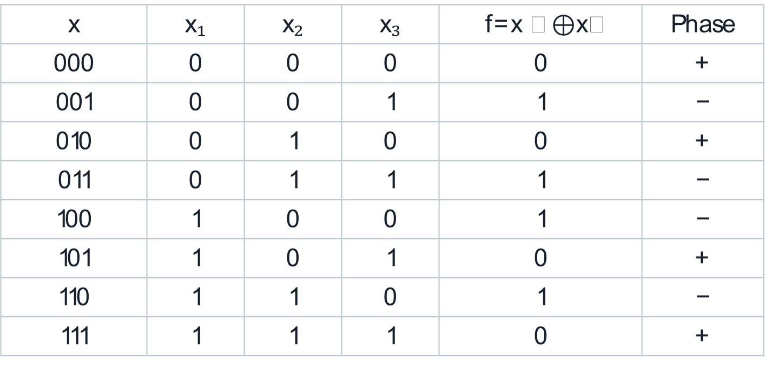
Oracle Output for All 8 Inputs
Point 13 of 36
x | x₁ | x₂ | x₃ | f=x ₁ $⊕$x₃ | Phase
000 | 0 | 0 | 0 | 0 | +
001 | 0 | 0 | 1 | 1 | −
010 | 0 | 1 | 0 | 0 | +
011 | 0 | 1 | 1 | 1 | −
100 | 1 | 0 | 0 | 1 | −
101 | 1 | 0 | 1 | 0 | +
110 | 1 | 1 | 0 | 1 | −
111 | 1 | 1 | 1 | 0 | +

Slide 16
Important: We Have Not Yet Obtained 101
Point 14 of 36
After the oracle, the secret is stored as a pattern of + and − phases.
000:+ 001:− 010:+ 011:− 100:− 101:+ 110:− 111:+
Direct computational-basis measurement cannot reveal these signs.
A second Hadamard layer is required to convert phase information into measurable bits.

Slide 17
Factor the Phase Pattern
Point 15 of 36
1/√8 (|000⟩−|001⟩+|010⟩−|011⟩−|100⟩+|101⟩−|110⟩+|111⟩)
= |−⟩ |+⟩ |−⟩
Secret bit 1
Secret bit 0
Secret bit 1
encoded as |−⟩
encoded as |+⟩
encoded as |−⟩

Slide 18
Final Hadamard Decodes the Phase
Point 16 of 36
H|+⟩ = |0⟩
H|− ⟩ = |1⟩
|− + − ⟩ —H⊗3→ |1 0 1⟩
Hadamard is its own inverse: H² = I.
It converts the phase-basis representation back to computational bits.

Slide 19
Decode Qubit 1
Point 17 of 36
Before final H: q₁ = |−⟩
H|−⟩ = |1⟩
Therefore the first secret bit is 1.

Slide 20
Decode Qubit 2
Point 18 of 36
Before final H: q₂ = |+⟩
H|+⟩ = |0⟩
Therefore the second secret bit is 0.

Slide 21
Decode Qubit 3
Point 19 of 36
Before final H: q₃ = |−⟩
H|−⟩ = |1⟩
Therefore the third secret bit is 1.

Slide 22

Measurement Gives the Secret
Point 20 of 36
q₁ q₂ q₃ = 1 0 1
Measured secret: s = 101
The unknown black-box rule is therefore f(x) = x₁ $⊕$ x₃.
In the ideal noiseless BV circuit, the correct bit string is obtained deterministically.

Slide 23
Entire BV Circuit at a Glance
Point 21 of 36
Oracle s = 101
q1 |0⟩
H
H
q2 |0⟩
H
H
q3 |0⟩
H
H
qa |1⟩
H
First H layer → oracle/phase kickback → final H layer → measurement.

Slide 24
Complete State Evolution
Point 22 of 36
Initial
After first H
After oracle
|000⟩|1⟩
|+++⟩|−⟩
|−+−⟩|−⟩
Final H⊗3 → |101⟩|−⟩ → Measure → 101

Slide 25
Where Is the Quantum Parallelism?
Point 23 of 36
1/√8 Σₓ |x⟩ —U_f→ 1/√8 Σₓ (−1)^{f(x)} |x⟩
The oracle acts coherently on the superposition in one quantum query.
But we do not read eight separate answers.
Instead, the phase pattern is engineered so that interference reveals one global property: the hidden mask s.

Slide 26
Interference: Constructive and Destructive
Point 24 of 36
Wrong candidates
Correct candidate s = 101
+1 − 1 +1 −1 … = 0
1 +1 +1 +1 +1 +1 +1 +1 = 8
Destructive interference cancels incorrect output amplitudes.
Constructive interference concentrates amplitude on |101⟩.

Slide 27
Why Only the Secret State Survives
Point 25 of 36
After oracle: 1/√(2ⁿ) Σₓ (−1)^{s·x}|x⟩
After H⊗n: 1/2ⁿ Σᵧ [Σₓ (−1)^{x·( s⊕y)}] |y⟩
If y = s, then s ⊕ y = 0…0 and every term contributes +1 → amplitude 1.
If y ≠ s, positive and negative terms cancel → amplitude 0.

Slide 28
Connection to Cryptanalysis
Point 26 of 36
Cipher / Boolean map
Search structure
Research use
Treat part of a construction as a black-box function.
Look for linear/XOR relations or useful differentials.
Build distinguishers or analyze partial-key information under quantum access models.
This is a research connection; textbook BV is not a direct “break any cipher” algorithm.

Slide 29
Fields Where BV Ideas Are Useful
Point 27 of 36
Field | How BV contributes
Cybersecurity / cryptanalysis | Hidden linear structure in Boolean functions
Quantum learning | Learning parity / linear functions
LPN / LWE research | Noisy linear relations under special quantum-sample models
Boolean-function analysis | Identify participating variables in linear parity
Quantum hardware testing | Check phase coherence and gate quality
Education | Teach oracles, phase kickback, interference

Slide 30
Application 1: Cybersecurity and Cryptanalysis
Point 28 of 36
Cryptographic components are often built from Boolean functions and XOR-based structures.
BV-derived Fourier-sampling ideas can help expose linear structures under appropriate oracle access.
Research has connected these ideas with quantum distinguishers, Feistel-style constructions, and partial-key analysis.
Most mature interpretation: research tool for discovering hidden linear structure.

Slide 31

Application 2: Learning Parity Functions
Point 29 of 36
Example target: y = x₂ $⊕$x₅ $⊕$x₉
The hidden mask identifies which features participate in the parity relation.
This is mathematically the same structure as f(x) = s · x (mod 2).
BV therefore provides a clean quantum example of learning a linear Boolean rule.

Slide 32
Application 3: Learning with Noise / Cryptographic Problems
Point 30 of 36
Noiseless: b = s · x
Noisy: b = s · x ⊕ e
The error bit e turns parity learning into a noisy linear-learning problem.
This resembles Learning Parity with Noise (LPN); related work also studies LWE-type settings.
Practical advantage depends strongly on how the required quantum samples/oracles can be prepared.

Slide 33
Application 4: Boolean Function Analysis
Point 31 of 36
f(x₁,…,x₁₀₀) = x₃ ⊕ x₁₇ ⊕ x₆₄ ⊕ x₉₁
The mask indicates exactly which variables participate in the linear relation.
Under the BV promise and coherent oracle access, the hidden mask can be recovered directly.
General software dependency analysis is not automatically a BV problem—the linear promise matters.

Slide 34
Application 5: Quantum Hardware Benchmarking
Point 32 of 36
Prepare phases
Entangle / kick back
Measure success
Hadamards create |+⟩ and |−⟩ states.
CNOT-based oracle must preserve phase information.
Noise appears as wrong bit strings instead of the ideal secret.
BV is compact enough for small-device demonstrations and gate/coherence experiments.

Slide 35
Is BV a Commercially Deployed Real-Time Algorithm?
Point 33 of 36
Mostly no—not in the textbook “find a hidden password” form.
Its direct problem is a specially promised oracle problem.
Its strongest present value is foundational research, cryptanalysis research, quantum learning research, and hardware experimentation.
So teach it as a model of quantum advantage and algorithmic technique—not as a routine banking or hospital application.

Slide 36
Why Study Bernstein–Vazirani in Quantum Computing?
Point 34 of 36
1
2
3
4
5
Superposition
Quantum oracle
Phase kickback
Interference
Measurement
These ideas recur in more advanced algorithms such as Simon, Grover, phase estimation, and Shor.

Slide 37
One Visual Way to Remember BV
Point 35 of 36
SPREAD
ENCODE
DECODE
Hadamard
|000⟩ → superposition
Oracle
secret → phase pattern
Hadamard
phase → |101⟩
|000⟩|1⟩ → |+++⟩|− ⟩ → |−+−⟩|−⟩ → |101⟩|−⟩

Slide 38
Key Interpretation and Lecture Takeaway
Point 36 of 36
Bernstein–Vazirani finds a hidden binary linear/parity structure s in f(x)=s·x (mod 2).
First Hadamards create the superposition.
The oracle uses phase kickback to encode the hidden relation.
Final Hadamards convert phase into measurable bits through interference.
For the example s = 101, the ideal output is exactly 101.
Main fields: cryptanalysis research, parity learning, Boolean-function analysis, quantum hardware testing, and education.
Memory line: Hadamard → Superposition → Oracle → Phase Kickback → Interference → Measurement.

