Slide 1
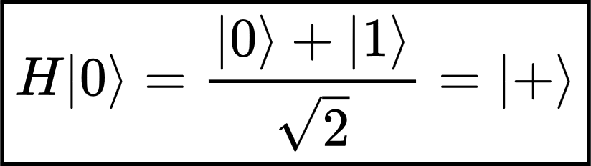
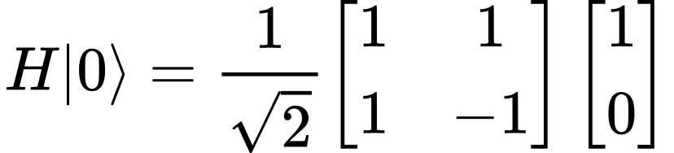
Hadamard Gate
Superposition Foundation for Bernstein–Vazirani
The Hadamard gate takes a qubit that is definitely 0 and creates an equal superposition of 0 and 1.
Formula-preserved lecture PPT

Slide 2
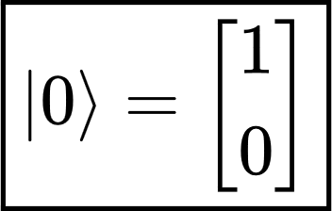
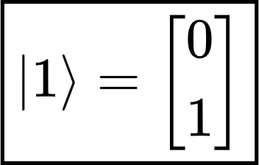
1. First, what is |0⟩?
In quantum computing, the two basic qubit states are represented as vectors.
These are called the computational basis states.
You can think of them as the quantum equivalents of classical 0 and 1, although a qubit can also exist in combinations of these two states.
A qubit can exist in combinations of these two states
Hadamard Gate: Superposition Foundation for Bernstein–Vazirani
1

Slide 3
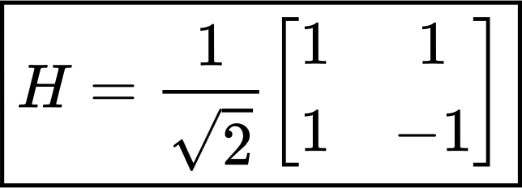

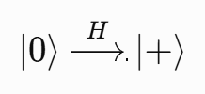
2. What is the Hadamard gate?
The Hadamard gate is written as H.
Its major purpose is to convert a definite computational-basis state into a superposition.
For example:
computational-basis state → superposition
Hadamard Gate: Superposition Foundation for Bernstein–Vazirani
2

Slide 4
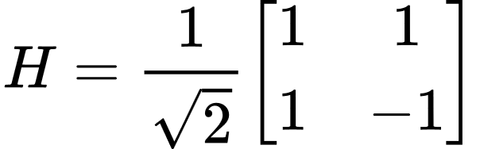
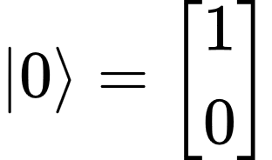
3. We want to calculate H|0⟩
We know:
Therefore:
and:
Now we simply perform matrix multiplication.
Hadamard Gate: Superposition Foundation for Bernstein–Vazirani
3

Slide 5
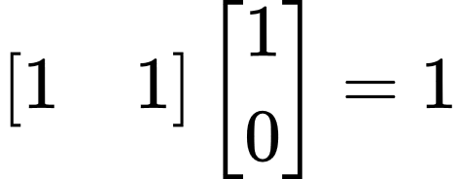
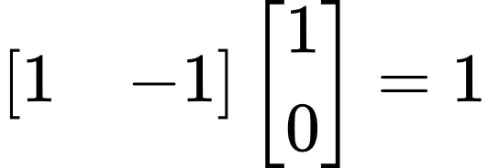
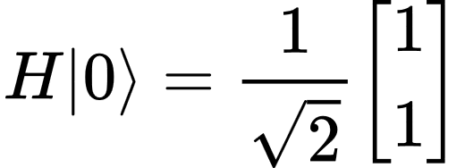
4. How is the matrix multiplication done?
Take the first row [1 1] and multiply it by the column.
So: (1×1)+(1×0)=1
Therefore, the first element of the answer is 1.
Now take the second row [1 -1] and multiply it by the column.
We get: (1×1)+(-1×0)=1
Therefore the second element is also 1.
Hadamard Gate: Superposition Foundation for Bernstein–Vazirani
4

Slide 6
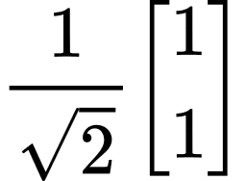
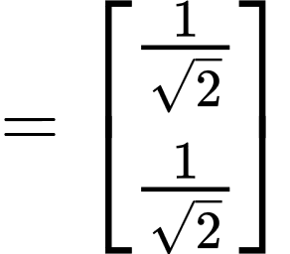
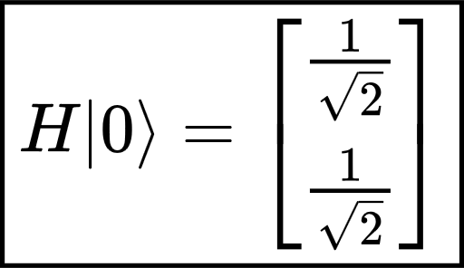
5. Where does the 1/√2 go?
The 1/√2 multiplies every component of the vector.
It means:
Therefore:
The scalar is distributed to every component.
Hadamard Gate: Superposition Foundation for Bernstein–Vazirani
5

Slide 7
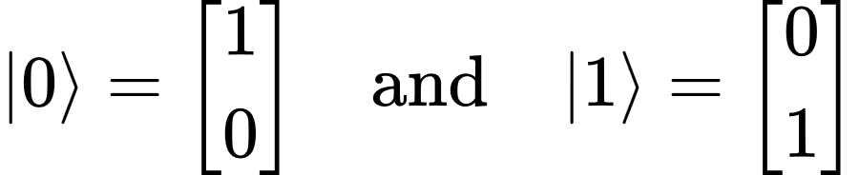
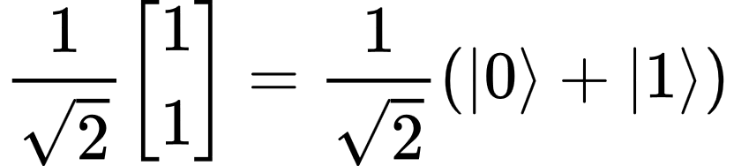
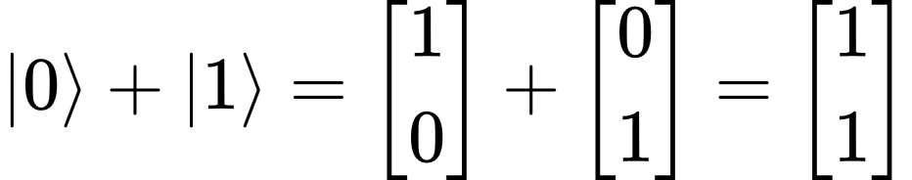
6. Now how does this become |0⟩ + |1⟩?
Remember:
So:
Now add them:
Hadamard Gate: Superposition Foundation for Bernstein–Vazirani
6

Slide 8
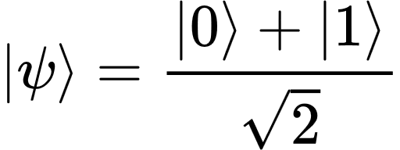


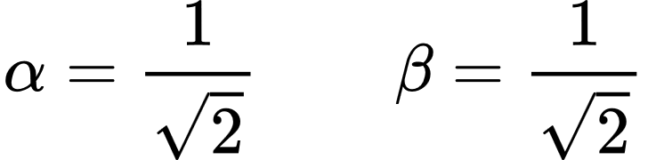
7. What does |+⟩ actually mean?
This is the physical interpretation.
Before applying Hadamard: |0⟩
The qubit is definitely in state 0.
So if we measure immediately:
After Hadamard:
Compare this with the general qubit equation:
These are called probability amplitudes.
Hadamard Gate: Superposition Foundation for Bernstein–Vazirani
7

Slide 9
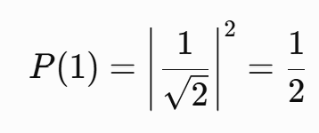
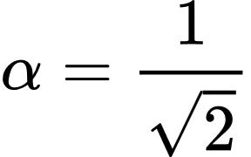
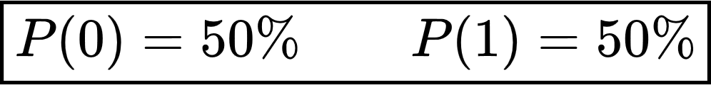
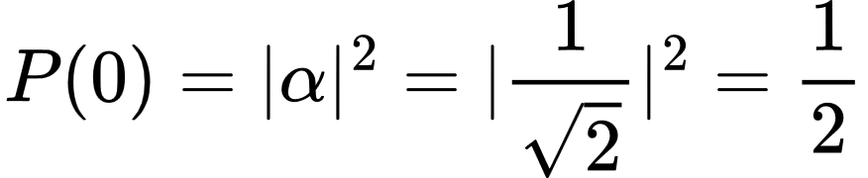
8. Amplitude is not probability
This is an important distinction.
For state 0, amplitude is:
Similarly:
Probability of measuring 0 is:
Hadamard transformed |0⟩ into an equal superposition of 0 and 1.
Hadamard Gate: Superposition Foundation for Bernstein–Vazirani
8

Slide 10
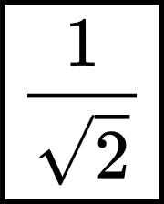

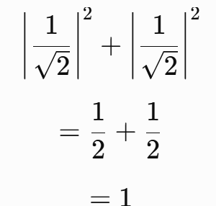

9. Why exactly 1/√2?
Because quantum states must be normalized.
For a valid qubit:
So we normalize the state for
Then α= β=
Suppose we incorrectly used |0⟩ + |1⟩.
Then α=1, β=1.
Probability total would be 2, meaning 200% probability, which is impossible.
Therefore the factor
ensures that the total measurement probability is 100%.
Hadamard Gate: Superposition Foundation for Bernstein–Vazirani
9

Slide 11
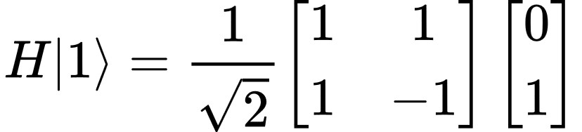
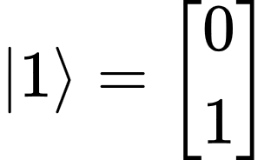

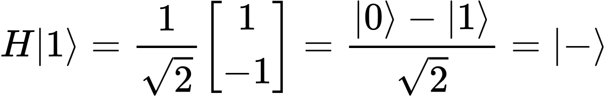
10. Let’s also calculate H|1⟩
This becomes very important for Bernstein–Vazirani because the ancilla starts in |1⟩.
We know:
Our two important equations: H|0⟩ = |+⟩ and H|1⟩ = |−⟩
Hadamard Gate: Superposition Foundation for Bernstein–Vazirani
10

Slide 12
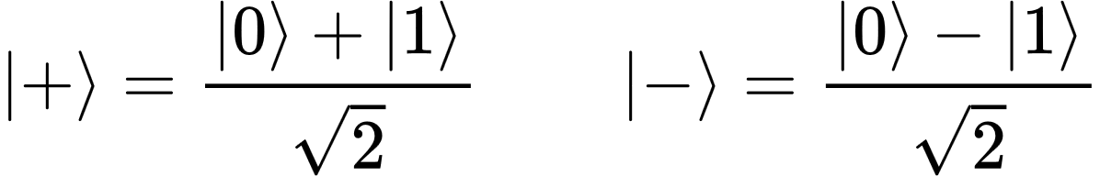
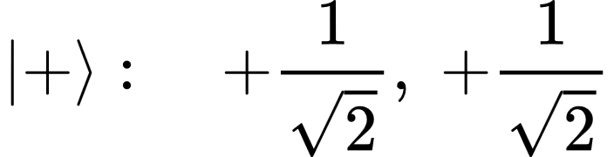
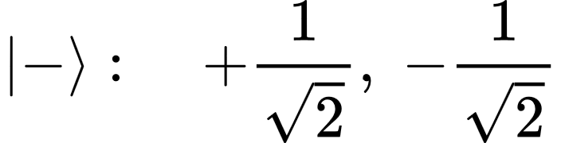
11. Difference between |+⟩ and |−⟩
This is subtle but extremely important.
If you measure either one directly in the computational basis, the probabilities are the same:
? : If measurement probabilities are the same, what is the difference?
The difference is the phase.
That minus sign is a relative phase difference.
This phase becomes extremely important during interference.
Hadamard Gate: Superposition Foundation for Bernstein–Vazirani
11

Slide 13

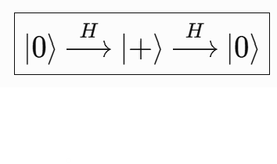
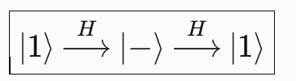
12. Another property of Hadamard
Now consider applying H again.
Because H² = I, applying H again gives:
You can think of H as converting between two different bases:
|0⟩ ↔ |+⟩ and |1⟩ ↔ |−⟩
Hadamard Gate: Superposition Foundation for Bernstein–Vazirani
12

Slide 14


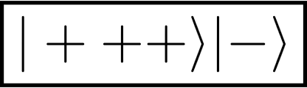
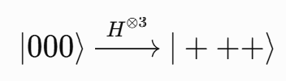
13. Why is this useful in Bernstein–Vazirani?
Now it connects directly to what we were discussing.
Suppose your BV secret is:
So each qubit goes from |0⟩ to |+⟩.
At the same time, the ancilla starts as |1⟩ and Hadamard converts it into |−⟩.
Initially the three data qubits are |000⟩.
After H:
The |+⟩ states create the input superposition.
The |−⟩ ancilla makes phase kickback possible.
Hadamard Gate: Superposition Foundation for Bernstein–Vazirani
13

