Slide 1
SOCIAL MEDIA ENGAGEMENT DASHBOARD
Little Red Zombies | Power BI Business Analytics Project

Slide 2
Project Objective
• Analyze multi-platform social media engagement performance
• Identify best-performing content strategies
• Track engagement trends and audience interaction
• Provide business recommendations for content optimization

Slide 3
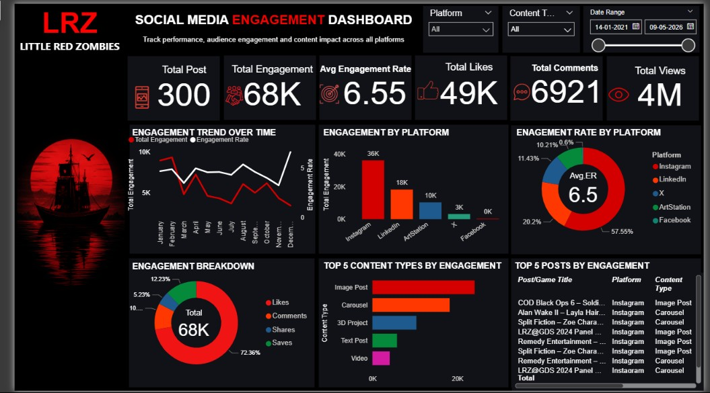
Dashboard Overview

Slide 4
Key Business Insights
• Instagram drives the highest overall engagement across platforms
• Carousel content generates the strongest audience interaction
• Consistent posting improves engagement trends over time
• Likes contribute the majority of engagement activity
• Video content receives high views but lower engagement quality

Slide 5
Business Recommendations
• Increase carousel and image-based storytelling content
• Focus more on Instagram for audience growth campaigns
• Maintain consistent posting schedule across platforms
• Improve engagement-focused CTAs to increase comments and shares
• Use high-performing content themes for future campaigns

Slide 6
Thank You
Social Media Analytics Dashboard for Little Red Zombies

