Slide 1


Symbiosis Institute of Technology, Nagpur
Symbiosis International (Deemed University)
HEALTHCARE ANALYTICS | PROJECT PRESENTATION
AI Health Assistant
A Voice-Enabled Health Risk Assessment System using Machine Learning, RAG and Vapi
Mukund Kuthe
Manasvi Puranik
PRN 23070521082
PRN 23070521090
7th Semester | Subject: Healthcare Analytics | Faculty Guide: Dr. Prerna Mishra

Slide 2




Introduction and Objectives
01 OVERVIEW
Preliminary health guidance is hard to reach: long forms, unreliable searches, no idea where to go. The AI Health Assistant removes that friction. A person phones in, answers spoken questions and gets a risk class, a source-grounded answer and nearby care.
OBJECTIVES
Hands-free screening over a phone call
Predict risk from 9 easy inputs
Ground answers in a medical book
Find nearby healthcare from a spoken place
Expose clean REST endpoints
Voice agent
ML risk model
Vapi phone call
Low, Moderate, High
RAG
Location
Scope: screening and information only. Not a diagnosis or a clinician substitute.
1,163-page book
Nearby facilities

Slide 3
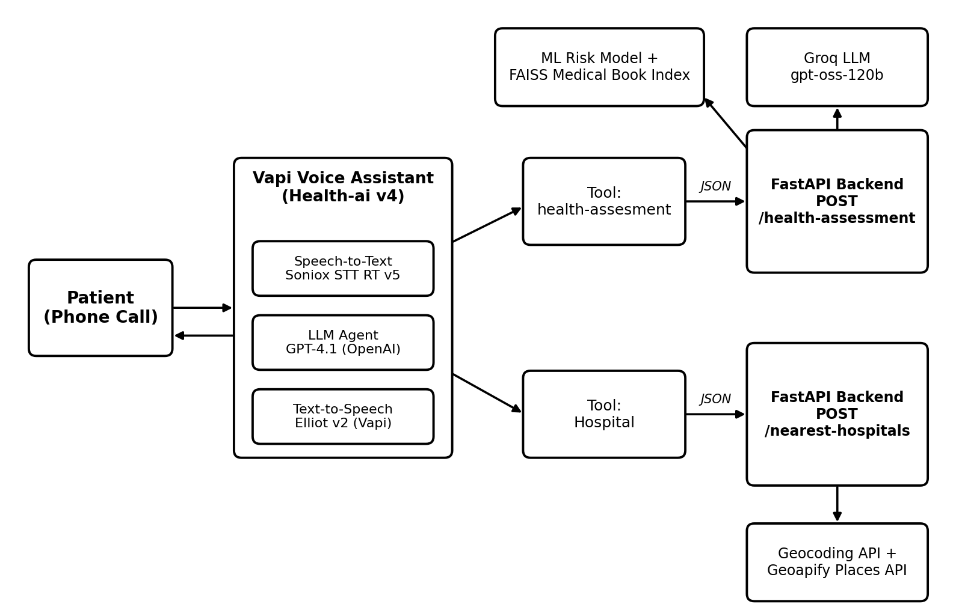
System Architecture
02 DESIGN
Interaction layer
Vapi agent Health-ai: speech to text, LLM reasoning, text to speech
Service layer
FastAPI: POST /health-assessment, POST /nearest-hospitals, GET /
Intelligence and data
Risk model, FAISS index, Groq LLM, geocoding and places APIs

Slide 4



Technology Stack
03 TOOLS
Voice platform
Backend
Machine learning
Vapi assistant Health-ai v4
Soniox STT RT v5 (1.8% WER)
GPT-4.1 conversation model
Elliot v2 text to speech
FastAPI and Uvicorn
Pydantic validation
Auto-generated /docs
httpx for external calls
scikit-learn 1.7.2, joblib
XGBoost, LightGBM, CatBoost
SHAP with fallback
pandas for cleaning
RAG
Language model
Location
LangChain RetrievalQA
all-MiniLM-L6-v2 embeddings
FAISS (faiss-cpu) index
pdfplumber PDF parsing
Groq-hosted gpt-oss-120b
Temperature 0.5
Prompt: answer from context
Fixed fallback reply
geocode.maps.co geocoding
Geoapify Places API
Healthcare category search
Radius and proximity bias

Slide 5
Dataset
04 DATA
Age: 18 to 79
BMI: 10.6 to 39.8
Gender: 3 groups
Smoking: 3 types
Alcohol: up to 19/wk
Activity: up to 10 h
Sleep: up to 11.7 h
Chronic: 4 types
Stress: 1 to 10
1,000
9
3
records
inputs
classes
“None” in Chronic Disease is a real category, so the file is read with keep_default_na=False.

Slide 6
Rule-Based Risk Score
05 TARGET DESIGN
Factor | Rule: points
Age | <40: 0 | 40-54: 5 | 55-64: 10 | 65+: 15
BMI | <18.5: 5 | 18.5-24.9: 0 | 25-29.9: 5 | 30-34.9: 10 | 35+: 15
Smoking | Never: 0 | Former: 5 | Current: 15
Alcohol / week | Up to 7: 0 | 8-14: 5 | 14+: 10
Activity h/week | 2.5+: 0 | 1-2.5: 5 | <1: 10
Sleep h/day | 7-9: 0 | 6-7 or 9-10: 5 | other: 10
Stress (1-10) | 1-3: 0 | 4-6: 5 | 7-10: 10
Chronic disease | None: 0 | HTN: 10 | Diabetes: 12 | Heart: 15
The original label matched the rules only 33.9% of the time, which is random-guess level. So a transparent 0 to 100 score is the training target.
Low: 34 or below
244 cases
Moderate: 35 to 49
420 cases
High: 50 and above
336 cases

Slide 7
Model Training Pipeline
06 MODELLING
1
Clean
2
Encode
3
Score
4
Split
5
Compare
Standardise names, impute, dedupe, drop implausible rows
Scale numerics, one-hot categoricals (ColumnTransformer)
Derive the 0 to 100 risk target and level
80/20 stratified: 800 train, 200 test, seed 42
5-fold CV, best by macro-F1 or MAE
CLASSIFIERS
REGRESSORS
EXPLAINABILITY
Logistic Regression
Random Forest
XGBoost
Weighted Ensemble (1, 1, 2)
Random Forest and XGBoost predict the 0 to 100 score.
Best chosen by mean absolute error.
predict_risk returns level, score, probabilities and the top 5 factors via SHAP, with a feature-importance fallback.

Slide 8
Results
07 EVALUATION
84.0%
Weighted Ensemble test accuracy (best classifier)
REGRESSION (RISK SCORE)
Model | CV MAE | R² | Test MAE
Random Forest | 4.58 | 0.855 | 3.88
XGBoost | 2.03 | 0.974 | 1.66
ENSEMBLE PER-CLASS (TEST)
Class | Precision | Recall
High | 0.90 | 0.90
Low | 0.88 | 0.73
Moderate | 0.78 | 0.86

Slide 9
Knowledge Base and RAG Pipeline
08 GROUNDED ANSWERS
BUILT ONCE
Extract
Chunk
Embed
Index
pdfplumber reads Medical_Book.pdf, 1,163 pages
Recursive splitter: 150 characters, 25 overlap
all-MiniLM-L6-v2 sentence vectors
FAISS saved to vectorstore, built lazily once
AT QUERY TIME
Query
Retrieve
Generate
Answer
Profile + predicted risk + caller’s question
Top 3 chunks (k = 3)
Groq gpt-oss-120b, temperature 0.5
Grounded reply, spoken by the agent
Guard rail: off-topic questions get a fixed “I don’t know” reply instead of an invented answer.

Slide 10
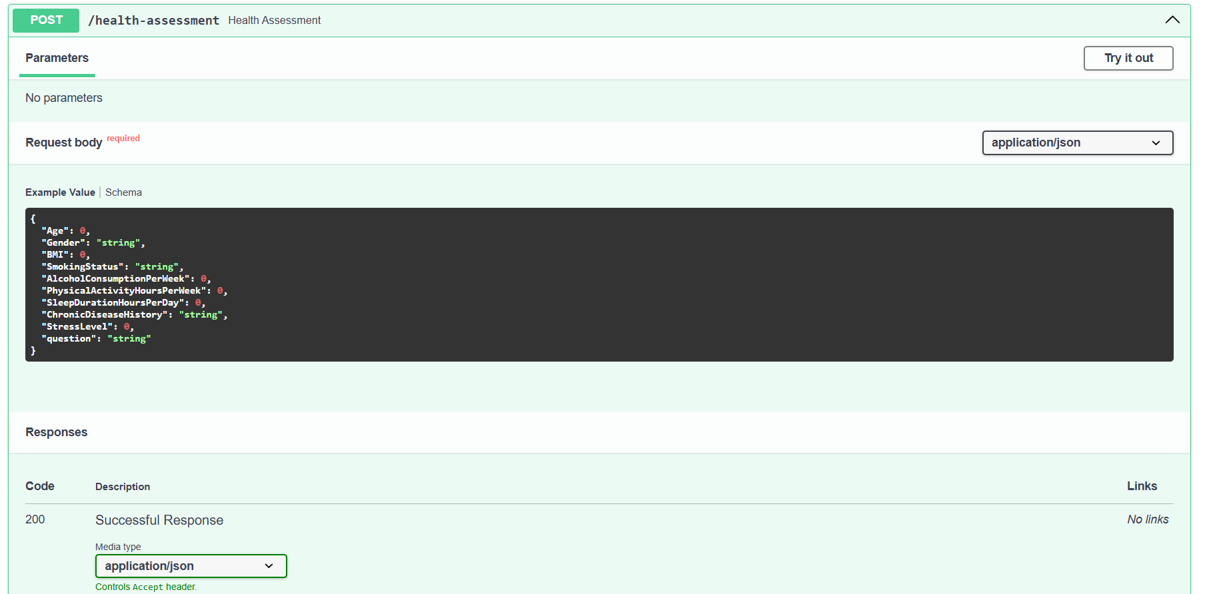
Backend API Design
09 SERVICE LAYER
GET
/
Health check: “Health Assistant Running”
POST
/health-assessment
Predicts risk, then RAG answer from the book
POST
/nearest-hospitals
POST /health-assessment
{ "Age": 45, "Gender": "Male", "BMI": 27.5,
"SmokingStatus": "Former",
"AlcoholConsumptionPerWeek": 4,
"PhysicalActivityHoursPerWeek": 3,
"SleepDurationHoursPerDay": 6.5,
"ChronicDiseaseHistory": "Hypertension",
"StressLevel": 6, "question": "..." }
Geocode, then Geoapify search: 5 km, max 20
Inputs: Age, Gender, BMI, SmokingStatus, Alcohol, Activity, Sleep, ChronicDisease, StressLevel + question. Invalid body returns HTTP 422.

Slide 11
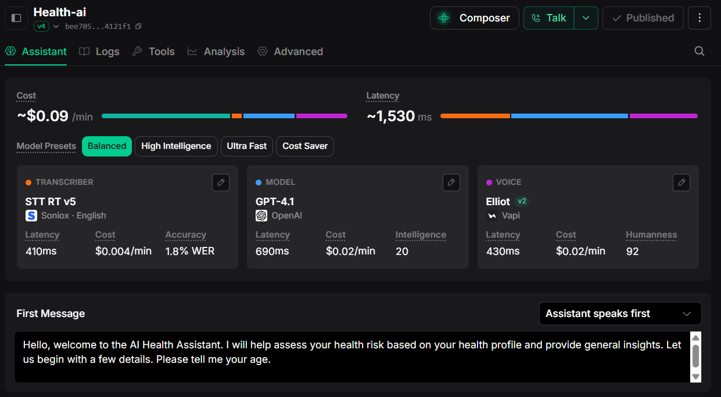
Voice Assistant on Vapi
10 INTERACTION LAYER
Soniox STT RT v5
410 ms
GPT-4.1
690 ms
Elliot v2 voice
430 ms
About 1.5 s total, roughly $0.09 per minute. Published v4, Balanced preset, assistant speaks first and asks for age.
TOOL: health-assesment
TOOL: Hospital
Posts 9 inputs + question to /health-assessment
Asks for city, posts to /nearest-hospitals

Slide 12
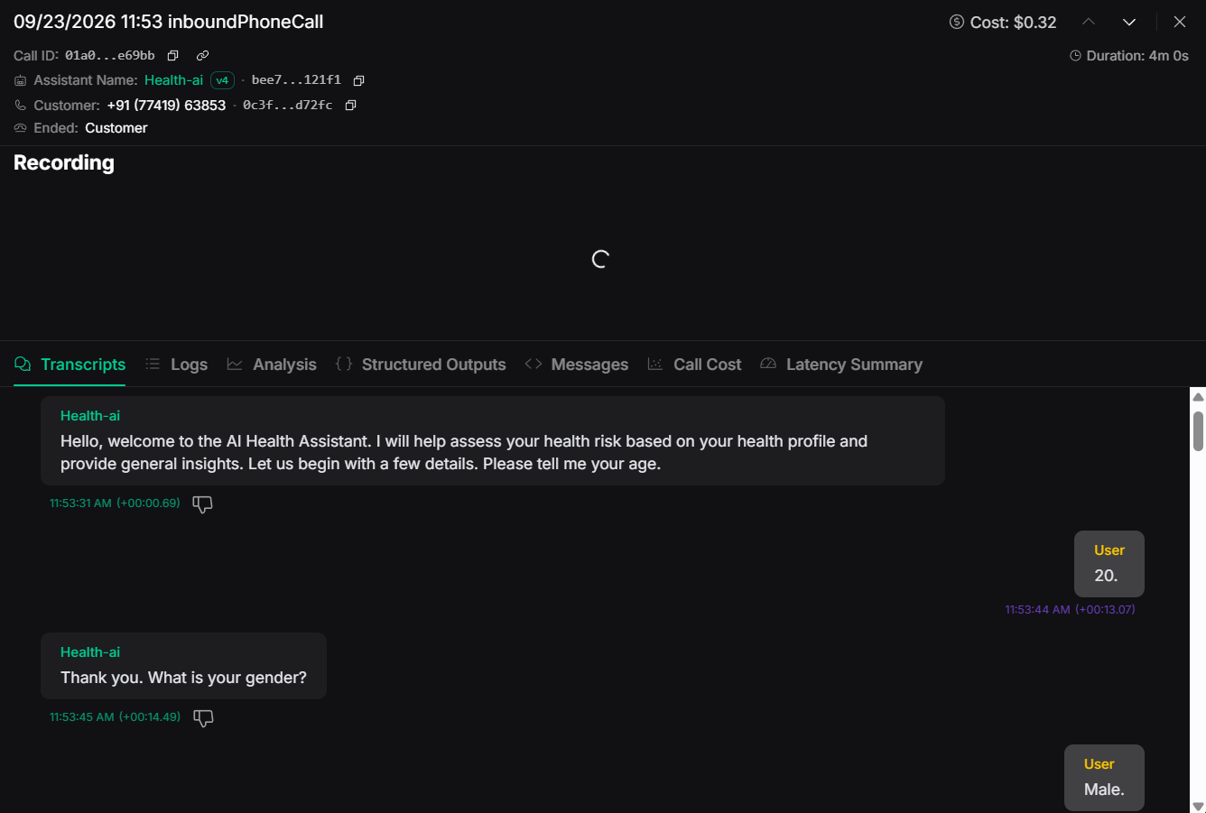
Workflow and Test Call
11 END TO END
1
2
3
4
5
6
Dial in
Collect 9 details
Ask question
Call API
Risk + answer
Speak, find care
4 min
$0.32
call duration
cost of the call
4,567
1 by 1
log events
confirmed questions
Inbound call, 23 Sep 2026
Transcript confirmed the greeting, age (20) and gender (Male) flow.

Slide 13


Limitations and Future Scope
12 REFLECTION
Limitations
Future scope
Screening only, not clinically validated
Dataset’s own label is unreliable
Saved model keys need aligning with the API
150-character chunks give thin context
Facility search mixes clinics and pharmacies
Open CORS, no authentication
Real, clinically labelled data
Emergency detection for red-flag symptoms
Hindi and Marathi voice support
Larger chunks, re-ranking, cited sources
Consent, auth, secure data storage
Filter hospitals, add directions

Slide 14



Project Files and Setup
13 REPOSITORY
main.py
FastAPI, model loading, RAG, endpoints
RUN THE BACKEND
1
pip install -r requirements.txt
model
Cleaning, scoring, training, SHAP
2
Add secret_api_keys.py (Groq, geocoding, Geoapify)
dataset.csv
1,000 lifestyle and health rows
3
Place health_risk_model.joblib beside main.py
Medical_Book.pdf
1,163-page RAG knowledge base
requirements.txt
Python dependency list
4
uvicorn main:app, first call builds the index
photos/
8 screenshots: FastAPI docs, Vapi
5
Open /docs, expose over HTTPS, point both Vapi tools to it

Slide 15


Conclusion
End to end
Transparent
Modular
Voice, API, ML, RAG and location work as one service
Rule-based score with SHAP-style explanations
Each part can be validated and improved alone
84.0%
1,163
2
1.5 s
test accuracy
page knowledge base
Vapi tools
voice latency
Next: validate on clinical data, align the model artifact, harden deployment.
Thank you
Mukund Kuthe | Manasvi Puranik | Guide: Dr. Prerna Mishra

