Slide 1

PREDICTIVE ANALYTICS
“Discovering Crop Patterns and Co-Cultivation Relationships in Agriculture Using Association Rule Mining”
SYMBIOSIS INSTITUTE OF TECHNOLOGY, NAGPUR.
COMPUTER SCIENCE AND ENGINEERING BATCH 2023-27
SEMESTER- 7 | SECTION - B
NAME: MUKUND KUTHE
PRN: 23070521082

Slide 2
Problem Statement
Large volumes of district-level crop records exist, but the relationships hidden inside them are rarely used for planning.
Questions the project answers
Objectives
Which crops are grown in which season?
Which crops are grown together in the same district and season?
Which crops go with high or low yield?
Prepare the data for association rule mining
Find frequent crop, season, area and yield patterns
Discover co-cultivation groups of crops
Rank rules by support, confidence and lift and interpret them
Predictive Analytics | Symbiosis Institute of Technology, Nagpur

Slide 3
Dataset
Attribute | Description
State_Name | State or union territory
District_Name | District of the record
Crop_Year | Year (1997 to 2015)
Season | Kharif, Rabi, Whole Year, Summer, Winter, Autumn
Crop | Name of the crop (124 crops)
Area | Area under the crop
Production | Quantity produced
246,091
7
33
records
attributes
states and UTs
646
124
1997–2015
districts
crops
period covered
Crop Production in India (crop_production.csv): one row per district, year, season and crop.
Predictive Analytics | Symbiosis Institute of Technology, Nagpur

Slide 4
Data Understanding and Preprocessing
Data understanding
Preprocessing steps
Seasons: Kharif 39.0%, Rabi 27.2%, Whole Year 23.3% of records
Most recorded crops: Rice, Maize, Moong, Urad
Uttar Pradesh contributes the most records (33,306)
Area and Production are highly skewed: median area 582, maximum 8.58 million
3,730 records (1.5%) lack a Production value
1
Trimmed padded spaces in text columns
2
Dropped missing Production: 246,091 to 242,361 records
3
Created Yield = Production / Area
4
Binned Area and Yield into Low, Medium, High (equal-sized groups)
5
Left Production out of the items (redundant with Area)
Predictive Analytics | Symbiosis Institute of Technology, Nagpur

Slide 5
Predictive Modelling Approach
1. Data Preprocessing
2. Transaction Creation
3. Frequent Itemset Mining (FP-Growth)
4. Rule Generation
5. Rule Filtering (Confidence and Lift)
6. Visualization and Interpretation
7. Saving Results
Descriptive method: the if-then rules are used predictively, e.g. Wheat → Rabi (confidence 0.953).
Support
Confidence
Lift
Share of transactions containing the itemset
Support(A and B) / Support(A)
Confidence / Support(B); above 1 means a positive association
Predictive Analytics | Symbiosis Institute of Technology, Nagpur

Slide 6
Model Development
Analysis A: Attribute rules
Analysis B: Co-cultivation rules
Transaction: one record
Items: state, season, crop, area group, yield group
242,361 transactions, 169 items
Min support 0.02
Transaction: one district, year and season
Items: crops grown there
29,175 baskets with 2+ crops, 124 crops
Min support 0.03
Common settings: one-hot encoding, FP-Growth (mlxtend), minimum confidence 0.60, minimum lift 1.2, maximum itemset length 4. Results saved as CSV files and plots.
Predictive Analytics | Symbiosis Institute of Technology, Nagpur

Slide 7
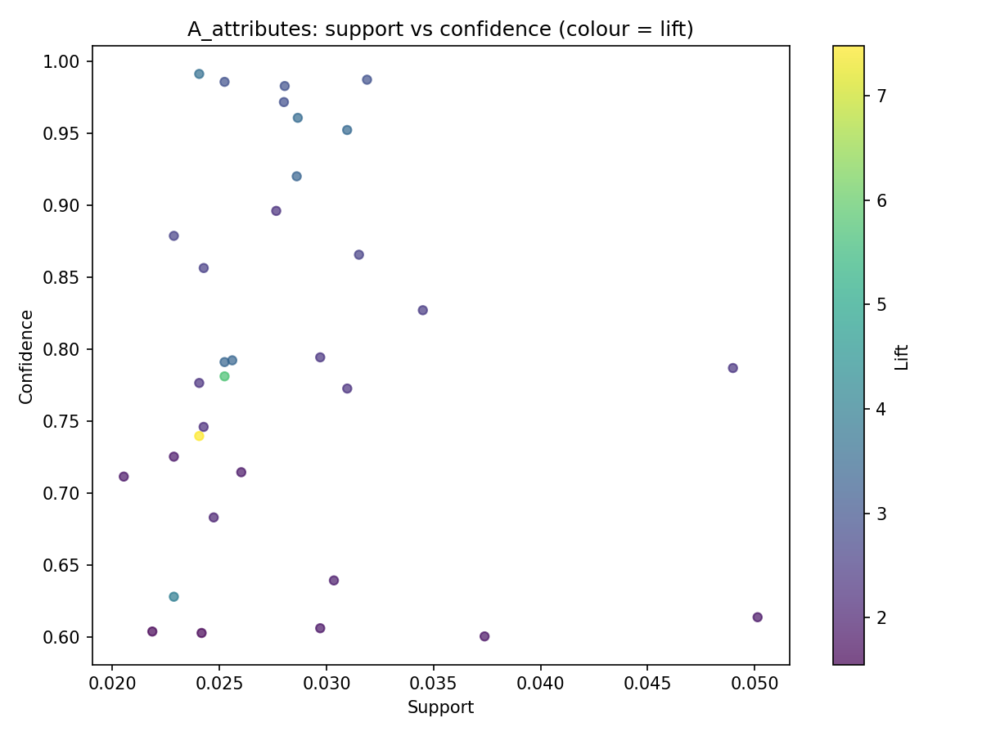
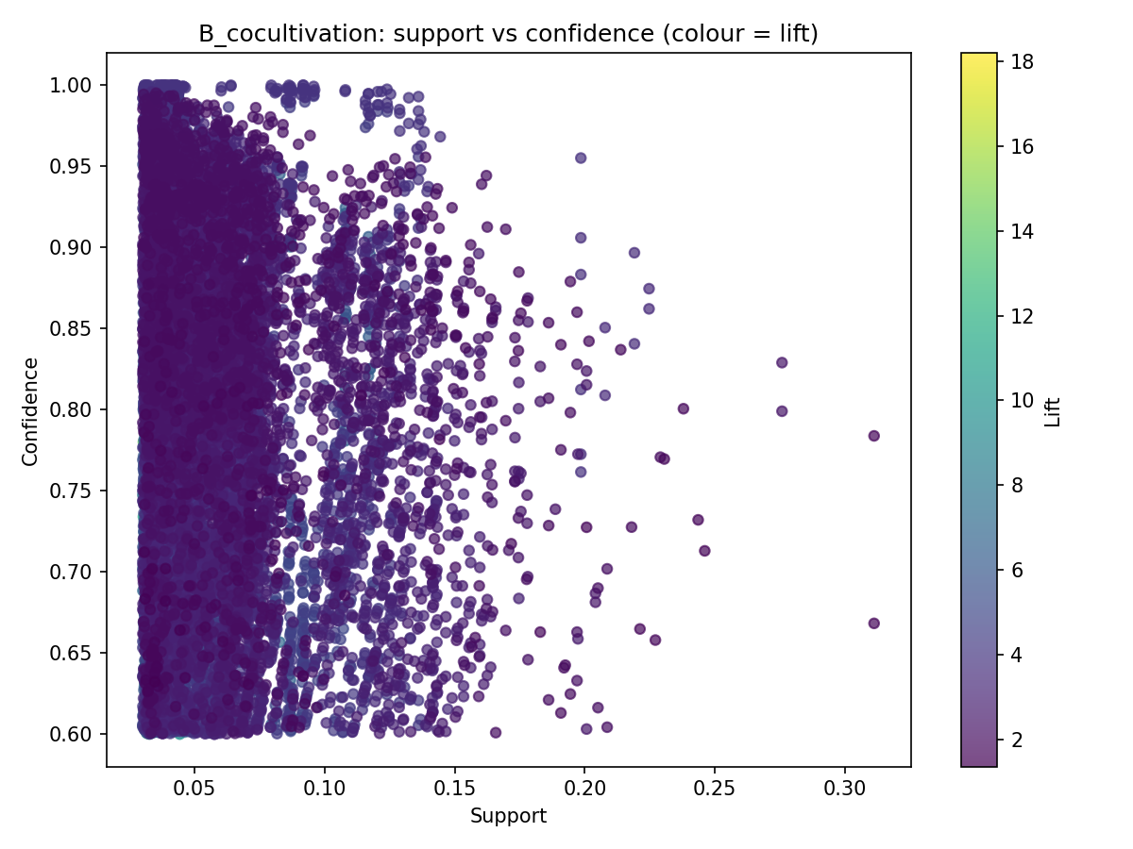
Evaluation of the Model
Measure | Analysis A | Analysis B
Frequent itemsets | 180 | 3,658
Rules | 33 | 12,569
Median confidence | 0.787 | 0.801
Median lift | 2.48 | 3.35
Highest lift | 7.48 | 18.20
Analysis A
Analysis B
A: 33 rules, most with lift 2 to 4
B: rules dense at support 0.03 to 0.10; highest lift at low support
No labels exist, so rules are judged by support, confidence and lift, and checked against agricultural knowledge (e.g. wheat, gram and mustard in Rabi).
Predictive Analytics | Symbiosis Institute of Technology, Nagpur

Slide 8
Results and Interpretation
Analysis A: crop and season
Analysis B: co-cultivation
Rule | Conf. | Lift
Wheat → Rabi | 0.953 | 3.49
Gram → Rabi | 0.961 | 3.52
Arhar/Tur → Kharif | 0.896 | 2.30
Sugarcane → Whole Year | 0.793 | 3.42
Rule | Conf. | Lift
Rapeseed & Mustard → Wheat | 0.875 | 3.36
Urad → Moong | 0.829 | 2.40
Arecanut → Coconut | 0.814 | 12.40
Khesari → Masoor | 0.985 | 6.92
Masoor, Moong → Peas & beans, Urad | 0.749 | 18.20
Crops follow clear seasons: wheat, gram and mustard are Rabi crops
Staples such as rice and wheat occupy large areas
Distinct clusters: staples, pulses, a wheat and mustard Rabi mix, and plantation crops
Maize and Rice are together in 31.1% of baskets
Predictive Analytics | Symbiosis Institute of Technology, Nagpur

Slide 9
Conclusion and Thank You
FP-Growth on 242,361 cleaned records gave 33 attribute rules and 12,569 co-cultivation rules
Crops follow strong seasonal patterns and form distinct cropping clusters
Rules agree with agricultural knowledge, so they can guide crop planning and diversification
Limits: association is not causation; yield groups mix crop-specific units
Future work: region-wise rules and rainfall and soil data
Thank You
Mukund Kuthe
PRN: 23070521082
Predictive Analytics | Symbiosis Institute of Technology, Nagpur

