Slide 1

Market Basket Analysis of Instacart Grocery Orders Using Association Rule Mining (FP-Growth)
SYMBIOSIS INSTITUTE OF TECHNOLOGY, NAGPUR.
PREDICTIVE ANALYTICS
COMPUTER SCIENCE AND ENGINEERING
BATCH 2023-27 | SEMESTER 7 | SECTION B
NAME: MUKUND KUTHE
PRN: 23070521082
Notes:
Introduce the project: Market Basket Analysis of Instacart grocery orders using FP-Growth for the Predictive Analytics course.

Slide 2



Problem statement
~3.2M
~50K
X → Y
orders in the full dataset
distinct products
“customers who buy X also buy Y”
The problem
The challenge
Buying patterns hide inside millions of baskets
Placement, bundles and promotions run on intuition
Outcome: missed cross-sell, less relevant recommendations
Find reliable “X → Y” rules in ~3.2M orders
Very sparse, high-dimensional data
Efficient mining that still gives actionable insight
Notes:
Retailers like Instacart handle millions of baskets. Without a systematic method they rely on intuition for placement, bundles and promotions. The challenge is mining reliable rules efficiently from very sparse, high-dimensional data.

Slide 3


Dataset
Sample transactions
order_products__prior.csv
Columns: order_id, product_id
916,605 order-product rows loaded
order_id | product_id
2 | 33120
2 | 28985
2 | 9327
2 | 45918
2 | 30035
products.csv
Columns: product_id, product_name
49,688 products in the catalogue
One order = one basket; each product in it is an item
Source: Kaggle, Instacart Market Basket Analysis
Notes:
Two files from the Kaggle Instacart dataset: the order-product transactions (prior orders) and the product catalogue. Each order is a basket.

Slide 4
Data understanding
18.7%
of baskets contain Banana, the top item
14 of 15
top products are fresh produce (milk is the exception)
Long tail
most products are rare, so the basket matrix is very sparse
Notes:
Bananas are in almost one in five baskets. Nearly all of the top 15 items are fresh produce. Most products are rare, which makes the data sparse.

Slide 5


Data preprocessing
1. Sample
2. Filter
3. Merge
4. Encode
100,000 random orders (seed 42) keep memory manageable
Top 200 most-bought products reduce sparsity
Product IDs joined to names for readable rules
Boolean sparse basket matrix (SciPy CSR)
72,283 × 200
baskets × products. 72,283 of the 100,000 sampled orders contain at least one top-200 product.
Notes:
Sampling and filtering keep the problem tractable. After filtering, 72,283 baskets and 200 products remain, stored as a sparse boolean matrix.

Slide 6

Predictive modelling approach
Support how common the itemset is
baskets with X and Y ÷ all baskets
Association rule mining
Unsupervised: no target label, it finds “X → Y” co-purchase patterns
FP-Growth compresses baskets into an FP-tree, with no repeated candidate generation
Scales better than Apriori on large, sparse data
Confidence how often Y follows X
support(X, Y) ÷ support(X)
Lift strength beyond chance (keep ≥ 1.5)
confidence ÷ support(Y)
Notes:
This is an unsupervised, pattern-discovery task. FP-Growth finds frequent itemsets efficiently; rules are scored with support, confidence and lift.

Slide 7
Model development
1
Factorize order and product IDs into row and column indices
Parameter | Value
Sampled orders | 100,000
Top products kept | 200
Min support | 0.01 (1%)
Min lift | 1.5
Random seed | 42
2
Build a boolean CSR matrix (72,283 × 200) with SciPy
3
Run fpgrowth() from MLxtend with min_support = 0.01
4
Generate rules with association_rules(), lift ≥ 1.5
Tools
Python, Pandas, NumPy, SciPy, MLxtend, Matplotlib, Jupyter
5
Sort by lift, then confidence; export results to CSV
Notes:
The sparse matrix keeps memory small. Parameters: 100,000 sampled orders, top 200 products, minimum support 1%, minimum lift 1.5, random seed 42.

Slide 8
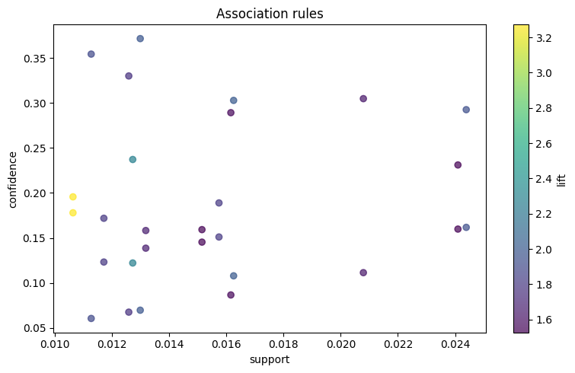
Evaluation of the model
161
frequent itemsets at 1% min support
28
rules kept with lift ≥ 1.5
3.27×
highest lift (Limes ↔ Large Lemon)
Unsupervised model: rules are judged on support, confidence and lift, not accuracy.
Notes:
There is no target variable, so evaluation uses rule-quality metrics. 161 itemsets, 28 rules. The scatter plot shows support against confidence for all 28 rules, coloured by lift; the two yellow points are the Limes and Large Lemon rules.

Slide 9
Results: strongest rules
Rule (antecedent → consequent) | Support | Confidence | Lift
Limes → Large Lemon | 1.06% | 19.6% | 3.27
Organic Raspberries → Organic Strawberries | 1.27% | 23.7% | 2.28
Organic Raspberries → Bag of Organic Bananas | 1.63% | 30.3% | 2.01
Organic Fuji Apple → Banana | 1.30% | 37.2% | 1.99
Organic Hass Avocado → Bag of Organic Bananas | 2.44% | 29.3% | 1.94
Honeycrisp Apple → Banana | 1.13% | 35.5% | 1.90
Organic Hass Avocado → Organic Strawberries | 1.57% | 18.9% | 1.81
Top unique pairs by lift. Every rule also holds in reverse with identical support and lift.
Notes:
Rules sorted by lift. Limes and Large Lemon have the highest lift at 3.27. Apple rules toward Banana have the highest confidence, about 35 to 37 percent.

Slide 10



Interpretation and business use
Natural pairs: citrus (Limes ↔ Large Lemon) and berries (Raspberries ↔ Strawberries)
Business recommendations
Bundle related produce: berry mixes, citrus packs, avocado with spinach
Place related items together on shelves and in the app layout
Show “frequently bought together” picks at add-to-cart
Target promotions on one item to lift its partner
Bananas anchor many rules, but their popularity inflates confidence, so lift is the fairer guide
Fresh produce dominates: all top-20 rules link produce items
Notes:
Lift is the key lens: it corrects for how popular an item is. Use the rules for bundles, shelf and app placement, recommendations and promotions.

Slide 11
Conclusion
FP-Growth on a sparse 72,283 × 200 basket matrix mined 161 itemsets and 28 rules efficiently
1
Next steps
Mine more data: 200K orders, top 500 products
Lower min support to surface niche pairs
Validate recommendations with A/B tests
Strongest co-purchases are fresh-produce pairs, with lift up to 3.27
2
The rules convert directly into bundles, layout changes and recommendations
3
Notes:
Summarise: efficient pipeline, 28 actionable rules, strongest pairs in fresh produce. Next steps: scale up the sample and product list, and validate with experiments.

