Slide 1

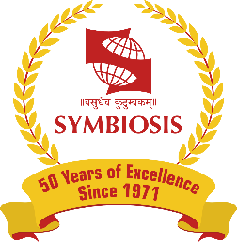
Department of Computer Science and Engineering
CA: Seminar
of
One Month Industry Internship
Session: 2025-26
Presented By:
Name: Mukund Kuthe
PRN: 23070521082
Industry Mentor:
Name: Sushant Choudhari
Designation: Developer
Institute Mentor:
Name: Dr. Gagandeep Kaur
Designation: Assistant Professor
Symbiosis Institute of Technology, Nagpur Campus (SIT-N)

Slide 2
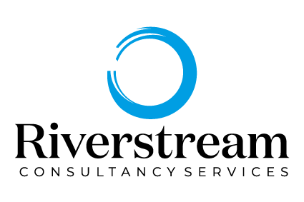
Introduction of Company (Structure/Information)
Riverstream Consultancy Services is an IT-consulting and software company based in Nagpur; it was founded in 2011. The company has many services offered, including the desktop services, IT advisory, long-term maintenance and web and mobile application development. Riverstream, having a team of well-educated specialists, focuses on the delivery of safe, scalable, and high-quality digital services to clients representing various sectors.
Riverstream, the company developing over 25 applications and offering its services to clients both on the domestic and foreign market, is also more than familiar with client-centric methodology and having based much of its work on focusing on efficiency and simplicity. The company, because of its reliability and innovativeness, has been in line with the current trends in the industry.
Logo of the Company

Slide 3
Objectives of the Internship
Core Project Goal: Develop a Domain-Specific Chatbot The central objective was to create a functional conversational medical assistant. This was not a general-purpose chatbot; its key feature was the ability to answer user inquiries by relying exclusively on the information contained within a specific, user-provided PDF document.
Technical Skill Application: Utilize Modern AI Tools and Architectures A major goal was to investigate and practically apply a modern AI stack. This involved using contemporary tools such as HuggingFace embeddings for text vectorization, the Groq-hosted LLaMA 3.3 Large Language Model for response generation, and the LangChain framework to structure the application.
User Interface and Experience: Implement a User-Friendly Solution The project also aimed to deliver the AI solution through an accessible and easy-to-use interface. The objective was to use the Streamlit framework to build this front-end.
Holistic Understanding: Comprehend the Full Application Lifecycle Beyond just coding, a key learning objective was to understand the entire process of developing and deploying a web-based AI application.
Professional Development: Acquire Essential Soft Skills Finally, the internship was designed to help acquire and refine crucial soft skills within a professional work setting. This included practical experience in debugging complex code, systematic problem-solving when faced with technical challenges, and the ability to adapt to new frameworks and technologies as required by the project.

Slide 4
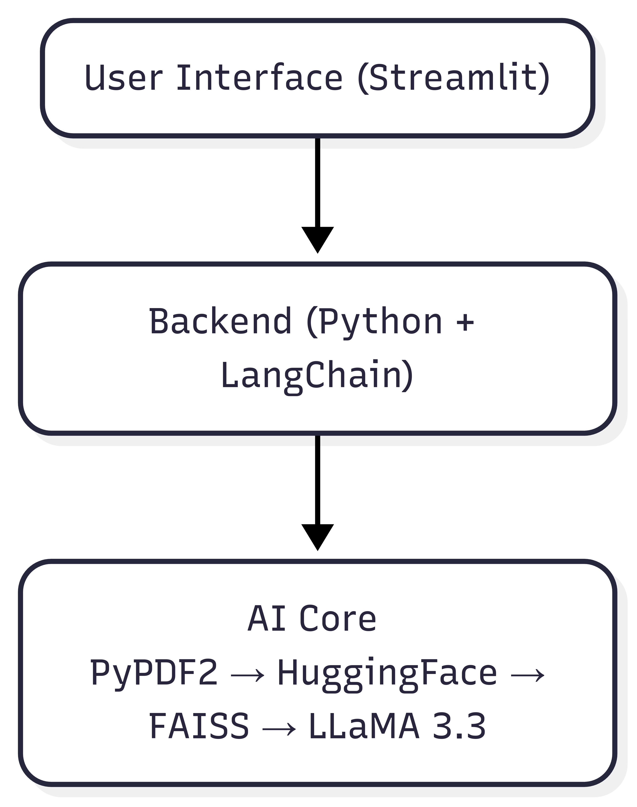
Work Assigned/ Technologies Working on
The primary work involved the end-to-end design and development of "MediBot," a proof-of-concept medical chatbot. Key responsibilities included:
Structuring the Application: Designing the complete workflow, from PDF data extraction and text chunking to generating relevant answers using the Retrieval-Augmented Generation (RAG) framework.
2. Prompt Engineering: Creating custom prompt templates specifically designed to handle medical questions and guide the language model to provide accurate responses.
3. UI Development: Building the interactive and user-friendly web interface for the chatbot using the Streamlit library.
4. Testing and Optimization: Performing extensive testing with various user queries to ensure the system provided accurate, useful responses and continuously improving its performance.
Technologies Stack

Slide 5
Project Description
Project Name: MediBot
MediBot is a smart medical assistant designed to provide accurate, context-sensitive answers to medical questions based on a specific, user-provided document.
Goal and Problem Solved
The primary goal was to address the increasing demand for fast and reliable access to healthcare information. MediBot acts as a bridge between a user and credible medical knowledge by interpreting and answering questions using a designated medical PDF as its single source of truth. This ensures the responses are not just generic, but are factual, traceable, and directly relevant to the provided document.
Core Technology
The project is built on a Retrieval-Augmented Generation (RAG) architecture, which enhances the capabilities of a traditional Large Language Model (LLM). Instead of relying solely on its pre-trained knowledge, the system:Retrieves the most relevant information from the provided medical document.Augments the user's question with this retrieved context.Generates a precise answer using the LLaMA 3.3 model, ensuring the response is grounded in the source material

Slide 6
Hardware/Software Specification
Requirement | Description
langchain | Framework for building LLM-powered applications with chains and agents
langchain-huggingface | Integration to use HuggingFace embedding models with LangChain
langchain_community | Community-contributed tools for extended LangChain support
PyPDF2 | Python library to extract text and metadata from PDF documents
faiss-cpu | Facebook AI Similarity Search for efficient vector similarity queries (CPU version)
sentence-transformers | Library for generating dense sentence embeddings using transformer models
streamlit | Python framework for creating interactive web apps
langchain-groq | LangChain integration for Groq-hosted LLaMA LLM
Software Requirements Used in MediBot Development

Slide 7
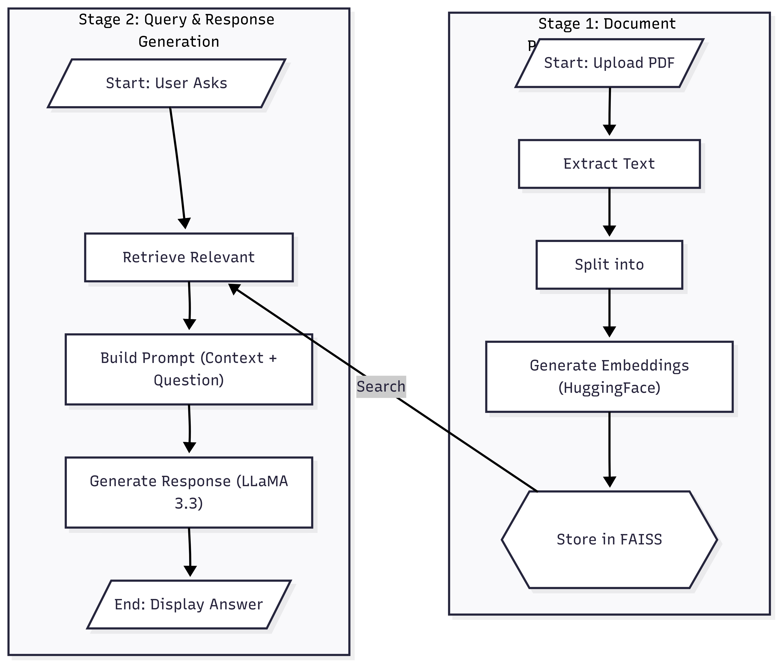
Methodology
1. Document Processing & Indexing
Text Extraction: The system first ingests a medical PDF document and extracts raw text from its pages using the PyPDF2 library.
Text Chunking: The extracted text is then divided into smaller, manageable chunks to prepare it for processing.
Embedding Generation: Each text chunk is converted into a numerical vector (embedding) using HuggingFace Sentence Transformers. This allows for semantic understanding and comparison.
Vector Storage: The generated embeddings are indexed and stored in a FAISS (Facebook AI Similarity Search) vector database for fast and efficient retrieval.
2. Query, Retrieval, and Response Generation
User Query: The user inputs a medical question through the Streamlit interface.
Context Retrieval: The system searches the FAISS database to find the most relevant text chunks (context) related to the user's query.
Prompt Engineering: The retrieved context is combined with the user's question into a specialized prompt, which is designed to guide the language model to provide a precise answer.
LLM Response: The complete prompt is sent to the Groq-hosted LLaMA 3.3 model, which generates a detailed, context-specific answer.
Display Answer: The final answer is displayed to the user, with an option to view the source text from the original document to ensure traceability and trust.
Workflow of the Project

Slide 8
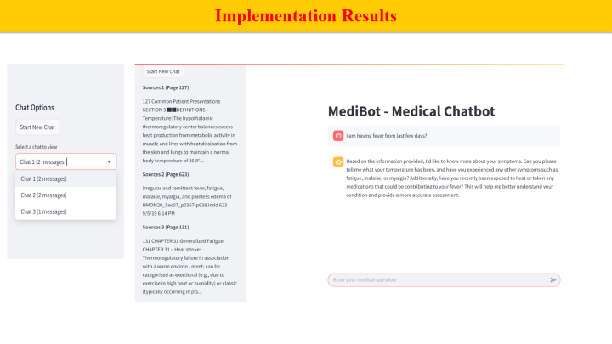
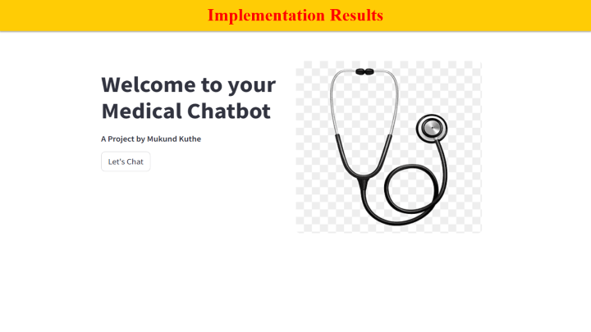
Implementation Results
Page 1
Page 2

Slide 9
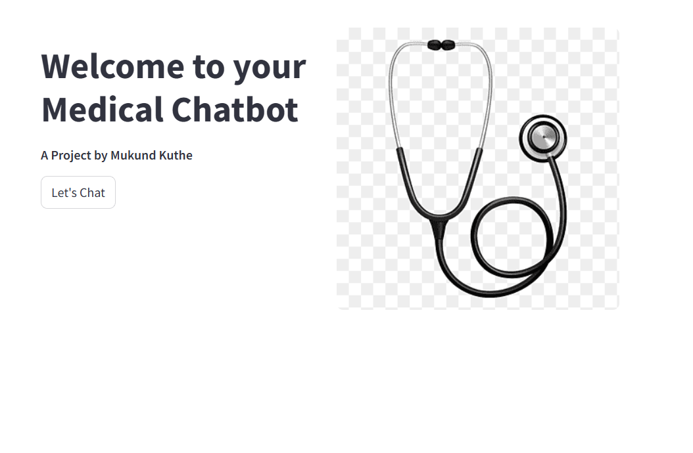
Implementation Results

Slide 10
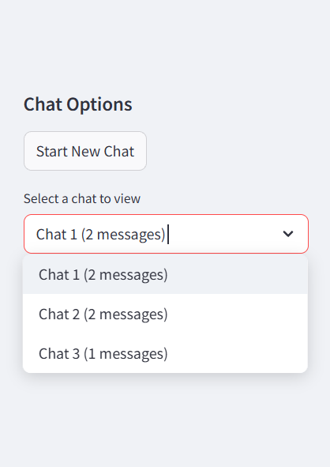
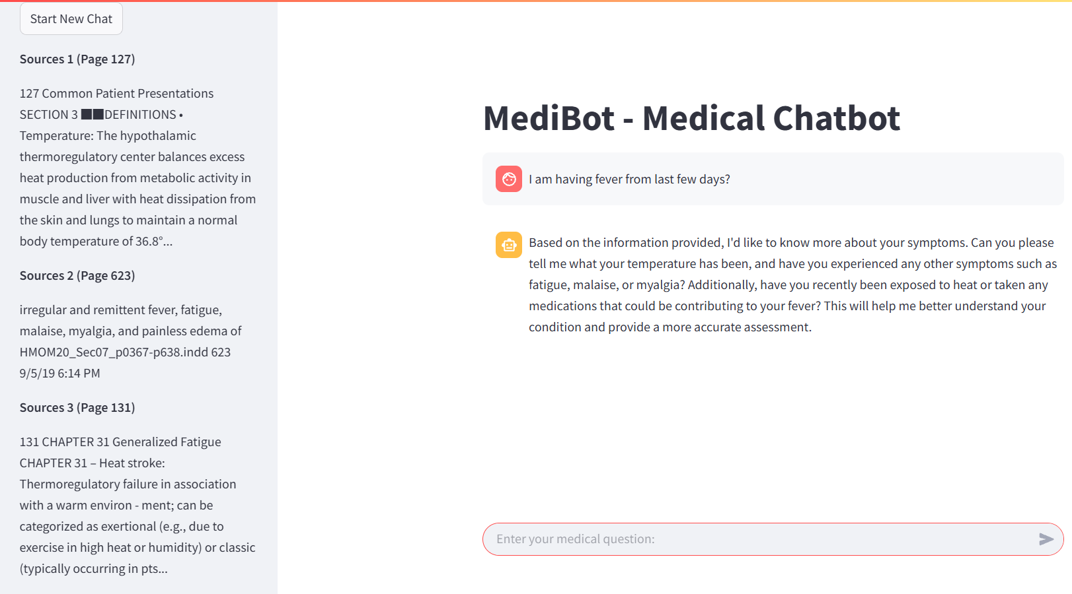
Implementation Results

Slide 11
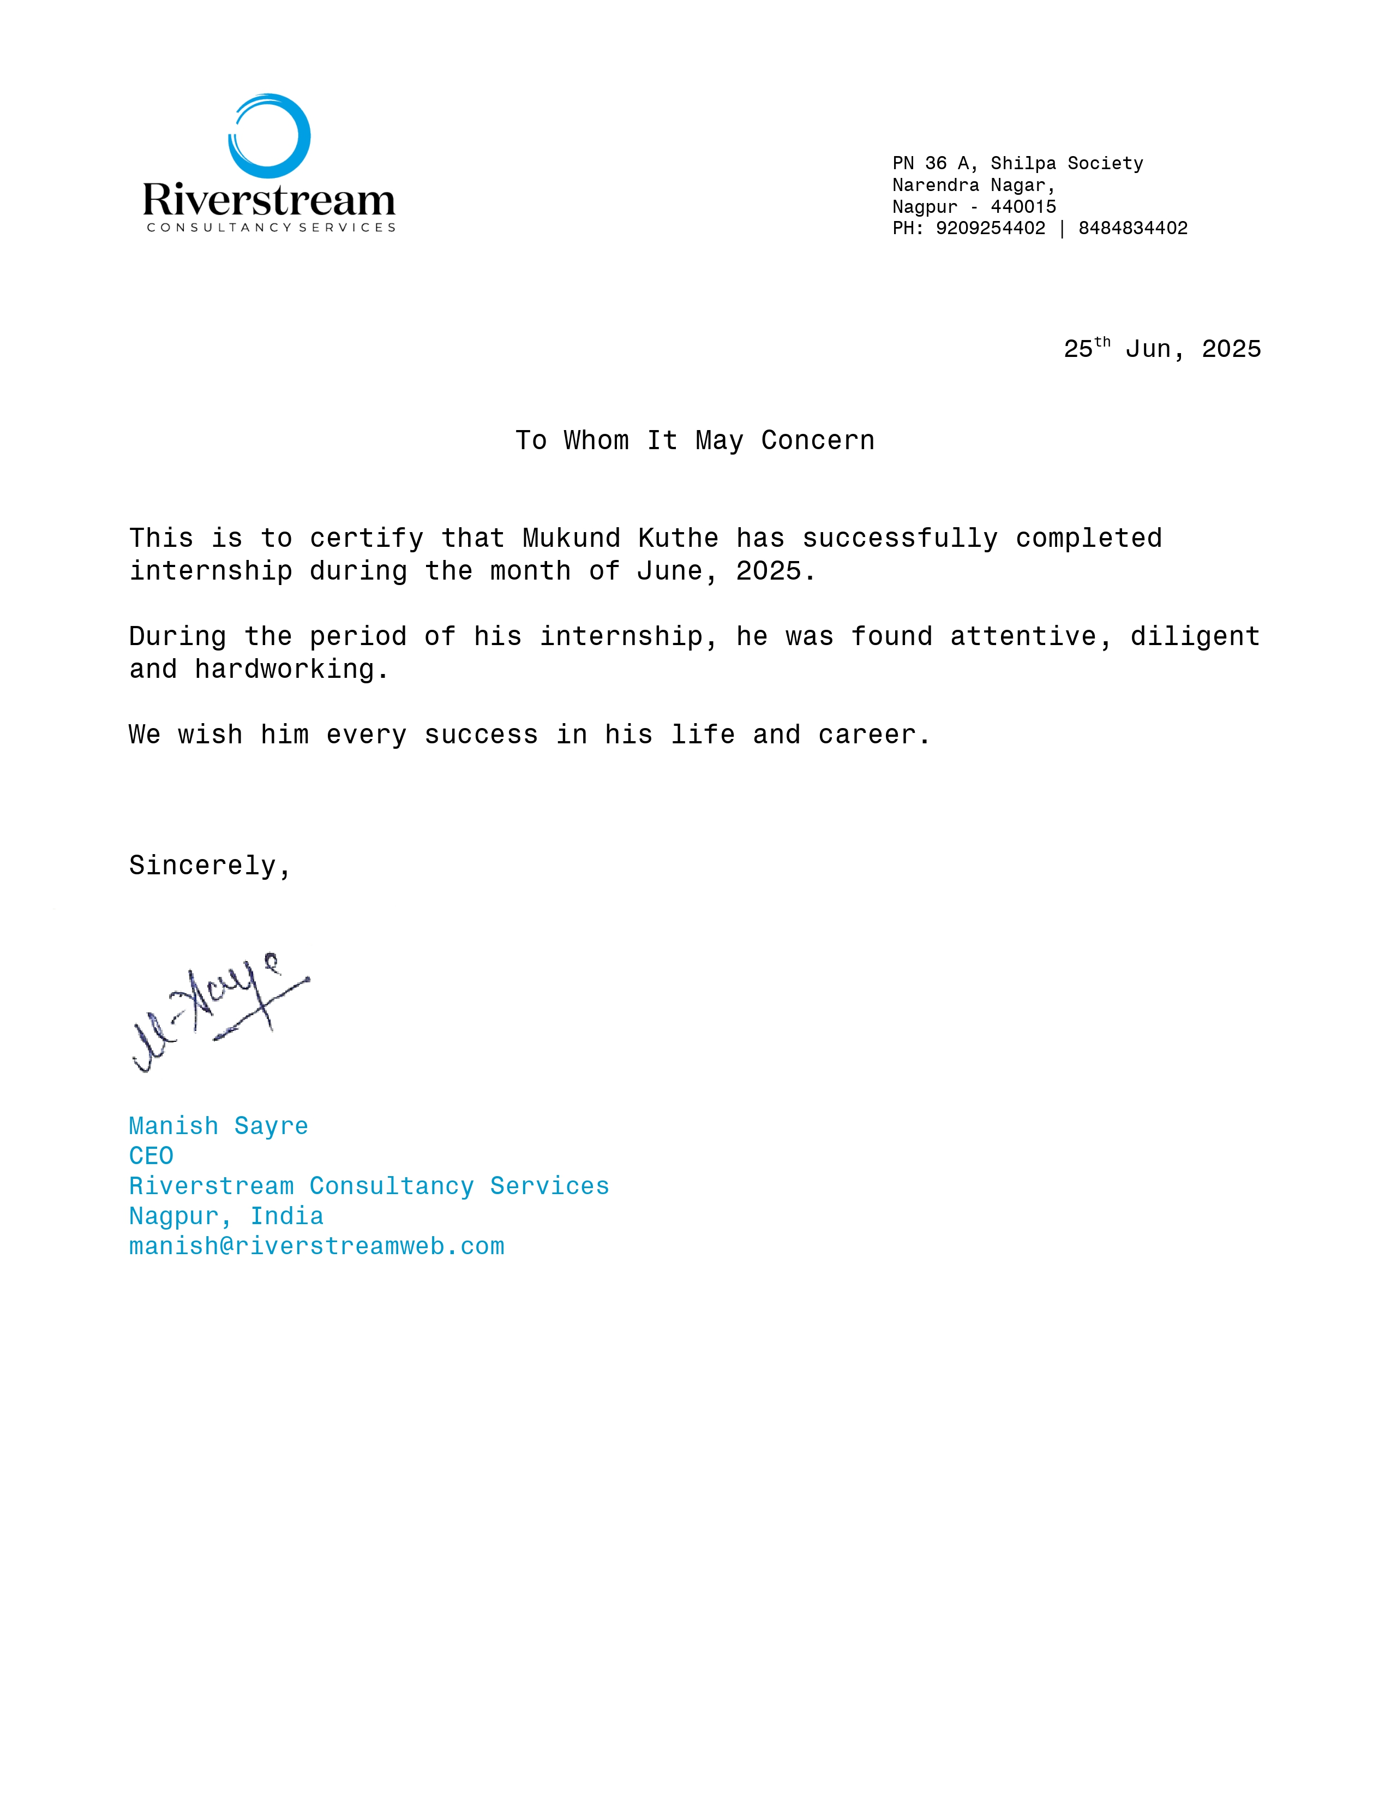
Internship Completion Certificate

Slide 12
Internship Experience and Learnings
Internship Experience
Developed "MediBot," a medical AI chatbot, from concept to prototype.
Implemented a Retrieval Augmented Generation (RAG) architecture to ensure accuracy.
Managed the full development cycle: data extraction, UI creation with Streamlit, and LLM integration.
Conducted extensive testing and optimization for performance and usability.
Key Learnings
Core Technologies: Gained hands-on skills in Python, RAG, FAISS Vector Stores, and LangChain.
AI & LLMs: Learned to integrate and utilize Large Language Models (LLaMA 3.3) and HuggingFace embeddings.
Practical Application: Mastered building scalable, document-driven Q&A systems and creating interactive web UIs with Streamlit.
Professional Growth: Enhanced problem-solving, debugging in a corporate setting.

Slide 13
Thank You…..

