Slide 1

Data Analysis Essentials
Cornerstone Project — Second Review
Traffic Accident Data Analysis System
Presented by
S.KIRAN PRABHU - (25B11AIB29)
V.GANESH - (25B11AIC58)
M.MUNI KIRAN - (25B11AI646)
T.SAI MANISH - (25B11AIB78)
Department
Department of Artificial Intelligence & Machine Learning

Slide 2

AGENDA
Project Overview
Problem, objective, domain and target variable
Data Cleaning
Removing duplicates and filling missing values
01
04
Dataset & Tools
12 columns of accident data; Python stack in Google Colab
Data Preprocessing
Scaling, standardization and encoding
02
05
Data Loading & Inspection
Upload, read, preview and measure the raw dataset
Workflow & Conclusion
End-to-end pipeline, summary and Q&A
03
07
Scope of this review
Implementation, preprocessing and analysis on the traffic accident dataset.

Slide 3
PROJECT OVERVIEW — TRAFFIC ACCIDENT DATA ANALYSIS
Problem: Identify the factors most associated with accident severity and frequency and highlight high-risk accident locations.
Objective: Inspect, clean and preprocess the traffic accident dataset for further analysis.
Domain: Road Safety / Transportation.
Dataset used: 3,024 raw accident records and 12 columns; 3,000 records after cleaning.
Outcome: Cleaned and preprocessed dataset ready for further analysis.
Target Variable
Severity → Minor / Serious / Fatal
Important Features
Location, Weather_Condition, Road_Type, Vehicle_Type, Light_Condition, Speed_Limit
Tools
Python • Pandas • NumPy • Google Colab

Slide 4
DATASET DESCRIPTION — 12 COLUMNS
# | Column | Type | Description
1 | Accident_ID | Identifier | Unique ID of each accident record
2 | Month_Year | Date | Month and year of the accident
3 | Time | Time | Time of day of the accident
4 | Location | Categorical | City and state of the accident
5 | Accident_Severity | Categorical | Minor / Serious / Fatal
6 | Light_Condition | Categorical | Lighting condition at the time
7 | Weather_Condition | Categorical | Weather condition at the time
8 | Road_Type | Categorical | Type of road where it occurred
9 | Vehicle_Type | Categorical | Type of vehicle involved
10 | Speed_Limit | Numeric | Speed limit at the location
11 | Number_of_Casualties | Numeric | Casualties in the accident
12 | Number_of_Fatalities | Numeric | Fatalities in the accident
3,024
raw accident records
12
columns / features
3
severity classes

Slide 5
TOOLS & LIBRARIES USED
Python
Core programming language used to write the whole workflow from loading to analysis.
Pandas
Loads the CSV into a DataFrame; used for inspection, duplicate removal and missing-value handling.
NumPy
Numerical computing support for the numeric columns during preprocessing.
Google Colab
Cloud notebook where each stage runs with code and output shown together.

Slide 6
DATA LOADING & INSPECTION
Upload
Raw CSV file uploaded into Colab with files.upload().
# Load the raw dataset
uploaded = files.upload()
df = pd.read_csv(
"traffic_accidents_raw.csv")
# Inspect
Print(df.head())
print("Number of rows:", df.shape[0])
print("Number of columns:", df.shape[1])
1
Read
Loaded into a Pandas DataFrame using pd.read_csv().
2
Preview
df.head() checks the columns and sample records.
3
Measure
df.shape gives row and column counts; nulls and duplicates are counted.
4
3,024 × 12 raw data shape
50 missing values found
24 duplicate rows found

Slide 7
DATA CLEANING — HANDLING DUPLICATE RECORDS
3,024
rows before cleaning
24
duplicate rows removed
3,000
rows after cleaning
Method
Identical records were identified and dropped with drop_duplicates(), keeping the first occurrence of each.
Why it matters
Repeated records would double-count accidents and distort location frequencies and severity counts in the analysis.
# Remove duplicate rows and keep the result
df = df.drop_duplicates()

Slide 8
DATA CLEANING — HANDLING MISSING VALUES
50 missing values found in the raw data → 0 remaining after filling
Categorical columns → Mode
Light_Condition, Weather_Condition
Filled with the most frequent category, so no new label is introduced.
Numeric columns → Median
Number_of_Casualties, Number_of_Fatalities
Median is not pulled by extreme values, so it is a safe fill for count data.
# Fill missing values
for col in ["Light_Condition", "Weather_Condition"]:
df[col] = df[col].fillna(df[col].mode()[0])
for col in ["Number_of_Casualties", "Number_of_Fatalities"]:
df[col] = df[col].fillna(df[col].median())

Slide 9
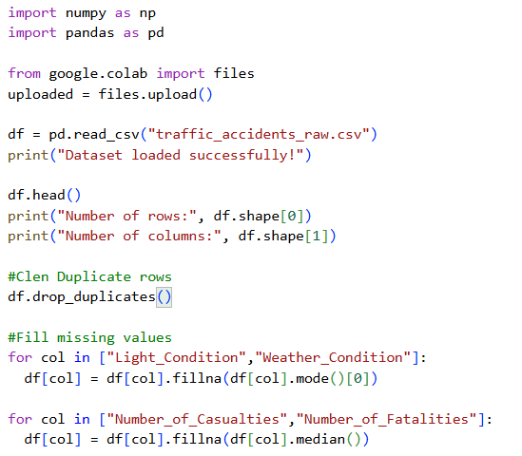
DATASET SNAPSHOT — BEFORE & AFTER CLEANING
Check | Before | After
Rows | 3024 | 3000
Columns | 12 | 12
Missing values | 50 | 0
Duplicate rows | 24 | 0

Slide 10
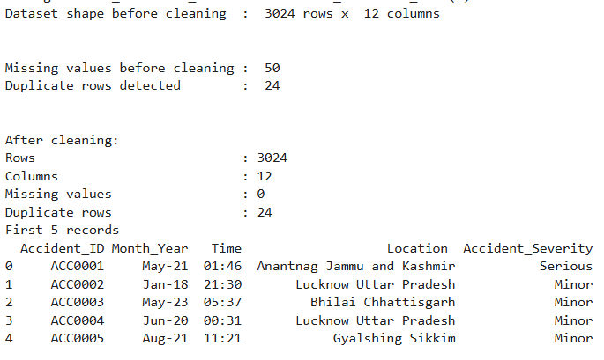
IMPLEMENTATION — DATA PREPROCESSING WITH EVIDENCE
Step 1 — Duplicates
24 duplicate accident records detected and removed.
Step 2 — Missing Values
Filled 50 missing values:
categorical → mode, numeric → median.
Step 3 — Final Check
Re-checked null count and duplicate count.
Final Dataset
Clean dataset ready for further analysis.

Slide 11
DATA PREPROCESSING — TRANSFORMATION TECHNIQUES
Feature Scaling
Rescales numeric values to a common range so that no feature dominates because of its unit or size.
Suited for: Speed_Limit (km/h)
Standardization
Transforms values to mean 0 and standard deviation 1 (z-score) for comparable spread.
Suited for: Number_of_Casualties, Number_of_Fatalities
Label Encoding
Converts ordered categories into integer codes.
Suited for: Accident_Severity (Minor / Serious / Fatal)
One-Hot Encoding
Creates one binary column per category, so unordered categories get no false ranking.
Suited for: Vehicle_Type
Cleaned data
Scale / standardize numeric
Encode categorical
Analysis-ready dataset

Slide 12
COMPLETED PROJECT WORKFLOW
Raw Dataset
Data Inspection
Cleaning
Preprocessing
Implementation — Google Colab notebook (Python • Pandas • NumPy)
Preprocessing
Analysis
Every stage is backed by working code and its output in the notebook.
This review covers the stages from the raw dataset to preprocessing.

Slide 13
CONCLUSION — SECOND REVIEW
The Traffic Accident Data Analysis project has been successfully implemented in Google Colab.
The dataset was inspected and cleaned by handling duplicate and missing values.
Data preprocessing was completed using feature scaling, standardization, label encoding and one-hot encoding.
The final dataset is ready for further analysis.
Final message
Data inspection, cleaning and preprocessing are complete on the dataset.”

Slide 14
THANK YOU
Questions & Viva

