Slide 1
Kafka Connect
Shalini Mittal
Corporate Trainer

Slide 2
What we will Cover?
Producer
Consumer

Slide 3
Kafka Connect?
An open source framework that works as a centralized data hub for integrating data between databases, file systems, key-value stores, search indexes, and many more.
It was built as another layer on the core platform of Apache Kafka®, for supporting large scale streaming data. It works in the two modes i.e.
Import from any external system (called Source) like mysql, hdfs, etc to Kafka broker cluster
Export from Kafka cluster to any external system (called Sink) like hdfs, s3, etc
Notes:
https://supergloo.com/kafka-connect/
https://datacouch.medium.com/getting-started-with-kafka-connect-1b9c54a8b80a
Development framework for building Apache Kafka connectors.
The framework provides Java based API for building a type of Kafka connector called either a Sink or a Source.
A “Sink” connector is designed to stream data from Apache Kafka and push to a destination such as an object store (S3, HDFS), database (relational, NoSQL, columnar), search index such as Elastic, etc.
A “Source” connector is designed to read data from an external system such as a file system, object store, database, SaaS, etc. and stream to an Apache Kafka

Slide 4
Why?
In an ETL pipeline Kafka Connect take cares of E(Extract) and L(Load) part irrespective of Processing engine
Using Kafka Connect one can reuse a piece of code for different processing engines
It ensures Decoupling and Reusability
It reduces the effort in implementing any Stream processing framework by taking up how-to-ingest-data responsibility
It guarantees the best parallelism, fault tolerance, delivery semantics, ordering, etc. as per Connector’s underlying implementation
Its ability to handle a wide range of data sources and sinks that can be used to integrate Kafka with external systems, such as databases, file systems, and messaging systems. This makes it easy to build end-to-end data pipelines that can handle a wide range of data formats and sources.
Designed to be scalable and fault-tolerant. It can handle large volumes of data by distributing the workload across a cluster of computers, making it possible to process data in parallel.
It also provides a range of features for managing and monitoring data pipelines, such as automatic schema detection and compatibility checking

Slide 5
Features?
A common framework for Kafka connectors
Distributed and standalone modes
REST interface
Automatic offset management
Distributed and scalable by default
Streaming/ batch integration

Slide 6
Concepts?
An operating-system process (Java-based) which executes connectors and their associated tasks in child threads, is what we call a Kafka Connect worker.
Also, there is an object that defines parameters for one or more tasks which should actually do the work of importing or exporting data, is what we call a connector.
To read from some arbitrary input and write to Kafka, a source connector generates tasks.
In order to read from Kafka and write to some arbitrary output, a sink connector generates tasks.
for “source” connectors, this function considers that the tasks transform their input into AVRO or JSON format; the transformation is applied just before writing the record to a Kafka topic.
“sink” connectors, this function considers that data on the input Kafka topic is already in AVRO or JSON format.

Slide 7
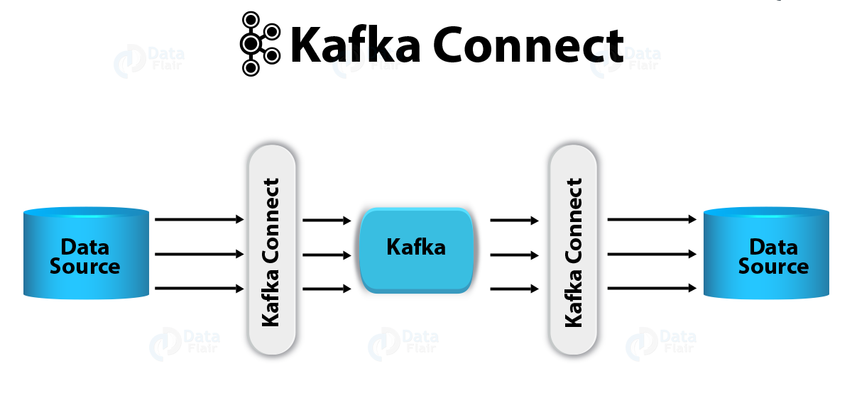

Slide 8
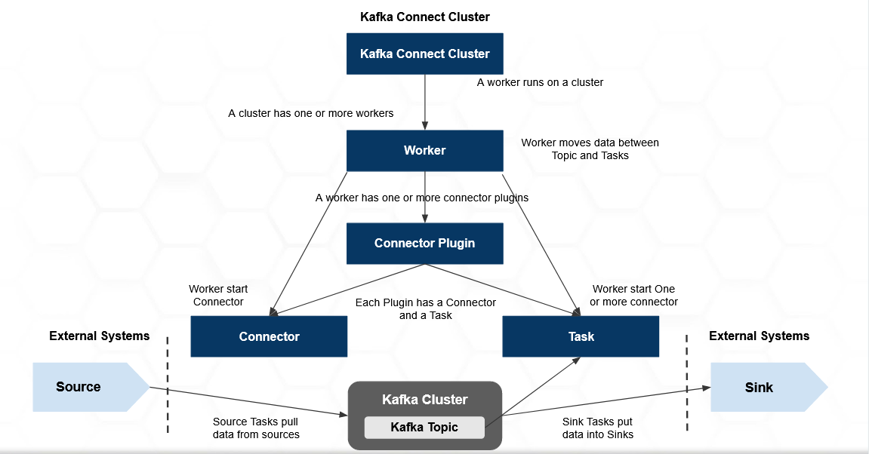
Architecture
Notes:
Kafka Connect is a separate Cluster
So with-in Kafka Connect Cluster there are workers, connector plugins, connector and tasks
A cluster can have multiple workers and worker runs on the cluster only
Each Worker contains one or many Connector Tasks
Tasks for a Connector are started by the Worker only
Tasks in Kafka Connect act as Producer or Consumer depending on type of Connector
Tasks are automatically load balanced if there is any failure as shown in the picture below

Slide 9
Kafka Connect Components
Component | Description
Workers | A worker denotes a server capable of executing connectors and tasks, overseeing their lifecycle, and offering scalability.
Connectors | A connector is a plugin mainly responsible for establishing connections to external data systems. Two types of connectors are - 1. Source Connectors for external data sources, and 2. Sink Connectors for external data destinations.
Tasks | A task is an independent unit of work responsible for processing specific data partitions. You can assign several tasks to a connector based on the scale and complexity of the data pipeline.
Transformations | Single Message Transformations (SMTs) allow data manipulation as messages move through Kafka Connect. You can use them for filtering, modifying, or enriching messages before they reach their destination.
Converter | A converter is responsible for converting the message into a format that can be sent to the Kafka cluster as byte arrays. It can also deserialize the byte arrays into their original format. Although Kafka Connect provides pre-built converters, you can also create custom converters.
Dead Letter Queues | Dead Letter Queues (DLQs) act as a fail-safe mechanism for vital messages that were not processed successfully.

Slide 10
Demo
Download the kafka connector for respective type of source
For demo we will download jdbc connector
Paste the connector
Configure the path.plugin in connect properties file
Notes:
https://docs.confluent.io/platform/current/streams/concepts.html#streams-concepts-processor-topology

Slide 11
ThankYou

