Slide 1
Kafka Streams
Shalini Mittal
Corporate Trainer

Slide 2
What we will Cover?
Kafka Streams
Topology
Producer
Consumer

Slide 3
Kafka Streams?
Kafka Streams is a Java virtual machine (JVM) client library for building event streaming applications on top of Kafka.
The library allows developers to build elastic and fault-tolerant stream processing applications with the full power of any JVM-based language.
KafkaStreams enables us to consume from Kafka topics, analyze or transform data, and potentially, send it to another Kafka topic.
These are scalable and provides with load balancing and fault tolerance.
http://kafka.apache.org/27/documentation/streams/tutorial
Notes:
Apache kafka – no support and u on your alone
Commercial – bunch of tools and utilities to manage . Comes with cost but most popular. Offers community edition as well
Managed Service – on the cloud.

Slide 4
Kafka Stream Abstraction?
Kafka Streams is a Java virtual machine (JVM) client library for building event streaming applications on top of Kafka.
The library allows developers to build elastic and fault-tolerant stream processing applications with the full power of any JVM-based language.
KafkaStreams enables us to consume from Kafka topics, analyze or transform data, and potentially, send it to another Kafka topic.
These are scalable and provides with load balancing and fault tolerance.
http://kafka.apache.org/27/documentation/streams/tutorial
Notes:
Apache kafka – no support and u on your alone
Commercial – bunch of tools and utilities to manage . Comes with cost but most popular. Offers community edition as well
Managed Service – on the cloud.

Slide 5
Implement kafka streams – 1/2
Providing Stream configurations:
Properties props = new Properties();
props.put(StreamsConfig.APPLICATION_ID_CONFIG, AppConfigs.applicationID);
props.put(StreamsConfig.BOOTSTRAP_SERVERS_CONFIG, AppConfigs.bootstrapServers);
props.put(StreamsConfig.DEFAULT_KEY_SERDE_CLASS_CONFIG, Serdes.Integer().getClass());
props.put(StreamsConfig.DEFAULT_VALUE_SERDE_CLASS_CONFIG, Serdes.String().getClass());
Building the Stream and fetching data.
StreamsBuilder streamsBuilder = new StreamsBuilder();
KStream<Integer, String> kStream = streamsBuilder.stream(AppConfigs.topicName);
Processing of Stream:
kStream.foreach((k, v) -> System.out.println("Key= " + k + " Value= " + v));

Slide 6
Implement Kafka Streams – 2/2
Create topology
Topology topology = streamsBuilder.build();
Start the stream
KafkaStreams streams = new KafkaStreams(topology, props);
System.out.println("Starting stream.");
streams.start();
Close the stream
Runtime.getRuntime().addShutdownHook(new Thread(() -> {
System.out.println("Shutting down stream");
streams.close();
}));

Slide 7
Topology
A processor topology or simply topology defines the computational logic of the data processing that needs to be performed by a stream processing application i.e., how input data is transformed into output data.
A topology is a graph of stream processors (nodes) that are connected by streams (edges).
There are two special processors in the topology:
Source Processor: A source processor is a special type of stream processor that does not have any upstream processors. It produces an input stream to its topology from one or multiple Kafka topics by consuming records from these topics and forward them to its down-stream processors.
Sink Processor: A sink processor is a special type of stream processor that does not have down-stream processors. It sends any received records from its up-stream processors to a specified Kafka topic.
Developers can define topologies either via the low-level Processor API or via the Kafka Streams DSL, which builds on top of the former.
A processor topology is merely a logical abstraction for your stream processing code.
Notes:
https://docs.confluent.io/platform/current/streams/concepts.html#streams-concepts-processor-topology

Slide 8
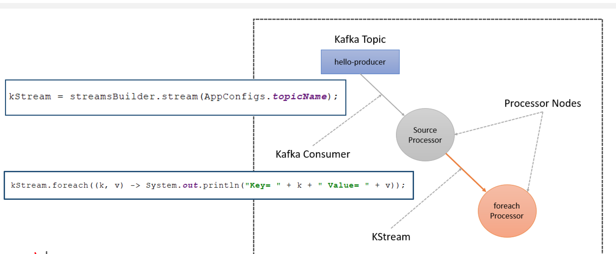
Understand Topology
Notes:
https://docs.confluent.io/platform/current/streams/concepts.html#streams-concepts-processor-topology

Slide 9
What is KStream
Abstraction of stream of kafka message records.
Filter()
Map()
Flatmap()
Foreach()
To()
Notes:
https://docs.confluent.io/platform/current/streams/concepts.html#streams-concepts-processor-topology

Slide 10
Throughput
https://docs.confluent.io/cloud/current/client-apps/optimizing/throughput.html#:~:text=application%20and%20environment.-,Number%20of%20Partitions,unit%20of%20parallelism%20in%20Kafka.&text=In%20general%2C%20a%20higher%20number,in%20your%20Confluent%20Cloud%20cluster.
Notes:
https://docs.confluent.io/platform/current/streams/concepts.html#streams-concepts-processor-topology

Slide 11
References
https://medium.com/@agvillamizar/implementing-custom-serdes-for-java-objects-using-json-serializer-and-deserializer-in-kafka-streams-d794b66e7c03
https://nuwancs.medium.com/kafka-kstream-joins-for-json-objects-39ad2c31a51c

Slide 12
ThankYou

