Slide 1
Microbial seedbanks and their evolutionary implications
Will Shoemaker

Slide 2
Dormancy background
Resources are finite
Microbes respond by entering a reversible dormant state
Forms seed-banks
Ecological implications well-characterized(Jones & Lennon, 2010; Lennon & Jones, 2011 )
So are molecular & physiological mechanisms (Sturm & Dworkin, 2015)

Slide 3
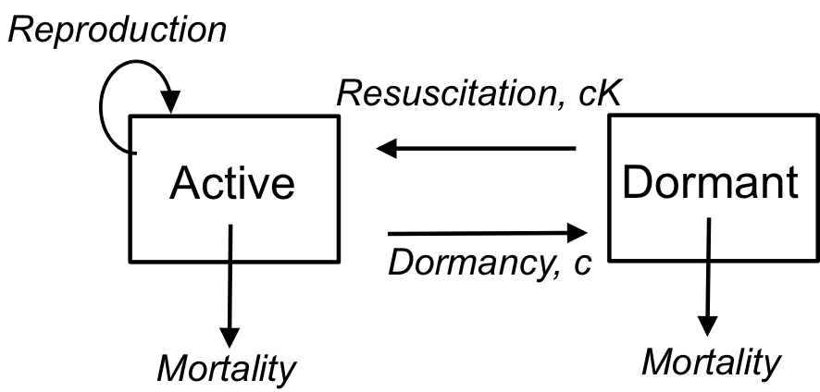

Slide 4

Molecular evolution and dormancy
Organisms enter dormancy in times of stress
Environmental stress as selective force on μ (Foster 1998 Corzett et al. 2013)
Doesn’t change site-specific μ
Doesn’t change beneficial μ
Alt hyp = Higher μ of dormant pops. is an obvious outcome
Drift-barrier hypothesis (Sung et al., 2012)
Limit on efficiency of selection (i.e. )) )
Difficult for selection to maintain unused pathways

Slide 5
Little data on microbial seed-banks & evolution
Controversy on stress-induced mutation in dormant pops
Seed-banks have been proposed as source of genetic variation in plants and microbes (Levin 1990; Sogin et al., 2006; González-Casanova, 2004)
Dormancy considered trait that’s under selection (Dalling et al., 2011)

Slide 6
Recent surge of theoretical work
Based in coalescent theory (Blath et al., 2014; Kaj et al., 2001)
Wright-Fisher model with a seed-bank component
Useful framework to predict neutral evolution of a microbial dormant population

Slide 7
Characteristics of dormant populations
No, or very slow, turnover
Long survivorship
Still has a mutation rate
No replication-associated mutation

Slide 8
Pop Gen Background
Founded on Wright-Fisher model
N indiv’s
Offspring number Poisson distributed
Discrete and non-overlapping gen’s
Depends on the Markov property
Requires that all individuals sampled each generation

Slide 9
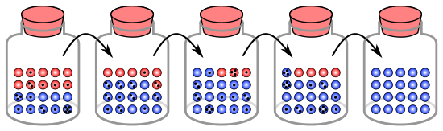

Slide 10
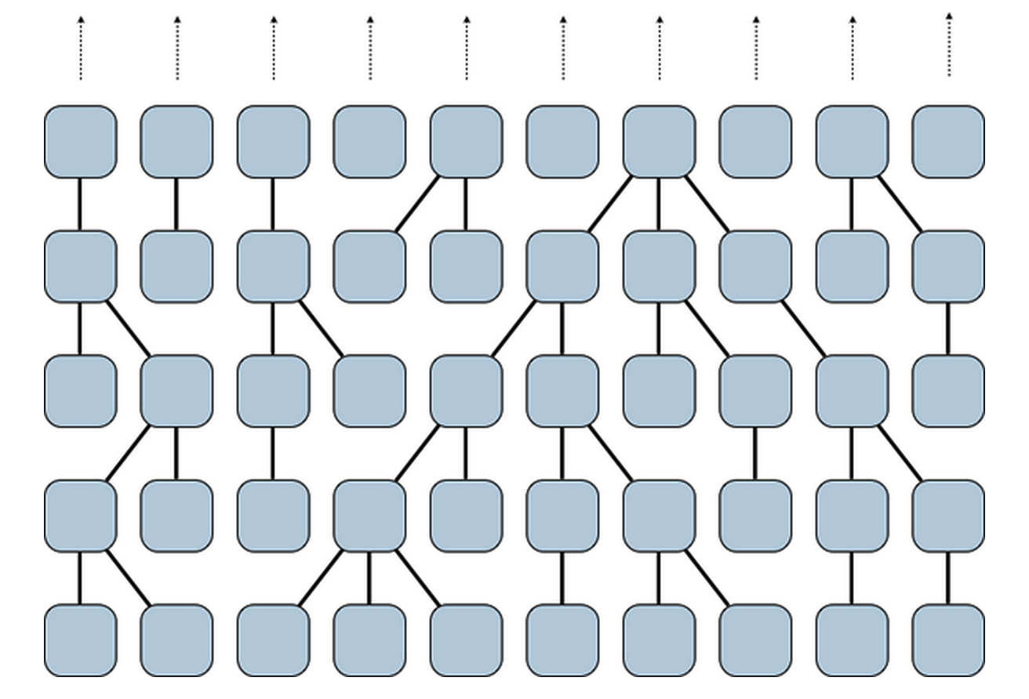

Slide 12
Population genetic implications
No turnover = no resampling
Limits the role of drift
Violates Markov assumption
Dormant lines have different mutation rate
μ_{D}
Different interpretation of Drift-barrier hyp
Lessened role of drift
Lower genome-wide selection coefficient

Slide 13



Mutation-drift equilibrium
Expected neutral site heterozygosity
Active population
Dormant population

Slide 14
Mutation-drift equilibrium
Expected neutral site heterozygosity
Active population
Dormant population

Slide 15
Mutation-drift equilibrium
Expected neutral site heterozygosity
Active population
Dormant population

Slide 16
Break the model

Slide 17
Seed-bank WF model

Slide 18
Resampled each
time unit
No resampling

Slide 19
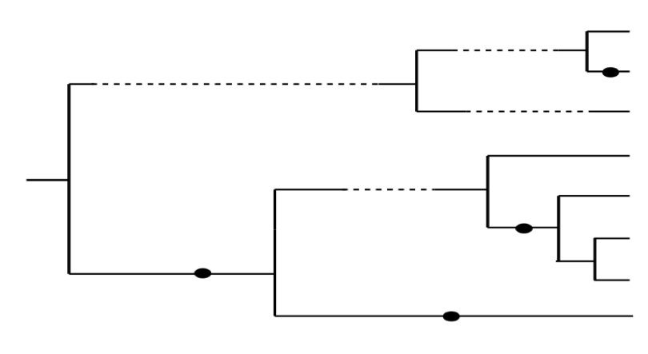
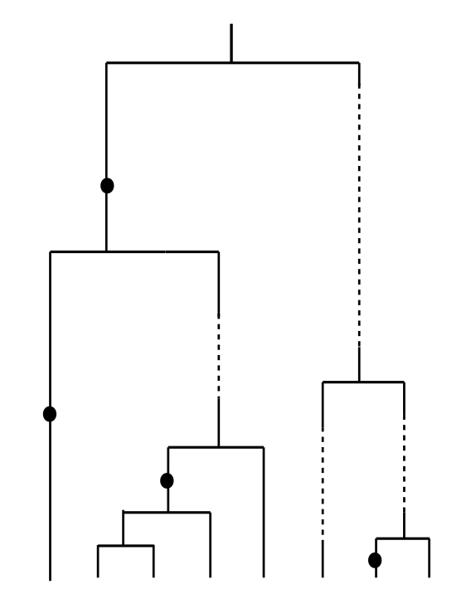

Slide 20
What would the SFS look like?

Slide 21
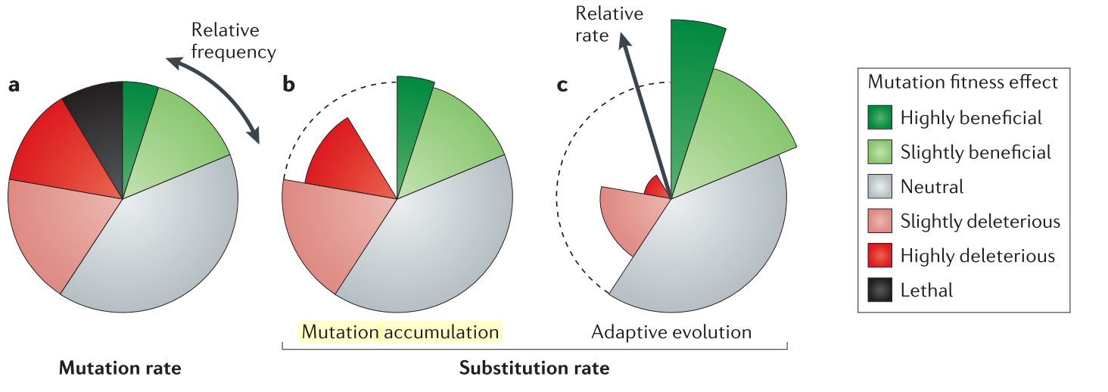
Mutation rate vs substitution rate
Barrick & Lenski, 2013

Slide 22
Testing our theory

Slide 23
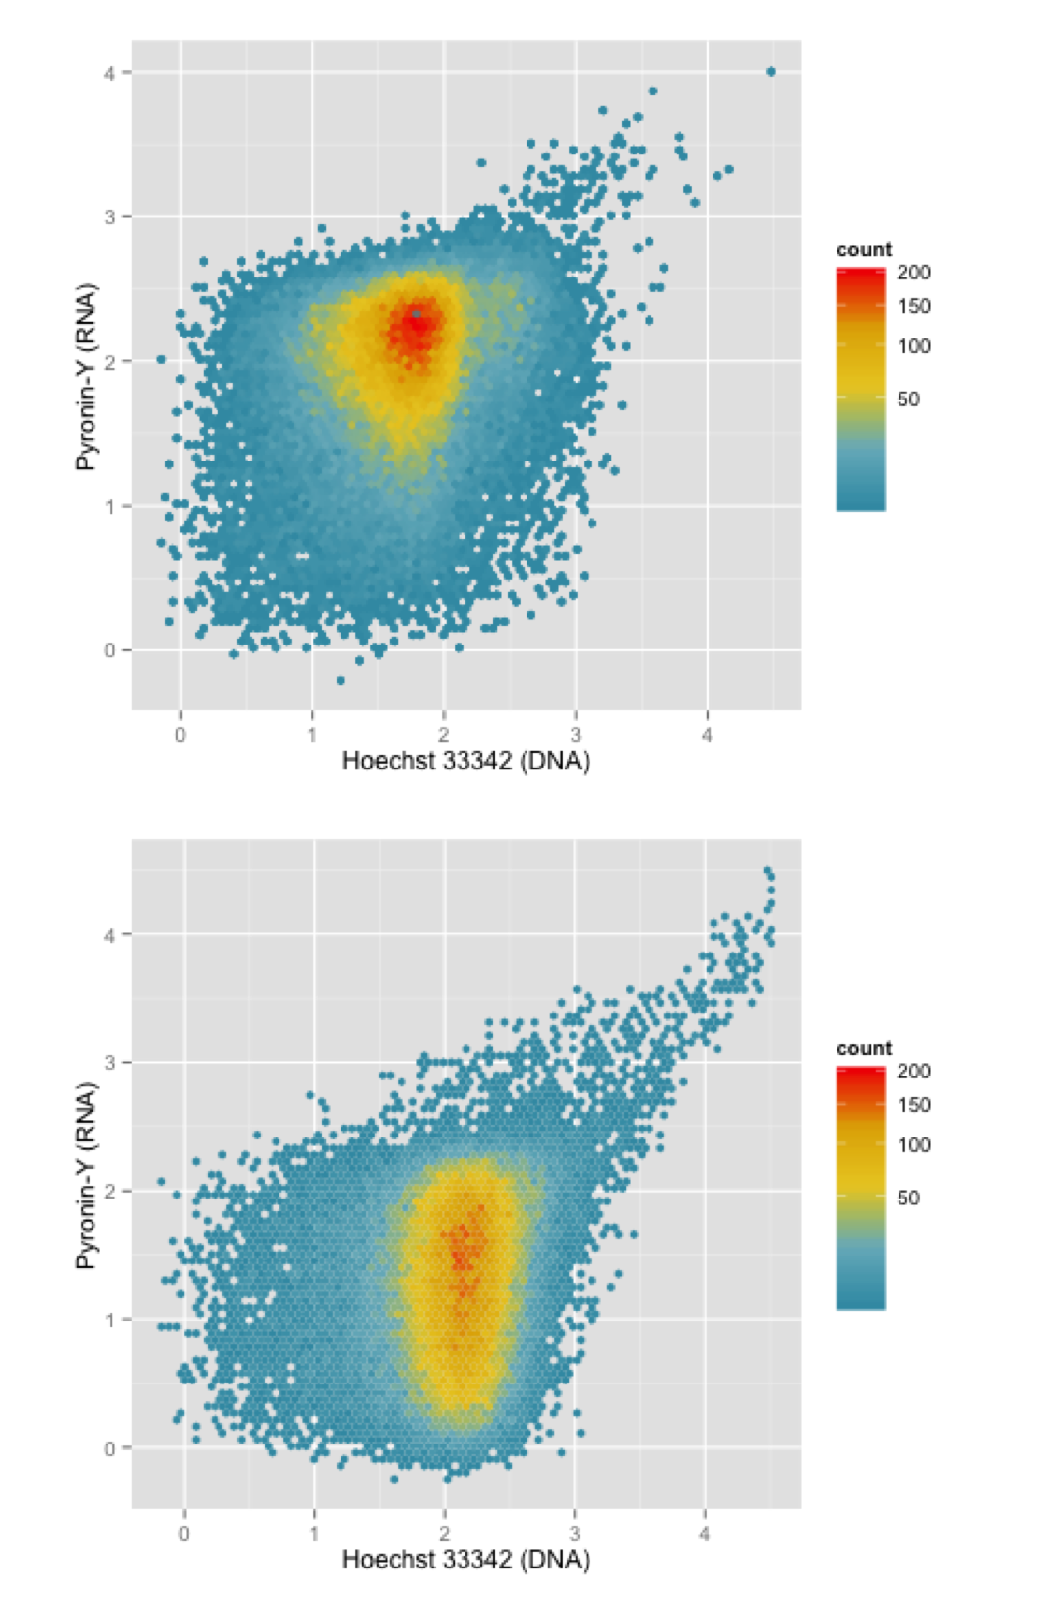

Estimating the size of the dormant pool

Slide 24
Issues with standard culture techniques
Nutrient replenishment = boom-bust cycles
Different rates of resuscitation/ dormancy (i.e. migration) during growth kinetics
Different selective pressures
Have to track both population size and migration rate
Risk of loosing low-frequency alleles during transfer bottlenecking
Not a theoretical issue (neutral evolution)
Issue with detecting low freq. alleles with low μ

Slide 25
Chemostats as a solution

Slide 26
Which organism to test

Slide 27
Fantasy figures

