Slide 1
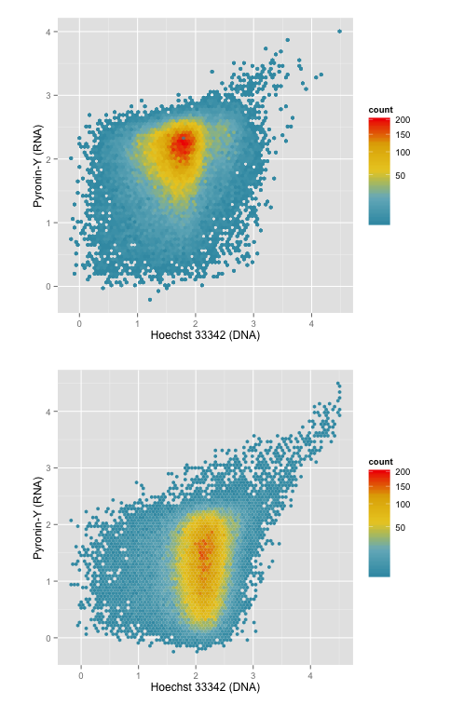
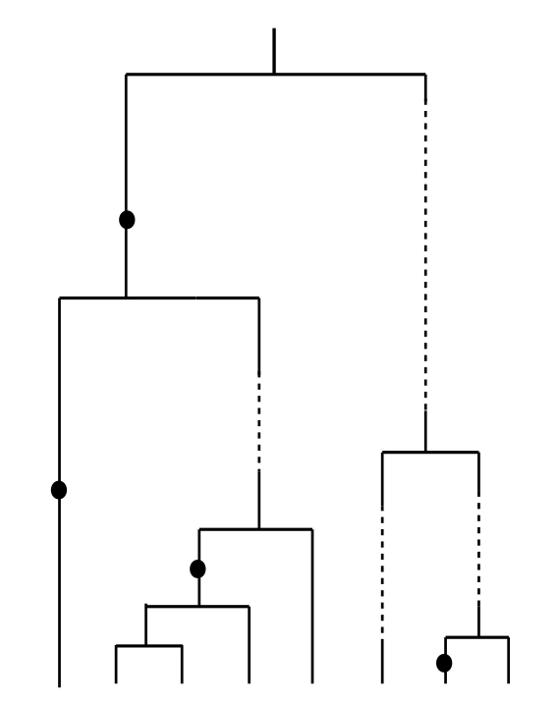
Estimating the Evolutionary Impact of Seed Banks
Will Shoemaker and Jay T. Lennon
Indiana University Bloomington
Background
Estimating the Dormant Pool
Review
Microorganisms contend with finite levels of resources.
No clear clustering of active and dormant subpopulations
2a)
A common strategy is to enter state of reduced metabolic activity (i.e. dormancy)¹.
Currently measuring change in respiration using CTC (5-cyano-2,3-ditolyl tetrazolium chloride), SYTOX green, and Hoechst 33342
A persistent pool of dormant individuals can greatly alter a population’s evolutionary trajectory
Preliminary analysis with CTC shows clear subpopulation-level differentiation.
Known as the seed bank effect².
Model organism: Janthinobacterium
Future Work
Exhibits population dynamics expected of taxa with a dormant pool³.
Complete analysis of starved populations using CTC and SYTOX green.
Contains genes that may allow it to contend with environmental stress⁴.
Estimate size of subpopulations using clustering techniques.
Reproduction
Proportion of dormant individuals (A) and “species” (B) can be high, but varies among ecosystems².
Use subpopulation-level data to inform estimates of resuscitation rates.
1a)
Resuscitation, cK
2b)
Active
Dormant
Model eco-evolutionary dynamics of microbial population with a seed-bank component.
Dormancy, c
Mortality
Mortality
1b)
Acknowledgements
The Lennon Lab
Christiane Hassel and the IUB Flow Cytometry Core Facility
References
Fig.1 a: Dynamics of microbial dormancy. K = N_{A}/N_{D}, c = rate at which the population enters dormancy (Jones & Lennon, 2010; Blath et al., 2015). b: Genealogical representation of the effect of a seed bank on inferring ancestry (Blath et al., 2015).
Fig.2: 2-D plots depicting events with the fluorescence excitation/emission spectra associated with DNA (Hoechst 33342, x-axis) and RNA (Pyronin-Y, y-axis) of (a) a one-day old homogenous culture and a (b) a 10-day old culture of Janthinobacterium sp. KBS0711.
1) Jones, S.E., & Lennon, J.T. (2010). Dormancy contributes to the maintenance of microbial diversity. PNAS 107: 5881-5886
2) Alonso-SÃez, L. et al., (2014). Winter bloom of a rare betaproteobacterium in the Arctic Ocean. Frontiers in Microbiology, 5:, 1–9.
3) Blath, J. et al., (2015). Genetic Variability Under the Seedbank Coalescent. Genetics. 200: 921-934
4) Shoemaker, W. R., Muscarella, M. E., & Lennon, J. T. (2015). Genome Sequence of the Soil Bacterium Jantinobacterium sp . KBS0711 Genome Announc 3: 10–11.

Slide 2
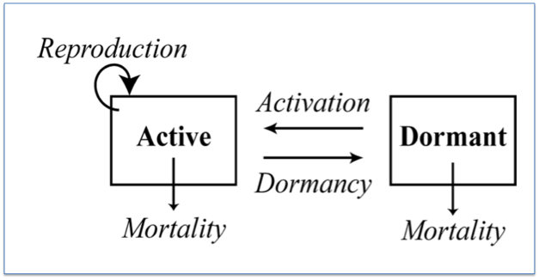
Reproduction
Resuscitation
Active
Dormant
Dormancy
Mortality
Mortality
Active

