Slide 1
Text Mining
Topics
PostGIS: Common issues from the assignment
Return to the Twitter API
Sentiment analysis: Trump’s tweets – confirming he only writes the [angrier] Android half
MUSA 620: Week 8

Slide 2
PostGIS
Adding a WHERE clause to speed up a spatial query
SELECT DISTINCT ON (a.id) a.*, r.id AS streetid
FROM phillystreets AS r, phillyaccidents AS a
WHERE ST_Distance(r.geom, a.geom) < 0.01
ORDER BY a.id, ST_Distance(r.geom, a.geom)
Saving a query as a view vs. exporting / importing as a new table

Slide 3
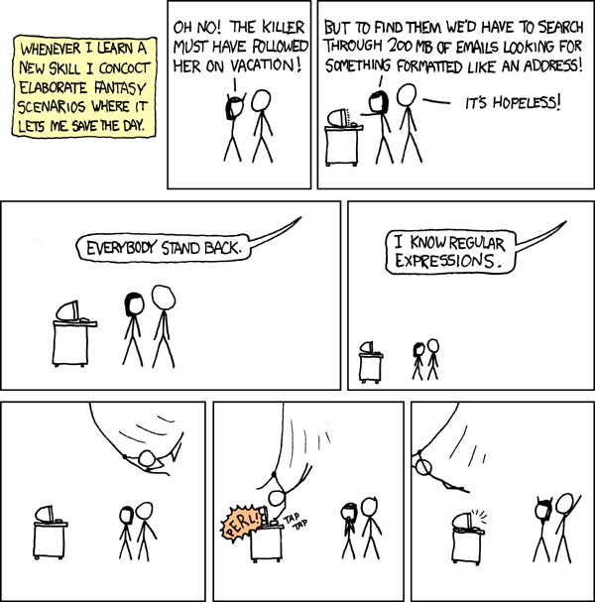
Text Mining: Regular Expressions (Regex) -- Wildcards on Steroids
xkcd

Slide 4
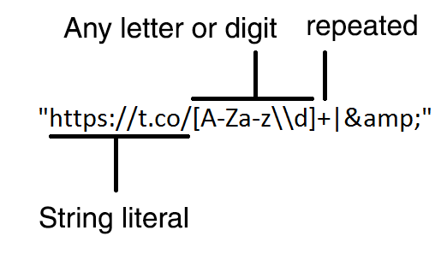
Text Mining: Regular Expressions (Regex)
Regular expressions are text strings for describing search patterns
This one looks for t.co links in a tweet (for example, https://t.co/S8nZgmeMMV)
xkcd

Slide 5
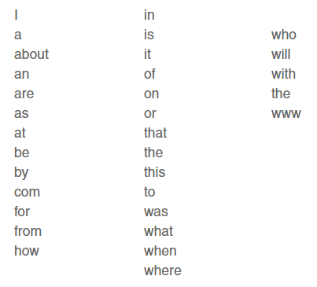
Text Mining: Stop Words
Stop words: common words that don’t carry much significance and are often ignored in text analysis. There is no standard list of stop words, but below are a few common examples.

Slide 6
Text Mining: Tokenizer / Parser
Tokenizer: breaks text into sentences, words, letters, symbols or some other meaningful elements (these elements are called tokens).
Parser: takes the tokens and organizes them into some sort of data structure, usually a tree. This definition is different from the one used in computer programming. A parser in computer programming is what we are calling here a tokenizer.

Slide 7
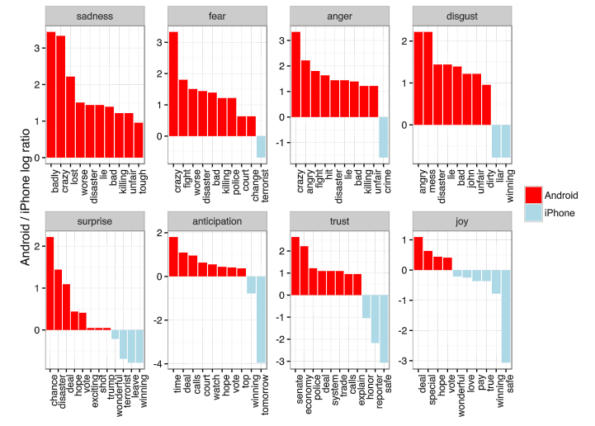
Text Mining: Sentiment Analysis
The analysis of a block of text to derive the attitude or emotional state of the speaker – used by brands to evaluate public opinion about a product
Sentiment analysis of Donald Trump’s tweets: Android vs iPhone

Slide 8
Text Mining: Other Definitions
Semantic data: data that is structured to represent “meaning.” It is commonly in the form of triples: [object A, object B, the relationship between them]. Example: [Pennsylvania, USA, “A is a subregion of B”]
Named entity recognition (NER): methods for searching a block of text for items matching a predefined category of object (names, places, organizations). Example: to classify a collection of news stories by the country in which they took place, you might use an NER algorithm to search the text for the mention of places.
Ngram: chunks of text (tokens) that have been extracted from a body of text. -- normally ngram is synonymous with “word.”
Corpus: a large collection of texts used for statistical analysis, often for the purpose of “training” a natural language processing algorithm.

