Slide 1
Census Data
MUSA 620: Week 2

Slide 2
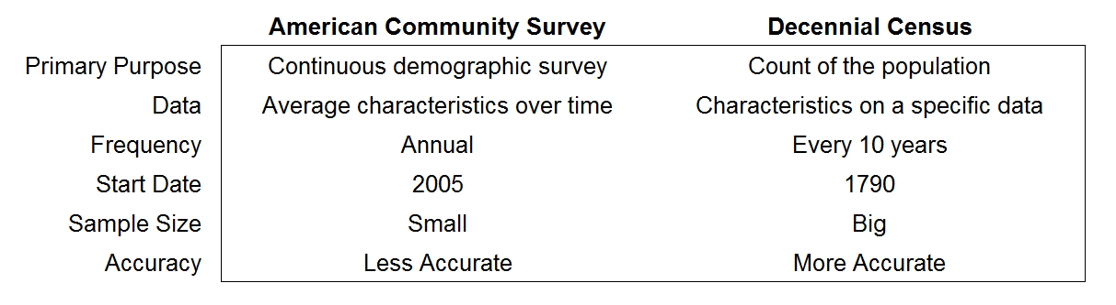
Two Primary Census Surveys
Other important Census surveys:
American Housing Survey (AHS)
Current Population Survey (CPS)
Consumer Expenditure Survey (CE)
National Health Interview Survey (NHIS)
Many others:
American Time Use Survey (ATUS)
Housing Vacancy Survey (HVS)
National Ambulatory Medical Care Survey (NAMCS)
National Crime Victimization Survey (NCVS)
National Household Education Survey (NHES)
National Survey of College Graduates (NSCG)
Private School Universe Survey (PSS)
Survey of Income and Program Participation (SIPP)

Slide 3
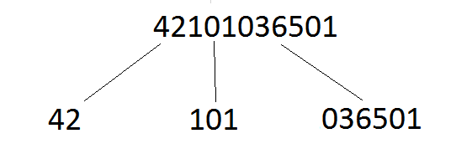
ACS: Geographic Levels
Easier to Work With
State
County
Tract
Harder to Work With
Metropolitan areas (MSAs, CBSAs)
Cities (Places)
Zip Code Tabulation Areas (ZCTA – similar to postal service zip codes, but not the same)
Hierarchical, can be combined into a clean GeoID
Definitions change often, may not match up well with other geographic levels
State (FIPS)
County (FIPS)
Tract ID

Slide 4
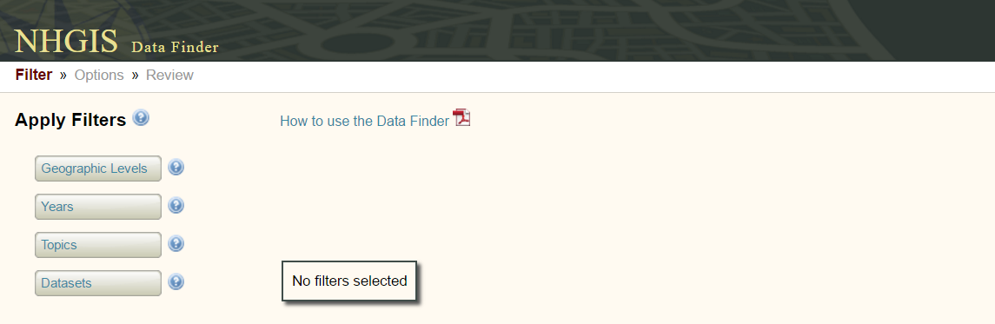
ACS: Summary-Level Data
Exercise: Select an ACS variable for a particular geographic level and plot it on a map
Select a geographic level (state / county / tract)
Select a year / dataset
Download the data and the GIS boundary file
If need be, filter the boundary file to include only the region you wish to examine (you may also want to reduce the file size by simplifying)
Make sure there is a matching “GeoID” and join the data to the boundary file
Plot it on a map
https://data2.nhgis.org/main

Slide 5
ACS Microdata
aka PUMS (Public Use Microdata Sample)
Microdata is a line-by-line list of individual responses to the Census survey. It does not allow you to go down to small geographic levels, but it does allow you to:
Calculate summary-level statistics not published by the Census,
Across any geography of your choosing (above some threshold),
Including a long list a variables that you will not find anywhere in Census publications
https://usa.ipums.org/usa/

Slide 6
ACS Microdata: Important Fields
Household weight / Person weight
One or the other must be included in every microdata calculation.
Group quarters status
Institutions and other group living arrangements, limited sampling. Consider whether or not to exclude.
Household number / Person number
Identifiers for grouping household members

Slide 7
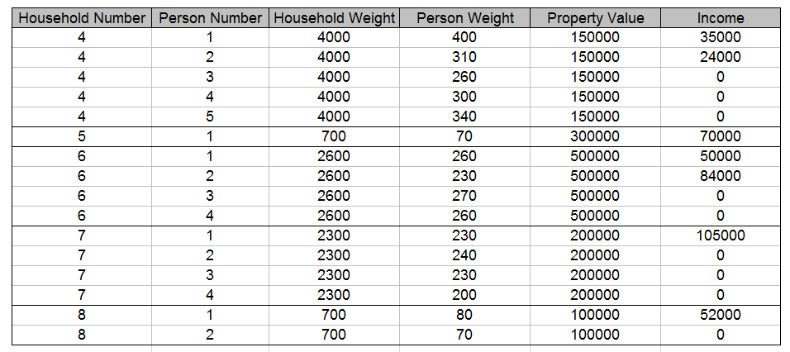
ACS Microdata: Weighting
Per Capita Income = ?
Average Property Value = ?
Correction from class: These weights do have a specific meaning. A person weight of 400 means this individual is representative of 400 people in the U.S., likewise for household weights.

Slide 8
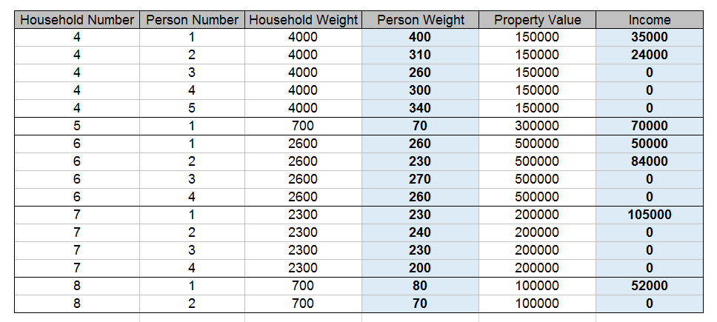
ACS Microdata: Weighting
Per Capita Income = average across all people, weighted by person weight

Slide 9
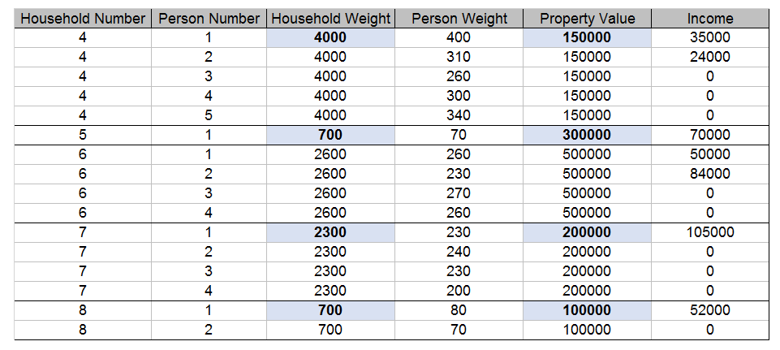
ACS Microdata: Weighting
Average Property Value = average across all households (all rows with Person Number = 1),
weighted by household weight

Slide 10
ACS Microdata: Obfuscation
The Census makes some adjustments to the micro data to reduce “reidentification risk.” It is important to be aware of these when calculating summary-level statistics.
Top-coding (be careful when calculating mean averages)
Data swapping (careful interpreting information from individual line items)
Population thresholds (sometimes data for small regions will be suppressed)

