Slide 1
Data Wrangling + Data Visualization
Topics
Housekeeping
Thinking about data visualization
ggplot2
QGIS
MUSA 620: Week 1
Max Galka

Slide 2
Housekeeping
TA: Evan Cernea
Office hours: Evan (on campus) + myself (remote)
Github setup – sign up + invite to workspace
Slack setup – musa620-s2018.slack.com
Background survey

Slide 3
The Data “Pipeline”
Collection (APIs, web scraping)
Storage (data frames, databases)
Analysis (tidyverse/dplyr, NLP)
Visualization (ggplot, Leaflet)
Combining it all into a web app (Shiny)

Slide 4
Technology
Goal: The concepts we learn in this course are intended to be technology agnostic
Primary technologies we will use:
RStudio
QGIS (to a lesser degree)
At your option, you may also use:
JavaScript, Python, other programming languages
ArcGIS

Slide 5
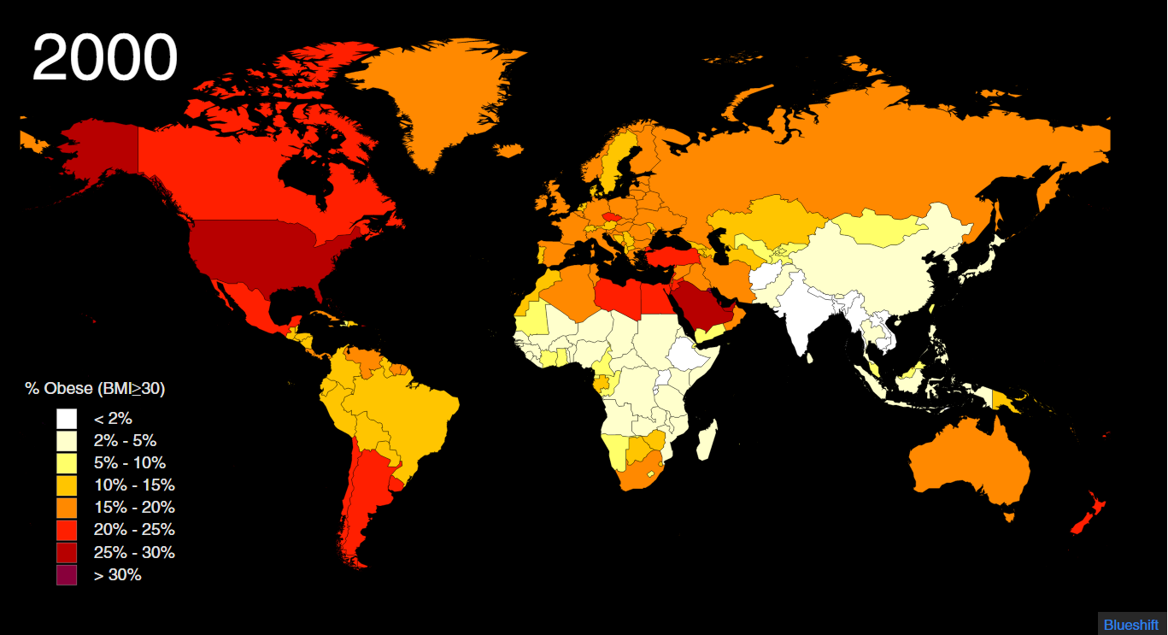
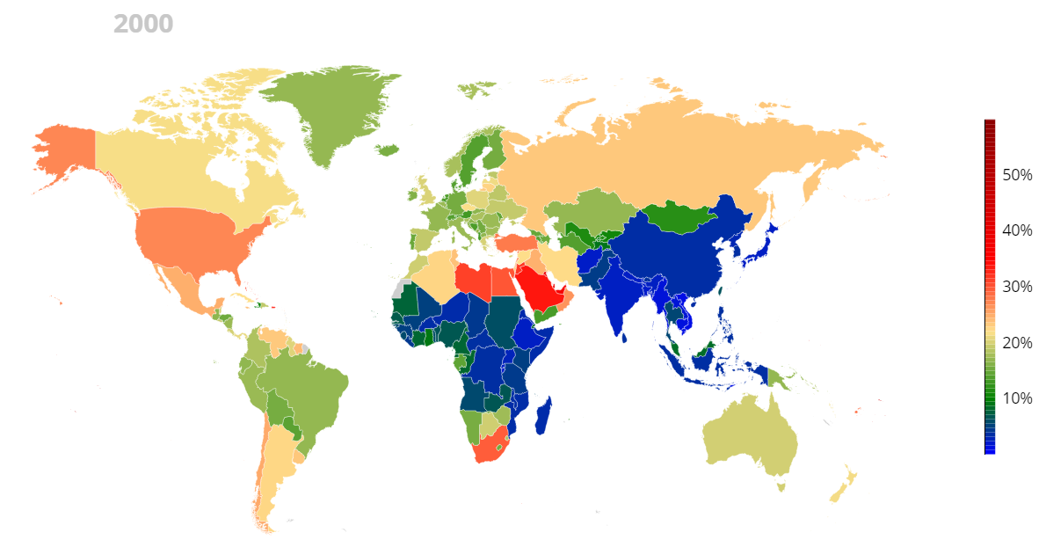
Thinking About Data Visualization: World Obesity Maps
At the webpages below are two animated maps displaying the same data. Which one tells a clearer story? What design elements account for the difference?
http://www.ncdrisc.org/obesity-prevalence-map.html
https://www.theguardian.com/global-development-professionals-network/2017/jan/03/using-data-visualisations-to-help-explain-the-global-obesity-explosion

Slide 6
Thinking About Data Visualization: World Obesity Maps
At the webpages below are two animated maps displaying the same data. Which one tells a clearer story? What design elements account for the difference?
Discrete Sequential -- clear hierarchy Labeled, prominent colors Familiar -- Miller projection Slow
Color scale Color palette Legend Map projection Animation speed
Continuous -- necessary to go up to 60%? Categorical -- which colors are high/low? No label, takes concentration to read Why is the northern US border curved? Fast

Slide 7
Data Visualization: ggplot2
What it does:
Grammar of graphics
High level of abstraction
Themes for styling the display
What it doesn’t do:
Interactive graphics
3D graphics
Graph networks
Basic concepts:
aes (aesthetics): defines which variables map to which aesthetic properties Example: aes(x = age, y = population, fill=gender)
geom_xxxxx: adds a layer, which inherits the aesthetic properties Example: geom_bar (bar chart), geom_point (scatter plot), geom_polygon (map features)
+ Structure: new features/properties are added to the plot by appending with a + Example: ggplot(data, aes(x = age, y = population) ) + geom_point() + labs(title=“My Title“)

Slide 8
Data Visualization: ggplot2
20 minutes to learn, a lifetime to master
Tips for using ggplot2 effectively:
ggplot2 includes a very large number of commands/options/parameters for fine tuning your plot. It typically offers many different ways of accomplishing the same end goal.
Focus on understanding how ggplot works, rather than on memorizing keywords.
When constructing a plot, Make heavy use of online examples and “cheatsheets” for reference.
See the last two slides for a reference cheatsheet

Slide 9
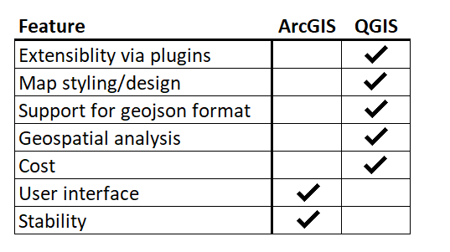
QGIS
QGIS is a [free] open source GIS application, similar to ArcGIS. For assignments, you are welcome to use whichever application you prefer. For in class demonstrations, we will use QGIS.

