Slide 1
Data Wrangling + Data Visualization
Topics
Housekeeping items
Map projections
Data frames
Tidyverse
MUSA 620: Week 2
Max Galka

Slide 2
Housekeeping
Class schedule
First homework assignment
Don’t forget to sign up for Slack!

Slide 3
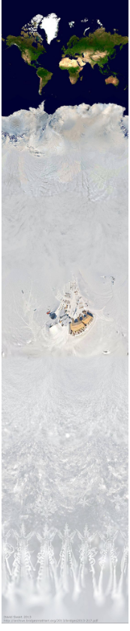
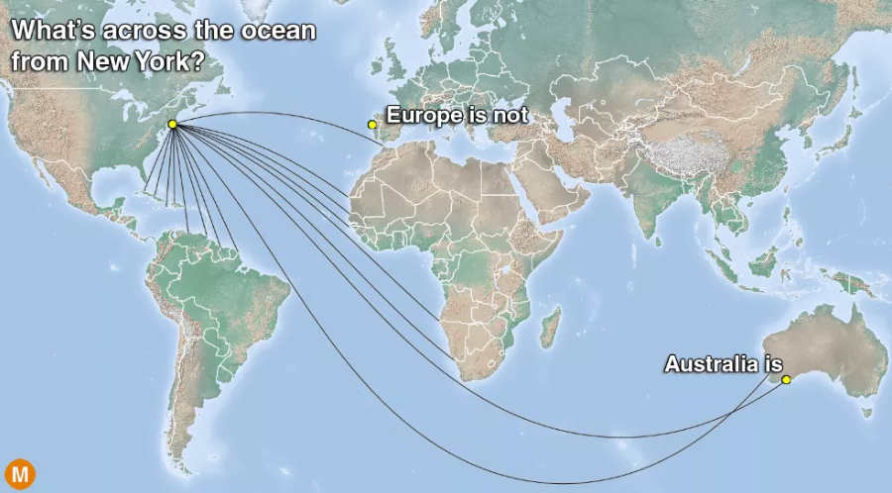
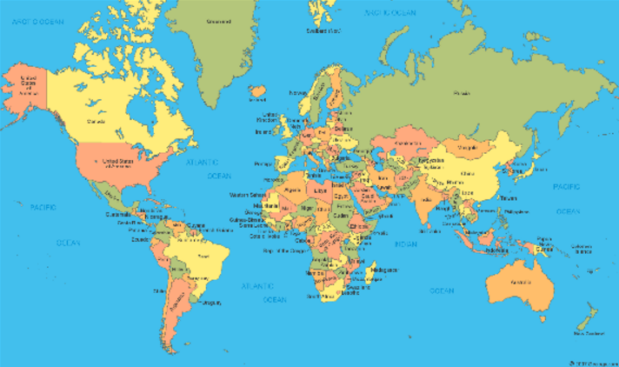
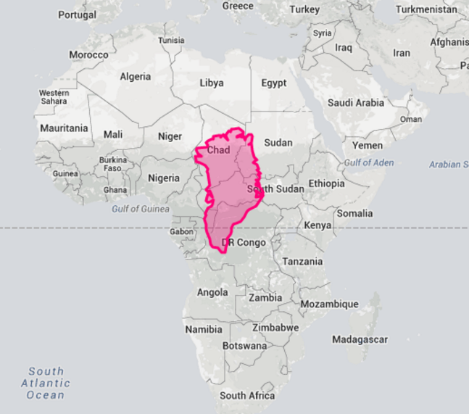
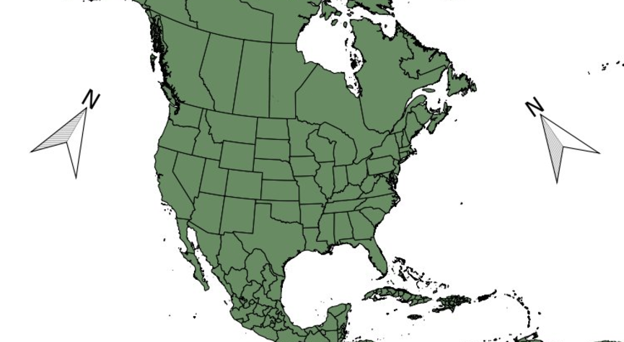
Map Projections: the World is Weird
All of these lines are straight
Mercator Uncropped
Both of these arrows point north
Greenland is not the same size as Africa

Slide 4
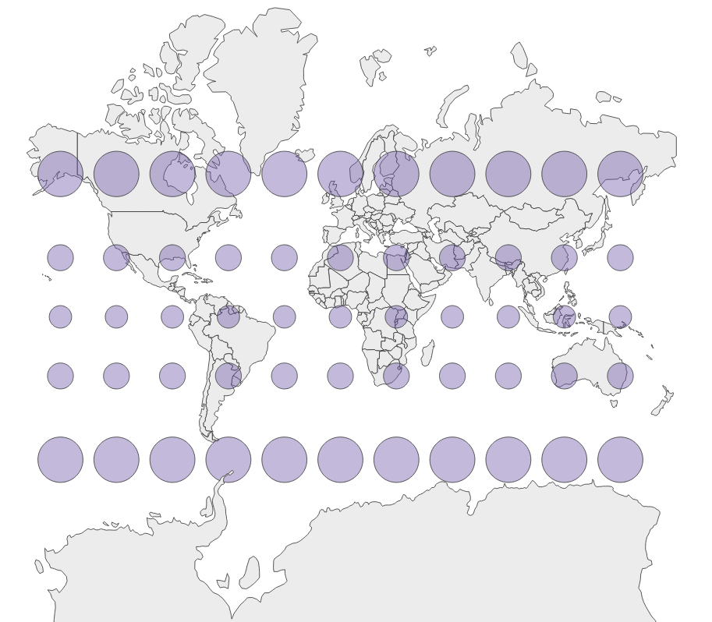
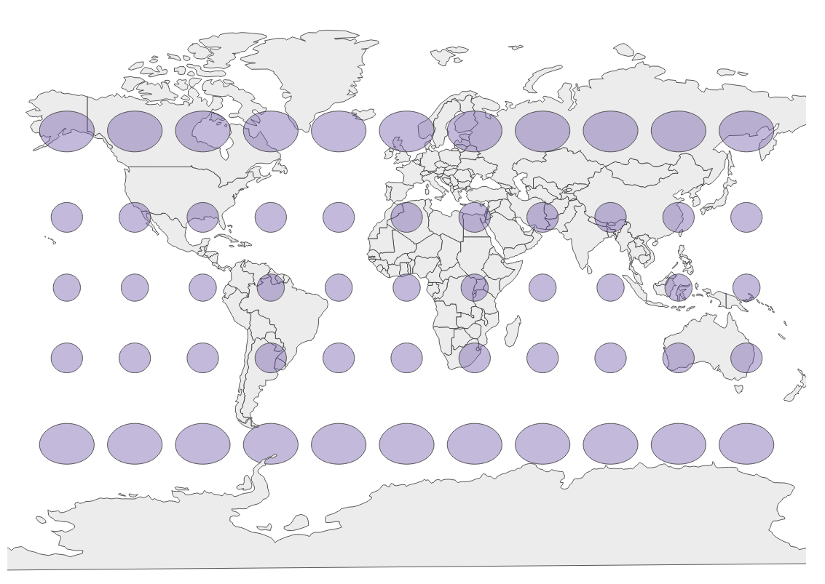
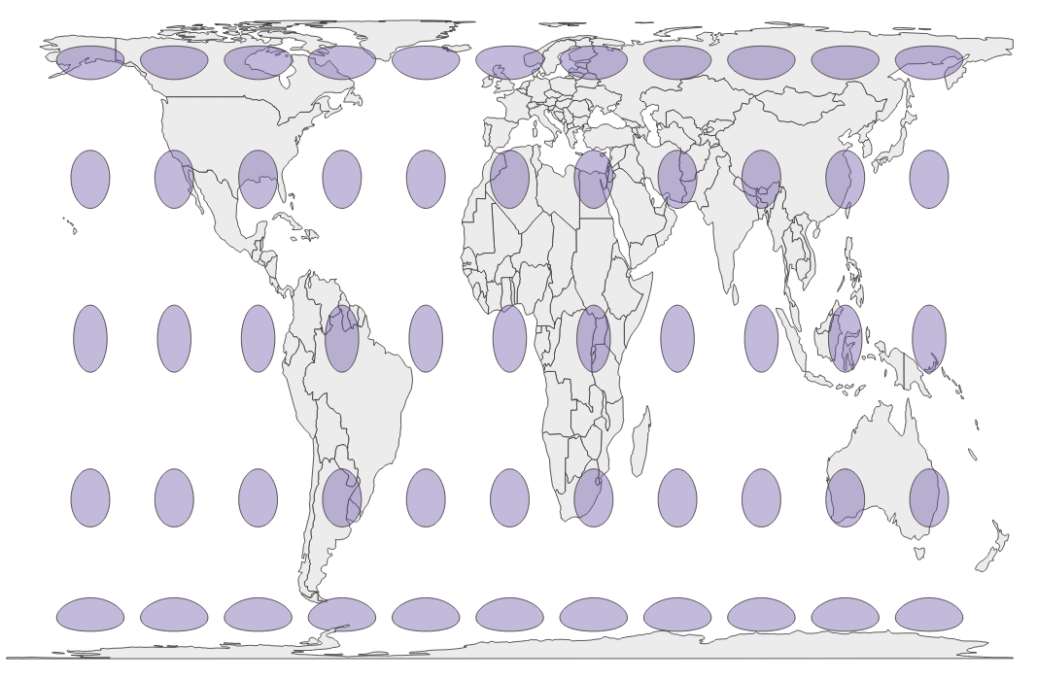
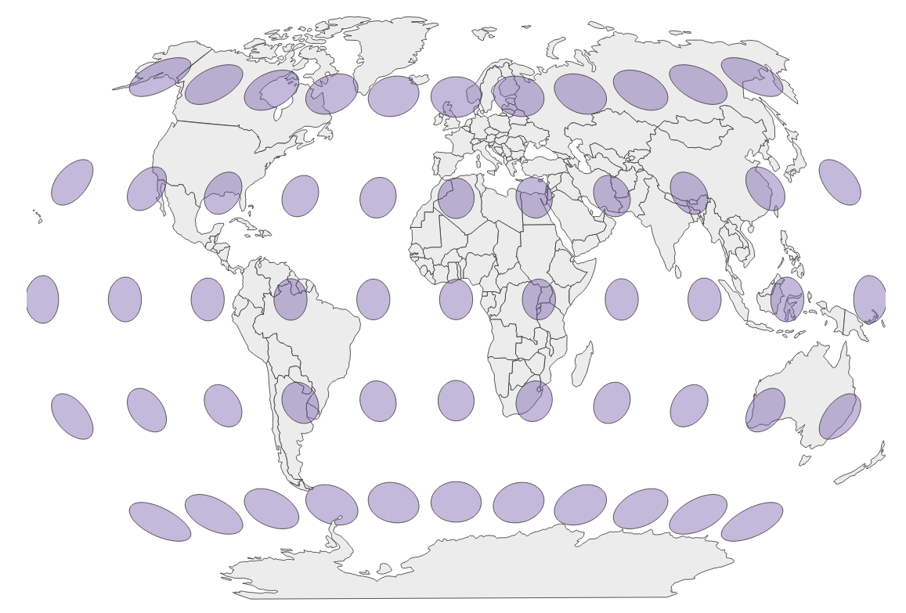
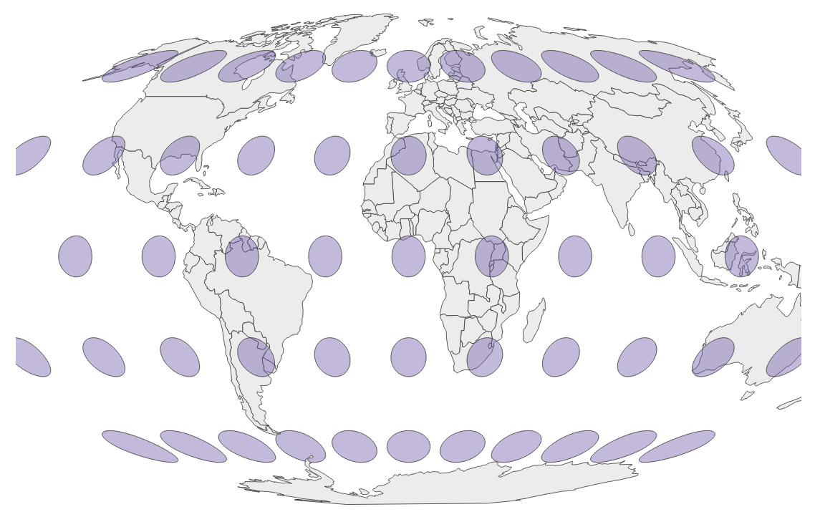
Map Projections to Know
No 2D map can accurately portray the Earth’s 3D surface. Every map projection offers a different tradeoff, less accuracy in certain areas for more accuracy in others. Compare these map projections online.
Mercator: accurate with shapes and angles, inaccurate with size. At the global level, avoid it!
Gall-Peters*: accurate with size & angles, inaccurate with shapes. Unfamiliar. Just my opinion: avoid it!
Miller: retains the familiarity of Mercator without the extreme distortions.
Winkel-Tripel*: generally considered the most balanced map projection. Used by National Geographic.
Mollweide*: also very balanced. Some prefer it over Winkel-Tripel for its elliptical shape.
* Equal area projection

Slide 5
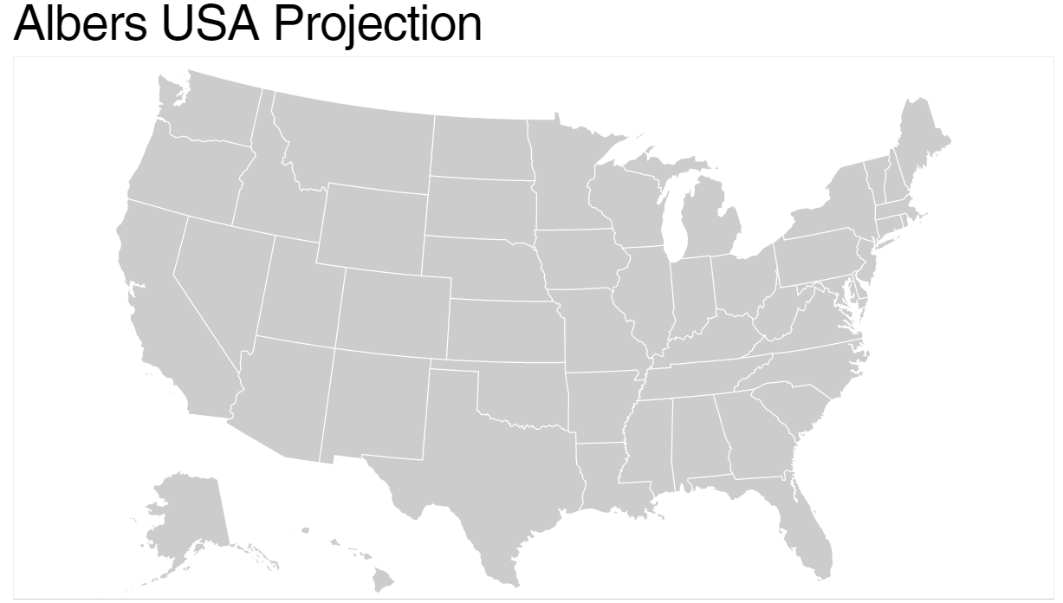
Map Projections to Know: USA Maps
In addition to the Miller, Winkel-Tripel, and Mollweide projections, the Albers projection, for US maps, is another good one to know. It is the likely the US map you’re most familiar with, and like Winkel-Tripel and Mollweide, it is an equal area projection.
The composite Albers USA projection, with Alaska and Hawaii tucked in underneath

Slide 6
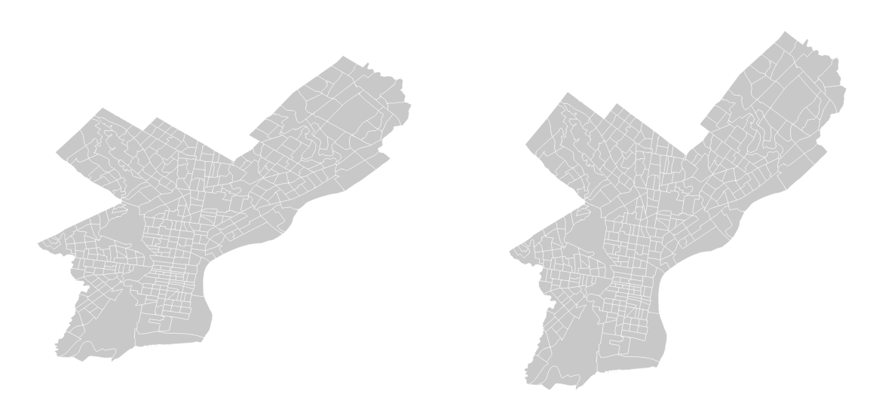
Map Projections at the Scale of Cities
BEWARE: GIS applications will often use the equirectangular projection by default. City-level maps will appear wider and flatter than they really are. When in doubt, use Mercator for city-level maps.
Equirectangular (WGS 84)
Mercator

Slide 7
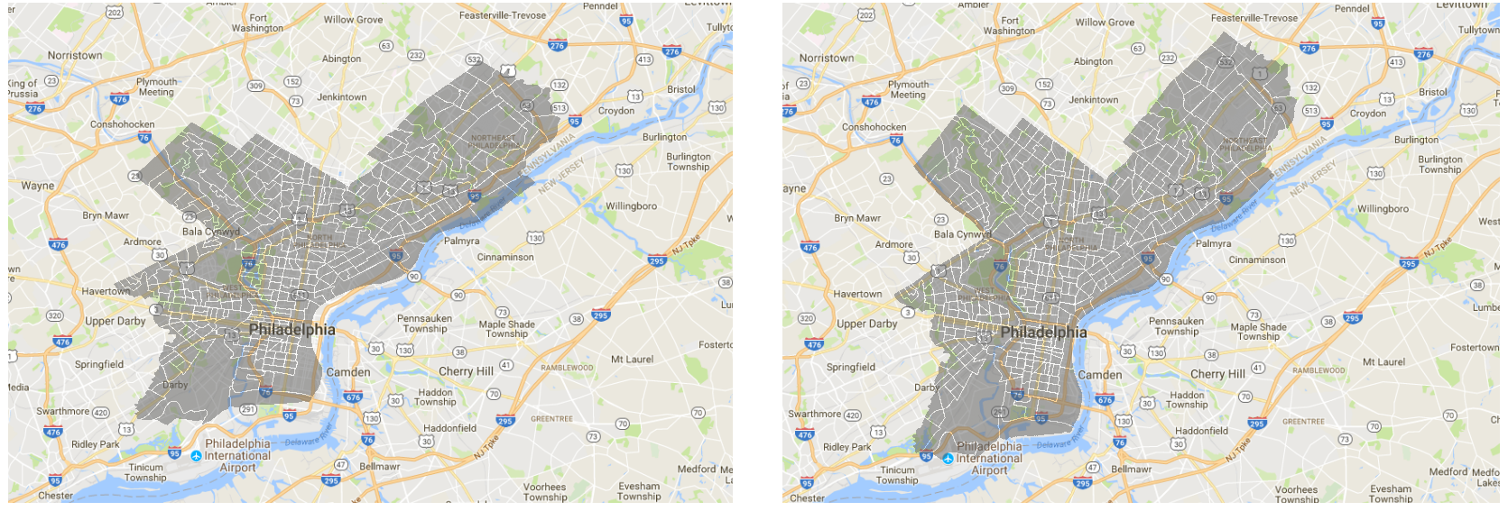
Map Projections at the Scale of Cities
Equirectangular
Mercator
This is *not* the shape of Philly
A perfect fit!

Slide 8
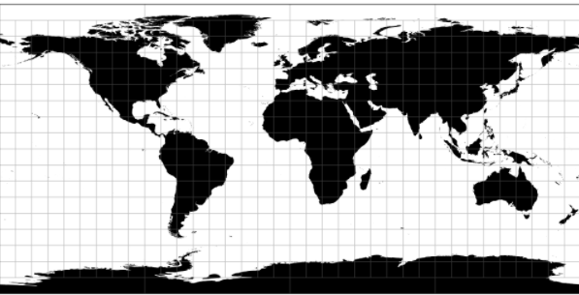
Map Projection vs Coordinate Reference System
Often these concepts are used interchangeably, but it is important to understand the difference
Coordinate reference system (CRS)
System of numbers (coordinates) Specifies locations on Earth Example: WGS 84 (standard latitude, longitude pairs) Philadelphia: (39.9,-75.2) Tokyo: (35.7,139.7) Cape Town: (-33.9,18.4)
Map projection
Function (from globe to flat surface)
Specifies locations on your screen (or other flat surface)
Example: Equirectangular projection

Slide 9
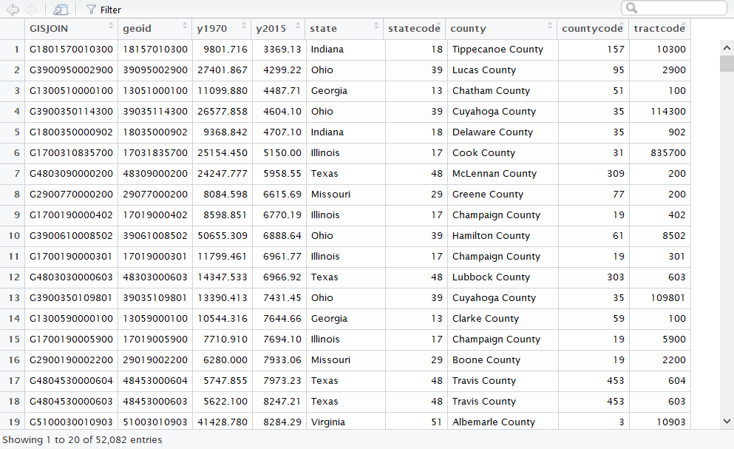
Data Frames
Like a super-charged Excel spreadsheet, contained within a single variable
You can display the contents of a data frame with the View() command

Slide 10
Tidyverse: A Collection of Useful Data Science Packages
Tidyverse packages we will use throughout the course
ggplot2: a system for declaratively creating graphics, based on The Grammar of Graphics. You provide the data, tell ggplot2 how to map variables to aesthetics, what graphical primitives to use, and it takes care of the details.
dplyr: provides a grammar of data manipulation, providing a consistent set of verbs that solve the most common data manipulation challenges
tidyr: provides a set of functions that help you get to tidy data. Tidy data is data with a consistent form: in brief, every variable goes in a column, and every column is a variable.

Slide 11
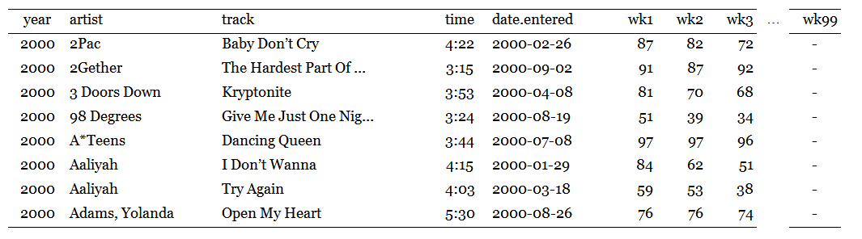
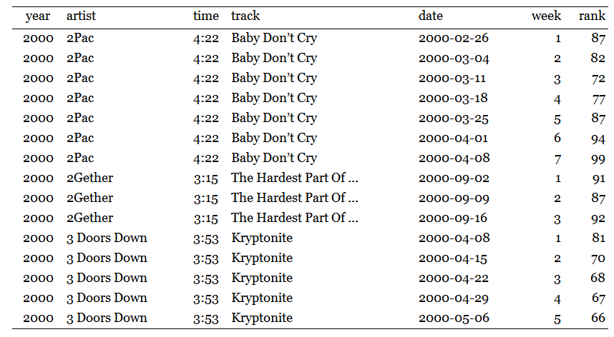
Data Shaping: Same Data, Different Format
Wide format
Tall format
(usually better)

Slide 12
Data Shaping: Tall Format
ID variables
-vs-
measured variable(s)
Each measured variable gets one column
Each row is one observation

