Slide 1
Geocoding and Mapping with SF
Topics
A few notes on Census data
Colors and color scales
Geocoding with ggmap
Mapping with SF (simple features)
MUSA 620: Week 3
Max Galka

Slide 2
Census Data: American Community Survey
Until 2010, there was one major Census survey (the Decennial Census). Since 2010, the Decennial Census has been replaced by two annual surveys:
Current Population Survey (CPS) – large sample, only basic questions
American Community Survey (ACS) – smaller sample, detailed questions
The results of these surveys are combined to achieve the best of both worlds (detailed responses, weighted using a large population sample). Confusingly, the combined results are published as the American Community Survey. For all intents and purposes the ACS is “The Census.”

Slide 3
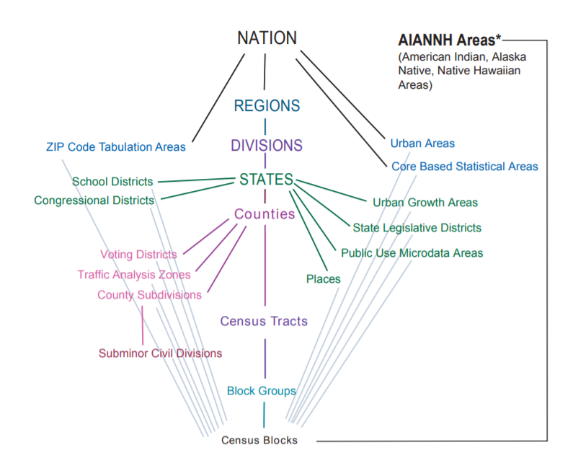
Census Data: Geographic Entities
Census friendly:
States
Counties
Tracts
Block groups
Blocks
Not so Census friendly:
ZCTAs (not the same as zip codes!)
Cities
Metro areas
Neighborhoods

Slide 4
Color

Slide 5
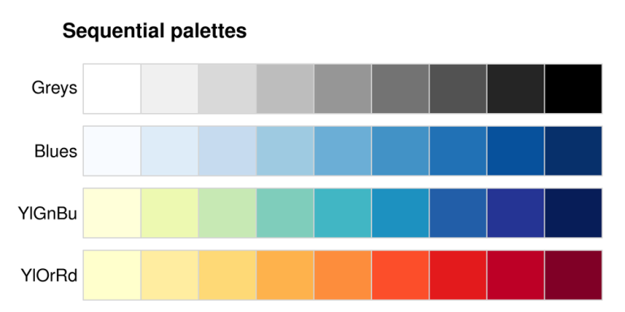
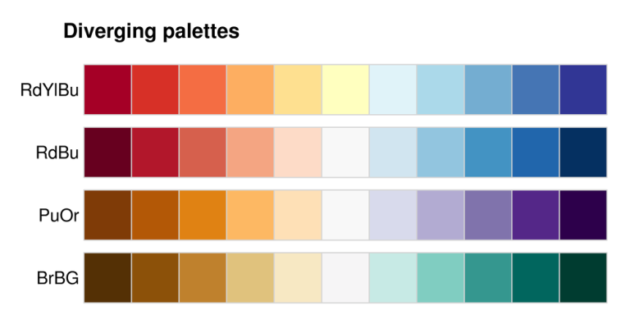
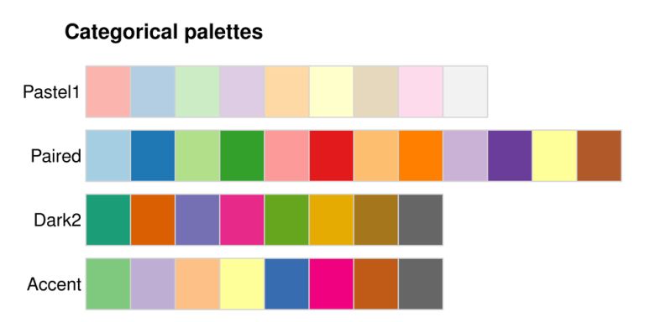
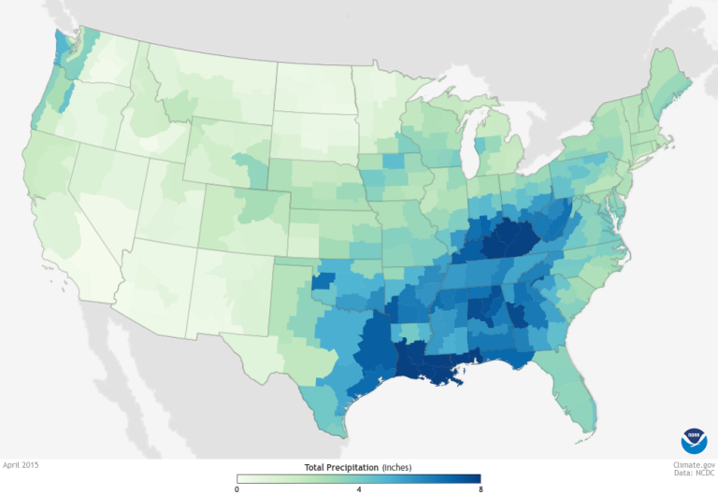
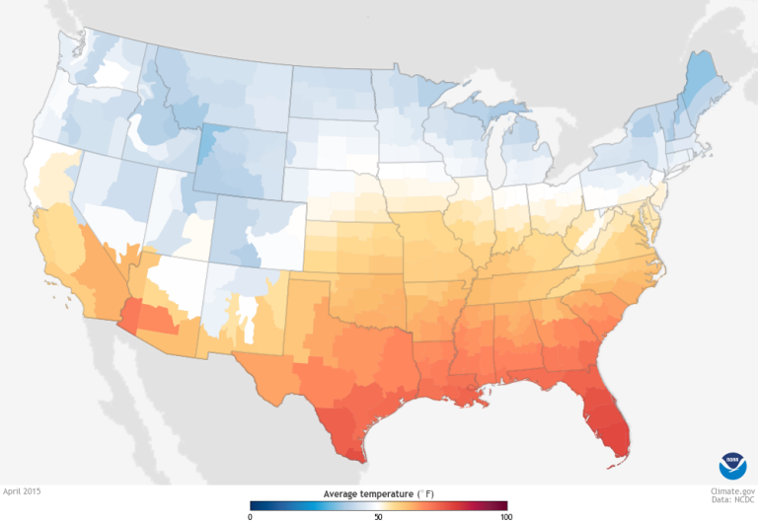
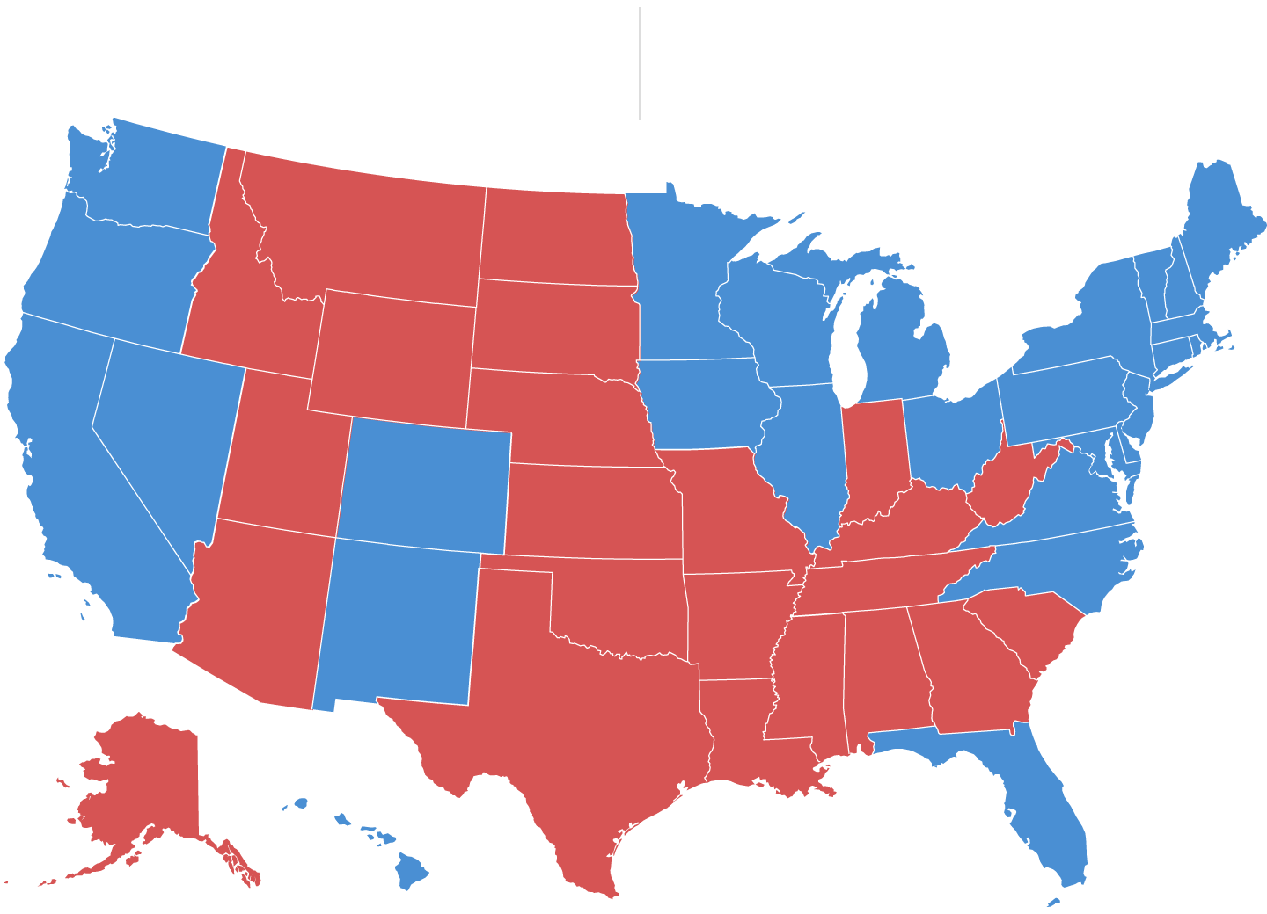
Color Scheme Type Should Always Match the Data Type
Used when the numbers go in one direction only:
Population density
Precipitation
Used when the numbers go in both directions:
More conservative – more liberal
Hotter -- colder
Used when the numbers go in both directions:
State flower
Winning election candidate
Colorbrewer
Notes:
Eye tracking, % of adults who can read a scatter plot

Slide 6




Perceptually Uniform Scales: Be Careful With Traditional RGB Model
Pure (100% saturated) colors vary greatly in perceived brightness
These scales are physically uniform, but not perceptually uniform
Notes:
Eye tracking, % of adults who can read a scatter plot

Slide 7
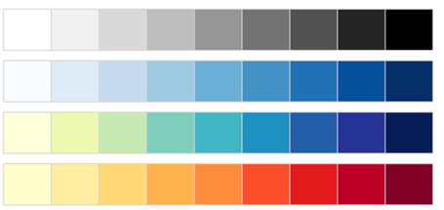

Perceptually Uniform Scales: HCL Model
HCL Model Perceptually Uniform
Traditional RGB Model Not Perceptually Uniform
In practical terms, use: colorbrewer.org, R viridis package, Chroma.js
Vis4
Notes:
Eye tracking, % of adults who can read a scatter plot

Slide 8
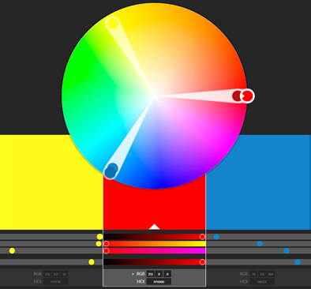
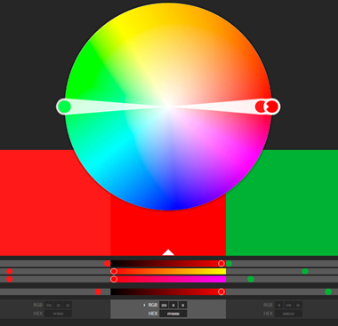
Colors That Match
color.adobe.com
Notes:
Eye tracking, % of adults who can read a scatter plot

Slide 9
Geocoding

Slide 10
Geocoding: ggmap
ggmap uses Google’s geocoding API
Limited to 2,500 queries per day
Much like Google Maps, it accepts addresses in a variety of different formats. All of the queries below return the same location. geocode("210 South 34th Street; Philadelphia, PA")
geocode("Meyerson Hall; Philadelphia, PA") geocode("Meyerson Hall, PA")
geocode("210 South 34th Street")
geocode("210 S 34th st")
Be careful about ambiguities. geocode("15 e 57th st, new york, ny") -73.97275 40.76274
geocode("15 e 57th st, brooklyn, ny") -73.92402 40.6557
geocode("15 e 57th st") -73.97275 40.76274

Slide 11
SF (simple features)
Please download the R scripts and open in a clean RStudio project

