Slide 1
Databases
Topics
Assignment 1: some follow up notes, data classification
Databases: introduction
SQL: the language of databases
MUSA 620: Week 4

Slide 2
Assignment 1
Notes on design
Data classification

Slide 3
What is a Database?
What is the difference between a database and a dataset?
You are accustomed to accessing data from three different places:
From memory (data frames, variables)
From files (on a storage device)
From servers (web URLs)
Which category do databases belong to?

Slide 4
What is a Database?
What is the difference between a database and a dataset?
Two big differences:
A dataset is typically a single table. A database is a collection of tables.
Dataset refers primarily to the data itself, regardless of format or medium. Database typically refers to the architecture that stores the data, as well as the data itself.
You are accustomed to accessing data from three different places:
From memory (data frames, variables)
From files (on a storage device)
From servers (web URLs)
Which category do databases belong to?
Databases are a combination of all three

Slide 5
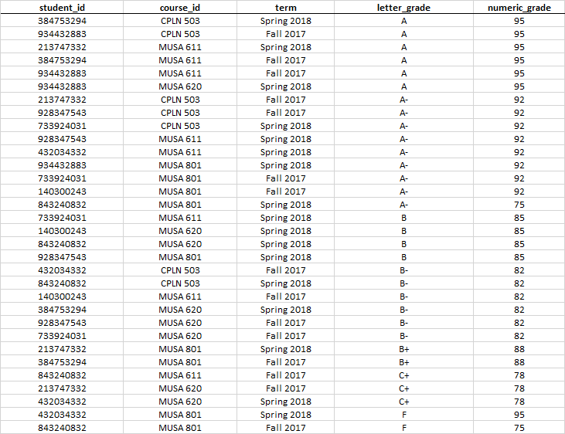
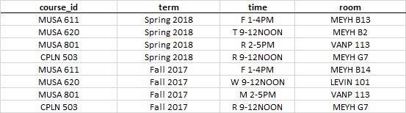

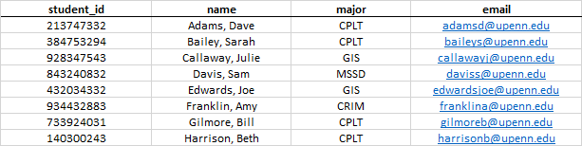
Database Example: UPenn Courses InTouch (Simplfied)
enrollment
semester_roster
courses
students

Slide 6
Database Terminology
Field: analogous to column
Record: analogous to row
Data table: a single table of data with a fixed set of fields
Database: a collection of one or more data tables that are linked by common fields

Slide 7
Database Terminology
Primary key: a table’s unique identifier, made up of one or more fields (denoted by bullet points)
Foreign key: an identifier that connects the records between two different tables (denoted by table-to-table lines)
Index: an ordered structure within a database that allows for faster searches

Slide 8
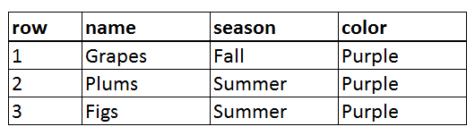
SQL (Structured Query Language)
A typical SQL query has the form:
SELECT field1, field2, … fieldn
FROM datatable
WHERE condition1 AND/OR condition2 AND/OR … condition
SELECT name, season, color
FROM fruits
WHERE color = ‘purple’

Slide 9
SQL: Example Queries
SELECT passenger_count, pickup_longitude, pickup_latitude
FROM taxi_trips
SELECT *
FROM taxi_trips
SELECT *
FROM taxi_trips
WHERE trip_distance > 1
SELECT passenger_count, COUNT(*) AS number_of_trip, AVG(total_amount) AS average_fare
FROM taxi_trips
GROUP BY Passenger_count

Slide 10
SQL: Example Queries
Returns the passenger count and coordinates of every taxi pickup.
SELECT passenger_count, pickup_longitude, pickup_latitude
FROM taxi_trips
SELECT *
FROM taxi_trips
Returns the entire data table. * = All columns.
SELECT *
FROM taxi_trips
WHERE trip_distance > 1
Returns every taxi trip longer than 1 mile.
SELECT passenger_count, COUNT(*) AS number_of_trip, AVG(total_amount) AS average_fare
FROM taxi_trips
GROUP BY passenger_count
Returns the number of trips and average fare by passenger count

Slide 11
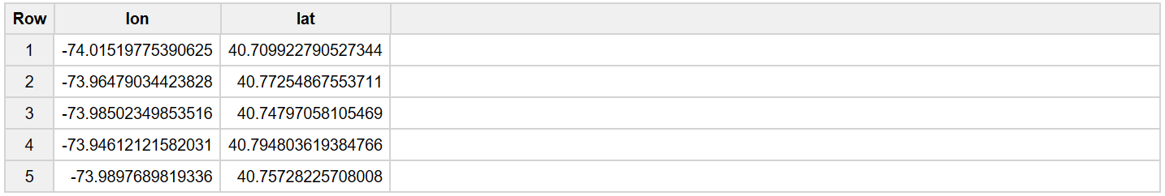
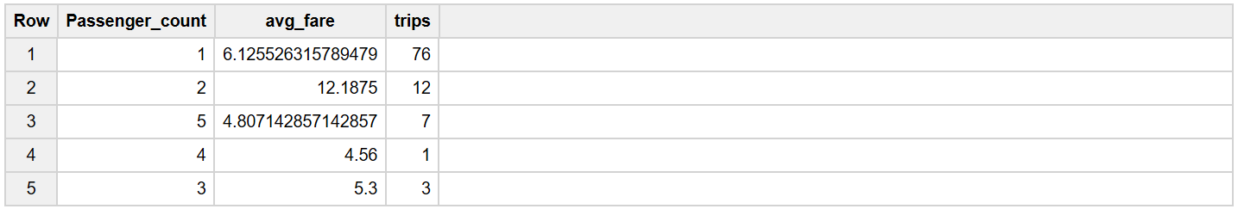
SQL: Continued
AS: Assigns a name to a column
SELECT Pickup_longitude AS lon, Pickup_latitude AS lat
FROM [TaxiTrips.example_table]
SUM / COUNT / AVG …. GROUP BY: Aggregates the data with summary-level stats
SELECT Passenger_count, AVG(Total_amount) as avg_fare, COUNT(*) as trips
FROM [TaxiTrips.example_table]
GROUP BY Passenger_count

Slide 12
SQL: Conventions
1) Use ALL CAPS FOR SQL KEYWORDS and lowercase for everything else.
Good: SELECT lat,lon,num_pickups FROM mytable ORDER BY pickups DESC
Bad: select lat,lon,NUM_PICKUPS FROM mytable Order By pickups desc
2) The names of databases, tables, and columns should use lowercase letters, numbers, and underscores only. Do not use uppercase letters or dashes.
Good: SELECT lat,lon,num_pickups FROM mytable ORDER BY pickups DESC
Bad: SELECT lat,lon,num-pickups FROM myTable ORDER BY Pickups DESC
3) Double quotes (“) are used to denote column names and table names. Single quotes (‘) are used to denote strings.
Good: SELECT name,email,major FROM students WHERE major = ‘CPLT’
Also good: SELECT “name”,”email”,”major” FROM “students” WHERE “major” = ‘CPLT’
Bad: SELECT name,email,major FROM students WHERE major = “CPLT”
4) It is proper syntax to end all SQL queries with a semicolon (;). But most of the time, we will omit them.
Good: SELECT name,email,major FROM students WHERE major = ‘CPLT’;
Also good: SELECT name,email,major FROM students WHERE major = ‘CPLT’

Slide 13
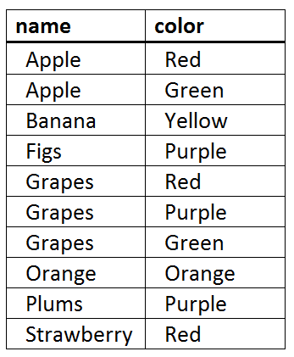
More SQL: Sorting (ORDER BY)
SELECT field1, field2, … fieldn
FROM database.datatable
ORDER BY fieldx1 [ASC / DESC], …. fieldxm [ASC / DESC]
SELECT name, color
FROM food.fruits
ORDER BY name ASC, color DESC

Slide 14
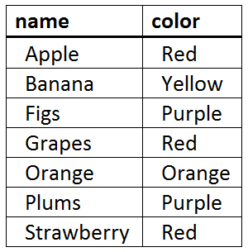
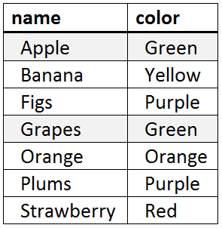
More SQL: Removing Duplicates (DISTINCT ON)
SELECT DISTINCT ON (fieldk) field1, field2, … fieldn
FROM database.datatable
*ORDER BY fieldk [ASC / DESC], …. fieldxm [ASC / DESC]
SELECT DISTINCT ON (name) name, color
FROM food.fruits
ORDER BY name ASC, color DESC
SELECT DISTINCT ON (name) name, color
FROM food.fruits
ORDER BY name ASC, color ASC

Slide 15
PostgreSQL (Postgres) / PostGIS
Postgres: a SQL database (similar to MySQL, MariaDB, MS SQL Server, Google BigQuery, and others).
PostGIS: extends Postgres, allowing SQL queries to be used on geospatial objects.
Adds Geometry (“geom”) field, to the database with its own set of operators.
Enables spatial searches using r-tree indexing,

Slide 16
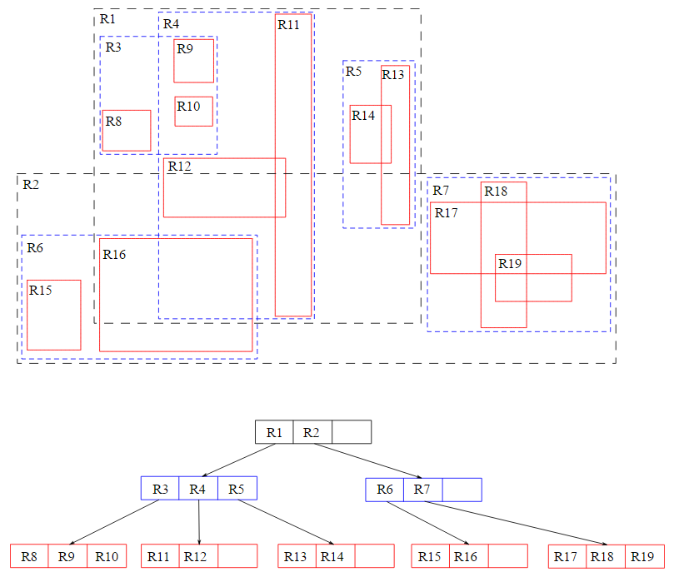
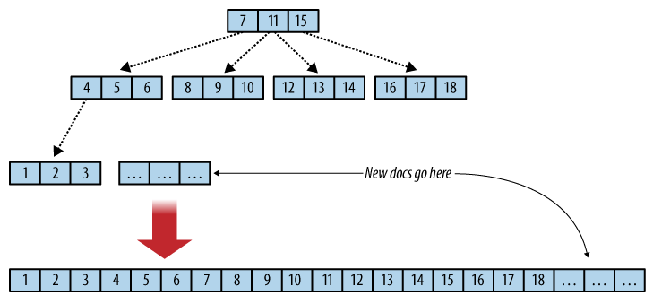
Database Concept: Indexing
B-Tree: One-dimensional index for normal queries
R-Tree: Multi-dimensional index for spatial queries

Slide 17
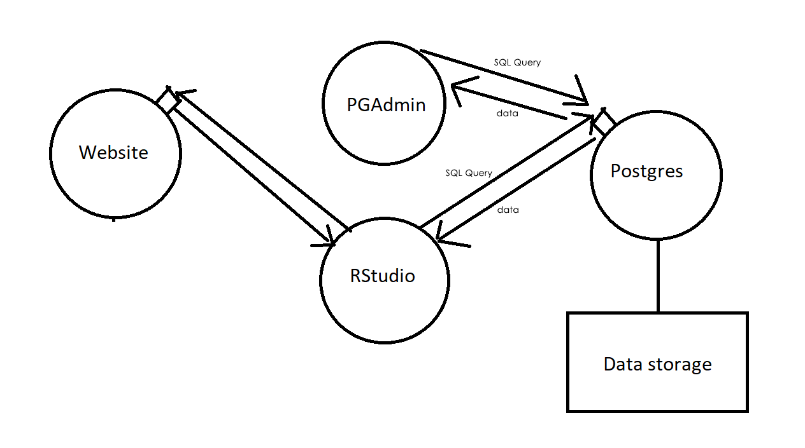
The relationship between RStudio, PGAdmin, and Postgres

