Slide 1
Postgres/PostGIS Setup

Slide 2
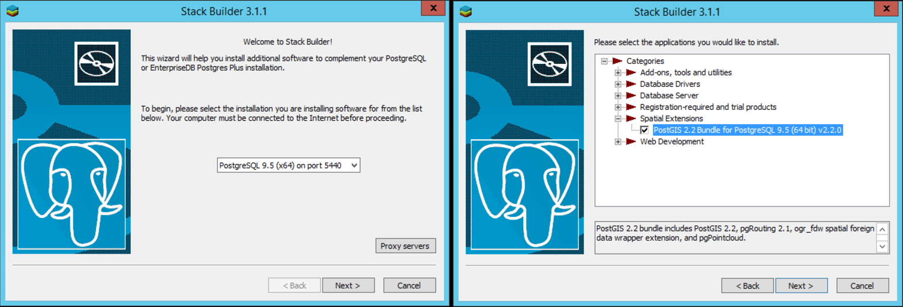
1) Install PostgreSQL (Postgres) / PostGIS
Download PostgreSQL and Install: https://www.enterprisedb.com/downloads/postgres-postgresql-downloads
After it finishes, it will give you the option to run Stack Builder. Install PostGIS.
Create a username and password. Use “postgres” the username and leave the password blank.
If it asks if you want to create a spatial database, either way is OK – we will create a new one anyway
Press “Yes” to all dialogue boxes that pop up

Slide 3
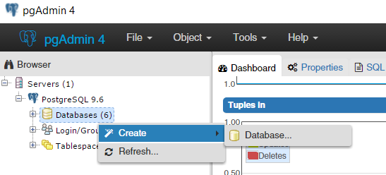
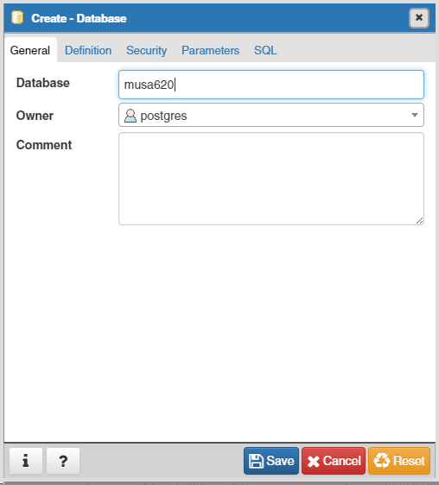
2) Create a New Database in PGAdmin
Right click on Database, then Create > Database…
Enter the name of your database (let’s go with “musa620”). Then press save.

Slide 4
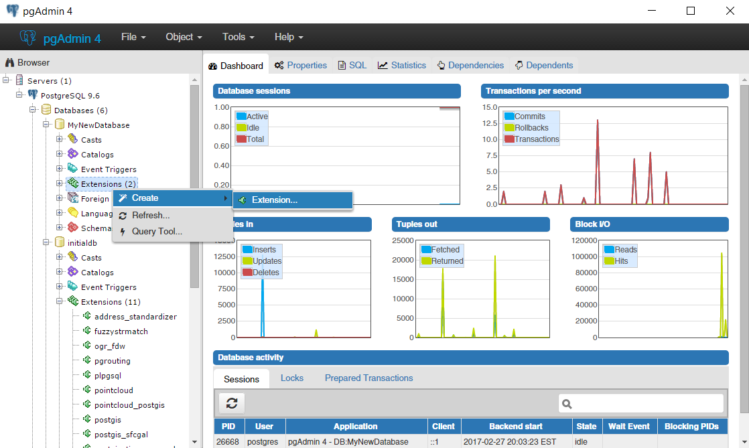
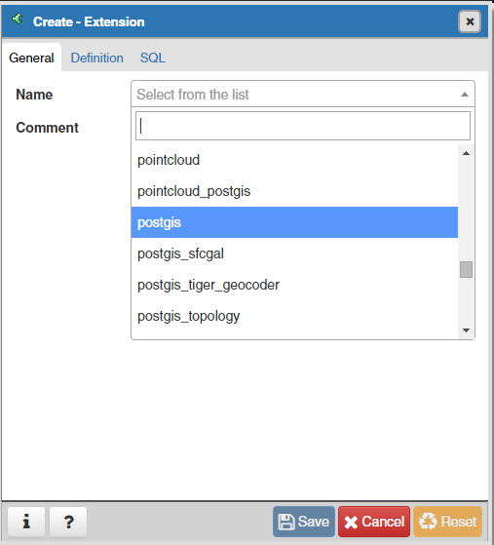
3) Add PostGIS Extension to the Database
This extension enables the database to store GIS data
Right click on extensions, then Create > Extension…
Select postgis and press Save

Slide 5
4) Connect to the database in R
Download the postgres.r script from Github or copy and paste the code blocks below. If you are able to successfully run the script and display the scatter plot at the end, everything is set up properly.
require(RPostgreSQL)
require(ggplot2)
drv <- dbDriver("PostgreSQL")
# connect to the database
con <- dbConnect(drv, dbname = "musa620",
host = "localhost", port = 5432,
user = "postgres", password = '')
# SQL command to create a new table
sqlCommand <- paste0("CREATE TABLE cartable (carname character varying NOT NULL,",
"mpg numeric(3,1),",
"cyl numeric(1,0),",
"disp numeric(4,1),",
"hp numeric(3,0),",
"drat numeric(3,2),",
"wt numeric(4,3),",
"qsec numeric(4,2),",
"vs numeric(1,0),",
"am numeric(1,0),",
"gear numeric(1,0),",
"carb numeric(1,0),",
"CONSTRAINT cartable_pkey PRIMARY KEY (carname)) WITH (OIDS=FALSE);")
# run the SQL command to create the table
dbGetQuery(con, sqlCommand)
# create some test data to load into the table
data(mtcars)
carData <- data.frame(carname = rownames(mtcars),
mtcars,
row.names = NULL)
carData$carname <- as.character(carData$carname)
# import the data into the table "cartable" in the "musa620" database
dbWriteTable(con, "cartable", value = df, append = TRUE, row.names = FALSE)
# run a SQL query for all of the data in cartable
queryResult <- dbGetQuery(con, "SELECT * from cartable")
head(queryResult)
# plot the results
ggplot(queryResult, aes(x = hp, y = mpg)) +
geom_point(aes(size = wt, colour = as.factor(cyl), alpha=0.5)) +
theme_bw()

