Slide 1
Spatial Databases
Topics
PostGIS: Spatial database
SQL: Spatial queries
QGIS: Database connections, spatial queries
MUSA 620: Week 5

Slide 2
PostgreSQL (Postgres) / PostGIS
PostgreSQL/Postgres: an open source SQL database (similar to MySQL, MariaDB, MS SQL Server, Google BigQuery, and others).
PostGIS: extends Postgres, allowing SQL queries to be used on geospatial objects.
Adds Geometry (“geom”) field, to the database with its own set of operators.
Enables spatial searches using r-tree indexing,

Slide 3
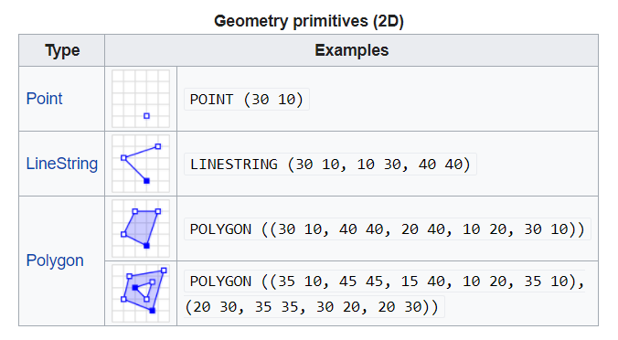
Well-Known Text (WKT) Format
A simple text-based format for defining geospatial features

Slide 4
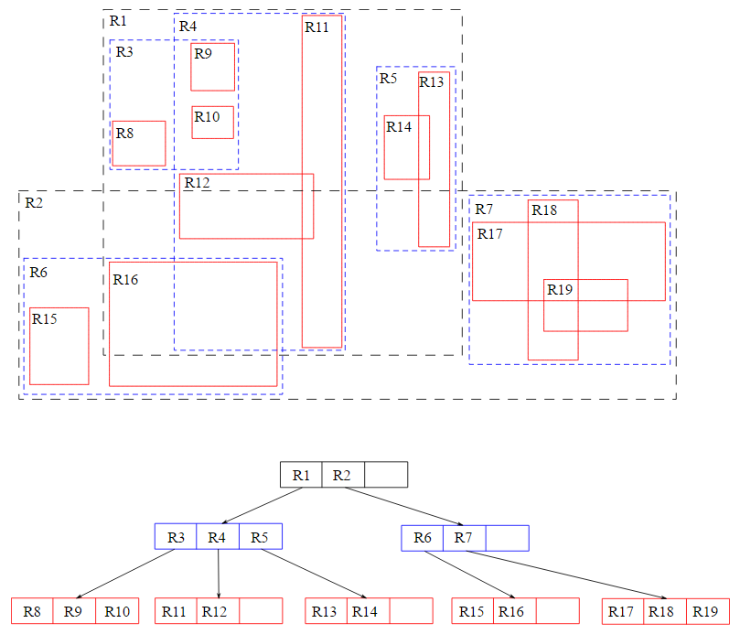
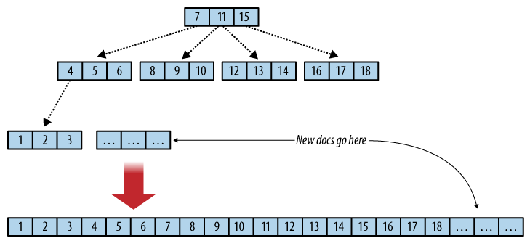
Database Concept: Indexing
B-Tree: One-dimensional index for normal queries
R-Tree: Multi-dimensional index for spatial queries

Slide 5
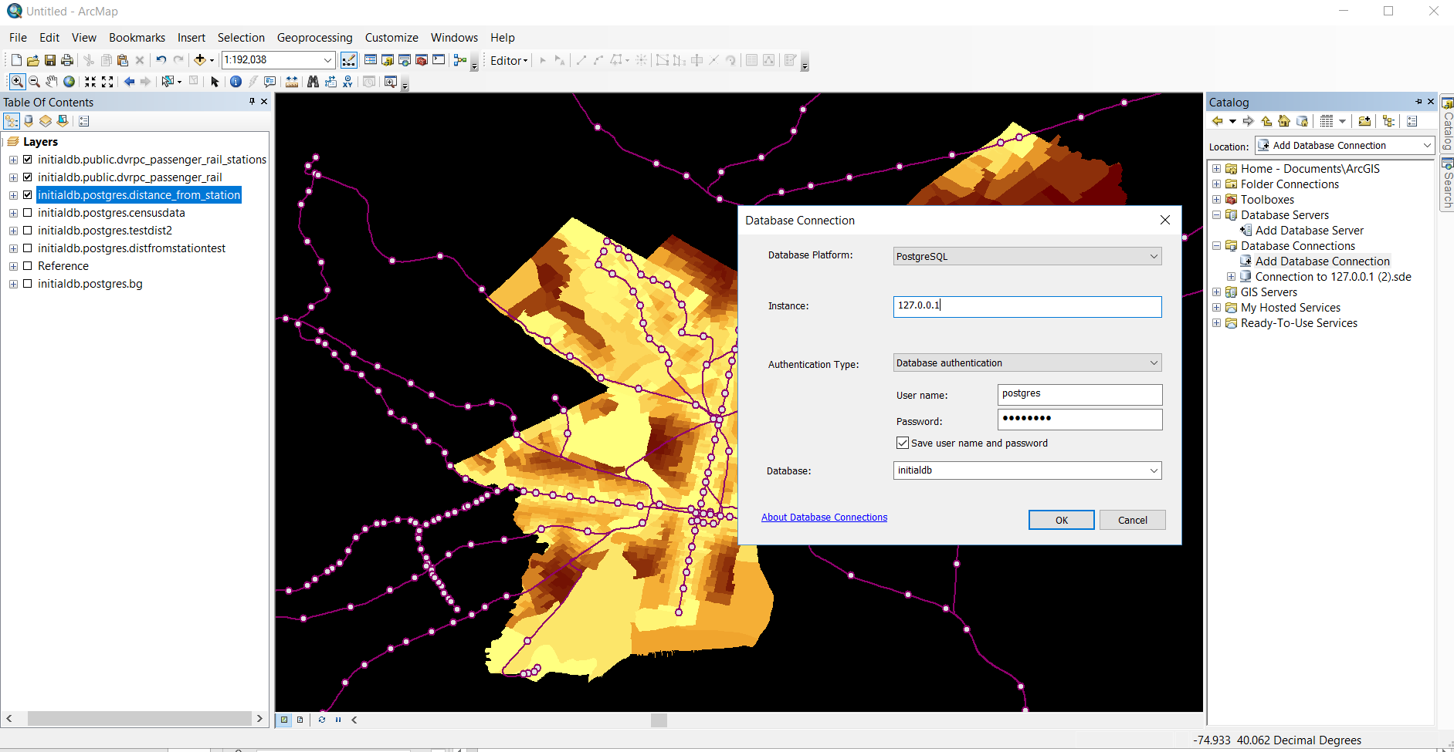
Database Connections in ArcMap
Catalog > Add Database Connection

Slide 6
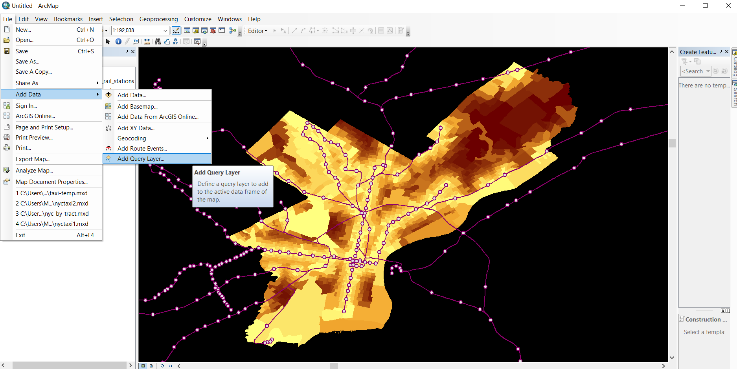
Spatial Queries in ArcMap
File > Add Data > Add Query Layer

Slide 7
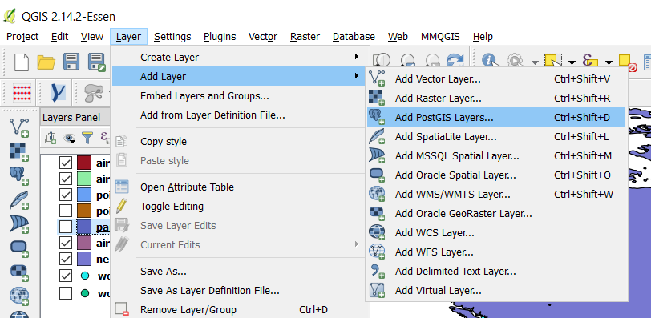
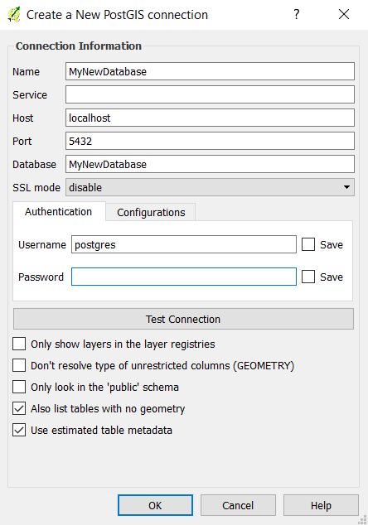
Database Connections in QGIS
Create a new connection with the settings below
Database = the database you created in PGAdmin
Username = the username you created when you installed PGAdmin
Open QGIS. In the menu at the top select Layer > Add Layer > Add PostGIS Layers

Slide 8
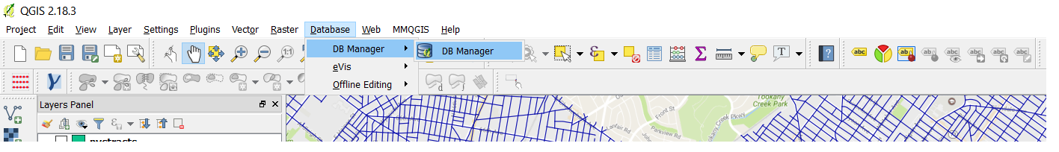
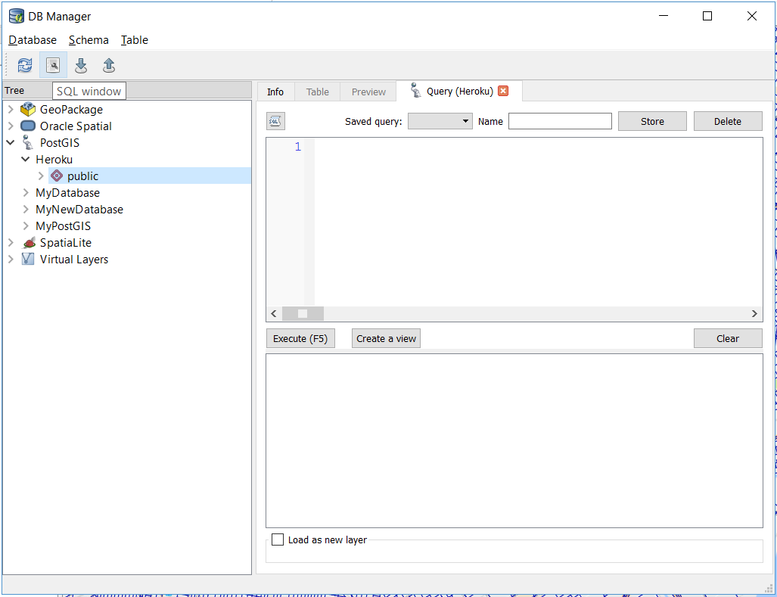
Spatial Queries in QGIS (With DB Manager Plugin)
1. Database > DB Manager > DB Manager
2. Select the database and press the “SQL window” button

