Slide 1
Web Scraping 1
Topics
Web inspector: examine the structure of a webpage
Web scraping: legal/ethical considerations
CSS selectors: a “query language” for HTML documents
MUSA 620: Week 5

Slide 2
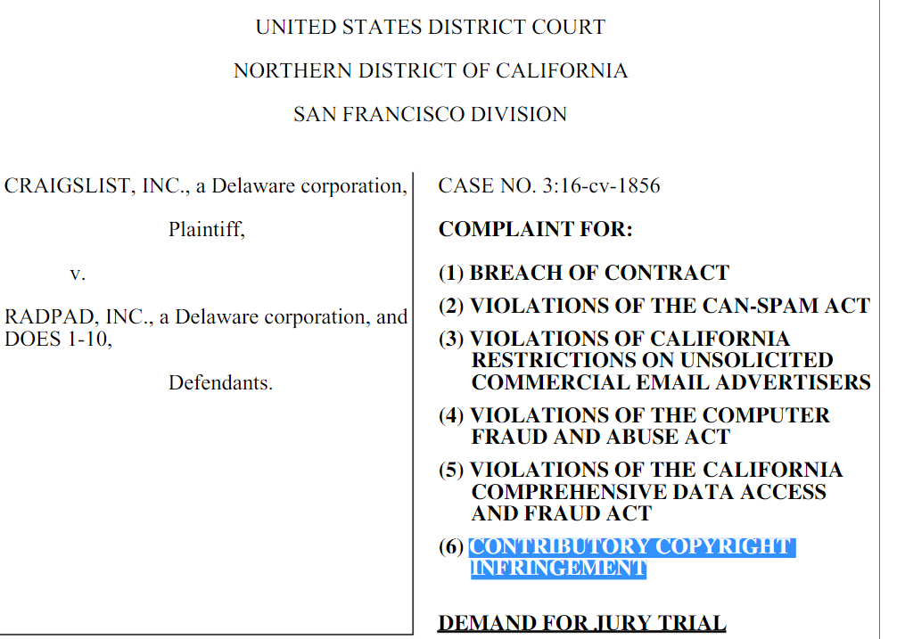
Legal Issues: Two Types of Claims
Copyright infringement
Terms of use violation
Only creative works can receive copyright protection. Facts cannot.
Examples:
Facts (no copyright): listing price for a home, number of floors, square footage.
Creative works (copyright): written description of a home, photographs.
Generally, must meet three standards:
Unauthorized: Is scraping prohibited in the website’s terms of use?
Intentional: Was the person aware of the terms? Did they check an “I agree to these terms” box?
Causes damage: Did the scraping overload the website, blocking user access?

Slide 3
Legal Issues: Continued
Web scraping defense
When web scraping is more likely to be ok
CAPTCHA
Web traffic monitoring
IP / user agent blocking
IP blacklists
Cease and desist letter
Legal action
.gov sites and [to a lesser degree] .edu sites
Website owner has no business reason to protect the information
IF not prohibited in terms of use
Limited number of requests
Not too many requests all at once
Done at night, when web traffic is low
Web scraping defense defense
When it’s less likely to be ok
NEVER WITH SEARCH ENGINES
E-commerce sites (e.g. Zillow, Expedia, Amazon)
Social media
If prohibited in terms of use
Large number of requests
High frequency of requests
Proxies
VPN (Virtual Private Network)
Simulating human behaviors (mouse movements, delays)

Slide 4
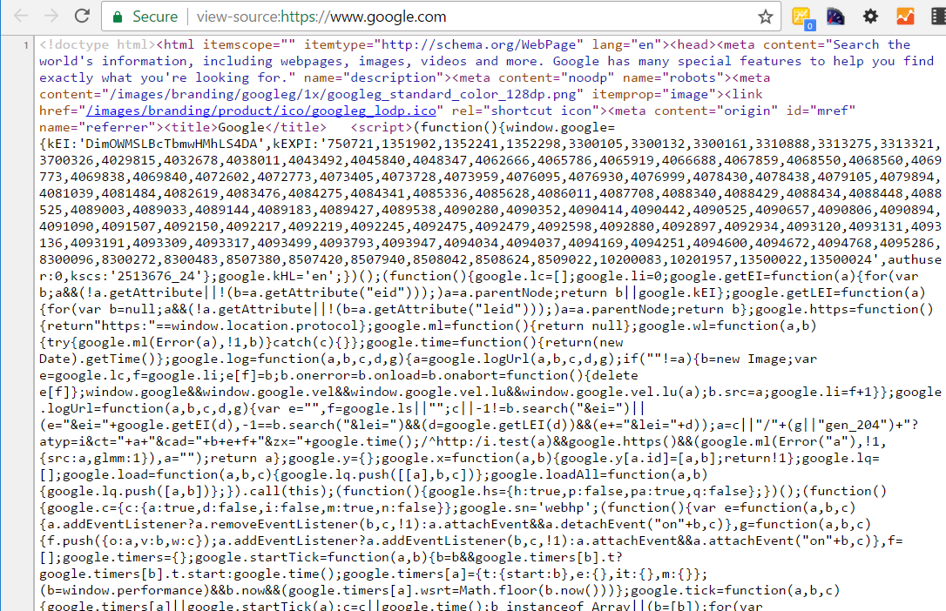
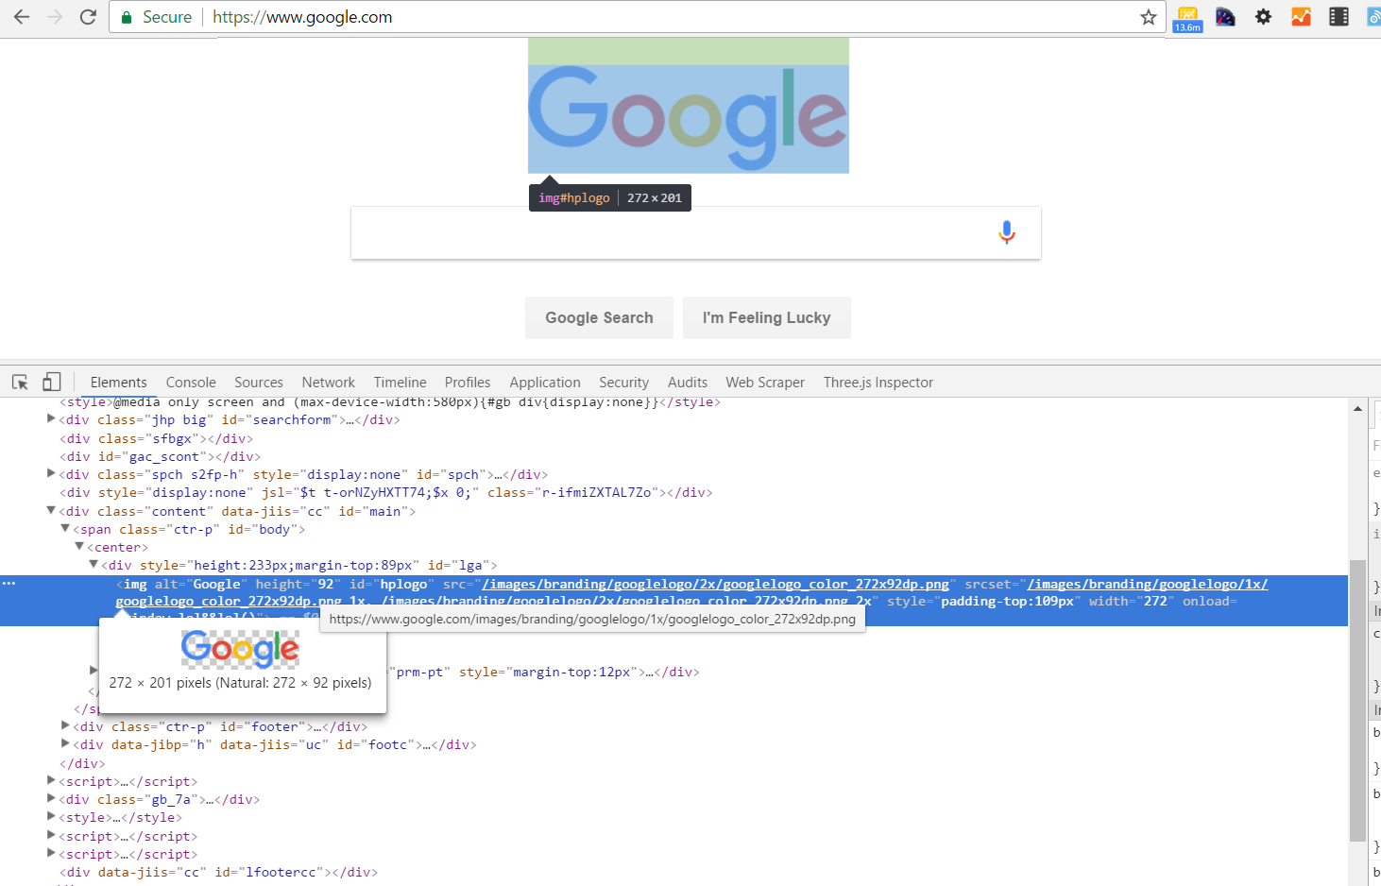
Web Definitions: HTML Document vs DOM
HTML Document An HTML document is a static document that describes the structure of a web page.
DOM (Document Object Model) The DOM is a dynamic HTML object that describes the structure of a web page in its current state.
What a web crawler sees (usually)
What a web browser sees

Slide 5
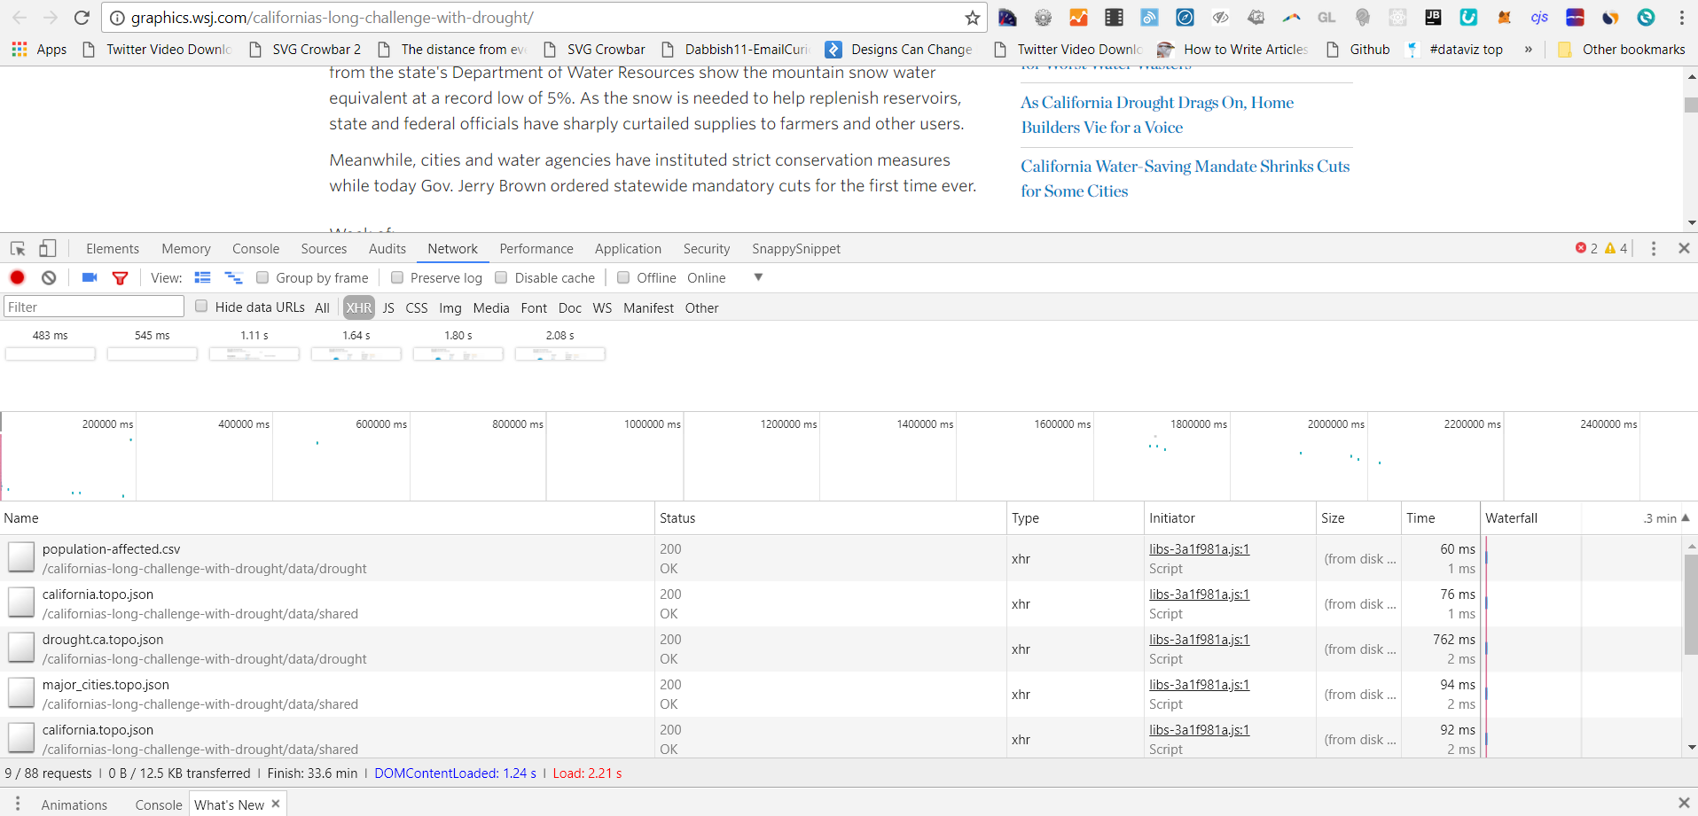
Getting to Know Your Browser’s Web Inspector
Web scraping is annoying and error-prone, so it should not be your first option. Often you can access a webpage’s data directly via your browser’s web inspector.
Open your browser and press F12

Slide 6
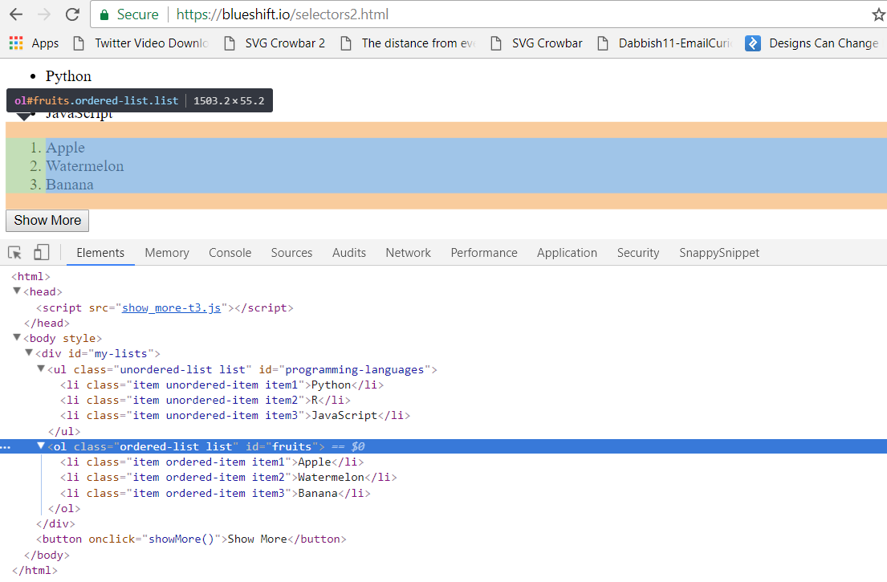
Web Inspector: Elements Tab
The Elements tab allows you to inspect the DOM directly
This tab will be helpful when building our web scrapers, but it has many other uses too…

Slide 7
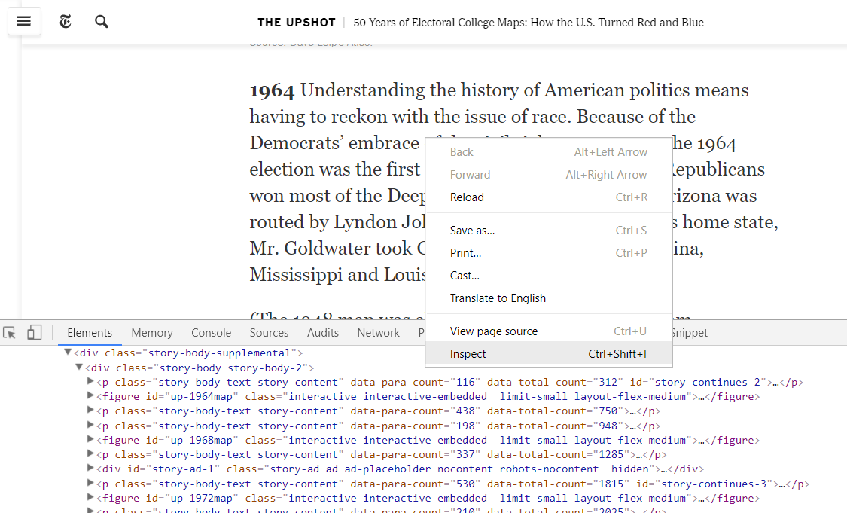
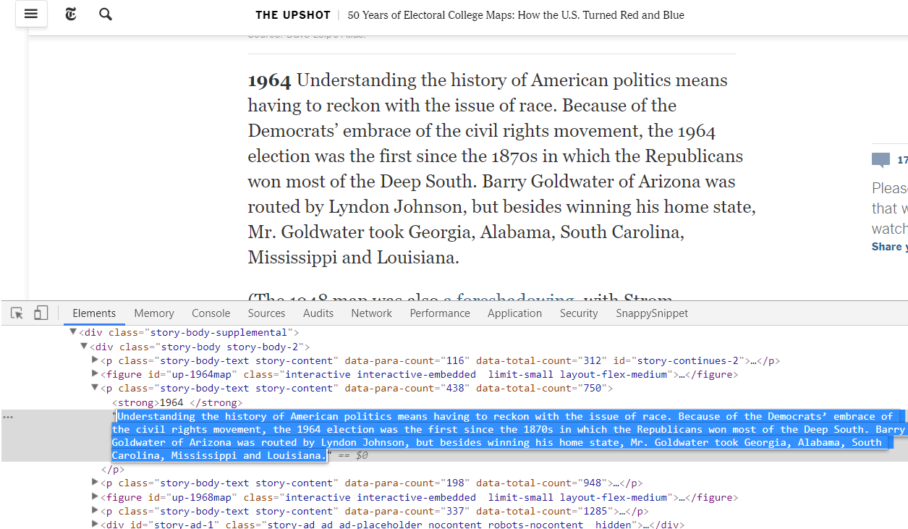
Web Inspector: Elements Tab
Grab text from sites that have disabled copying
Right click on the element you want to copy >> Inspect
In the Web Inspector pane, double click on the text and copy
https://www.nytimes.com/2016/08/23/upshot/50-years-of-electoral-college-maps-how-the-us-turned-red-and-blue.html

Slide 8
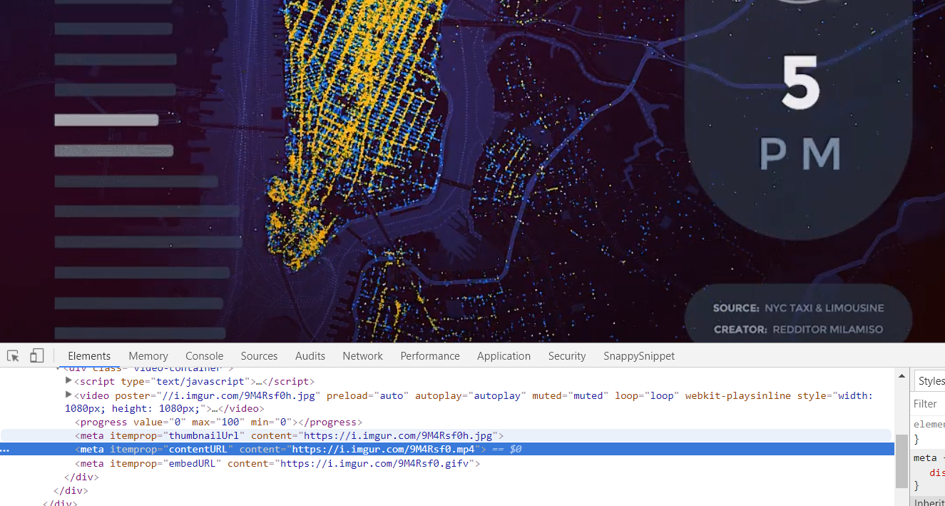
Web Inspector: Elements Tab
Find and download hidden image or video files
You can often find the URL of media files by exploring the DOM This one can be downloaded in .mp4 format from R using download.file()
https://i.imgur.com/9M4Rsf0.gifv

Slide 9
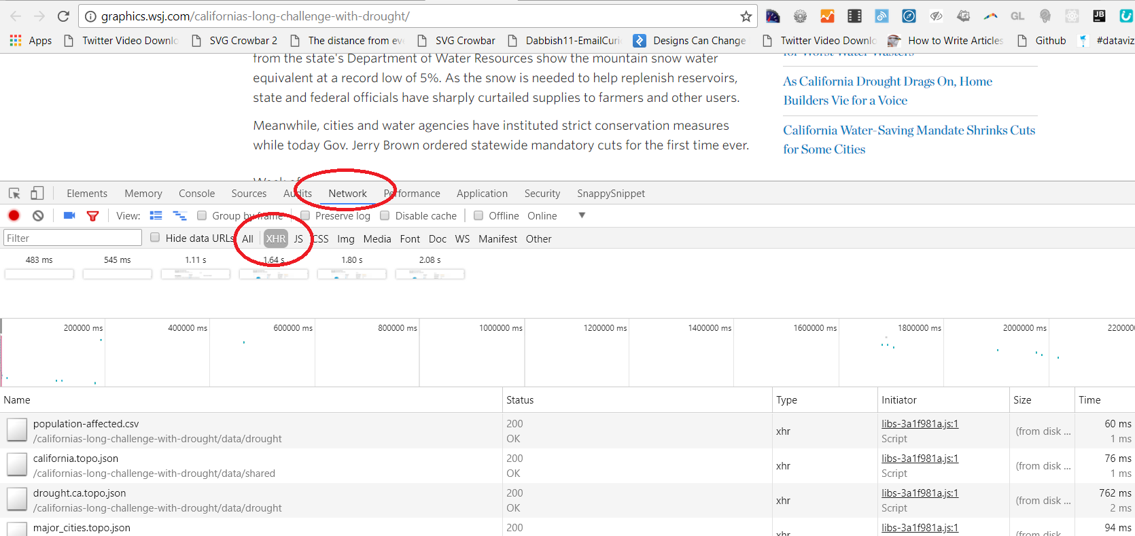
Web Inspector: Network Tab
The Network tab shows AJAX requests, files requested by the webpage after the initial HTML has loaded
Select XHR (XML HTTP Requests) to view requests for data

Slide 10
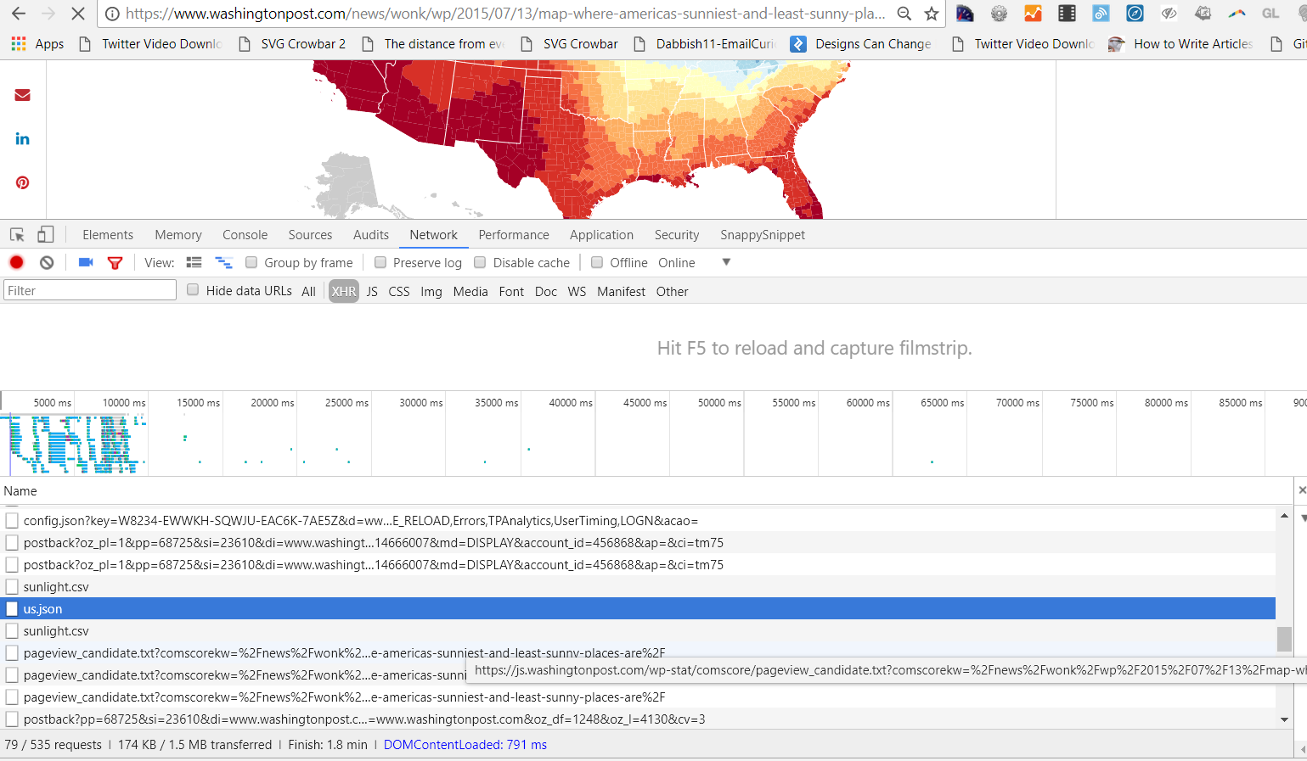
Web Inspector: Network Tab
GIS data will usually have a .json extension (geojson or topojson files) You may have to sort through a lot of junk to find what you’re looking for
https://www.washingtonpost.com/news/wonk/wp/2015/07/13/map-where-americas-sunniest-and-least-sunny-places-are/

Slide 11
Web Scraping

Slide 12

Web Definitions: Element, Tag, & Attribute
Element:
Tags:
Attributes:

Slide 13
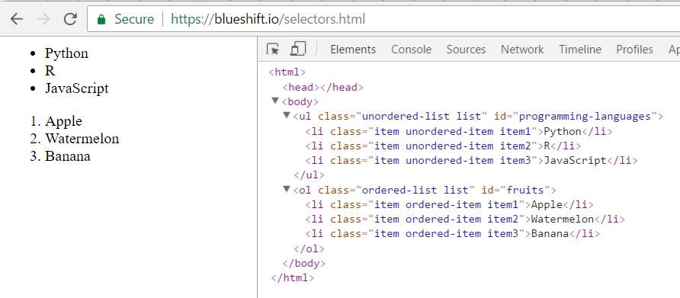
Selecting HTML Elements
Using the HTML elements, tags, and attributes shown here, how would you write a SQL-style query to return:
Python, R, JavaScript
Python, Apple
Apple, Banana
R

Slide 14
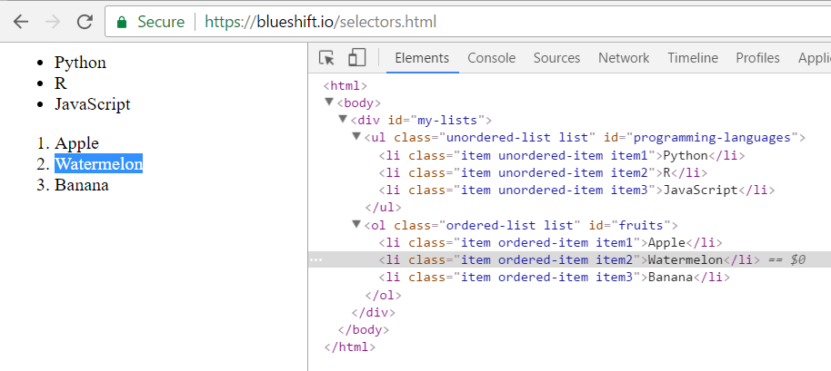
Web Definitions: Selectors
Describing the element you want to “select”
Basic Selectors
Class (e.g. “item”, “ordered-list”)
ID (e.g. “my-lists”, “fruits”)
Tag (e.g. “div”, “li”)
Complex Selectors
CSS Selectors
XPath

Slide 15
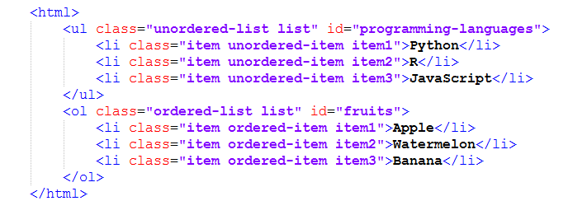

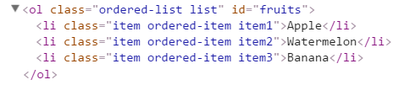

Basic Selectors: Class, ID, Tag
findElements("class name", "item1") ->
findElement("id", "fruits") ->
findElements( ‘tag name', “li") ->

Slide 16
Basic Selectors: Understanding IDs and Classes
IDs serve as unique identifiers. No two elements on a page will have the same ID.
Classes can be unique, but more often they function as categories. Often many elements will have the same class (there are six elements above with the class “list”). Also a single element may have many different classes (the “Python” element above has three: item, ordered-item, and item1).

Slide 17
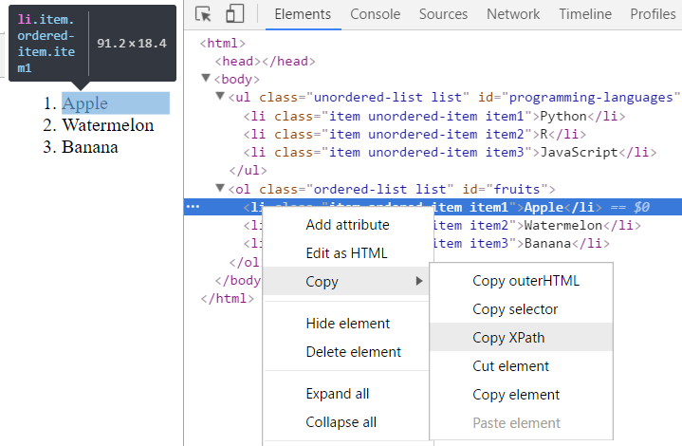
Complex Selectors: CSS & XPath
NOTE: Don’t get overwhelmed by the syntax. Your browser will give it to you.
For our purposes, there is no need to understand how these complex selectors work. But, as a reference…

Slide 18
CSS selectors (Not Always Complex)
CSS prefixes:
Period (.) = class
Hash (#) = id
No prefix = tag
Simple Selectors
CSS Equivalent
findElements("class name", "item1") =
findElement("css selector", “.item1")
findElement("id", "fruits") =
findElement("css selector", "#fruits")
findElements( ‘tag name', “li") =
findElements('css selector', "li")

Slide 19
Complex Selectors: XPath, CSS
CSS allows for compound selectors (“>” symbol means child elements)
findElement("css selector", "#programming-languages > .item2") ->
XPath selector for the same element
findElement(using = ‘xpath', value = “//*[@id=" programming-languages "]/li[2]") ->

Slide 20
The pages we looked at today were static. Dynamic web scraping next week…
Static pages
Dynamic pages
The simpler method involves downloading a web page’s HTML Document and parsing it. For simple web pages, this works great.
The more complex method involves parsing and manipulating the DOM – interacting with the web page as a human would, through a web browser. For web pages that rely on JavaScript (the majority, unfortunately), this is the only option.

