Slide 1
Web Scraping 2
Topics
Data visualization: light color scales on dark backgrounds
CSS selectors: a “query language” for HTML documents
Web scraping: static and dynamic webpages
MUSA 620: Week 7

Slide 2
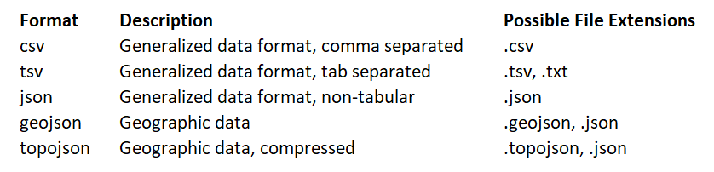
Recap: Data Formats
Data formats to look for in the web inspector network tab

Slide 3

Web Definitions: Element, Tag, & Attribute
Element:
Tags:
Attributes:

Slide 4
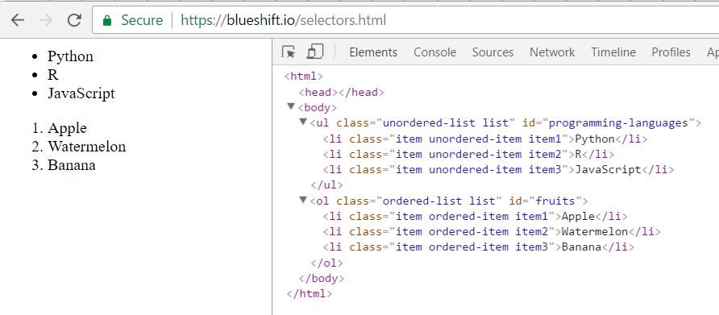
Selecting HTML Elements
Describing an HTML selection
Using the HTML elements, tags, and attributes shown here, how would you write a SQL-style query to return each of these?
Python, R, JavaScript
Python, Apple
Apple, Banana
R

Slide 5
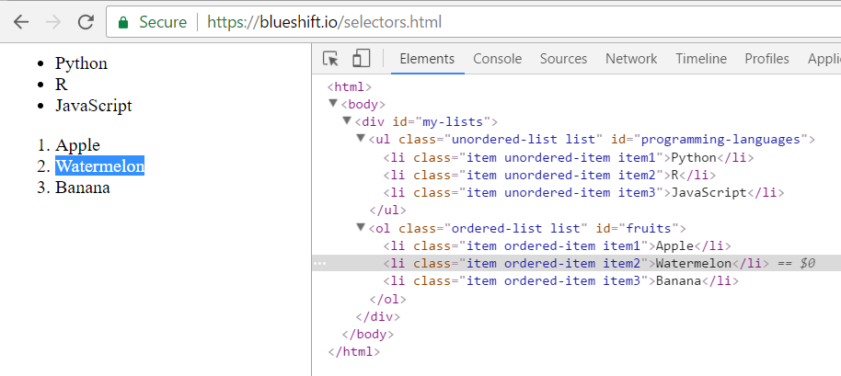
Web Definitions: CSS Selectors
Describing the element you want to “select”
Basic Selectors
Class (e.g. “.item”, “.ordered-list”)
ID (e.g. “#my-lists”, “#fruits”)
Tag (e.g. “div”, “li”)
Composite Selectors
“html > body > .my-lists > .unordered-list > li:nth-child(2)”
“#programming-languages > li[1]”
“body li[1]”

Slide 6
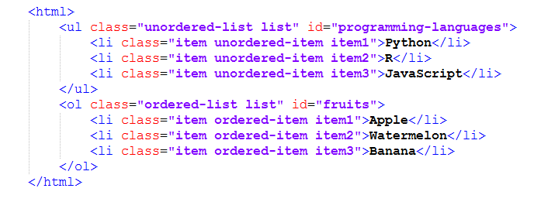

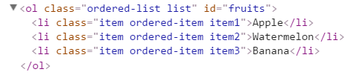

Basic Selectors: Class, ID, Tag
CSS prefixes:
. = class
# = id
No prefix = tag
“.item1" ->
“#fruits" ->
“.li" ->

Slide 7
Basic Selectors: Understanding IDs and Classes
IDs serve as unique identifiers. No two elements on a page will have the same ID.
Classes can be unique, but more often they function as categories. Often many elements will have the same class (there are six elements above with the class “list”). Also a single element may have many different classes (the “Python” element above has three: item, ordered-item, and item1).

Slide 8
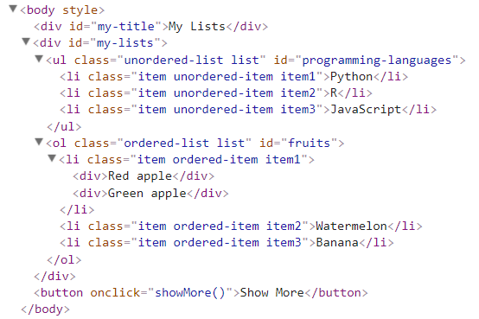
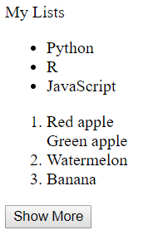
Compound Selectors
Other CSS syntax:
> = child of
space = decendant of
:nth-child(n) = nth child of its parent
Examples “body > div” = select all div’s immediately beneath a “body” tag “body div” = select all div’s beneath a “body” tag
“div:nth-child(2)” = select all div’s that are the 2nd child of their parents
Which elements will be selected?
https://blueshift.io/selectors3.html

Slide 9
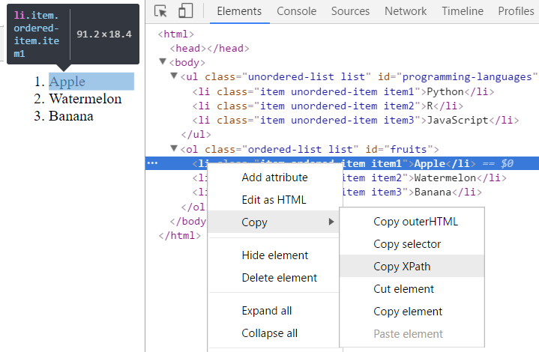
Getting CSS Selectors From Your Browser
NOTE: Don’t get overwhelmed by the syntax. Your browser will give it to you.

Slide 10
Web crawler vs web scraper
How are they different?

Slide 11
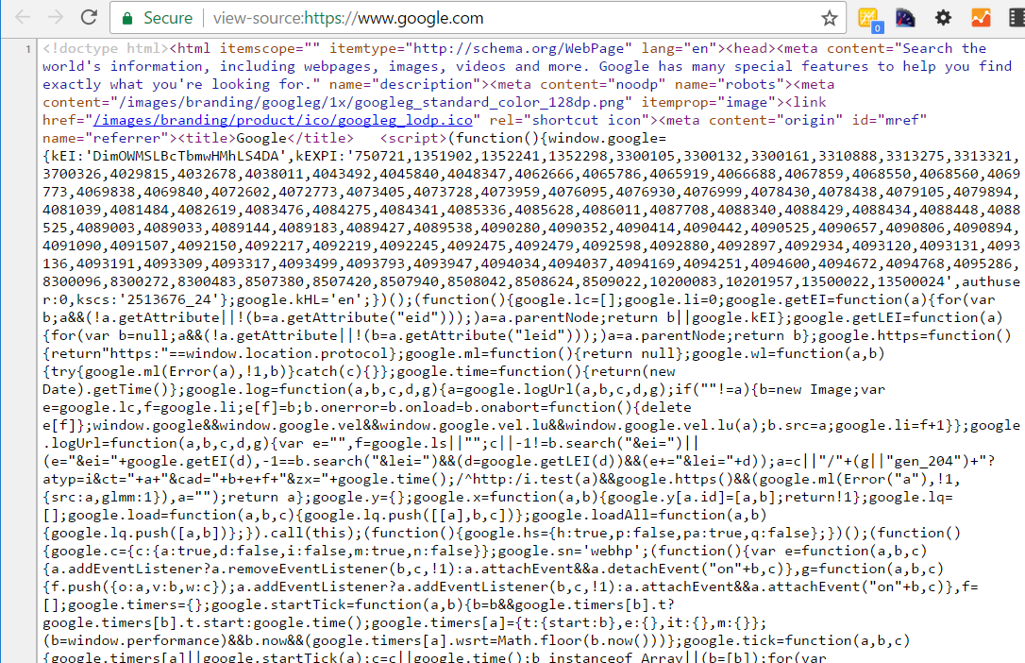
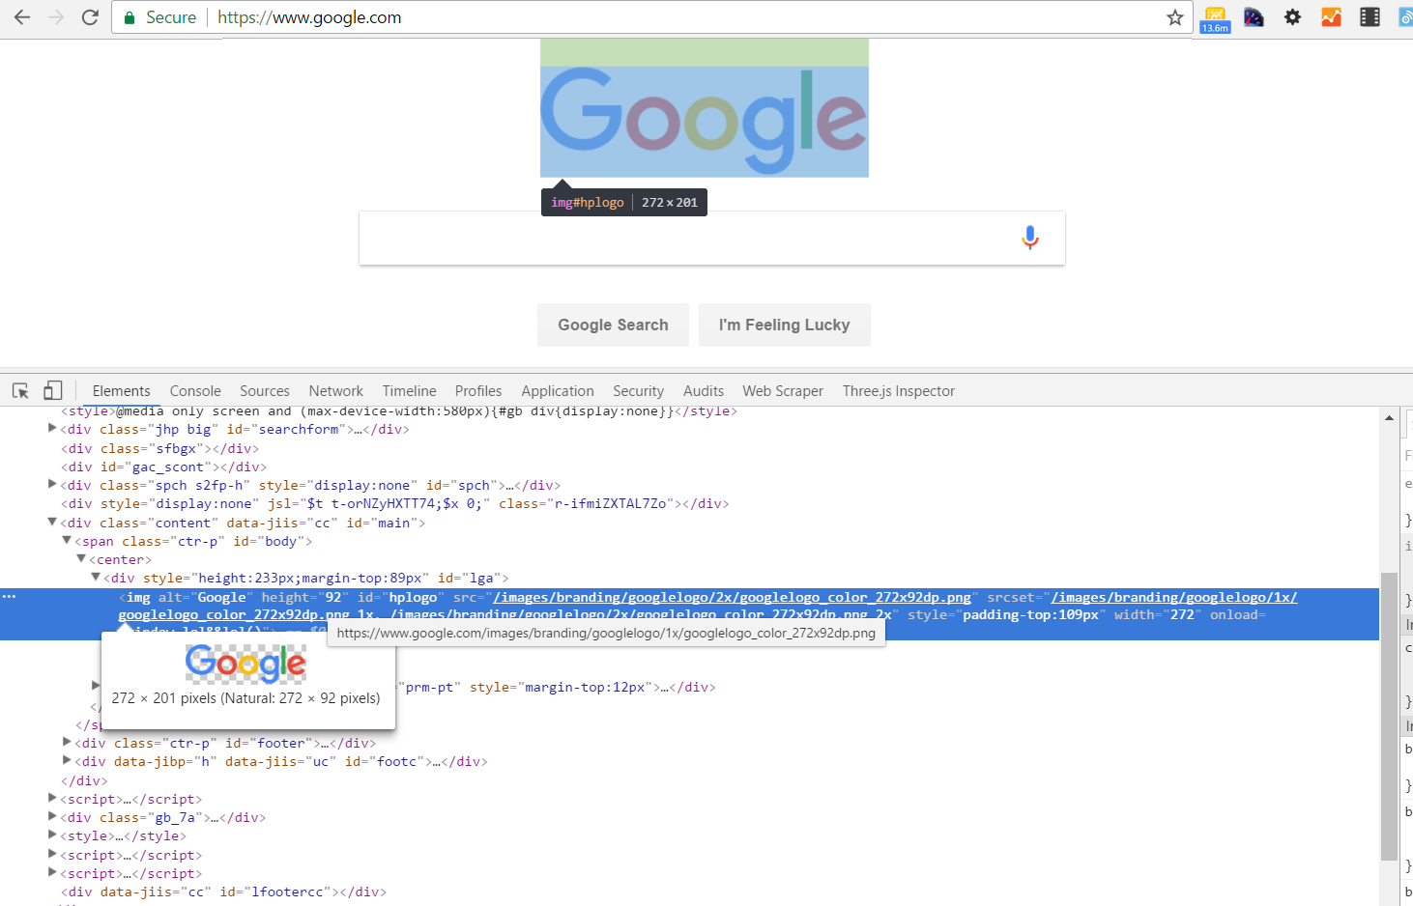
Refresher: HTML Document vs DOM
HTML Document An HTML document is a static document that describes the structure of a web page.
DOM (Document Object Model) The DOM is a dynamic HTML object that describes the structure of a web page in its current state.
What a web crawler sees (usually)
What a web browser sees

Slide 12
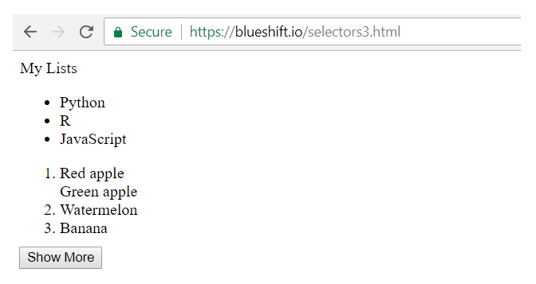
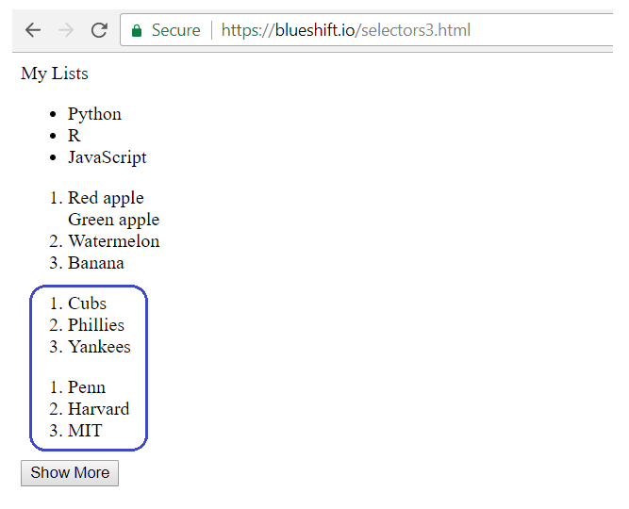
Dynamic Web Content
How do you scrape data that only appears after user interaction?
https://blueshift.io/selectors3.html

Slide 13

Selenium
But first, we need to set it up…

Slide 14
Two Types of Web Scraping: Static / Dynamic
Static pages
Dynamic pages
The simpler method involves downloading a web page’s HTML Document and parsing it. For simple web pages, this works great.
The more complex method involves parsing and manipulating the DOM – interacting with the web page as a human would, through a web browser. For web pages that rely on JavaScript (the majority, unfortunately), this is the only option.

