Slide 1
Twitter API
MUSA 620: Week 8

Slide 2
Two Important Concepts
The Twitter API is a great example of two concepts that are becoming increasingly more important.
APIS
Semi-structured Data

Slide 3
If you were building a webpage whose sole
was to be scraped, how would you design it?

Slide 4
What is an API?

Slide 5
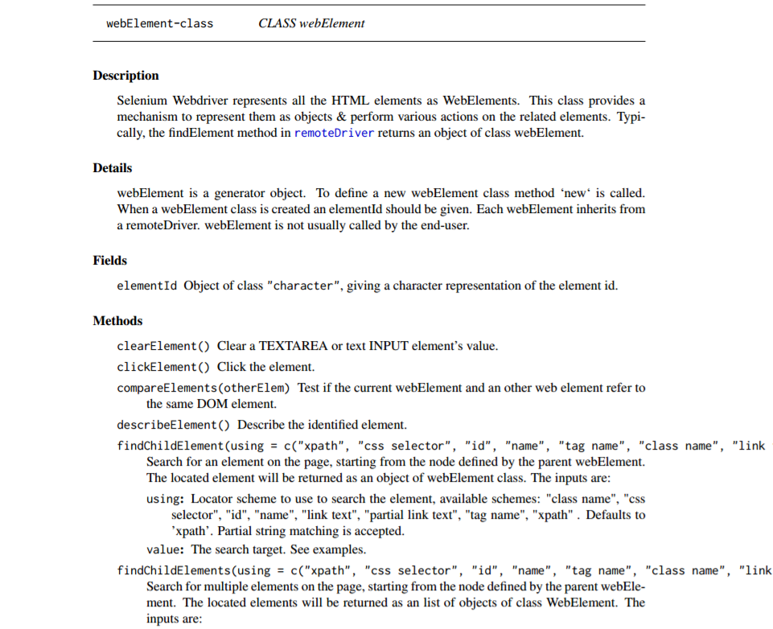
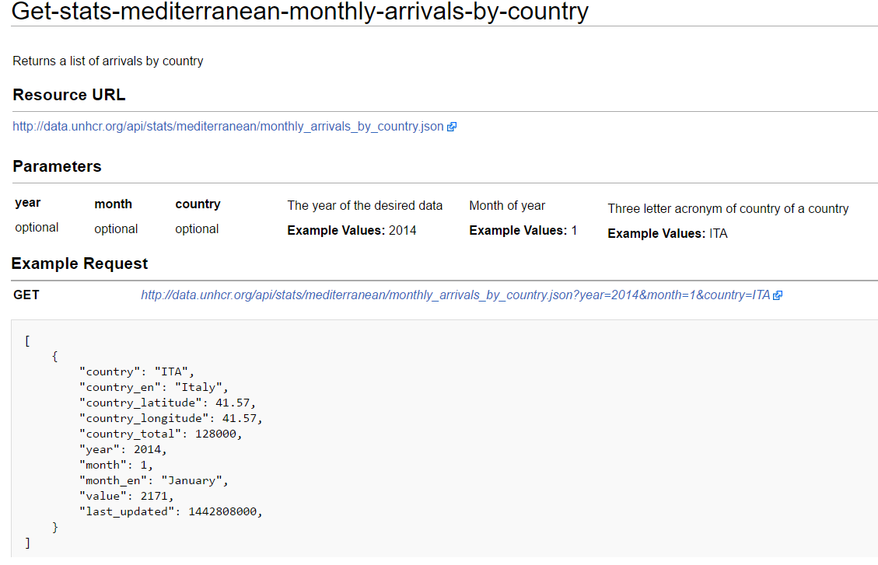
API (Application Program Interface)
Technical definition
What it usually means
Generically, API refers to any set of commands used by programmers to interact with an application / system
More often, API is used to describe a methods for pulling data from a remote system
The API for RSelenium
UN Refugee Agency REST API

Slide 6
API (Application Program Interface)
There are many other types of APIs, but these are the most common
REST API / RESTful API (Representational State Transfer): Make a request to a remote server, it responds by sending data. The request takes the form of a URL with query string parameters, just like a web page. Essentially, REST APIs are webpages that are designed for easy scraping. Example request: http://data.phila.gov/resource/npdr-96qp.json?parcel_number=881607040
Streaming API: Like a REST API, except that the connection remains open and the server “pushes” information to you instead of responding to requests.
Data is usually returned in .json (JavaScript Object Notation) format, but can also be .csv, .xml or others.

Slide 7
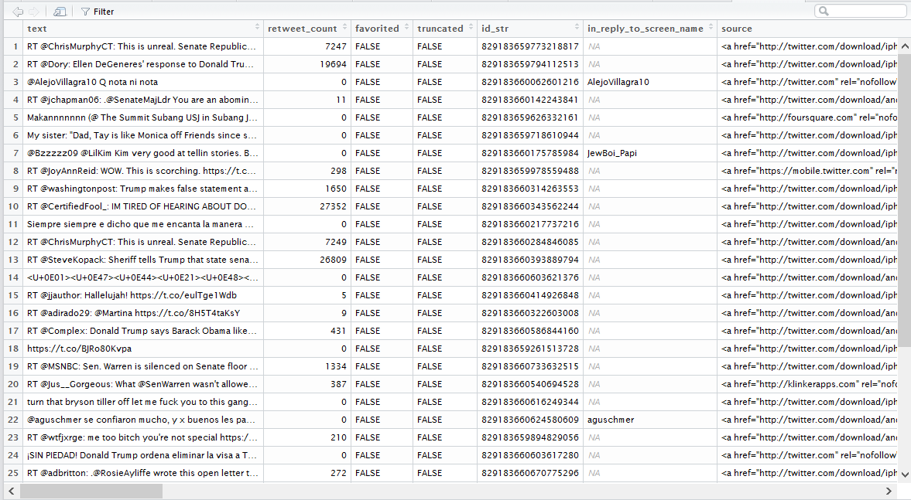
Semi-Structured Data
Structured data: Data that is machine readable. What most people think of as “data.”
Unstructured data: Data that is not machine readable: human-readable text, images, audio, etc.
Semi-structured data: Contains some structure, but has unstructured elements

Slide 8
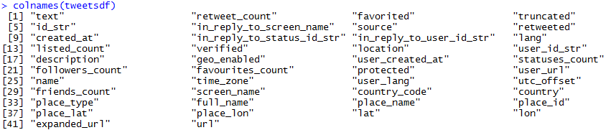
Twitter Streaming API
Input Fields
Track: keywords to filter
Follow: twitter users IDs (not usernames like @galka_max)
Lang: filter by language
Loc: filter by location (coordinate bounding box)
Output Fields

