Slide 1
Text Mining
Topics
Regular expressions
Natural language processing
Sentiment analysis: Trump’s tweets – confirming he only writes the [angrier] ones in the morning
MUSA 620: Week 9

Slide 2
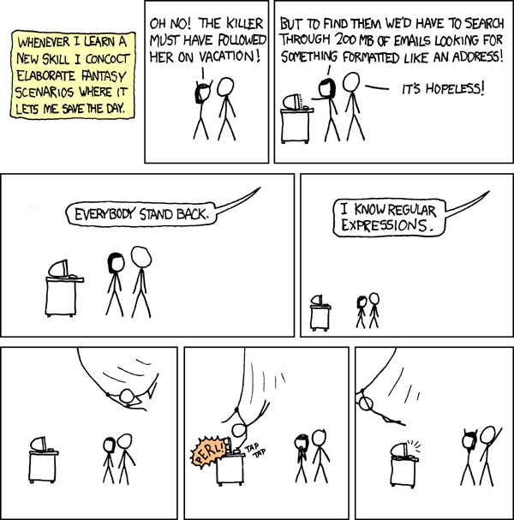
Text Mining: Regular Expressions (Regex) -- Wildcards on Steroids
xkcd

Slide 3
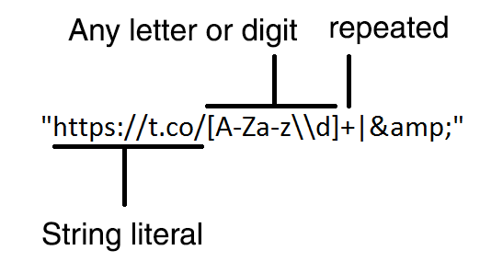
Text Mining: Regular Expressions (Regex)
Regular expressions are text strings for describing search patterns
This one looks for t.co links in a tweet (for example, https://t.co/S8nZgmeMMV)
xkcd

Slide 4
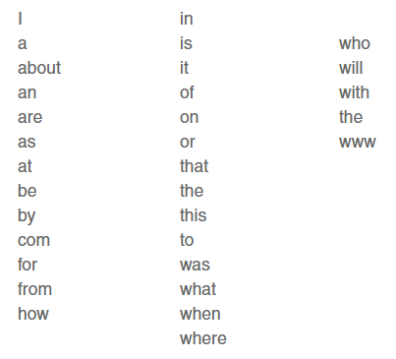
Text Mining: Stop Words
Stop words: common words that do not carry much significance and are often ignored in text analysis. There is no standard list of stop words, but below are a few common examples.

Slide 5
Text Mining: Tokenizer / Parser
Tokenizer: breaks text into sentences, words, letters, symbols or some other meaningful elements (these elements are called tokens).
Parser: takes the tokens and organizes them into some sort of data structure, usually a tree. This definition is different from the one used in computer programming. A parser in computer programming (for example, rvest) is what we are calling here a tokenizer.

Slide 6
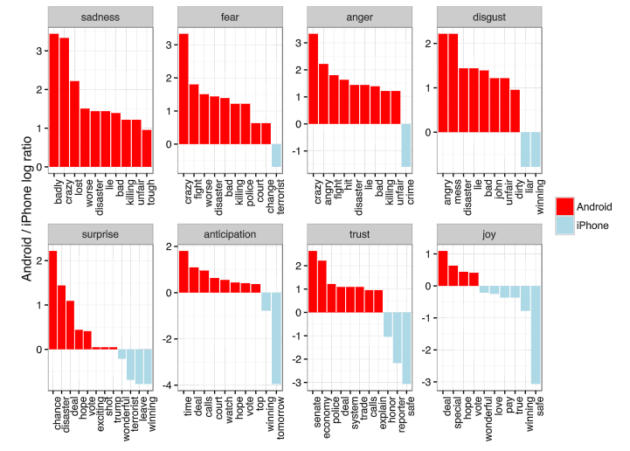
Sentiment Analysis
The analysis of a block of text to derive the attitude or emotional state of the speaker – used by brands to evaluate public opinion about a product
Sentiment analysis of Donald Trump’s tweets: Android vs iPhone

Slide 7
Text Mining: Other Definitions
Semantic data: data that is structured to represent “meaning.” It is commonly in the form of triples: [object A, object B, the relationship between them]. Example: [Pennsylvania, USA, “A is a subregion of B”]
Named entity recognition (NER): methods for searching a block of text for items matching a predefined category of object (names, places, organizations). Example: to classify a collection of news stories by the country in which they took place, you might use an NER algorithm to search the text for the mention of places.
Ngram: chunks of text (tokens) that have been extracted from a body of text. -- normally ngram is synonymous with “word.”
Corpus: a large collection of texts used for statistical analysis, often for the purpose of “training” a natural language processing algorithm.

