Slide 1
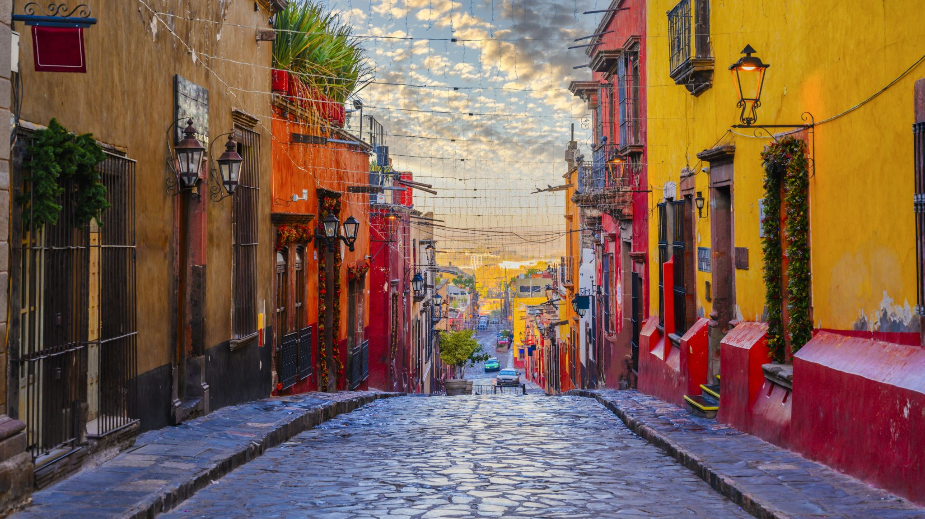
Mexico City HHTS Summary

Slide 2
City to City trips
2007: 124417 trips
2017: 99577 trips (excluding walking); 141775 trips (with walking)

Slide 3
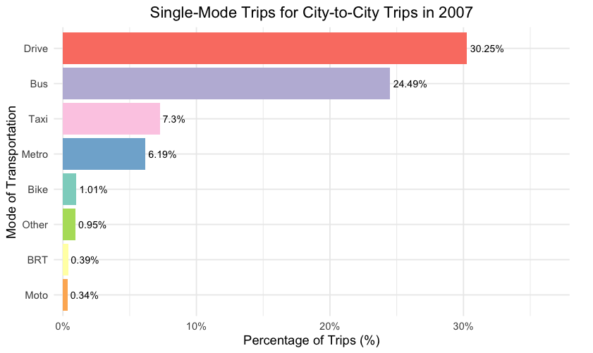
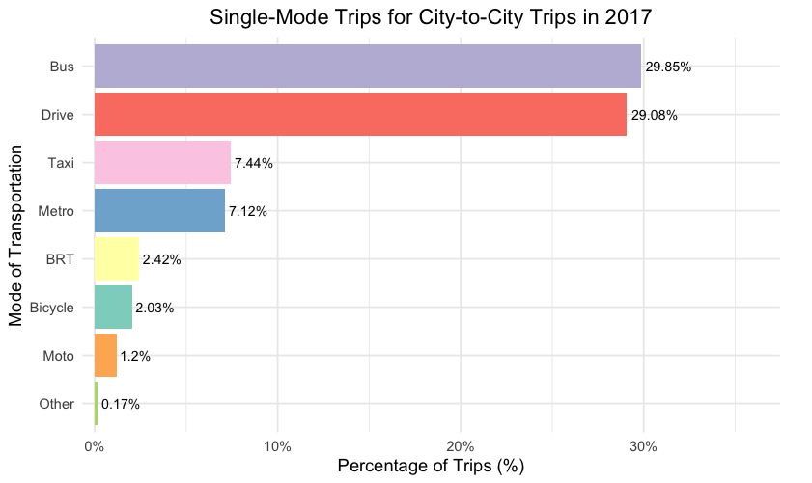
Single mode trips share

Slide 4
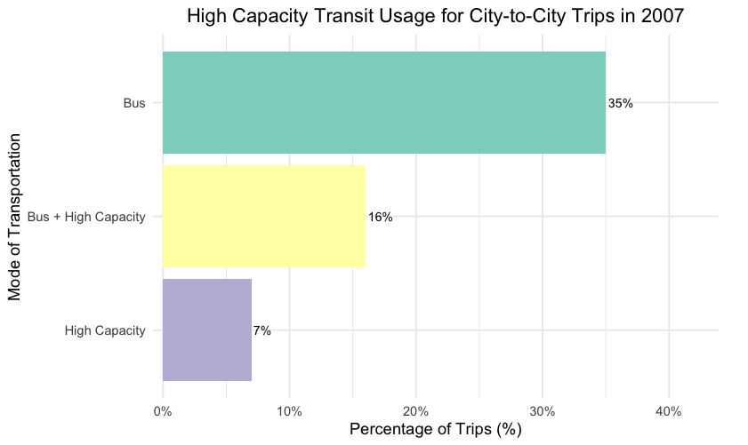
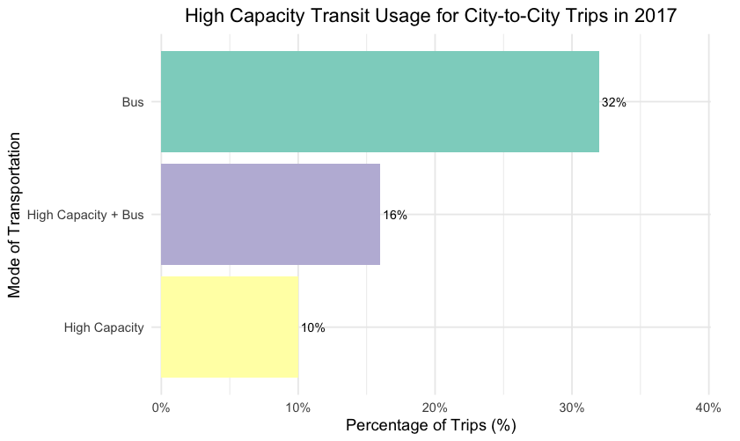
Bus vs High Capacities

Slide 5
Suburb to Suburb trips
2007: 81671 trips
2017: 79380 trips (excluding walking); 143520 trips

Slide 6
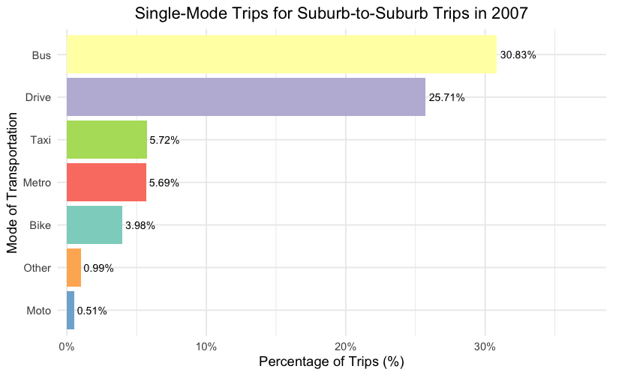
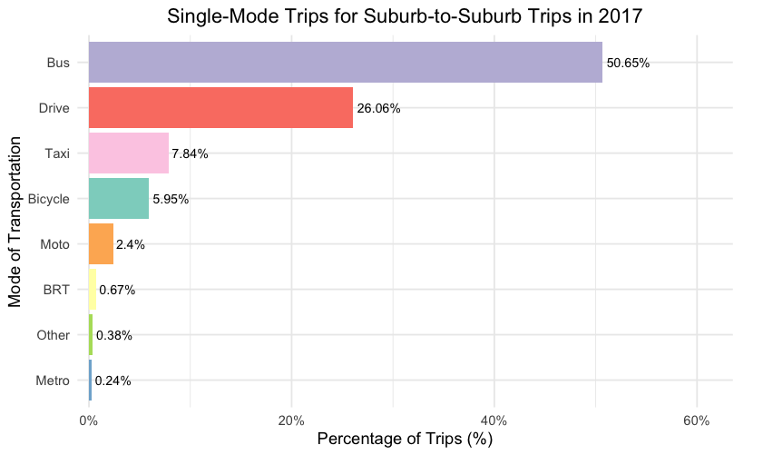
Single Mode share

Slide 7
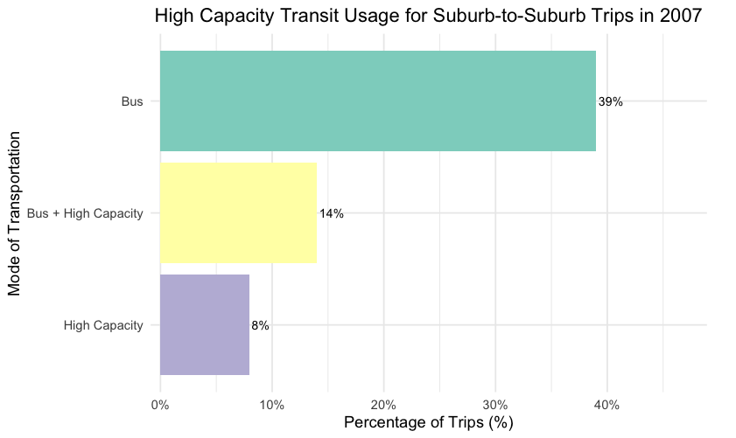
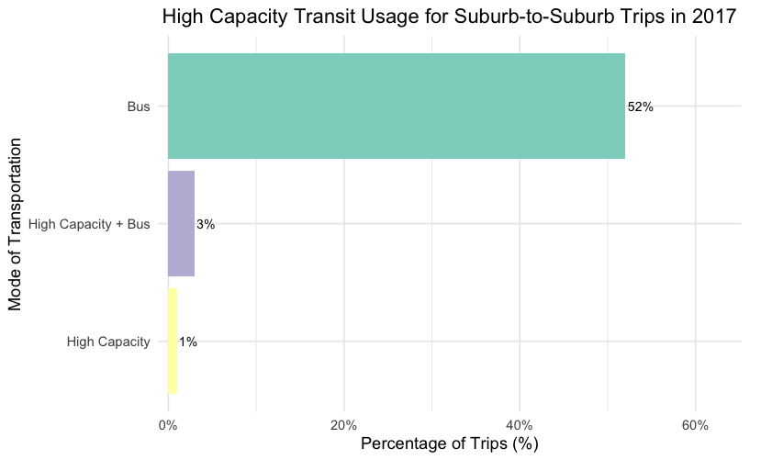
Bus vs High Capacities

