Slide 1
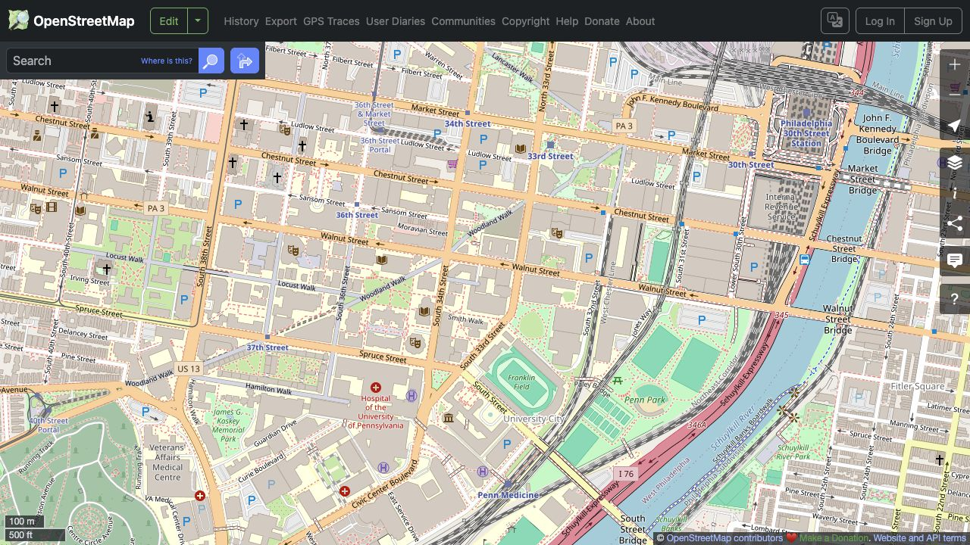
OpenStreetMap
and street networks
MUSA-5500 · Week 8
Zhanchao Yang
A map, a few features, and a walking route
01
Notes:
时间：0–2
先说今天先认识地图数据，再写几行 Python。不要先抛出完整可达性模型。今天所有例子都回到熟悉的 University City。

Slide 2
What is OpenStreetMap
A street? A building? A station?
© OpenStreetMap contributors
02
Notes:
时间：2–5
请学生指出三个熟悉对象。先观察，不解释 graph。邀请他们说说平时用地图时，哪些东西会被忽略。地图来源：https://www.openstreetmap.org/#map=16/39.9520/-75.1910

Slide 3
What is OpenStreetMap?
An editable geographic database.
People contribute locations, shapes, and descriptions of places.
03
Notes:
时间：5–8
介绍 OSM：开放的地理数据库，可以编辑、下载和重新使用。网页底图是这些数据的一种显示方式。可用 Wikipedia 作协作模式类比，但不把它说成完全相同的治理机制。来源：https://www.openstreetmap.org/about

Slide 4
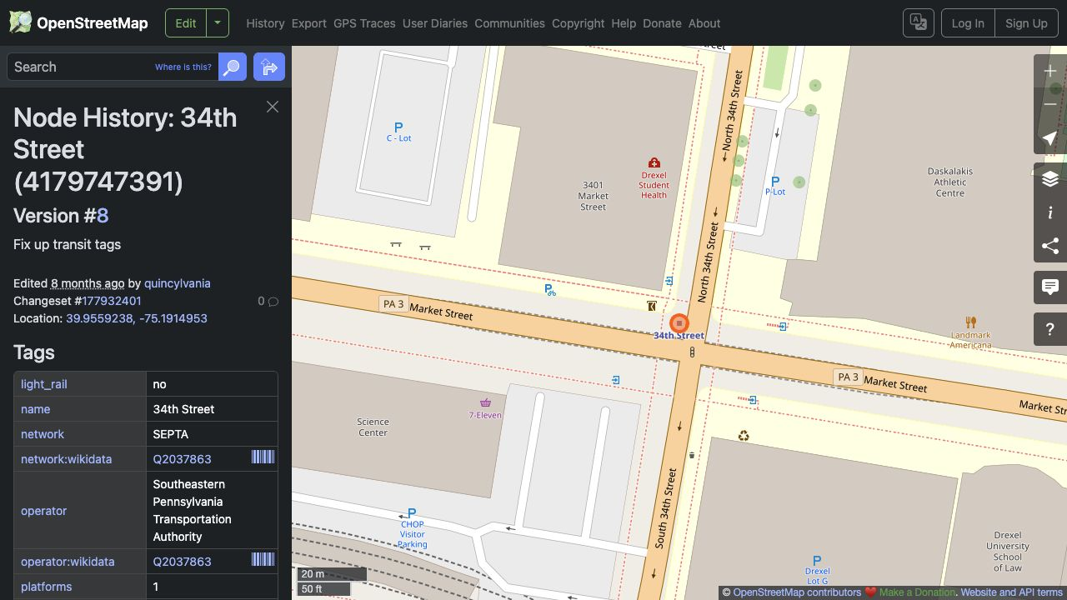
Who maintains the map?
A real object has an edit history.
A contributor can add a station, adjust its location, or improve its tags.
© OpenStreetMap contributors
04
Notes:
时间：8–11
用站点 history 讲人如何维护数据。截图显示真实对象的编辑版本。不要讲抽象 VGI 定义一整页。问：一个刚开业的咖啡馆会立即出现在地图上吗？来源：https://www.openstreetmap.org/node/4179747391/history

Slide 5
How does OSM store a city?
OSM object | What it stores | A familiar example
Node | One coordinate | A station or crossing
Way | An ordered list of nodes | Locust Walk or a building outline
Relation | Objects grouped with roles | A transit route or a complex area
05
Notes:
时间：11–13
这页只给三个词，然后用接下来的真实对象逐个展开。强调 way 是节点序列，闭合 way 是否表示面积取决于 tags。来源：https://wiki.openstreetmap.org/wiki/Elements

Slide 6
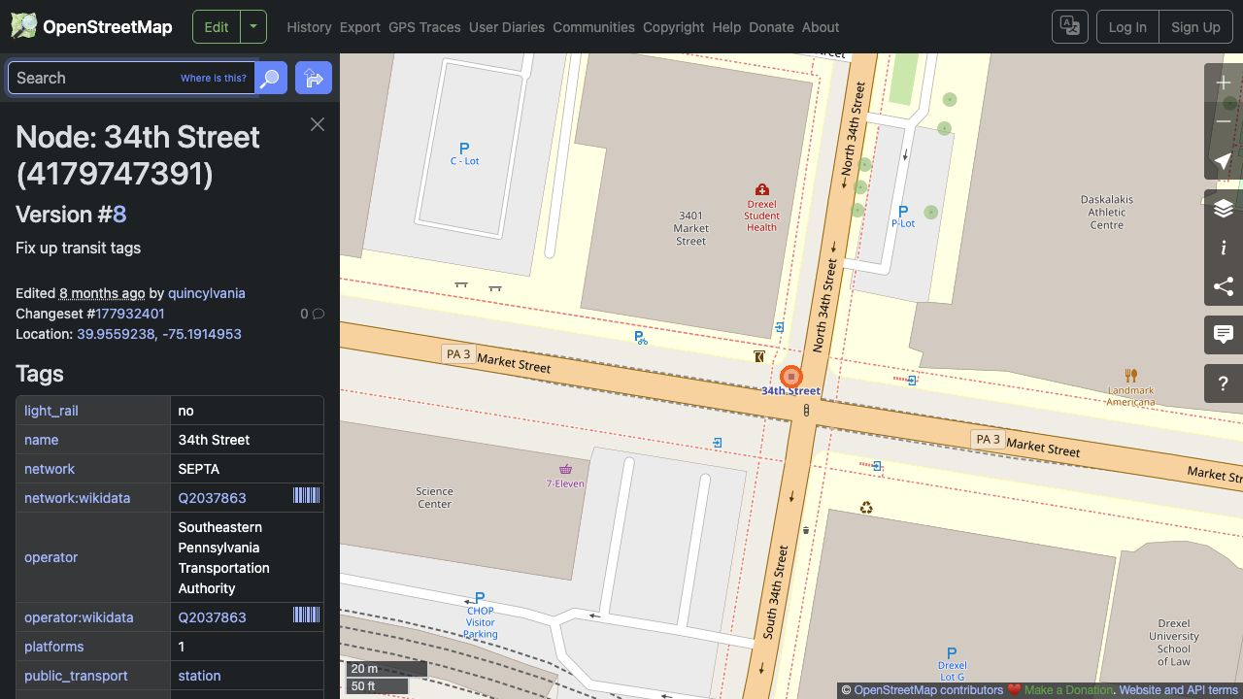
A station is a point with a description
34th Street station: one OSM node, several tags
© OpenStreetMap contributors
06
Notes:
时间：13–16
让学生找 name 和 network。OSM node 不等于 graph intersection：站点也是 node，但不一定是街道交叉口。网页来源：https://www.openstreetmap.org/node/4179747391

Slide 7
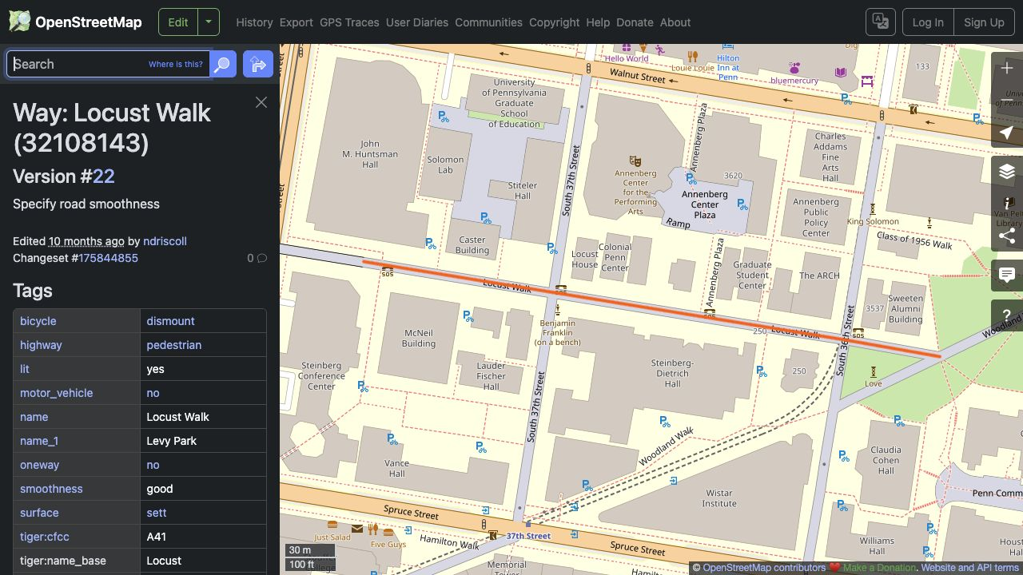
Locust Walk is an ordered line
The highlighted way carries a pedestrian tag.
© OpenStreetMap contributors
07
Notes:
时间：16–19
请学生找 highway=pedestrian 和 motor_vehicle=no。让这个例子为后面的 walk / drive 比较埋伏笔。来源：https://www.openstreetmap.org/way/32108143

Slide 8
A relation groups existing objects
One transit route can contain many ways and stops.
The relation records how those objects belong together.
08
Notes:
时间：19–21
relation 讲到理解即可，不进入原始 XML 和 Overpass syntax。举公交路线由多段街道和站点组成的例子，不宣称本课程后面会写 relation 解析。来源：https://wiki.openstreetmap.org/wiki/Elements

Slide 9
Tags turn geometry into meaning
Key | Value
name | Locust Walk
highway | pedestrian
motor_vehicle | no
surface | sett
Which tag explains
who can use
this path?
09
Notes:
时间：21–23
这是 Locust Walk 真实对象的四个标签。提问：哪一个标签最能解释为什么这里可以走路、通常不能开车？答 highway 和 motor_vehicle。来源：https://www.openstreetmap.org/way/32108143

Slide 10
What might the map miss?
A missing footpath.
A closed entrance.
A cafe that just opened.
10
Notes:
时间：23–26
https://www.openstreetmap.org/about

Slide 11
How can we use these data in Python?
OSM supplies the data.
OSMnx helps us work with them.
First: find a place and retrieve a few features.
11
Notes:
https://xiaojianggis.github.io/MUSA-5500-Geospatial-Data-Science-Python/labs/week-8-network-analysis/week-8A-street-network.html ; https://osmnx.readthedocs.io/en/stable/user-reference.html

Slide 12
Our first notebook cells
import osmnx as ox
import geopandas as gpd
One cell at a time. Run it, inspect it, then continue.
12
Notes:
时间：29–30
打开 01_OSM_Step_by_Step.ipynb，§1。完整 imports 在 notebook。cache 设置只是让已有下载可以重复使用，课堂不展开。原 tutorial 同样使用 import osmnx as ox。

Slide 13
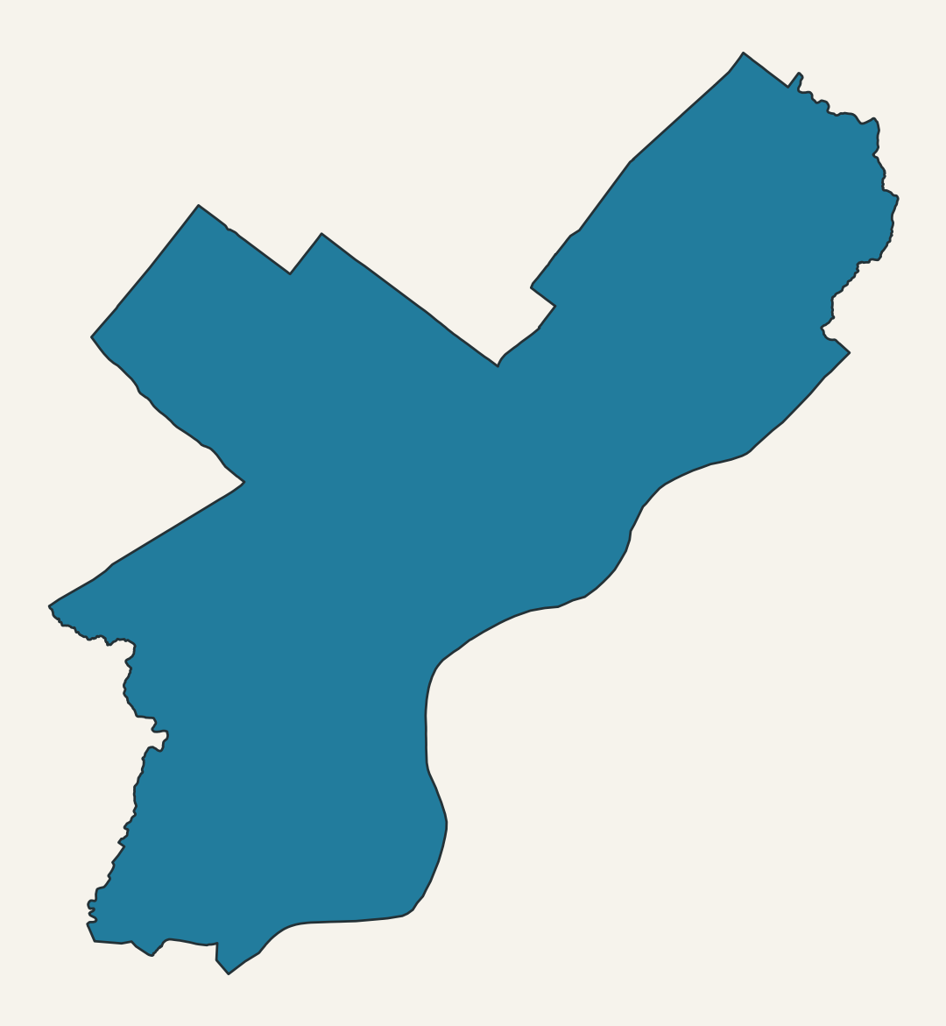
First, find Philadelphia
philly = ox.geocode_to_gdf(
"Philadelphia, Pennsylvania, USA"
)
philly.plot()
Notebook §2
© OpenStreetMap contributors
13
Notes:
时间：30–35
学生运行 §2。先看输出 GeoDataFrame，再看边界。问函数返回的是地图图片还是可以继续分析的数据？答 GeoDataFrame。若下载有问题，打开离线备用版相同位置。来源：https://osmnx.readthedocs.io/en/stable/user-reference.html

Slide 14
A buffer needs meaningful units
philly.crs
philly_m = philly.to_crs(
"EPSG:32618"
)
Longitude / latitude gives degrees.
Our local projection gives meters.
© OpenStreetMap contributors
14
Notes:
时间：35–38
这页不展开投影理论。让学生读 CRS，再说后面800m圆圈为什么不能直接用经纬度做。图是相同边界的投影结果，可作为重复教学比较。来源：https://osmnx.readthedocs.io/en/stable/user-reference.html

Slide 15
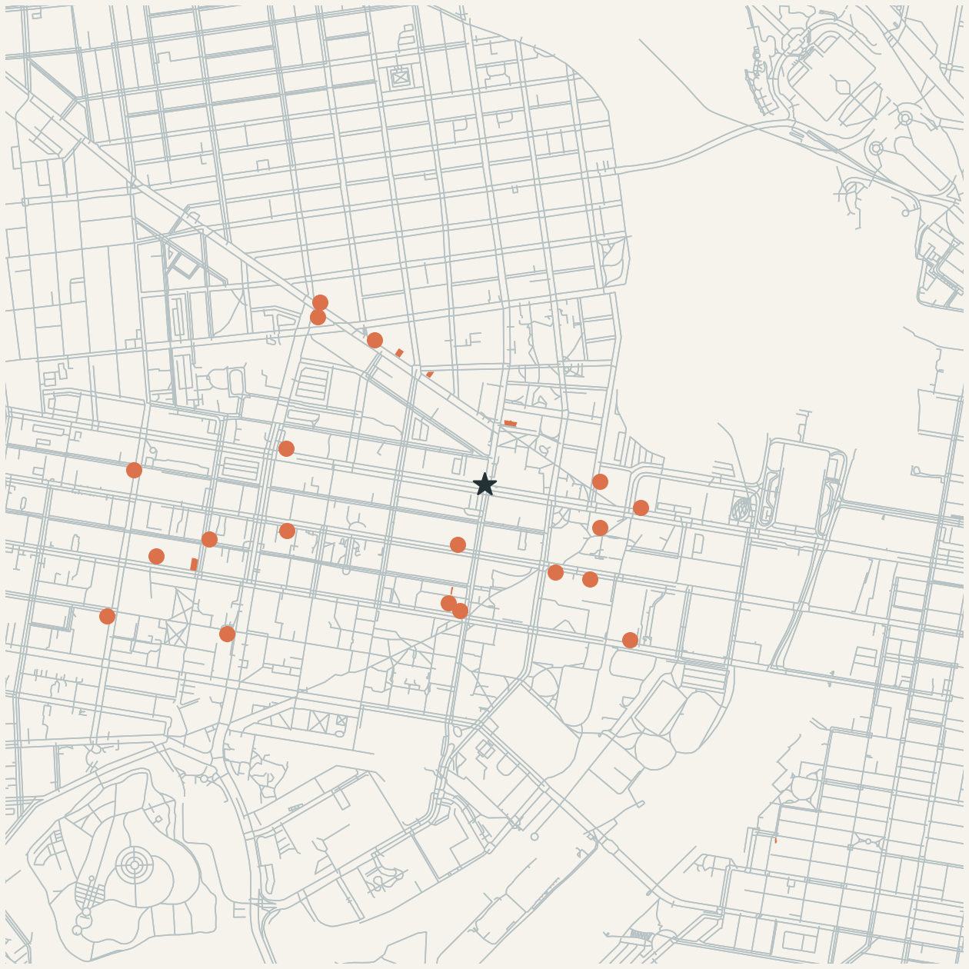
What is around 34th Street?
center = (39.9559238, -75.1914953)
cafes = ox.features_from_point(
center,
tags={"amenity": "cafe"},
dist=1000
)
Notebook §3
© OpenStreetMap contributors
15
Notes:
时间：38–44
先让学生猜数量，再运行。point query 的 center 顺序是纬度、经度。图是本地 OSM cafe features，点/面均可能。地图数据：© OpenStreetMap contributors，ODbL 1.0。https://www.openstreetmap.org/copyright 。新版 notebook 同一份数据，2026-09-27 UTC 下载。

Slide 16
Inspect before plotting
cafes[["name", "amenity", "geometry"]].head()
Each row is an OSM feature.
Some features are points. Others are polygons.
16
Notes:
时间：44–47
在 notebook 的输出表停下来，读一行。name 可以缺失。25 条 cafe features 不一定等于25家经过验证的独立商户。不要展开去重 pipeline。来源：https://osmnx.readthedocs.io/en/stable/user-reference.html

Slide 17
Your turn: find restaurants
Which word would you change?
{"amenity": "cafe"}
17
Notes:
时间：47–50
让学生先口头回答 restaurant。有网且时间允许再实际修改查询，保留原咖啡馆 cell 可重新运行。若担心服务器等待，只改写代码并解释预期输出。这个活动是1行变化。

Slide 18
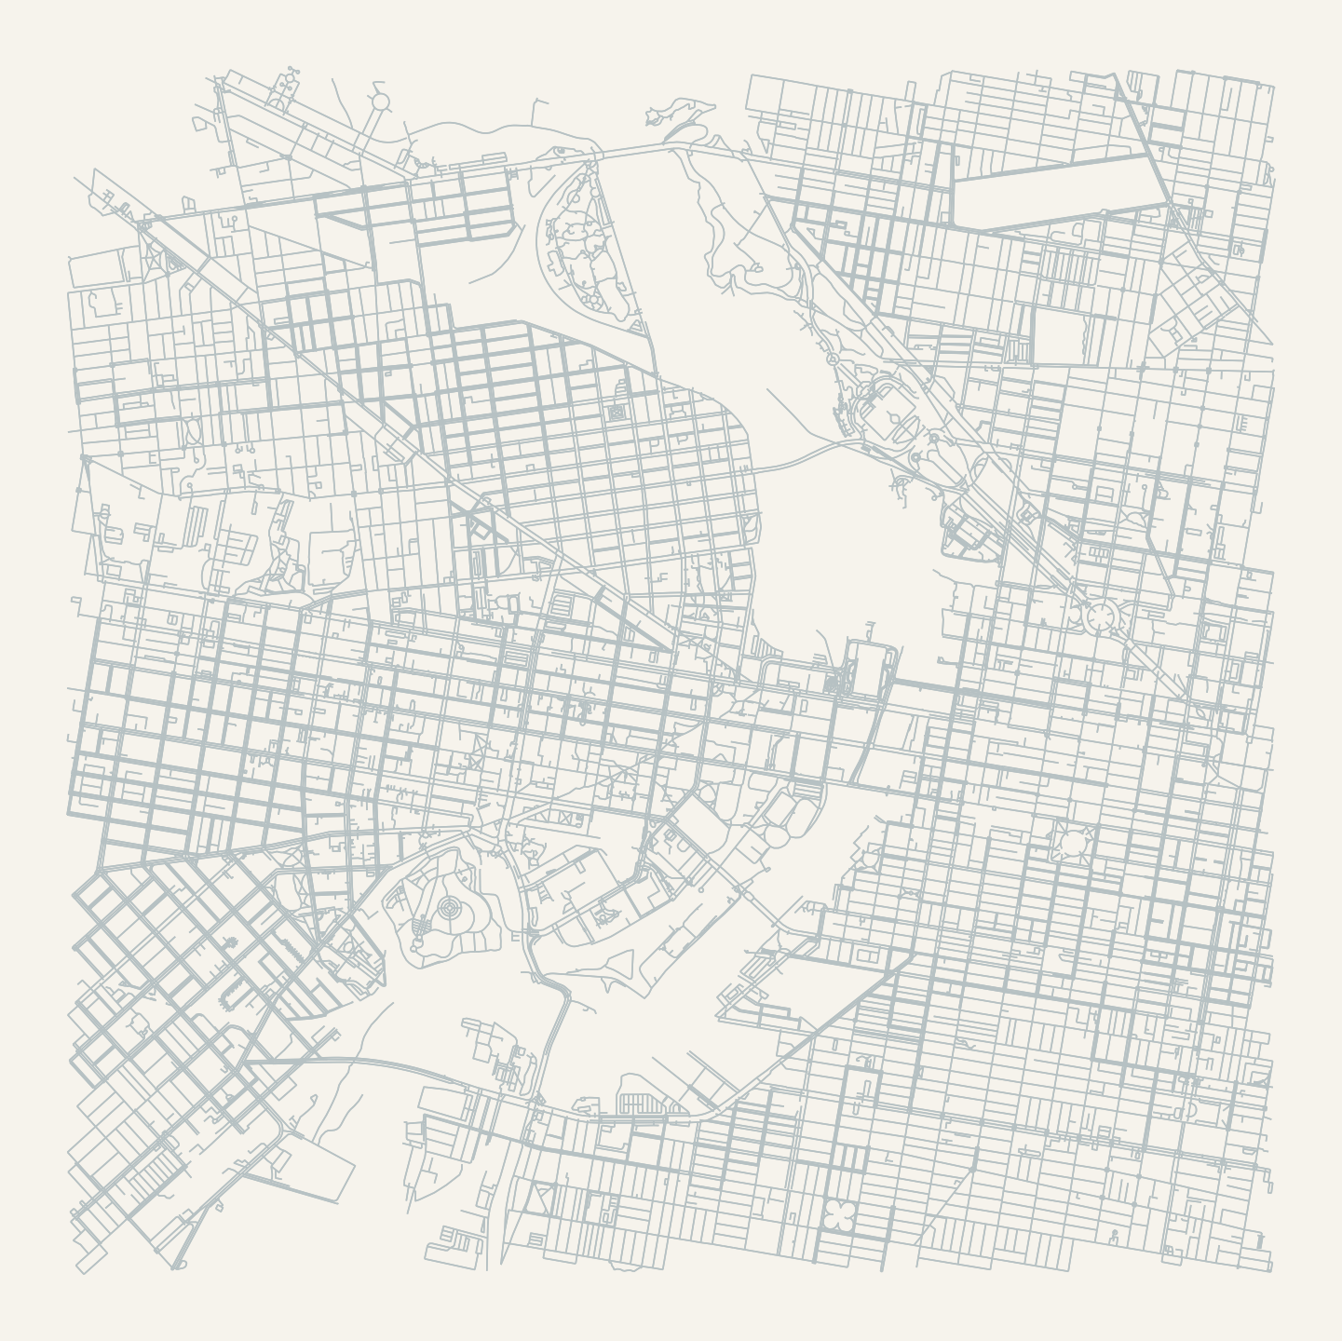
Now we want connections
G = ox.graph_from_point(
center, dist=2500,
network_type="walk"
)
ox.plot_graph(G, node_size=0)
Notebook §4
© OpenStreetMap contributors
18
Notes:
时间：50–56
解释为什么只画点不够回答怎么走。运行后先读形状，不急着定义 MultiDiGraph。下载大于之后分析的区域，给路线留余地。默认保留最大弱连通分量，这意味着本例不评估所有孤立点。地图数据：© OpenStreetMap contributors，ODbL 1.0。https://www.openstreetmap.org/copyright 。新版 notebook 同一份数据，2026-09-27 UTC 下载。

Slide 19
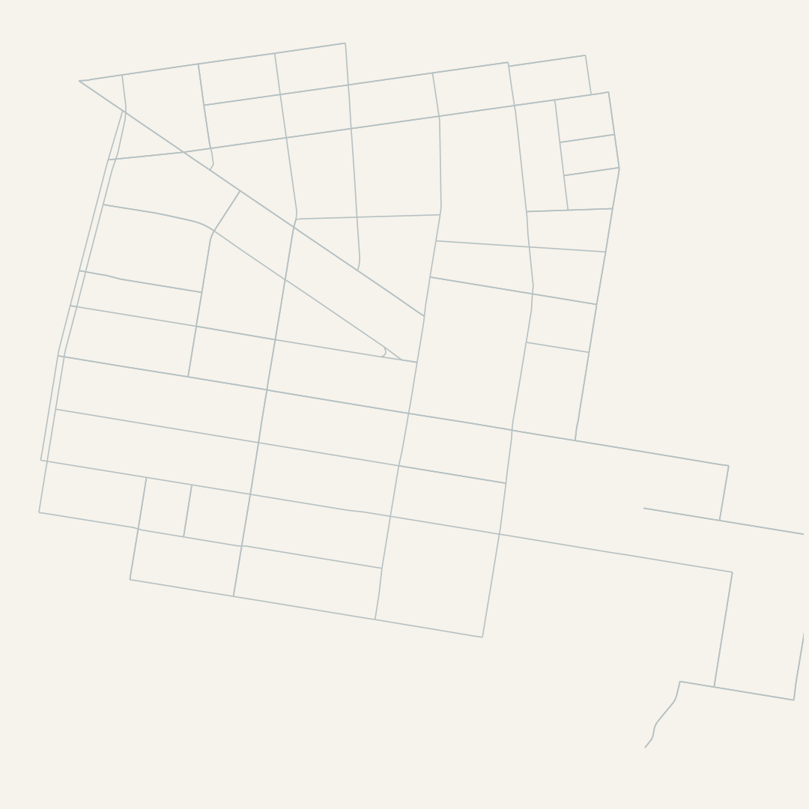
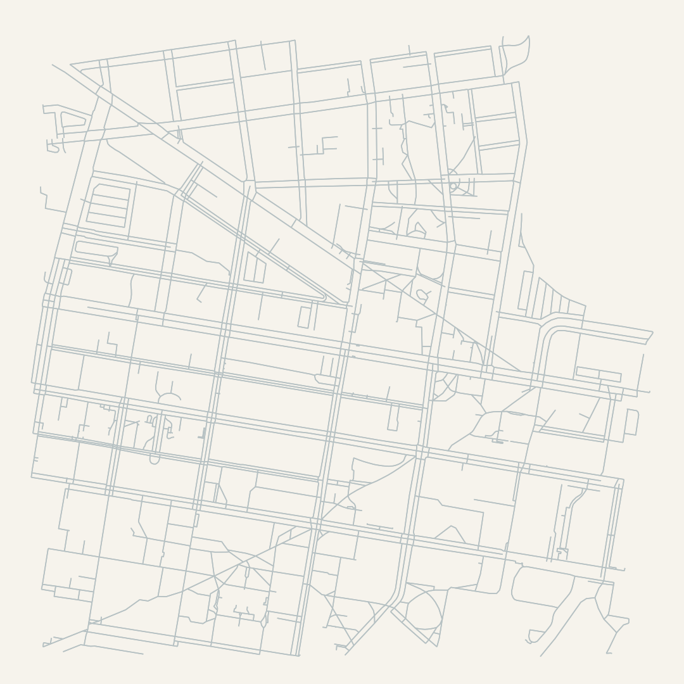
Can walking and driving use the same links?
Driving
Walking
© OpenStreetMap contributors
19
Notes:
时间：56–61
先显示左图，让学生预想步行图会多什么，再对比。相同 center、相同600m范围，唯一区别 network_type。回想 Locust Walk 的标签。Notebook §4。地图数据：© OpenStreetMap contributors，ODbL 1.0。https://www.openstreetmap.org/copyright 。新版 notebook 同一份数据，2026-09-27 UTC 下载。

Slide 20
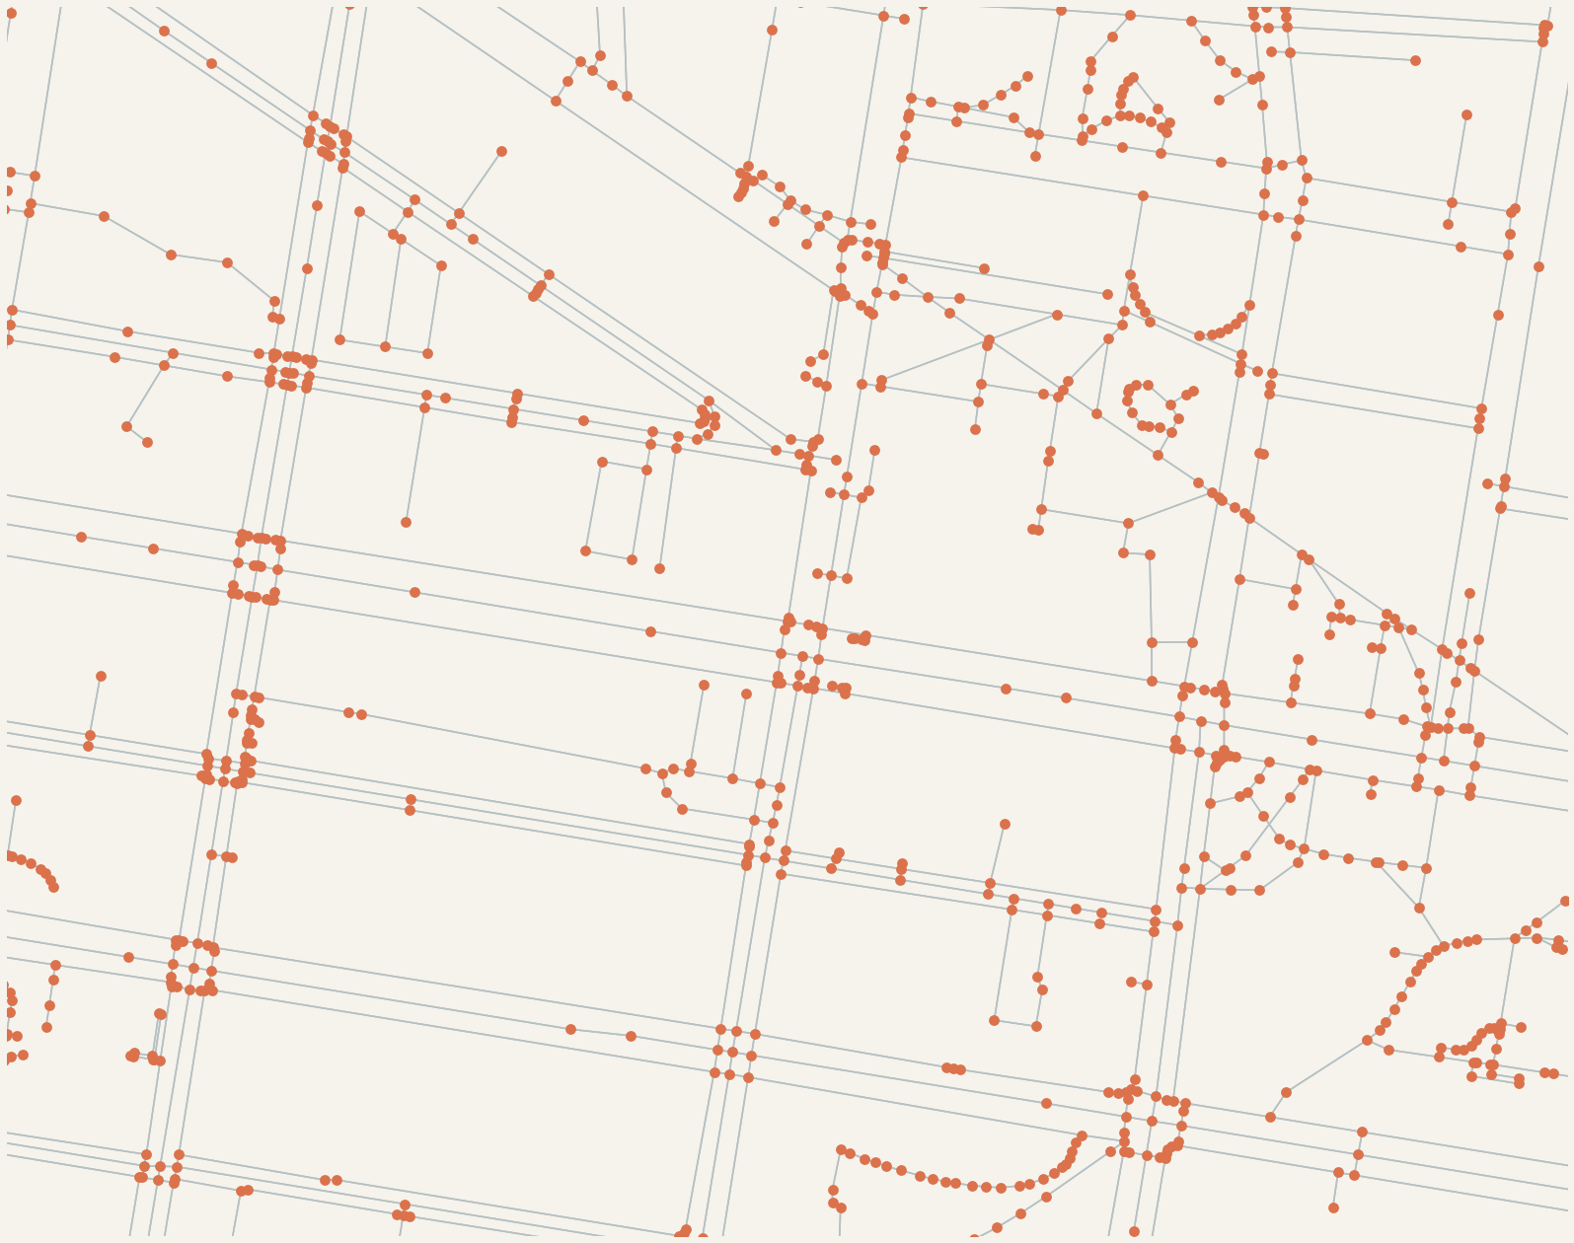
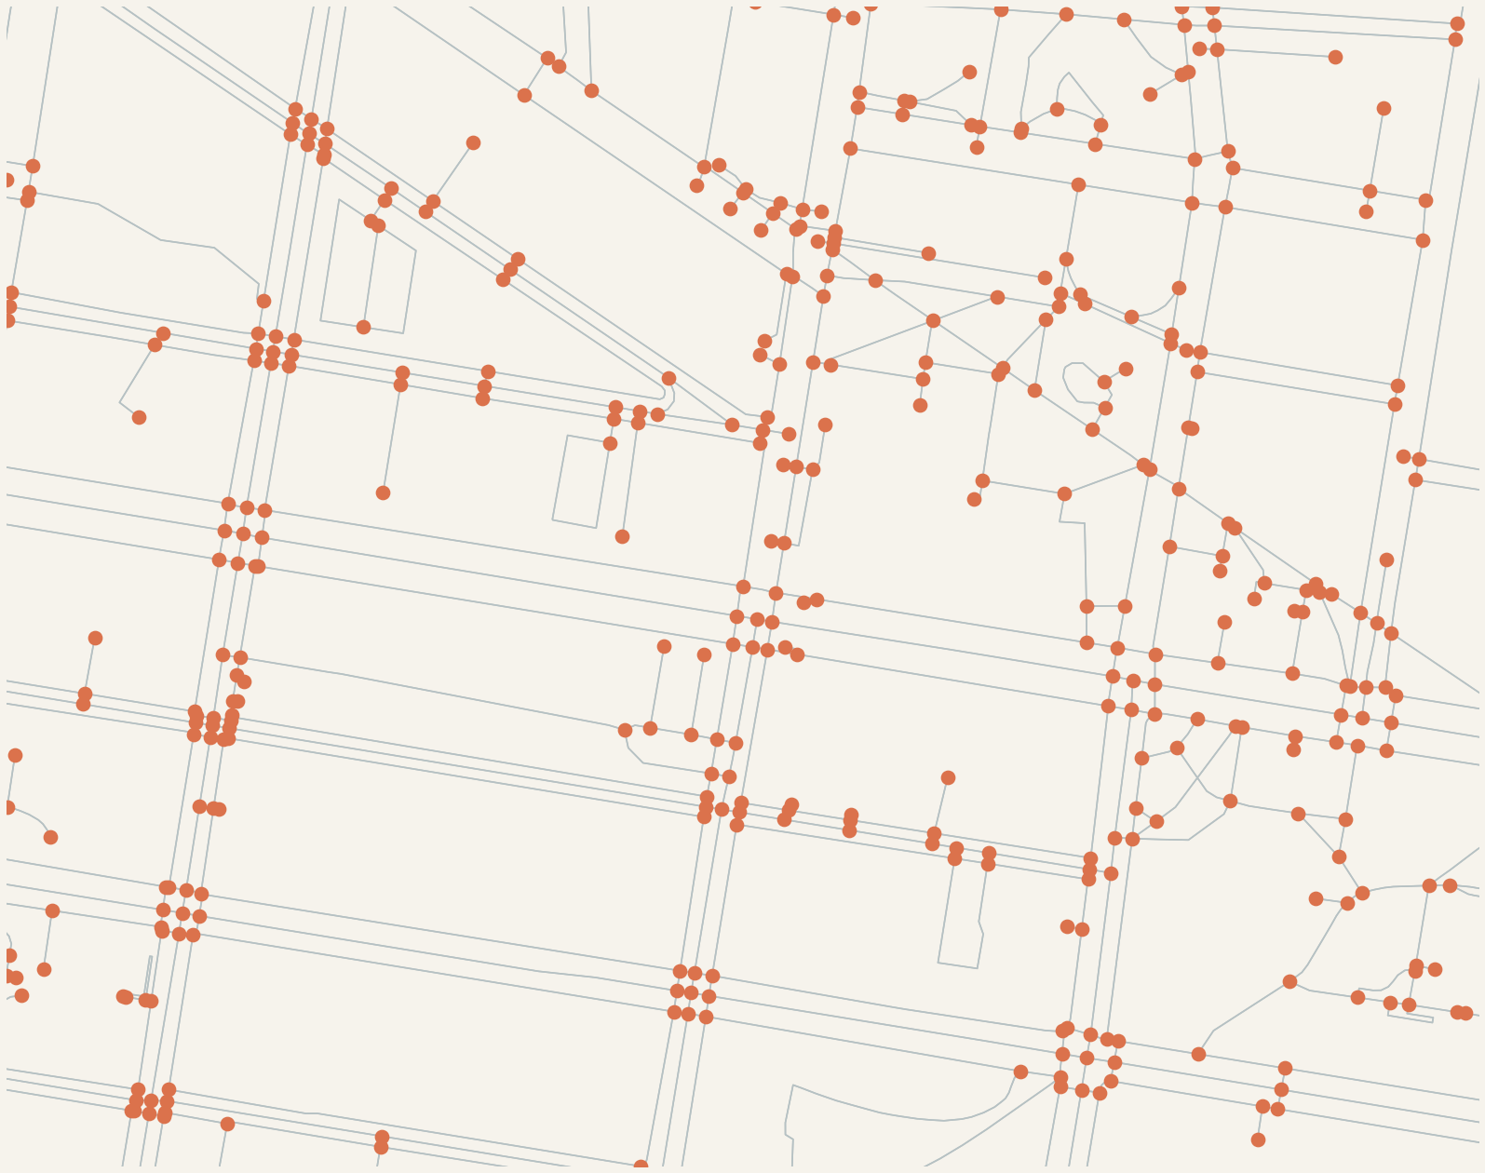
The dots and lines have names
OSM shape points
Simplified graph nodes
© OpenStreetMap contributors
20
Notes:
时间：61–66
两图来自同一份600m步行下载，同一缩放范围。解释形状点和连接点，弯道不必变成交叉口。接着运行 type(G) 和 len(G.nodes), len(G.edges)，一句话解释有向、允许平行边。不要要求学生掌握内部类。地图数据：© OpenStreetMap contributors，ODbL 1.0。https://www.openstreetmap.org/copyright 。新版 notebook 同一份数据，2026-09-27 UTC 下载。

Slide 21
The graph becomes two familiar tables
G_m = ox.project_graph(G)
nodes, edges = ox.graph_to_gdfs(G_m)
edges[["length", "highway", "geometry"]].head()
Nodes describe locations. Edges describe connections.
21
Notes:
时间：66–71
Notebook §5，逐格看 node表、edge表。length单位米。edge索引(u,v,key)点到为止。展示 edges.plot，让学生认出这就是刚才路网的另一种视图。来源：https://osmnx.readthedocs.io/en/stable/user-reference.html

Slide 22
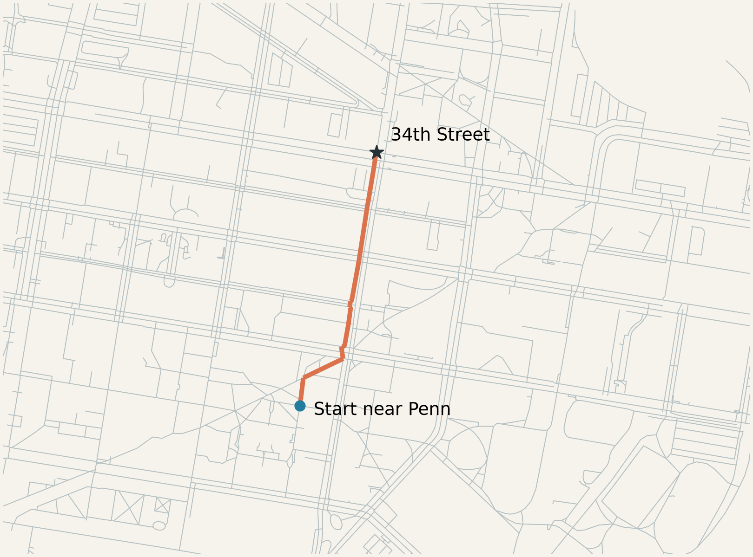
A first walking route
origin = ox.nearest_nodes(
G, X=-75.193, Y=39.952
)
route = ox.shortest_path(
G, origin, station_node,
weight="length"
)
Notebook §6: nearest node, then shortest path
© OpenStreetMap contributors
22
Notes:
时间：71–79
先运行 origin 和 station_node 两行。注意 nearest_nodes 的 X是经度，Y是纬度，和 center 的tuple顺序不同。route[:5]说明路径是ID列表，再plot_graph_route。截图代码是后半段摘录，station_node 在notebook前一格定义。地图数据：© OpenStreetMap contributors，ODbL 1.0。https://www.openstreetmap.org/copyright 。新版 notebook 同一份数据，2026-09-27 UTC 下载。

Slide 23
Break
10 minutes
Next: from one route to citywide accessibility
24
Notes:
时间：90–100
休息10分钟，保持notebook运行状态。

Slide 24
One route is easy.
What about the whole city?
From Routing to Accessibility
with Pandana
One origin → one route
Many origins → a citywide question
25
Notes:
Part II, slide 1: 3 minutes.
Full lecture timing: Part I 90 minutes, existing break 10 minutes, Part II 80 minutes = 180. Retain the original front half. Ask students to recall the origin, destination and length weight. New goal: compute a comparable measure for all origins.
Sources: https://udst.github.io/pandana/network.html ; https://udst.github.io/pandana/tutorial.html ; https://osmnx.readthedocs.io/en/stable/user-reference.html

Slide 25
Proximity and accessibility
PROXIMITY
ACCESSIBILITY
How close is it?
Can I get there?
Same destination. Different distance—and a different planning question.
26
Notes:
Part II, slide 2: 5 minutes.
5 min: Have students name a nearby place that is difficult to reach. Define proximity as straight-line separation; accessibility as reachable opportunities under a specified network, mode and budget. Transit entrance access does not measure train frequency or access to jobs via transit.
Sources: https://udst.github.io/pandana/network.html ; https://udst.github.io/pandana/tutorial.html ; https://osmnx.readthedocs.io/en/stable/user-reference.html

Slide 26
Buffer hypothesis
10 min × 80 m/min
800 m
= 800 m
The circle ignores the street network.
Assumed constant speed • buffer in a projected CRS with meter units
27
Notes:
Part II, slide 3: 5 minutes.
5 min: Draw a circle around the same network node used for the route. A flat 80 m/min walking speed gives an 800 m budget. In the same metric CRS, compare identical endpoints. Ask what happens at 60 m/min: threshold becomes 600 m. No crossing delay, slope or access restrictions beyond the graph are modeled.
Sources: https://udst.github.io/pandana/network.html ; https://udst.github.io/pandana/tutorial.html ; https://osmnx.readthedocs.io/en/stable/user-reference.html

Slide 27
Why Pandana?
50,000 origins
× 100 destinations
Which destination is nearest?
How many opportunities are within reach?
Illustrative workload: 5 million origin–destination pairs
28
Notes:
Part II, slide 4: 4 minutes.
4 min: The quantities are an illustrative workload, not a benchmark or actual Philadelphia counts. Pandana supports efficient repeated network queries, nearest POIs and aggregations. It also supports shortest paths; avoid presenting an exclusive division of tool capabilities.
Sources: https://udst.github.io/pandana/network.html ; https://udst.github.io/pandana/tutorial.html ; https://osmnx.readthedocs.io/en/stable/user-reference.html

Slide 28
Two tools in the same analysis
OSMnx
Pandana
Retrieve streets
Build and inspect the graph
Route and preserve geometry
Build a query network
Find nearest opportunities
Aggregate across origins
Use OSMnx to prepare the network; use Pandana to ask repeated access questions.
29
Notes:
Part II, slide 5: 4 minutes.
4 min: Discuss roles, not mutually exclusive features. Both can route. OSMnx obtains and prepares OSM street graphs and geometry; Pandana consumes node/edge tables for repeated queries. Geometry remains in GeoPandas for mapping.
Sources: https://udst.github.io/pandana/network.html ; https://udst.github.io/pandana/tutorial.html ; https://osmnx.readthedocs.io/en/stable/user-reference.html

Slide 29
From an OSMnx graph to a Pandana network
nodes
id x y
101 ... ...
102 ... ...
edges
u v length
101 102 84.2
102 103 61.0
pdna.Network
→
→
OSMnx graph
nodes + edges
Pandana Network
net = pdna.Network(
nodes.x, nodes.y,
e.u, e.v,
e[["length"]],
twoway=False
)
nodes.x, nodes.y
node coordinates
e.u, e.v
network connections (from → to)
e[["length"]]
impedance: edge cost in meters
twoway=False
keep OSMnx's directed edges
Same street network, different data structure optimized for repeated network queries.
30
Notes:
Part II, slide 6: 6 minutes.
6 min live demo (Week 8 tutorial). Walk through the conversion one input at a time.
- nodes.x, nodes.y: coordinates of every intersection/dead end, in the projected CRS (EPSG:32618, meters).
- e.u, e.v: the from-node and to-node of each edge. This is the connectivity.
- e[["length"]]: the impedance. Pandana will add these up along shortest paths, so the units here (meters) become the units of every answer later.
- twoway=False: the OSMnx walk graph already stores both directions as separate edges, so we tell Pandana not to duplicate them.
Preparation: nodes, edges = ox.graph_to_gdfs(G_m); e = edges.reset_index().sort_values("length").drop_duplicates(["u", "v"]) to keep the shortest parallel edge. Preserve integer node IDs.
Key point: nothing about the streets changes. Pandana just stores the same network in a structure (contraction hierarchies) built for many repeated queries. Check: one OSMnx route length from Part I should match Pandana's shortest-path length.
Sources: https://udst.github.io/pandana/network.html ; https://udst.github.io/pandana/tutorial.html ; https://osmnx.readthedocs.io/en/stable/user-reference.html

Slide 30
Put places onto the network
POI coordinate → network node
node_ids = net.get_node_ids(
places.geometry.x,
places.geometry.y
)
café (x, y)
node 102
1
A place starts as a geographic coordinate.
2
Pandana calculates on the network.
3
So each place gets a network node.
A geographic point has to become a network location before Pandana can use it.
31
Notes:
Part II, slide 7: 6 minutes.
6 min (Week 8 tutorial). Use a generic example: cafés or restaurants pulled with ox.features_from_place(..., tags={"amenity": "cafe"}), projected to nodes.crs, polygons reduced to points.
Explain the logic: a POI is only an (x, y) location. Pandana does not measure distance through space; it measures along edges between nodes. So every place has to be given a node ID first.
get_node_ids returns, for each point, the ID of the closest network node. Show the result as a column (places["node_id"] = node_ids) and plot a few snap lines.
Caveats to mention briefly: this is a nearest-node approximation. The short connector from the place to the node is not counted, and the nearest node in space may be across a highway or river. Optional mapping_distance drops places too far from any node.
Note: set_pois (next slide) does this mapping internally. We call get_node_ids here to see and check the mapping ourselves.
Sources: https://udst.github.io/pandana/network.html ; https://udst.github.io/pandana/tutorial.html ; https://osmnx.readthedocs.io/en/stable/user-reference.html

Slide 31
Tell the network what you are looking for
net.set_pois(
category="cafes",
maxdist=1000,
maxitems=5,
x_col=cafes.geometry.x,
y_col=cafes.geometry.y
)
Register
a category of opportunities: "cafes"
Attach
each café to its network node
Search
from every node: ≤ 1,000 m, ≤ 5 cafés
● café ● node holding a café
Pandana stores destinations as opportunities on the network.
32
Notes:
Part II, slide 8: 6 minutes.
6 min live demo (Week 8 tutorial). set_pois registers a named category of destinations on the network.
- category: the name we will use to ask about these places later.
- maxdist: the farthest search distance we will ever ask for (same units as the impedance, meters). Later queries must not exceed it.
- maxitems: the largest number of nearest places we will ever ask for. Later num_pois must not exceed it.
- x_col, y_col: the café coordinates. Pandana snaps each to its nearest node (the same mapping as get_node_ids).
Conceptually: after this line the network "knows" where cafés are, so it can search outward from every node at once. Nothing has been calculated yet.
Ask: if we want the three nearest cafés within 1.5 km, what must change here? (maxdist >= 1500, maxitems >= 3.)
Sources: https://udst.github.io/pandana/network.html ; https://udst.github.io/pandana/tutorial.html ; https://osmnx.readthedocs.io/en/stable/user-reference.html

Slide 32
Ask the network a question
nearest = net.nearest_pois(
distance=1000,
category="cafes",
num_pois=3
)
A
B
node
nearest
2nd
3rd
A
180 m
420 m
610 m
B
95 m
340 m
720 m
— Not a route geometry
— A network-distance query
— Values attached to every node
Pandana turns a network into a set of repeated accessibility measurements.
33
Notes:
Part II, slide 9: 7 minutes.
7 min live demo (Week 8 tutorial). nearest_pois asks, from every node at once: how far along the network are the nearest 1, 2, 3 cafés?
- Output is a DataFrame indexed by node ID, with columns 1, 2, 3 (nearest, 2nd, 3rd). The table here is illustrative, not Philadelphia output.
- It returns distances, not route lines. If you need the geometry of one route, go back to OSMnx.
- If fewer than num_pois cafés are found within distance, Pandana fills the value with the search distance (1000). Use max_distance=1001 (or similar) to make "not found" distinguishable from exactly 1000 m.
- distance must be <= maxdist and num_pois <= maxitems from set_pois.
Join back to nodes by node ID and map column 1: each node gets a value. Ask: what does the 3rd-nearest distance tell us that the nearest does not? (choice / redundancy.)
Sources: https://udst.github.io/pandana/network.html ; https://udst.github.io/pandana/tutorial.html ; https://osmnx.readthedocs.io/en/stable/user-reference.html

Slide 33
From nearest POI to accessibility
Nearest
Count
Gaps
What is the nearest grocery store?
How many parks are reachable within 800 m?
Which areas have poor access to rapid transit?
budget C = 800 m
B
A
X
0 m
400 m
800 m
1200 m
Accessible if network distance ≤ budget
Accessible_{i} = 1[ d_{i} ≤ C ]
The query gives a distance. A threshold turns it into an access answer.
34
Notes:
Part II, slide 10: 5 minutes.
5 min. Only now bring in the planning interpretation. The same nearest_pois output answers different planning questions:
- Nearest: column 1 of nearest_pois for grocery stores.
- Count: how many parks within 800 m. (In code this is net.aggregate or counting non-missing columns; mention only.)
- Gaps: which nodes have no rapid-transit entrance within the budget.
The threshold: pick a budget C (here 10 min × 80 m/min = 800 m). A node is accessible if its network distance is at most C. A and B are in; X at 950 m is out. In code: accessible = nearest[1] <= 800.
Keep the formula as notation, not the point. The choice of C is an analyst's assumption; changing it changes the map.
Sources: https://udst.github.io/pandana/network.html ; https://udst.github.io/pandana/tutorial.html ; https://osmnx.readthedocs.io/en/stable/user-reference.html

Slide 34
Who can reach rapid transit
within a 10-minute walk?
Application · Philadelphia
Proximity
Network access
800 m Euclidean buffer
800 m shortest walking-network distance
Origins
Destination
Budget
street nodes
34th Street station
10 min × 80 m/min
Same origins, same destination, same 800 m. Only the definition of distance changes.
35
Notes:
Part II, slide 11: 4 minutes.
4 min. Now the workflow is in place, apply it to one question. This is an application of the general method, not what Pandana is for.
Setup: origins are street nodes (not people or homes yet); destination is 34th Street from Part I; budget is 10 min at an assumed 80 m/min = 800 m.
Two answers to "within 10 minutes":
- Proximity: straight-line distance <= 800 m (the buffer from earlier).
- Network access: set_pois("stations", ...) then nearest_pois(800, "stations", num_pois=1, max_distance=801); accessible = d <= 800.
Ask students to predict where the two will disagree before showing the map.
To expand later: include every Market–Frankford and Broad Street entrance; state which systems count. Exclude bus, regional rail and trolley unless intentionally in scope.
Sources: https://udst.github.io/pandana/network.html ; https://udst.github.io/pandana/tutorial.html ; https://osmnx.readthedocs.io/en/stable/user-reference.html

Slide 35
Where exactly is the station?
Centroid
entrance
One point in the middle of the station, snapped to one node.
centroid
Entrances
Several points where people actually enter, each snapped to its own node.
The destination point you choose can change who counts as accessible. Inspect the snap.
36
Notes:
Part II, slide 12: 3 minutes.
3 min, one slide only. The same get_node_ids / set_pois step applies to stations, but which point represents a station matters.
A centroid of a large station or a platform in the middle of a street may snap to a node that nobody walks to. Entrances snap to nodes on the actual access streets and usually give shorter, more realistic distances.
For "any entrance" access use all entrances as POIs; for counting stations, deduplicate by station so entrances are not overcounted.
In today's demo we use the snapped node from Part I as the station proxy, so both methods share the same endpoint.
Sources: https://udst.github.io/pandana/network.html ; https://udst.github.io/pandana/tutorial.html ; https://osmnx.readthedocs.io/en/stable/user-reference.html

Slide 36
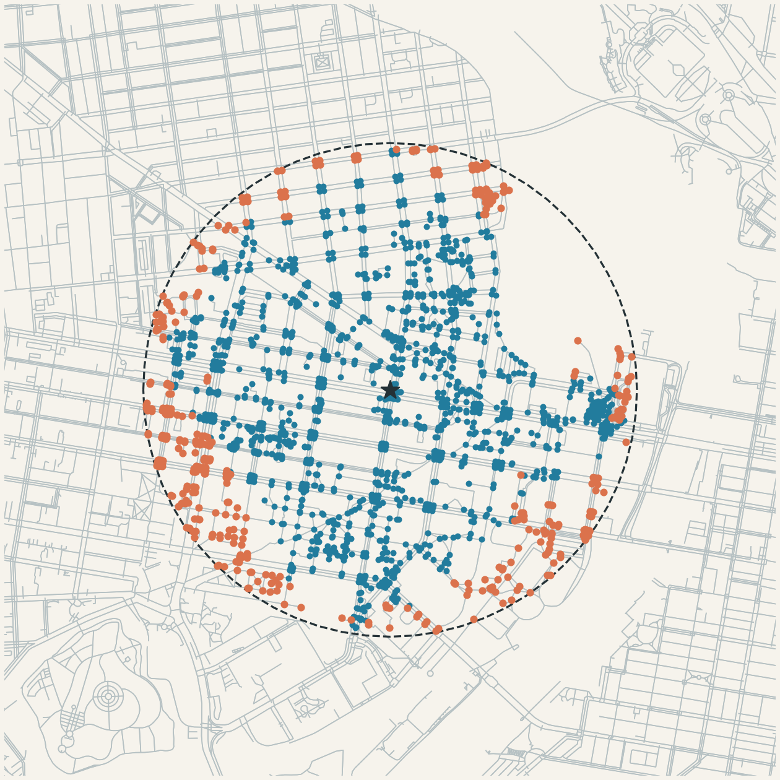
Compare the two catchments
Circle
Straight-line distance ≤ 800 m
Network catchment
Shortest walking distance ≤ 800 m
34th Street reference example from the original deck • © OpenStreetMap contributors
37
Notes:
Part II, slide 13: 6 minutes.
6 min: Reuse the original Philadelphia map as a supplied reference example. This image is from the source lecture, not a new Pandana calculation. Students should reproduce the comparison with the same station endpoints, origins, projection and threshold, first for 34th Street and then for any entrance. For multiple destinations compare unions of circles against minimum network distance. Pandana outputs distances at nodes, not a ready-made isochrone polygon. Avoid filling across rivers or disconnected streets.
Sources: https://udst.github.io/pandana/network.html ; https://udst.github.io/pandana/tutorial.html ; https://osmnx.readthedocs.io/en/stable/user-reference.html

Slide 37
Where do the answers disagree?
Both accessible
Within the circle and the walking budget
Neither
Outside both budgets
Euclidean yes / network no
Near the station, but the walking route is longer
Network yes / Euclidean no? Check that endpoints and distance units really match.
38
Notes:
Part II, slide 14: 6 minutes.
6 min activity: Compare the same set of origin coordinates against the same destination endpoints and distance budget. In a consistent metric network, straight-line distance is a lower bound on path length; network yes / Euclidean no should trigger a check of snapping, endpoints, projection, edge lengths and threshold units. An orange origin may reflect a legitimate detour or a data problem; route one example to investigate. Do not infer population from node counts.
Sources: https://udst.github.io/pandana/network.html ; https://udst.github.io/pandana/tutorial.html ; https://osmnx.readthedocs.io/en/stable/user-reference.html

Slide 38
Change the destination, keep the logic
Network
Attach
destinations
Query
network cost
Summarize
accessibility
→
→
→
pdna.Network()
set_pois()
nearest_pois()
d <= C
Grocery
Parks
Jobs
Healthcare
Transit
Which stores count?
Public entrances, not centroids
Weight by number of jobs
Relevant services and capacity
Entrances; frequency is separate
Same four steps for every row. Only the opportunity, the cost and the threshold change.
Pandana is not a transit package. It is a general network-accessibility tool.
39
Notes:
Part II, slide 15: 6 minutes.
6 min. The workflow on top is exactly what we ran for cafés and then for the station: build the network, attach destinations, query network cost, summarize.
Transit sits in the row as one destination among five: it is not special.
Ask groups to choose one application and state: the destination definition, the cost, and the threshold.
- Grocery: which stores are usable (full-service vs corner store).
- Parks: public entrances rather than centroids.
- Jobs: sum employment weights at destinations: net.set(node_ids, variable=jobs, name="jobs") then net.aggregate(800, type="sum", decay="flat", name="jobs").
- Healthcare: relevant service and capacity, not any clinic.
- Transit: entrances; walk access does not measure frequency.
Access measures are not utilization or quality. Change speed from 80 to 60 m/min and discuss which conclusions persist.
Sources: https://udst.github.io/pandana/network.html ; https://udst.github.io/pandana/tutorial.html ; https://osmnx.readthedocs.io/en/stable/user-reference.html

Slide 39
OSMnx represents movement;
Pandana measures access
OSM → OSMnx graph → Pandana network → opportunities → accessibility
The software answers the network query.
The analyst defines what counts as an opportunity, a cost, and an acceptable threshold.
Exit ticket: one finding · one assumption · one thing to check next
40
Notes:
Part II, slide 16: 4 minutes.
4 min. Retrace the chain: OSM data -> OSMnx graph (routing, geometry) -> Pandana network (repeated queries) -> opportunities registered with set_pois -> accessibility from nearest_pois plus a threshold.
Close on judgment: Pandana computes distances; it does not decide what counts as a grocery store, whether 800 m is reasonable, or whether length is the right cost.
Exit ticket: state one access finding, one modeling assumption, and one validation step.
Suggested schedule: Part I 90 minutes, break 10 minutes, Part II 80 minutes.
Sources: https://udst.github.io/pandana/network.html ; https://udst.github.io/pandana/tutorial.html ; https://osmnx.readthedocs.io/en/stable/user-reference.html

