Slide 1
Non-support Perception Portrait Cluster Analysis
Zhanchao Yang

Slide 2
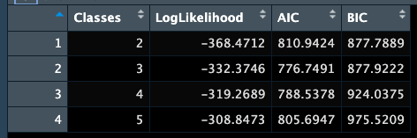
Latent Class Analysis (clustering)
Best option: k = 3/ k = 2

Slide 3
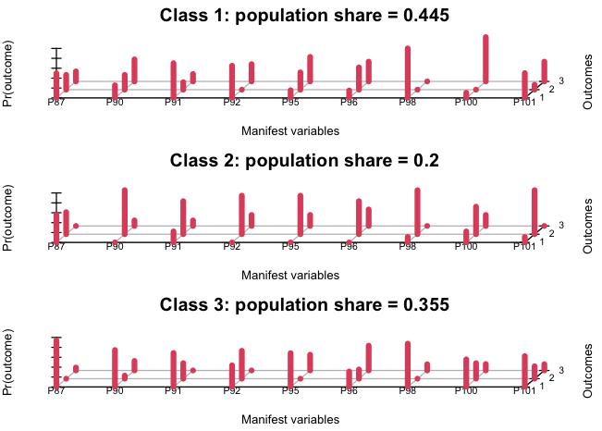
K = 3;
mixed
Deem metro will not make their lives better
All will increase, except commuting time will decrease, and local businesses will remain unchanged.

Slide 4
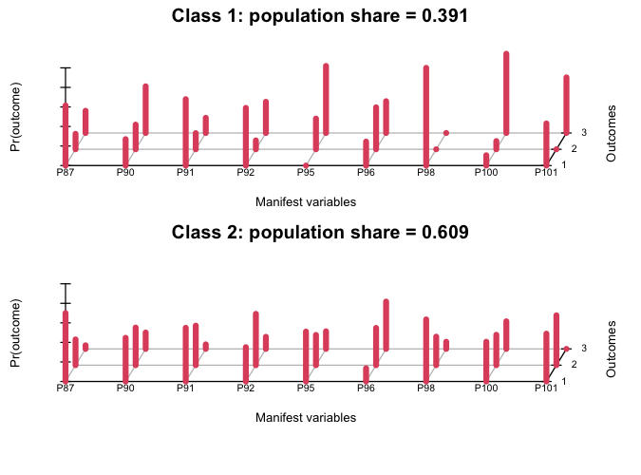
K = 2,

Slide 5
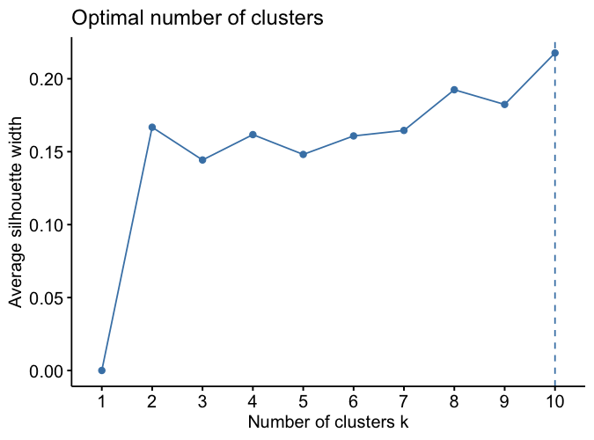
K-means
K = 10

Slide 6
(%) | 1 | 2 | 3 | 4 | 5 | 6 | 7 | 8 | 9 | 10
housingvalues | 100; 0; 0 | 100; 0; 0 | 50; 33.3; 16.7 | 66.7; 33.3; 0 | 62.5; 25; 12.5 | 33.3; 66.7; 0 | 100; 0; 0 | 87.5; 12.5; 0 | 100; 0; 0 | 0; 0; 100
safety | 100; 0; 0 | 100; 0; 0 | 83.3; 16.7; 0 | 0; 0; 100 | 12.5; 37.5; 50 | 0; 100; 0 | 33.3; 66.7; 0 | 50; 25; 25 | 0; 0; 100 | 0; 33.3; 66.7
expense | 33.3; 33.3; 33.3 | 100; 0; 0 | 66.7; 33.3; 0 | 66.7; 33.3; 0 | 87.5; 12.5; 0 | 16.7; 83.3; 0 | 66.7; 33.3; 0 | 75; 25; 0 | 0; 0; 100 | 33.3; 33.3; 33.3
business | 0; 66.7; 33.3 | 100; 0; 0 | 66.7; 33.3; 0 | 0; 66.7; 33.3 | 75; 12.5; 12.5 | 0; 83.3; 16.7 | 33.3; 66.7; 0 | 75; 25; 0 | 0; 0; 100 | 0; 0; 100
Public transit | 0; 0; 100 | 100; 0; 0 | 100; 0; 0 | 100; 0; 0 | 0; 37.5; 62.5 | 0; 66.7; 33.3 | 66.7; 33.3; 0 | 0; 62.5; 37.5 | 0; 50; 50 | 0; 0; 100
time | 0; 33.3; 66.7 | 66.7; 33.3; 0 | 0; 16.7; 83.3 | 0; 33.3; 66.7 | 37.5; 37.5; 25 | 0; 66.7; 33.3 | 0; 0; 100 | 37.5; 50; 12.5 | 0; 100; 0 | 0; 33.3; 66.7
noise | 100; 0; 0 | 100; 0; 0 | 100; 0; 0 | 100; 0; 0 | 100; 0; 0 | 0; 100; 0 | 0; 33.3; 66.7 | 100; 0; 0 | 50; 50; 0 | 100; 0; 0
Public space | 100; 0; 0 | 100; 0; 0 | 33.3; 16.7; 50 | 33.3; 33.3; 33.3 | 0; 12.5; 87.5 | 33.3; 66.7; 0 | 33.3; 33.3; 33.3 | 0; 12.5; 87.5 | 50; 50; 0 | 0; 0; 100
Housing project | 100; 0; 0 | 66.7; 33.3; 0 | 50; 50; 0 | 66.7; 33.3; 0 | 100; 0; 0 | 0; 100; 0 | 100; 0; 0 | 0; 25; 75 | 0; 50; 50 | 0; 0; 100
count | 3 (6.7%) | 3 (6.7%) | 6 (13.4%) | 3 (6.7%) | 8 (17.8%) | 6 (13.4%) | 3 (6.7%) | 8 (17.8%) | 2 (4.44%) | 3 (6.7%)

Slide 7
Hierarchical clustering
(%) | 1 | 2
Property values | 70.3, 16.2, 13.5 | 50, 50, 0
safety | 45.9, 21.6, 32.4 | 0, 87.5, 12.5
Living expense | 70.3, 21.6, 8.1 | 12.5, 75, 12.5
commercial | 54.1, 27, 18.9 | 0, 75, 25
Public transit | 37.8, 21.6, 40.5 | 0, 75, 25
time | 21.6, 32.4, 45.9 | 0, 75, 25
(noise) | 91.9, 2.7, 5.4 | 12.5, 87.5, 0
Public space | 29.7, 13.5, 56.8 | 25, 62.5, 12.5
New project | 56.8, 16.2, 27 | 0, 100, 0
count | 37 (82.2%) | 8 (17.8%)
Cluster 1: Mixed opinion (not significant and noticeable); Renting, living expense, and noise pollution are expected to increase
Cluster 2: highly rated unchanged, with some variation (noticeable toward increase)

