Slide 1
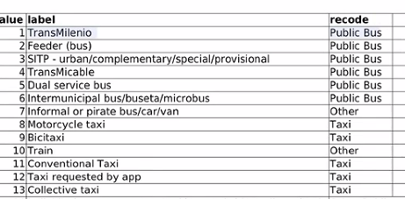
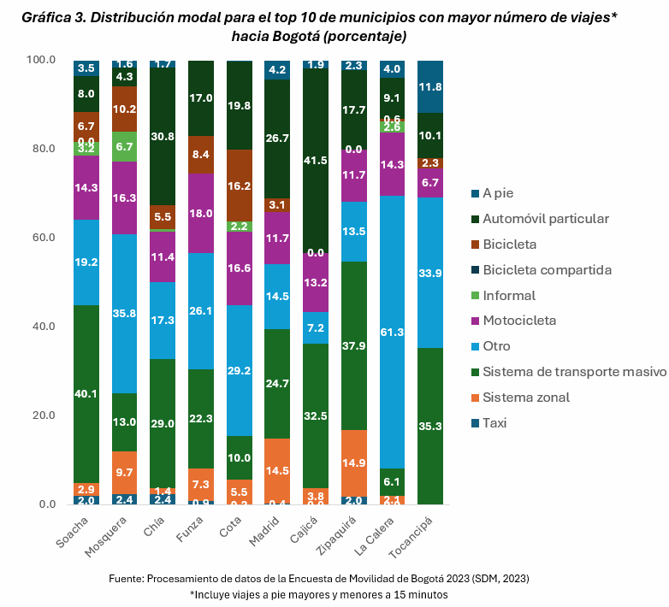
Transmilenio | BRT
Feeder bus | BRT
SITP | SITP
Transmicable | Cable Car
Dual service | SITP
Intermunicipal | Intermunicipal

Slide 2
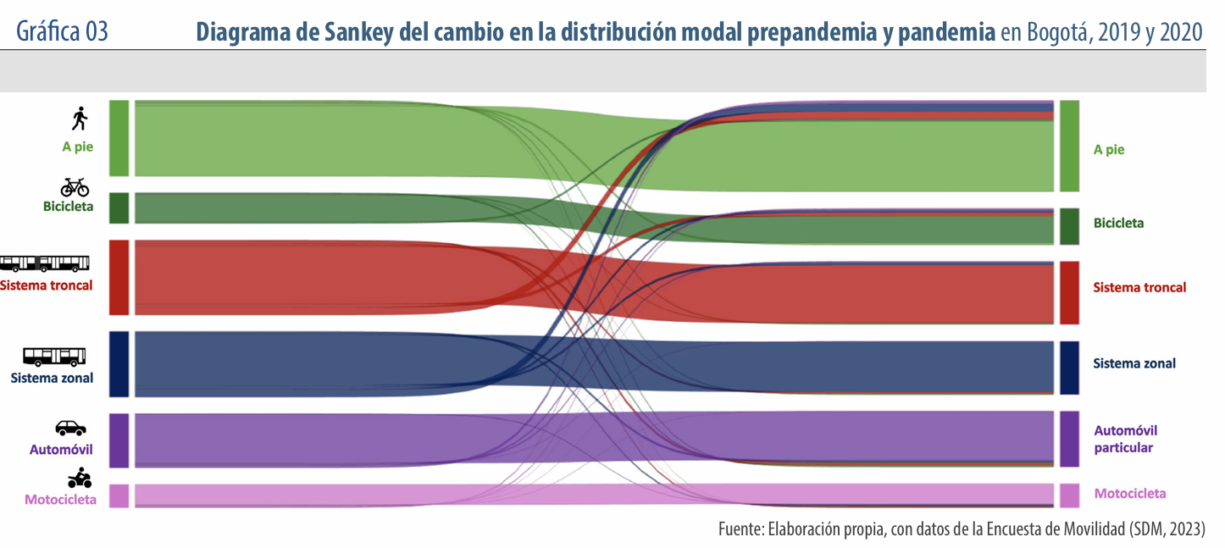
Transportation mode before and during the pandemic COVID-19
BRT
SITP

Slide 3
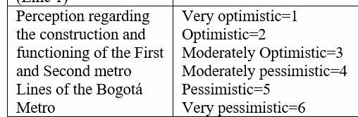
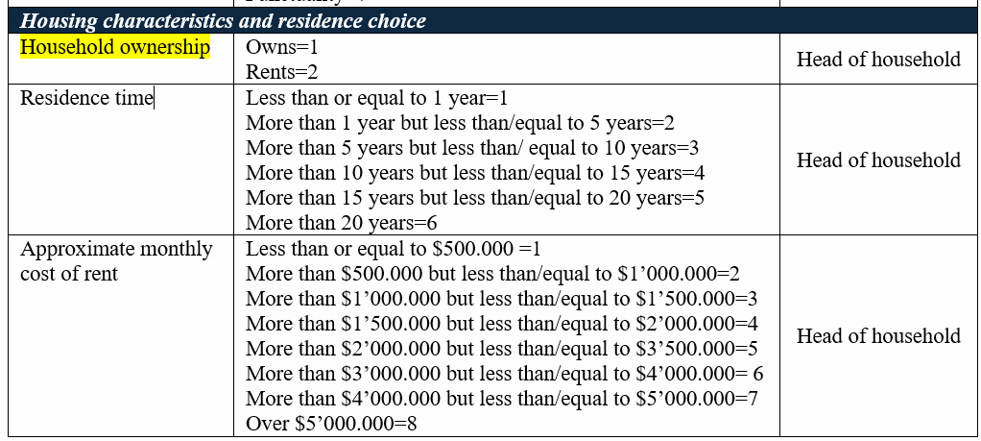
Relationship 1
Statistics
Bivarate Tables
Regression models
- According to the dependent variable
Hypotheses:
The more optimistic the person is the higher the probability is a renter
The more pessimistic the person is the higher the probability the person is an owner

Slide 4
Relationship 2
Purpose of trip:
WORK
Impacts of Metro Project on Housing rents
Renters
Hypotheses:
Most residents are renters
They prefer to live close to mass transit to reduce travel times
Statistics
Bivarate Tables
Regression models
- According to the dependent variable

Slide 5
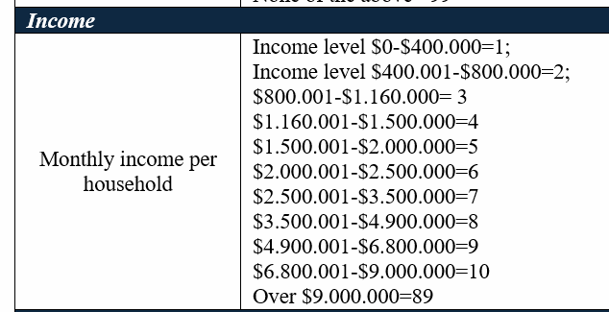
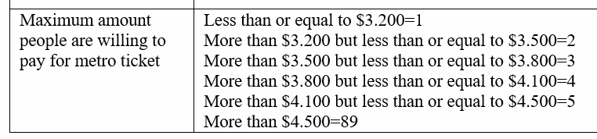
Relationship 3
Hypotheses:
The higher the income the higher the amount they are willing to pay
Statistics
Bivarate Tables
Regression models
- According to the dependent variable

Slide 6
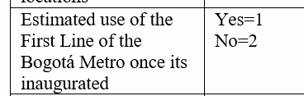

Relationship 4
Preffered mode of transport for trip purpose: WORK
Hypotheses:
The posibility of modal shift based on the transportación modes
Statistics
Bivarate Tables
Regression models
- According to the dependent variable

