Slide 1
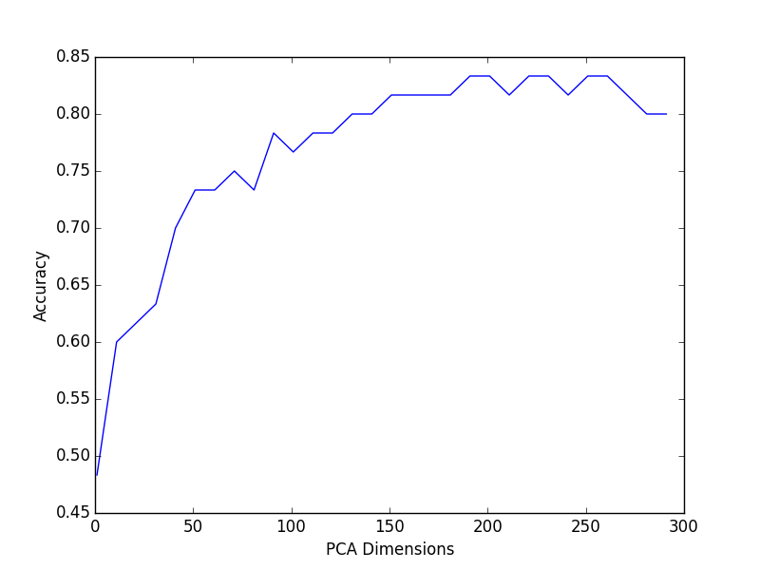
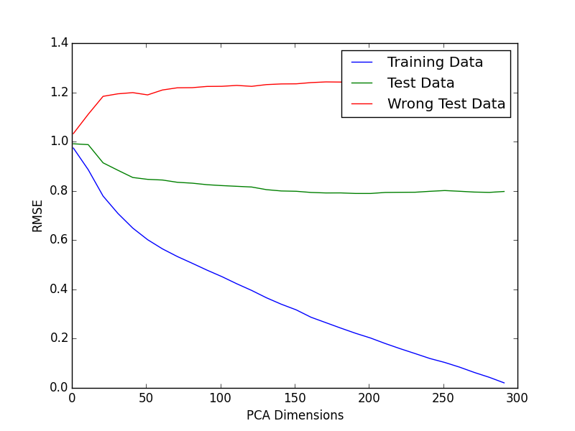
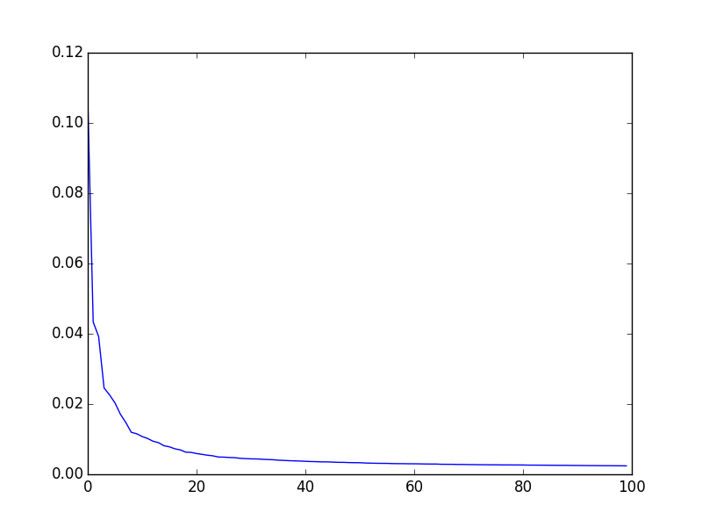
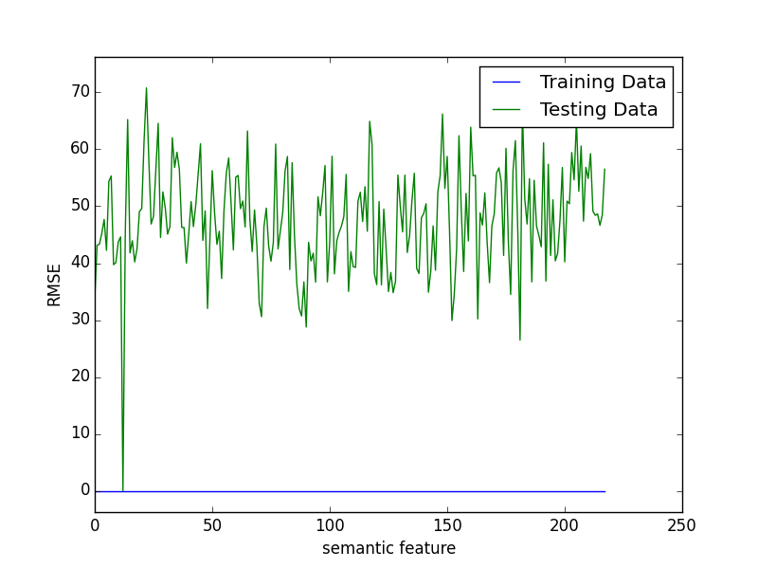
Reading minds : predicting words from FMRI images
Stella Stylianidou Tomasz Sakrejda
Goal : From FMRI image predict out of two words which one was shown to the subject
Data
60 Words
218 Semantic features : rated 1-5 eg. flies? animal?
300 + 60 FMRI images : values of voxels (20,000)
Methods
Find weights that predict each semantic feature (y) from fmri images (x) :
Lasso – 0.5 accuracy with different ways of choosing lambdas
PCA and Lasoo - 0.7 accuracy
PCA and Least Squares – 0.8 accuracy
Results : Accuracy
Predict semantic features from fmri image
Calculate distance from two given words
Choose word with least distance
A step further.. Ranking of words
Training data set : <rank> = 1
Test data set : <rank> = 13
Words with bad rank :
PCA dimensions
Semantic features
Wrong words – why?
('bear', 'airplane'),
('cow', 'screwdriver'),
('arm', 'saw'),
('shirt', 'skirt'),
('bee', 'telephone'),
('butterfly', 'train'),
('bottle', 'door'),
('cup', 'chisel'),
('refrigerator', 'coat'),
('lettuce', 'car'),
('celery', 'screwdriver'),
('carrot', 'apartment')]

