Slide 1
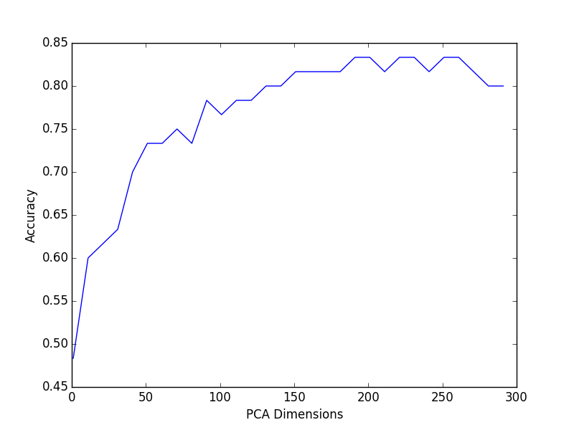
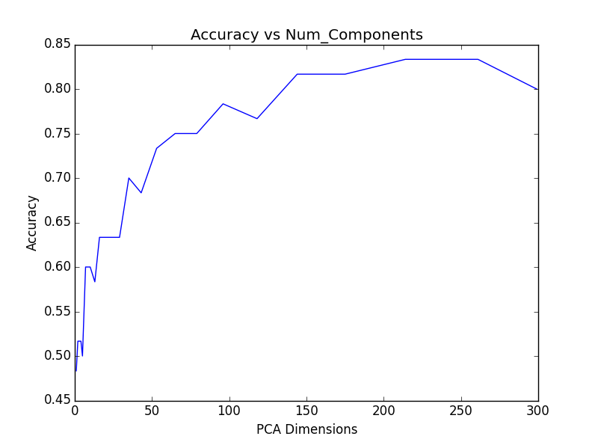
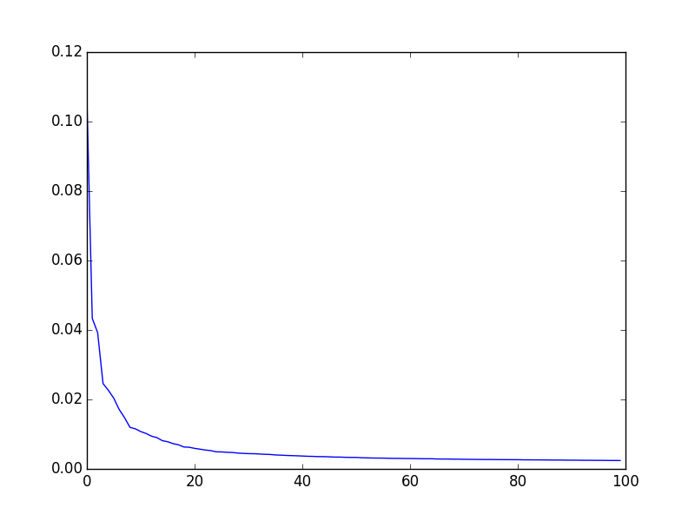
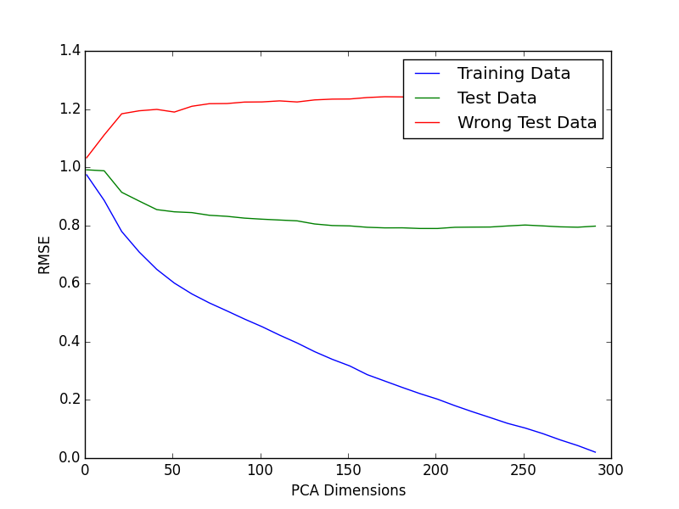
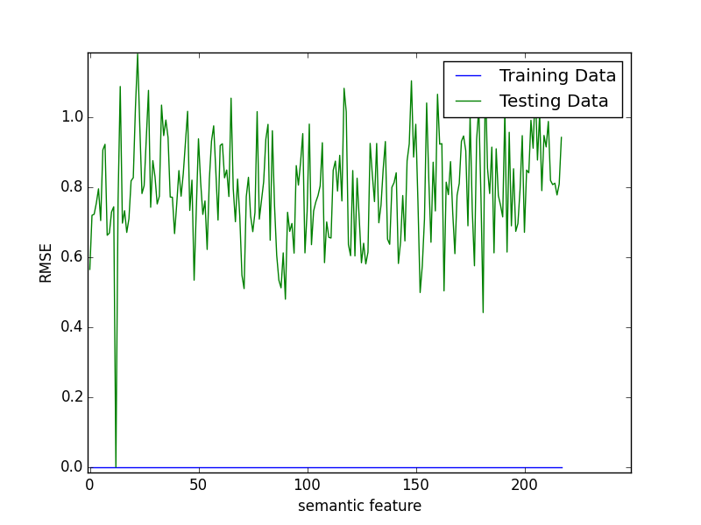
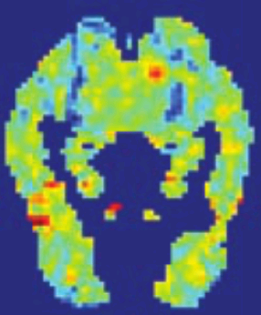
Reading minds : predicting words from FMRI images
Stella Stylianidou Tomasz Sakrejda
Goal
From an FMRI image predict which word which was shown to the subject
Data
60 Words
218 Semantic features : rated 1-5 eg. Does it fly? Is it an animal?
300 + 60 FMRI images : values of voxels (20,000)
Methods
Train different ML models on 300 fMRI’s
Predict semantic features ratings from fMRI image.
Calculate distance to prediction from features of two given words
Choose word with smallest distance
Results: Accuracy
Lasso – 50% accuracy regardless of how regularization chosen
PCA and Lasso - 70% accuracy
PCA and Least Squares – 80% accuracy
Same predictive power as ML model from research paper.
(Random cosines)
A step further.. Ranking of words
Rank likelihood of words according to semantic distance
Training data set : <rank> = 1
Test data set : <rank> = 13
Consistent with error rate on 2-word prediction
Words with bad rank :
PCA dimensions
Accuracy increases with PCA components- not overfitting
Compare test RMSE vs accuracy
Semantic features
Bad Words
('bear', 'airplane'),
('cow', 'screwdriver'),
('arm', 'saw'),
('shirt', 'skirt'),
('bee', 'telephone'),
('butterfly', 'train'),
('bottle', 'door'),
('cup', 'chisel'),
('refrigerator', 'coat'),
('lettuce', 'car'),
('celery', 'screwdriver'),
('carrot', 'apartment')]

