Slide 1

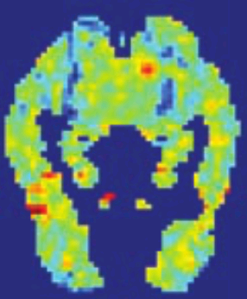
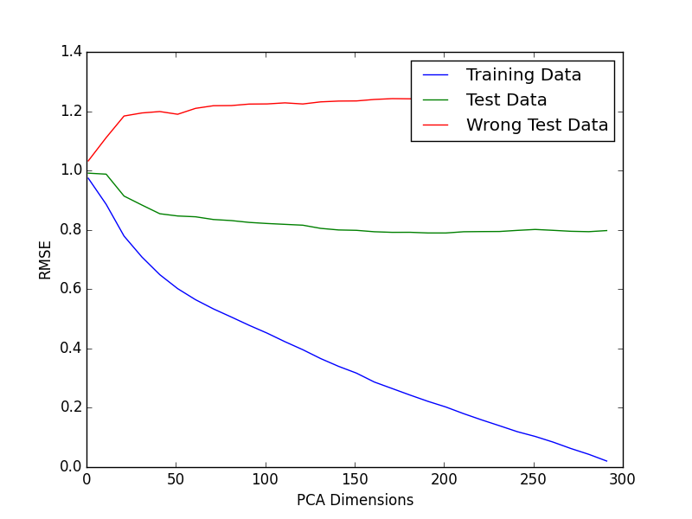
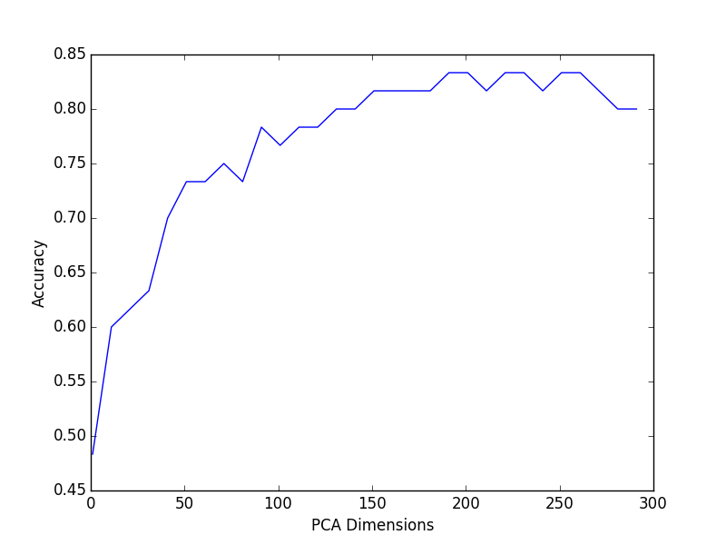
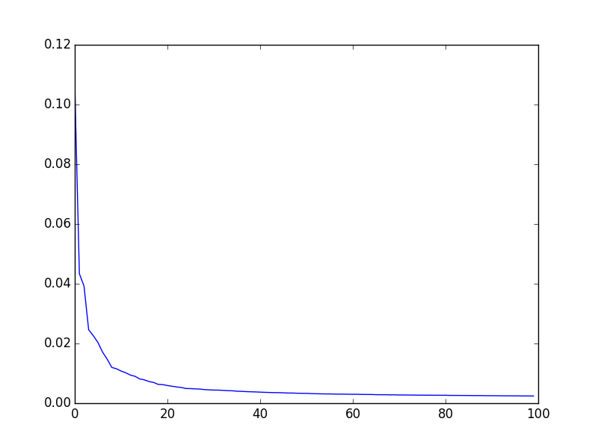
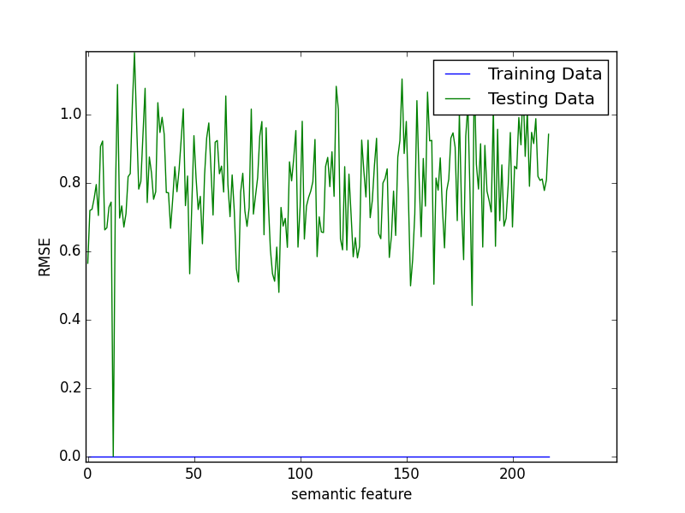
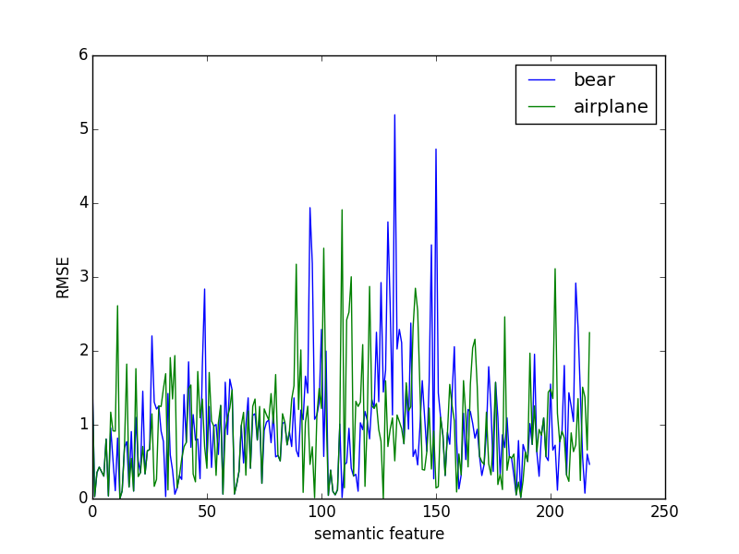
Reading minds : predicting words from FMRI images
Tomasz Sakrejda & Stella Stylianidou
Goal
From an FMRI image predict which word which was shown to the subject
Data
60 Words: nouns
218 Semantic features:
rated 1-5 ( Does it fly? Is it
an animal?)
300 + 60 FMRI images:
values of voxels (20,000)
Methods
Train different ML models on 300 fMRI’s
Predict semantic features ratings from fMRI image.
Calculate distance to prediction from features of two given words
Choose word with smallest distance
Results:
Predicting out of 2 words
Lasso – 50% accuracy regardless of how regularization chosen
PCA and Lasso - 70% accuracy
PCA and Least Squares – 80% accuracy
Same predictive power as random cosines ML model (Mitchel et al, 2008)
A step further:
Ranking of all 60 words
Rank likelihood of words according to semantic distance
Training data set : <rank> = 1
Test data set : <rank> = 13
Consistent with error rate on 2-word prediction
PCA dimensions
Accuracy increases with PCA components - not overfitting
Compare test RMSE vs accuracy
Figure 3. The RMSE of the training data and test data decreases as we include more PCA dimensions, where as the RMSE of incorrect words increases.
Figure 1. FMRI image (Mitchel et al, 2008)
Figure 4. The accuracy of selecting the correct word out of two increases with more PCA dimensions, reaching a plateau at ~ 150. Insert shows variance of PCA dimensions.
variance
Analysis of semantic features
Increased accuracy with addition of semantic features
Each semantic features shows similar values of RMSE in the test data.
Mistakes
Small difference between RMSE’s of correct and incorrect word
Not caused by particular semantic feature
May be due to head movement (Mitchel et al, 2008)
Correct Word | RMSE | Incorrect Word | RMSE
bear | 0.9823 | airplane | 0.9725
cow | 0.8577 | screwdriver | 0.8206
arm | 0.7299 | saw | 0.6092
shirt | 0.6587 | skirt | 0.6502
bee | 0.9628 | telephone | 0.7606
butterfly | 1.1005 | train | 0.7247
Table 1. Example of 5 incorrectly guessed words and their RMSE.
Figure 2. Each semantic feature versus the RMSE for the training and testing data, showing a similar range.
Figure 5. RMSE of each semantic feature for the correct and incorrect word for one of the incorrectly guessed cases.

