Slide 1
EMPLOYEE SALARY PREDICTION
CAPSTONE PROJECT
Presented By:
SHAIK MUSKAN
Annamacharya Institute of Technology and Sciences Tirupati
Computer Science and Engineering

Slide 2
OUTLINE
Problem Statement – Predict whether a person's income is <=50k or >=50k based on factors like age, education, occupation, etc., using machine learning.
System Development Approach (Technology Used) - Python, Pandas, Scikit-learn, Command Prompt(CMD), Flask, HTML/CSS (Frontend), Joblib (Model Storage)
Algorithm & Deployment (Step by Step Procedure) - Data preprocessing (cleaning, encoding), Model training using Logistic Regression, Save model & column structure with Joblib, Flask-based web app for real-time prediction
Result - Achieved ~85–88% accuracy, Web interface provides instant salary class prediction
References - UCI Dataset | scikit-learn | Flask | Pandas Docs

Slide 3
Problem Statement
This project aims to predict whether an individual's salary is more than $50K per year using demographic and work-related features.
It uses the UCI Adult Income dataset which contains data like age, education, occupation, hours per week, etc.
Data preprocessing is done through encoding, normalization, and feature engineering.
A Logistic Regression model is trained and deployed using a Flask-based web application.
The system provides a user-friendly interface for real-time salary class prediction based on user inputs.

Slide 4
System Approach
System requirements
Operating System: Windows 10 / Linux / macOS
Processor: Intel i3 or above
RAM: Minimum 4 GB
Software: Python 3.8+, Web Browser, Command Prompt (CMD)
Storage: At least 500MB free for dataset and model files
Library required to build the model
pandas, numpy, scikit-learn, joblib, Flask

Slide 5
Algorithm & Deployment
Data Collection ▸ Downloaded the UCI Adult Income dataset containing demographic attributes and salary class.
Data Preprocessing ▸ Cleaned missing values, encoded categorical variables using one-hot encoding, and normalized the data.
Feature Selection ▸ Selected relevant features such as age, education, workclass, hours-per-week, etc., for training.
Model Training ▸ Trained a classification model (e.g., Logistic Regression / Random Forest) using Scikit-learn. ▸ Evaluated model using accuracy, precision, and confusion matrix.
Model Saving ▸ Saved the trained model using joblib and stored column names for consistency.
Flask Web Application ▸ Developed a Flask app with HTML form input to collect user data and display prediction results.
Integration & Testing ▸ Integrated model with frontend, tested with sample inputs, and validated prediction results.
Deployment (Localhost) ▸ Hosted the app locally using Flask server for demonstration and evaluation.

Slide 6
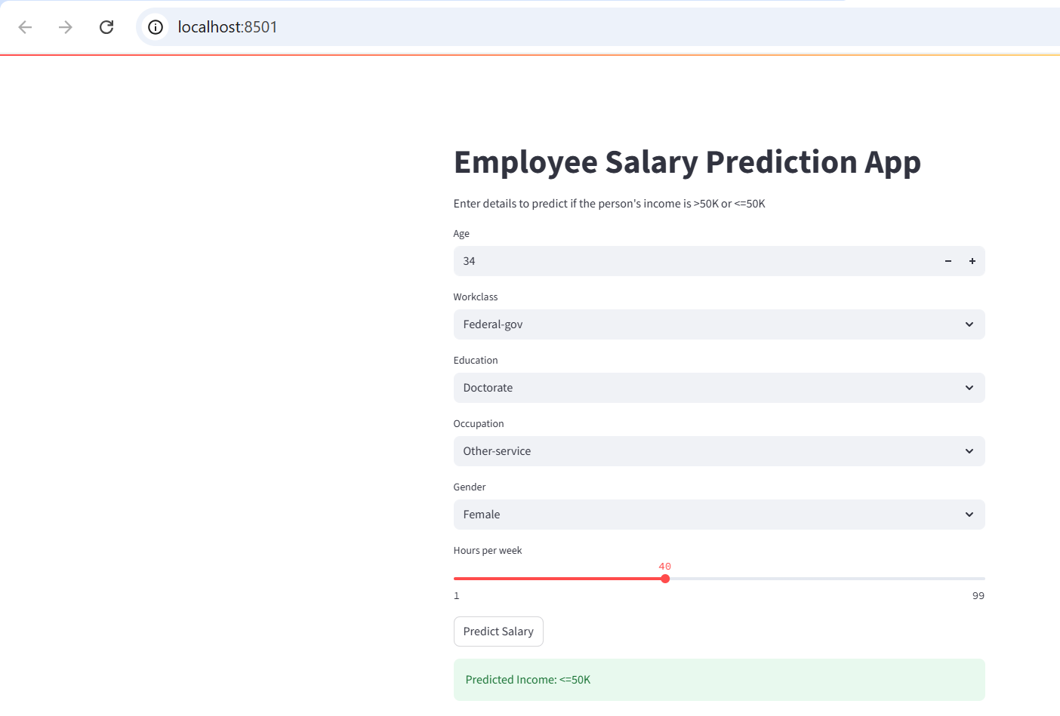
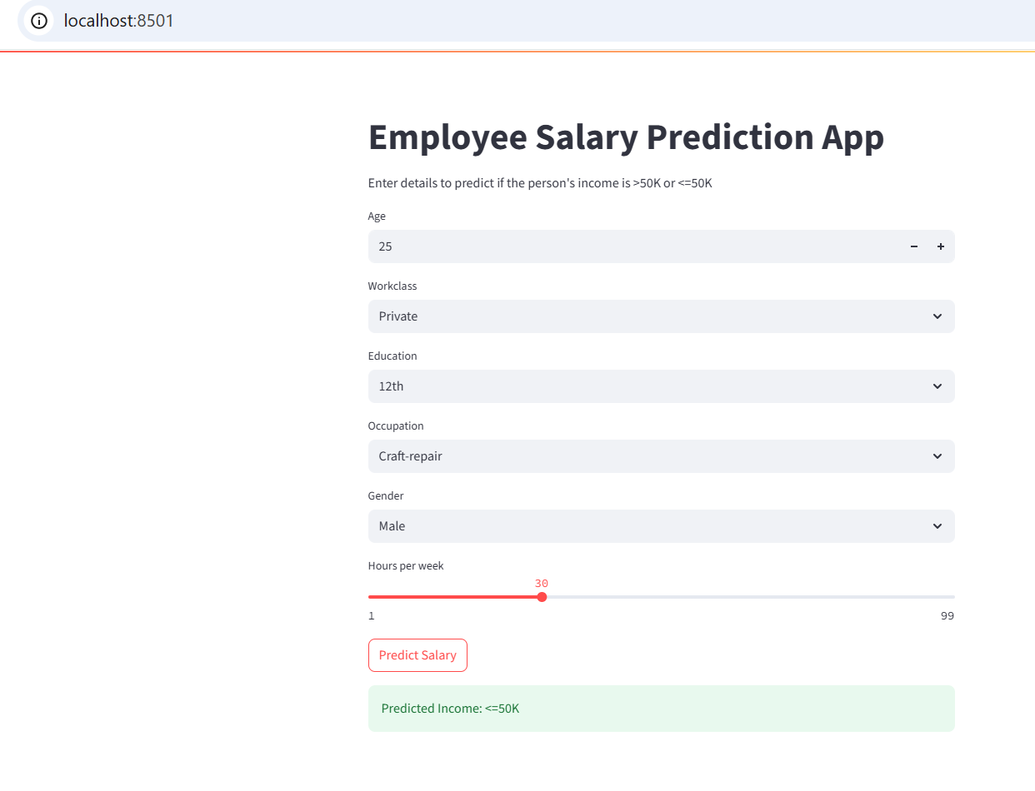
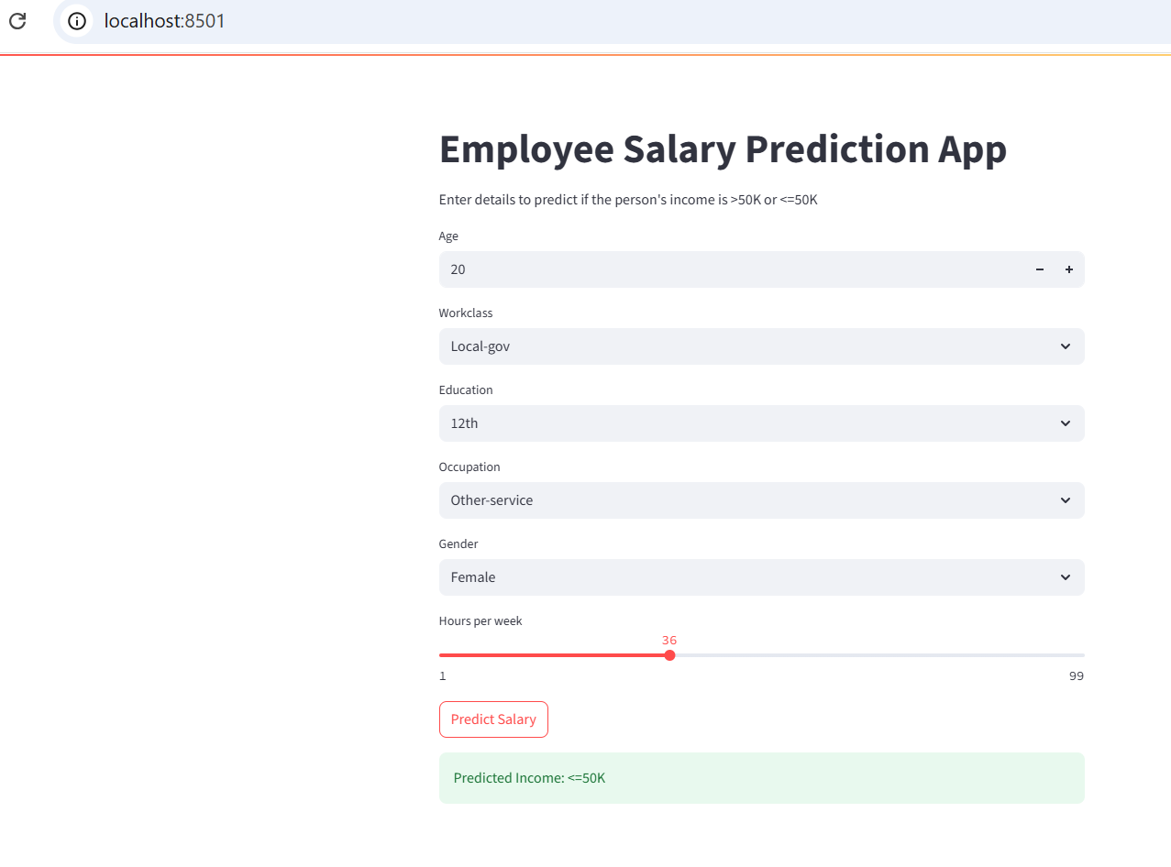
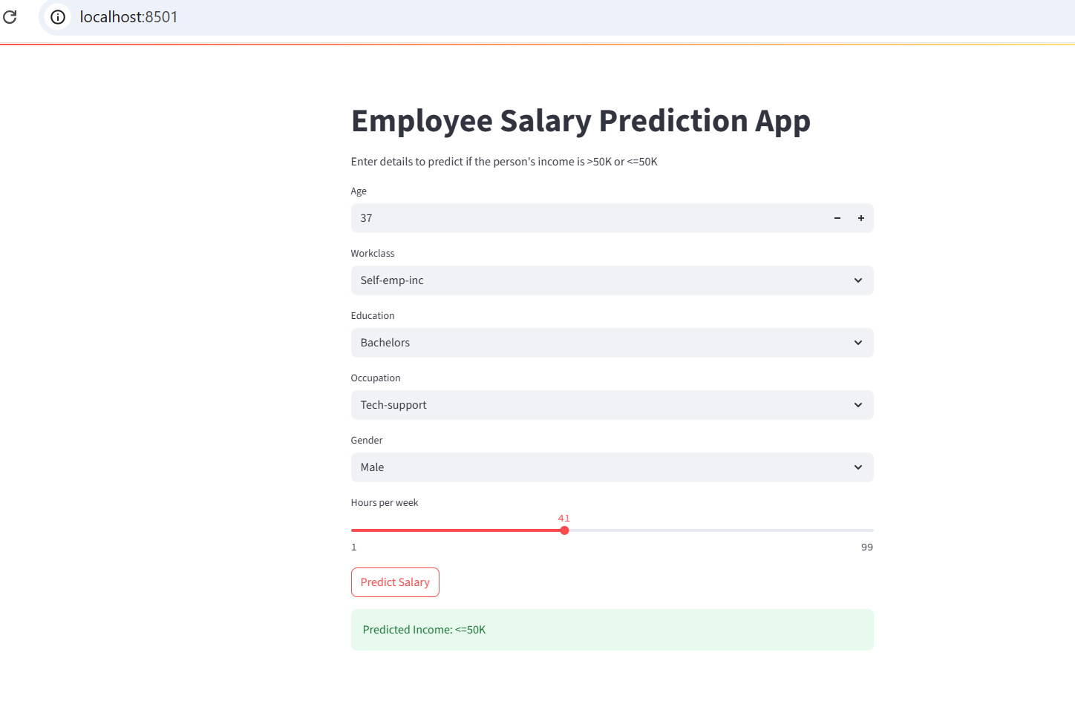
Result
GitHub Link : https://github.com/MUSKAN-SHAIK15/EmployeeSalaryPrediction

Slide 7
Conclusion
The Employee Salary Prediction project effectively classifies whether an individual's salary is greater than 50K or less than or equal to 50K based on various demographic and occupational attributes. The model, developed using logistic regression, demonstrated reliable performance and can be easily accessed through a user-friendly web application built with Flask. During implementation, challenges such as missing data handling, categorical feature encoding, and preventing overfitting were encountered and addressed. Overall, the project provided valuable insights into salary classification based on real-world data. In the future, the system can be enhanced by integrating more advanced machine learning models like XGBoost or neural networks, deploying the application on cloud platforms for broader accessibility, and improving the front-end interface to enhance user experience.

Slide 8
Future scope(Optional)
Integration of Advanced Algorithms: Future versions of the project can use more sophisticated models like Random Forest, XGBoost, or Neural Networks to improve prediction accuracy.
User Authentication: Adding login systems to secure user data and predictions for enterprise use.
Mobile App Integration: Developing a mobile version of the application for easier access by HR professionals and employees.

Slide 9
References
Scikit-learn Documentation https://scikit-learn.org/stable/documentation.html
Joblib Documentation https://joblib.readthedocs.io/
Flask Documentation – Web Application Framework https://flask.palletsprojects.com/
Python Official Documentation https://docs.python.org/3/

Slide 10
THANK YOU

