Slide 1
Language-Lens: Extracting Text And Detecting Language From Images Using MS Azure AI Cognitive Services
By Muskan

Slide 2
AGENDA
Introduction​
Azure cognitive services
​Services used
Demonstration
Future Scope
​Conclusion
​

Slide 3
Introduction
In the digital world, images are a common source of data, but the text in them can be hard to extract and use.
Optical Character Recognition (OCR) technology helps extract text from images.
Azure Cognitive Services offers OCR capabilities and other features for image analysis.
Developers can easily incorporate image text detection and analysis into their applications with Azure Cognitive Services.
Language detection identifies the language of text within images.
Azure Cognitive Services offers language detection for multilingual support and more accurate text analysis.

Slide 4
Azure Cognitive Services
Azure Cognitive Services is a set of cloud-based services that allow developers to easily integrate artificial intelligence capabilities into their applications.
It includes a range of services such as speech recognition, image and video analysis, language understanding, and more.
These services use machine learning algorithms to provide intelligent insights and actions, making applications more powerful and engaging.
Some of the key features of Azure Cognitive Services include easy integration with popular development tools, scalability, security, and global availability.

Slide 5
AZURE SERVICES USED
Computer Vision
Text Analytics
This service is used for reading the text from the uploaded image.
It provides Optical Character Recognition (OCR) capabilities to extract printed and handwritten text from images
In our project, we use the Computer Vision API to extract the text from the uploaded image.
This service is used for language identification of the extracted text.
It provides natural language processing capabilities to identify the language of a given text.
In our project, we use the Text Analytics API to detect the language of the extracted text.

Slide 6



HOW WE GET THERE
Input image
Text detection
LANGUAGE IDENTIFICATION
The user uploads an image to the system.
The image should contain text written in any language which is supported by the system.
The Computer Vision API is used to perform OCR on an uploaded image.
The OCR process extracts text from the image and returns the text as a string. The extracted text is then displayed in a text box on the GUI.
The Azure Text Analytics service is used to identify the language of the extracted text.
This involves analyzing the text and determining the most likely language it is written in.

Slide 7
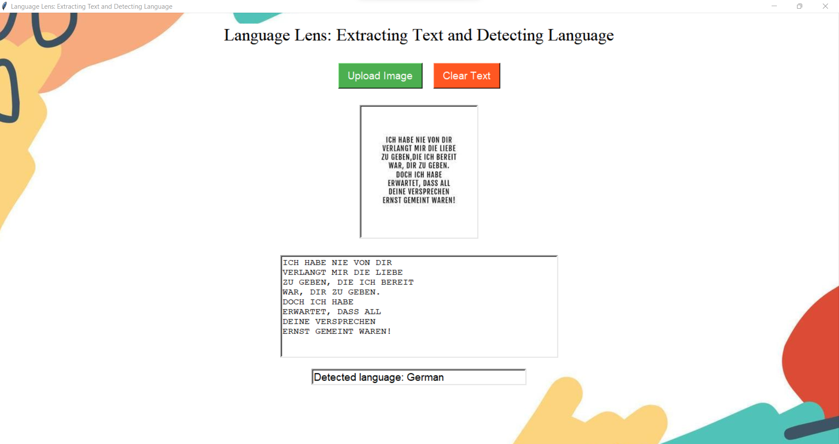
Demonstration

Slide 8
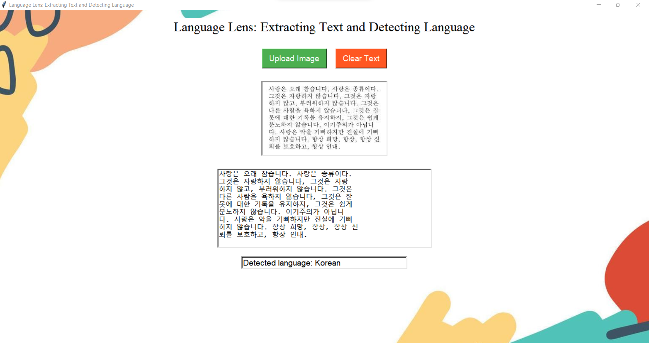
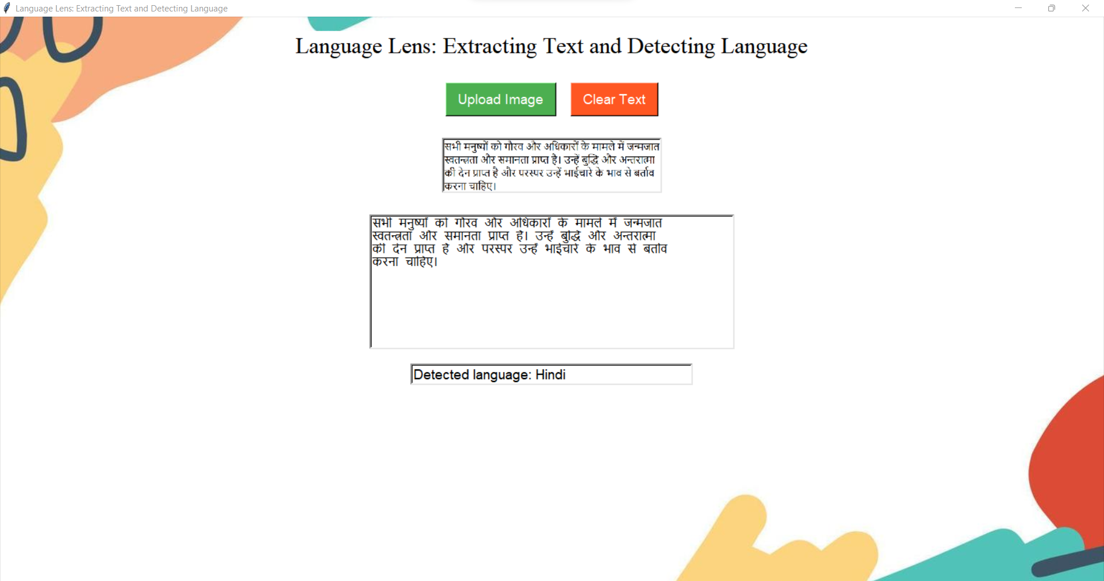
Demonstration

Slide 9
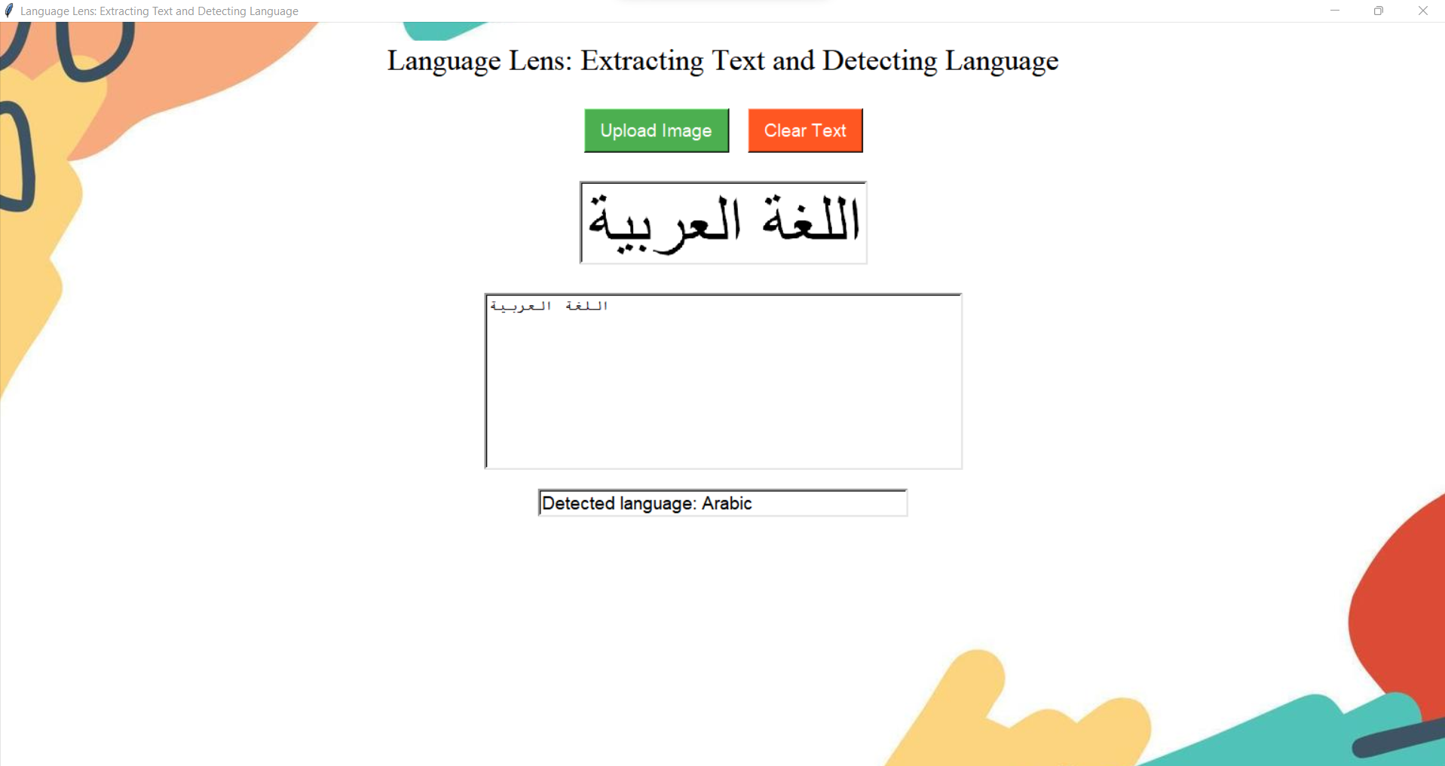
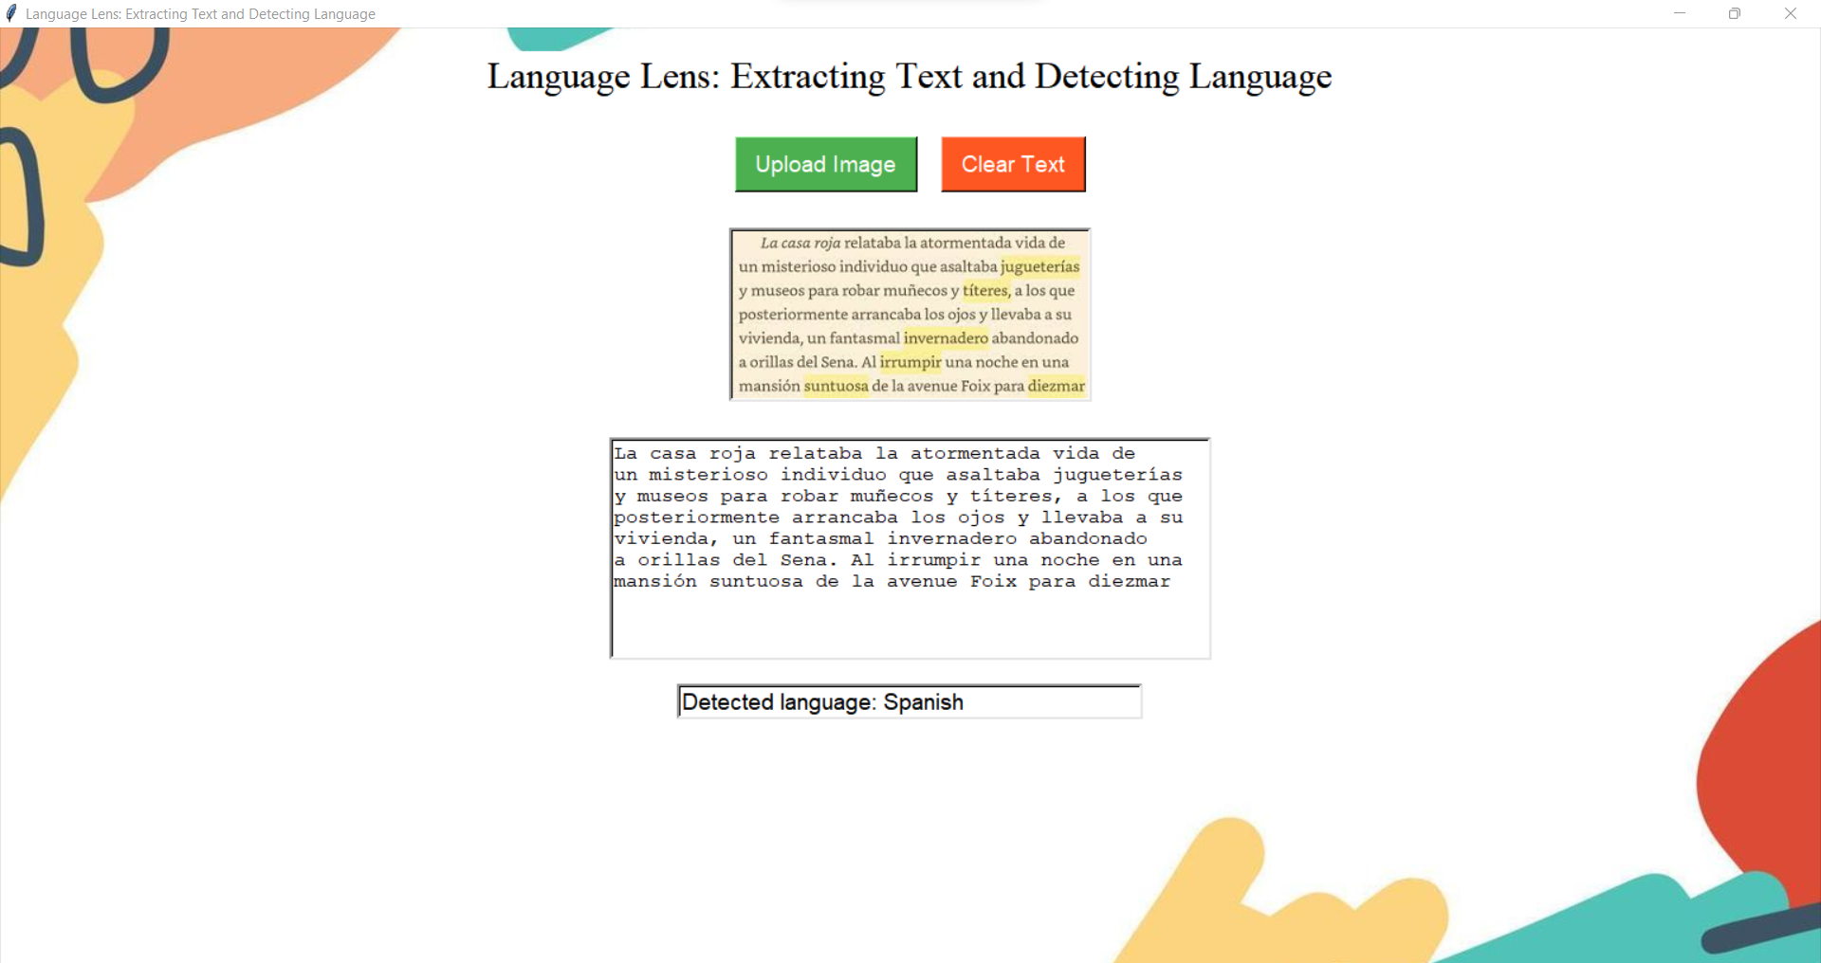
Demonstration

Slide 10
FUTURE SCOPE
Adding a translation feature that can translate the detected language to another language.
Implementing real-time image text detection using a live camera feed instead of uploading an image.
Developing a mobile application version of this project to make it more accessible to users on-the-go.
Expanding the sentiment analysis feature to not only detect the sentiment of the text, but also identify the entities and key phrases present in the text.
Integrating this project with other applications or services, such as a note-taking app, a cloud storage platform, or a social media site.

Slide 11
CONCLUSION
The project is about building an application that detects and extracts text from an image, identifies the language of the text, and performs sentiment analysis on it.
The application uses Azure Cognitive Services such as Computer Vision API and Text Analytics API for these tasks.
It can be useful in various industries that deal with text-based data and can improve efficiency by automating text extraction and language identification tasks.

Slide 12
THANK YOU

