Slide 1
Package in Java
Package in Java is a mechanism to encapsulate a group of classes, sub packages and interfaces.
A Package can be defined as a grouping of related types (classes, interfaces, enumerations and annotations ) providing access protection and namespace management.
Package in java can be categorized in two form, built-in package and user-defined package. Some of the existing packages in Java are −
java.lang − bundles the fundamental classes
java.io − classes for input , output functions are bundled in this package
It is a good practice to group related classes implemented by you so that a programmer can easily determine that the classes, interfaces, enumerations, and annotations are related.

Slide 2
Advantage of Java Package
Java package is used to categorize the classes and interfaces so that they can be easily maintained.
Java package provides access protection.
Java package removes naming collision.
The package keyword is used to create a package in java.

Slide 3
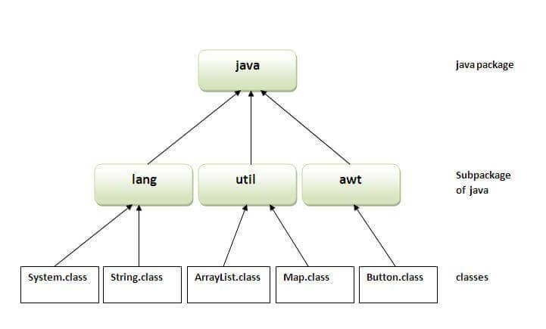

Slide 4
Example of java package
package mypack;
public class Simple
{
public static void main(String args[])
{
System.out.println("Welcome to package");
}
}

Slide 5
How to compile java package
If you are not using any IDE, you need to follow the syntax given below:
javac -d directory javafilename
For example
javac -d . Simple.java

Slide 6
How to run java package program
You need to use fully qualified name e.g. mypack.Simple etc to run the class.
To Compile: javac -d . Simple.java
The -d is a switch that tells the compiler where to put the class file i.e. it represents destination.
The . represents the current folder.
To Run: java mypack.Simple

Slide 7
How to access package from another package?
There are three ways to access the package from outside the package.
import package.*;
import package.classname;
fully qualified name.

Slide 8
1) Using packagename.*
If you use package.* then all the classes and interfaces of this package will be accessible but not subpackages.
The import keyword is used to make the classes and interface of another package accessible to the current package.
//save by A.java package pack; public class A{
public void msg(){System.out.println("Hello");}
}

Slide 9
//save by B.java
package mypack;
import pack.*;
class B{
public static void main(String args[]){ A obj = new A();
obj.msg();
}
}

Slide 10
2) Using packagename.classname
If you import package.classname then only declared class of this package will be accessible.

Slide 11
//save by A.java
package pack; public class A
{
public void msg(){System.out.println("Hello");}
}
package mypack;
import pack.A; class B
{
public static void main(String args[])
{
A obj = new A(); obj.msg();
}
}

Slide 12
3) Using fully qualified name
If you use fully qualified name then only declared class of this package will be accessible.
Now there is no need to import.
But you need to use fully qualified name every time when you are accessing the class or interface.
It is generally used when two packages have same class name e.g. java.util and java.sql packages contain Date class.

Slide 13
//save by B.java
package mypack; class B{
public static void main(String args[])
{
pack.A obj = new pack.A();//using fully qualified name obj.msg();
}
}
Output:Hello

