Slide 1
Java Applet
Applet is a special type of program that is embedded in the webpage to generate the dynamic content.
It runs inside the browser and works at client side.
Advantage of Applet
There are many advantages of applet. They are as follows:
It works at client side so less response time.
Secured
It can be executed by browsers running under many plateforms, including Linux, Windows, Mac Os etc.

Slide 2
Lifecycle of Java Applet
Applet is initialized.
Applet is started.
Applet is painted.
Applet is stopped.
Applet is destroyed

Slide 3
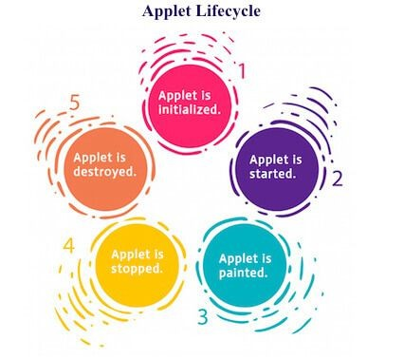

Slide 4
Lifecycle methods for Applet:
The java.applet.Applet class 4 life cycle methods and java.awt.Component class provides 1 life cycle methods for an applet.
java.applet.Applet class
For creating any applet java.applet.Applet class must be inherited. It provides 4 life cycle methods of applet.
public void init(): is used to initialized the Applet. It is invoked only once.
public void start(): is invoked after the init() method or browser is maximized. It is used to start the Applet.
public void stop(): is used to stop the Applet. It is invoked when Applet is stop or browser is minimized.
public void destroy(): is used to destroy the Applet. It is invoked only once.

Slide 5
java.awt.Component class
The Component class provides 1 life cycle method of applet.
public void paint(Graphics g): is used to paint the Applet. It provides Graphics class object that can be used for drawing oval, rectangle, arc etc.
How to run an Applet?
There are two ways to run an applet
By html file.
By appletViewer tool (for testing purpose).

Slide 6
Simple example of Applet by html file:
To execute the applet by html file, create an applet and compile it.
After that create an html file and place the applet code in html file. Now click the html file.
import java.applet.Applet; import java.awt.Graphics; public class First extends Applet
{
public void paint(Graphics g)
{
g.drawString("welcome",150,150);
}
}

Slide 7
myapplet.html
<html>
<body>
<applet code="First.class" width="300" height="300">
</applet>
</body>
</html>

Slide 8
Simple example of Applet by appletviewer tool:
To execute the applet by appletviewer tool, create an applet that contains applet tag in comment and compile it.
After that run it by: appletviewer First.java. Now Html file is not required but it is for testing purpose only.

Slide 9
//First.java
import java.applet.Applet; import java.awt.Graphics;
/*
<applet code="First.class" width="300" height="300">
</applet>
*/
c:\> javac First.java
c:\> appletviewer First.java
public class First extends Applet{
public void paint(Graphics g){ g.drawString("Hello World",150,150);
}
}

Slide 10
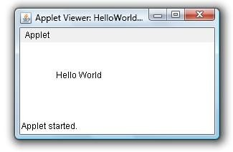

Slide 11
*/
import java.awt.*; import java.applet.*;
public class DisplayImageInApplet extends Applet
{
Image img; public void init()
{
img = getImage(getCodeBase(),"Images/Juggler.gif");
}
public void paint(Graphics g)
{
g.drawImage(img,10,20,this);
}
}

Slide 12
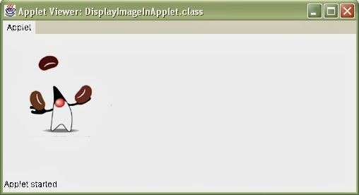

Slide 13
Displaying Image in Applet
Applet is mostly used in games and animation.
For this purpose image is required to be displayed.
The java.awt.Graphics class provide a method drawImage() to display the image.
Syntax of drawImage() method:
1. public abstract boolean drawImage(Image img, int x, int y, ImageObserver observer):
is used draw the specified image.

Slide 14
Other required methods of Applet class to display image:
public URL getDocumentBase(): is used to return the URL of the document in which applet is
embedded.
public URL getCodeBase(): is used to return the base URL.

Slide 15
Example of displaying image in applet:
import java.awt.*;
import java.applet.*;
public class DisplayImage extends Applet { Image picture;
public void init() {
picture = getImage(getDocumentBase(),"sonoo.jpg");
}
public void paint(Graphics g) { g.drawImage(picture, 30,30, this);
}
}

Slide 16
<html>
<body>
<applet code="DisplayImage.class" width="300" height="300">
</applet>
</body>
</html>

Slide 17
Animation in Applet
Applet is mostly used in games and animation. For this purpose image is required to be moved.
import java.awt.*;
import java.applet.*;
public class AnimationExample extends Applet { Image picture;
public void init() {
picture =getImage(getDocumentBase(),"bike_1.gif");
}

Slide 18
public void paint(Graphics g) {
for(int i=0;i<500;i++){ g.drawImage(picture, i,30, this);
try{Thread.sleep(100);}catch(Exception e){}
}
}
}

Slide 19
myapplet.html
<html>
<body>
<applet code="DisplayImage.class" width="300" height="300">
</applet>
</body>
</html>

Slide 20
Smiling Face
import java.applet.Applet;
g.fillOval(50,60,15,25); // Left Eye
import java.awt.*;
g.fillOval(120,60,15,25); // Right Eye
/* <applet code="SmileyExc.class" width="200" height="200">
int x[] = {95,85,106,95};
</applet>
int y[] = {85,104,104,85};
g.drawPolygon(x, y, 4); // Nose g.drawArc(55,95,78,50,0,-180); // Smile
*/
public class SmileyExc extends Applet {
// drawArc(RectF oval, float startAngle, float sweepAngle, boolean useCenter, Paint paint)
g.drawLine(50,126,60,116); // Smile arc1 g.drawLine(128,115,139,126); // Smile arc2
public void paint(Graphics g) {
g.setColor(Color.yellow);
g.fillOval(20,20,150,150);
// For face
g.setColor(Color.black);
}
}

Slide 21
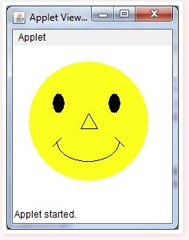

Slide 22
import java.awt.*; import javax.swing.*;
public class rectangle extends JApplet {
Draw a rectangle using drawRect(int x, int y, int width, int height)
// paint the applet
public void paint(Graphics g)
{
// set Color for rectangle g.setColor(Color.red);
// draw a rectangle g.drawRect(100, 100, 200, 200);
}
}
public void init()
{
// set size setSize(400, 400); repaint();
}

Slide 23
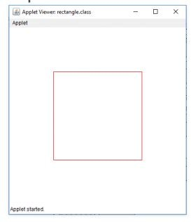

Slide 24
import java.applet.*;
import java.awt.*;
g.fillRoundRect(130,50,120,70,15,15);
g.setColor(Color.RED); g.drawOval(20,160,160,100);
// drawOval( int X, int Y, int width, int height )
g.fillOval(180,160,160,100);
/* <applet code="Geo.class" width =300 height=300>
</applet>
*/
public class
Geo
extends Applet
{
public void paint(Graphics g)
{
}
}
g.setColor(Color.GREEN);
g.drawLine(20,20,100,20);
g.drawRect(20,50,90,90);

Slide 25
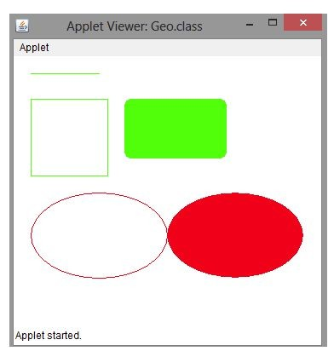

Slide 26
Write an applet that draws four Vertical bars of equal size & of different colors such that they cover up the whole applet area
import java.applet.*; import java.awt.*;
/*
<applet code="equalBars.class" width="500" height="500">
</applet>
*/
public class equalBars extends Applet
{
Color[] clr = {Color.red, Color.green, Color.pink, Color.blue}; int cnt = 0;

Slide 27
public void init()
{
setBackground(Color.black);
}
public void paint(Graphics g)
{
int w = getWidth(); int h = getHeight(); for(int i=0;i<4;i++)
{
g.setColor(clr[i]);
g.fillRect(w/4*i,0,w/4,h);
// fillRect(int x, int y, int width, int height)
}
}
}

Slide 28


Slide 29
Cartoon Character – Moving Hands
import java.applet.*; import java.awt.*;
/*
<applet code="Cartoon.class" width="500" height="700">
</applet>
*/
public class Cartoon extends Applet
{
int y = 200; public void init()
{
setBackground(Color.YELLOW);
}

Slide 30
public void stop()
{
if (y==200) y = 50;
else
y = 200;
}
public void paint(Graphics g)
{ g.drawOval(200,50,100,100);
g.drawRect(50,150,400,50); g.drawRect(50,y,50,100); g.drawRect(400,y,50,100); g.drawRect(150,200,200,300); g.drawRect(150,500,50,100); g.drawRect(300,500,50,100);
}

Slide 31
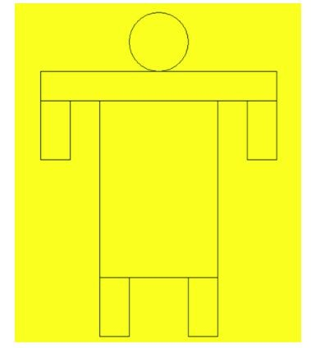

Slide 32
Analog clock in Applet
import java.applet.*;
import java.awt.*; import java.util.*; import java.text.*;
public class MyClock extends Applet implements Runnable {
int width, height; Thread t = null;
boolean threadSuspended;
int hours=0, minutes=0, seconds=0; String timeString = "";

Slide 33
public void init() {
width = getSize().width; height = getSize().height;
setBackground( Color.black ); }
public void start() {
if ( t == null ) {
t = new Thread( this );
t.setPriority( Thread.MIN_PRIORITY ); threadSuspended = false;
t.start();
}

Slide 34
else {
if ( threadSuspended ) { threadSuspended = false; synchronized( this ) {
notify(); }
} } }
public void stop() { threadSuspended = true;
}
public void run() {

Slide 35
Calendar cal = Calendar.getInstance();
hours = cal.get( Calendar.HOUR_OF_DAY );
if ( hours > 12 ) hours -= 12;
minutes = cal.get( Calendar.MINUTE ); seconds = cal.get( Calendar.SECOND );
SimpleDateFormat formatter
= new SimpleDateFormat( "hh:mm:ss", Locale.getDefault() ); Date date = cal.getTime();
timeString = formatter.format( date );

Slide 36
// Now the thread checks to see if it should suspend itself
if ( threadSuspended ) {
synchronized( this ) {
while ( threadSuspended ) { wait();
} } }
repaint();
t.sleep( 1000 ); // interval specified in milliseconds
} }
catch (Exception e) { }
}

Slide 37
void drawHand( double angle, int radius, Graphics g ) {
angle -= 0.5 * Math.PI;
int x = (int)( radius*Math.cos(angle) );
int y = (int)( radius*Math.sin(angle) );
g.drawLine( width/2, height/2, width/2 + x, height/2 + y );
}
void drawWedge( double angle, int radius, Graphics g ) { angle -= 0.5 * Math.PI;
int x = (int)( radius*Math.cos(angle) );
int y = (int)( radius*Math.sin(angle) );

Slide 38
angle += 2*Math.PI/3;
int x2 = (int)( 5*Math.cos(angle) ); int y2 = (int)( 5*Math.sin(angle) ); angle += 2*Math.PI/3;
int x3 = (int)( 5*Math.cos(angle) );
int y3 = (int)( 5*Math.sin(angle) );
g.drawLine( width/2+x2, height/2+y2, width/2 + x, height/2 + y ); g.drawLine( width/2+x3, height/2+y3, width/2 + x, height/2 + y ); g.drawLine( width/2+x2, height/2+y2, width/2 + x3, height/2 + y3 );
}

Slide 39
public void paint( Graphics g ) {
g.setColor( Color.gray );
drawWedge( 2*Math.PI * hours / 12, width/5, g ); drawWedge( 2*Math.PI * minutes / 60, width/3, g ); drawHand( 2*Math.PI * seconds / 60, width/2, g ); g.setColor( Color.white );
g.drawString( timeString, 10, height-10 );
}
}

Slide 40
myapplet.html
<html>
<body>
<applet code="MyClock.class" width="300" height="300">
</applet>
</body>
</html>

Slide 41
Applet Communication
java.applet.AppletContext class provides the facility of communication between applets. We provide the name of applet through the HTML file. It provides getApplet() method that returns the object of Applet.
Syntax:
1. public Applet getApplet(String name){}

Slide 42
Write a program to generate a Bouncing Ball on Click
import java.applet.*;
import java.awt.*;
import java.awt.event.*;
public class ContextApplet extends Applet implements ActionListener{ Button b;
public void init(){ b=new Button("Click"); b.setBounds(50,50,60,50);
add(b); b.addActionListener(this);
}

Slide 43
public void actionPerformed(ActionEvent e){
AppletContext ctx=getAppletContext(); Applet a=ctx.getApplet("app2"); a.setBackground(Color.yellow);
}
}

Slide 44
myapplet.html
<html>
<body>
<applet code="ContextApplet.class" width="150" height="150" name="app1">
</applet>
<applet code="First.class" width="150" height="150" name="app2">
</applet>
</body>
</html>

Slide 45
Java Swing
Java Swing tutorial is a part of Java Foundation Classes (JFC) that is used to create window-based applications.
It is built on the top of AWT (Abstract Windowing Toolkit) API and entirely written in java. Java Swing provides platform-independent and lightweight components.
Swing is more flexible and robust Some of the basic classes are
JApplet JFame JButton

Slide 46
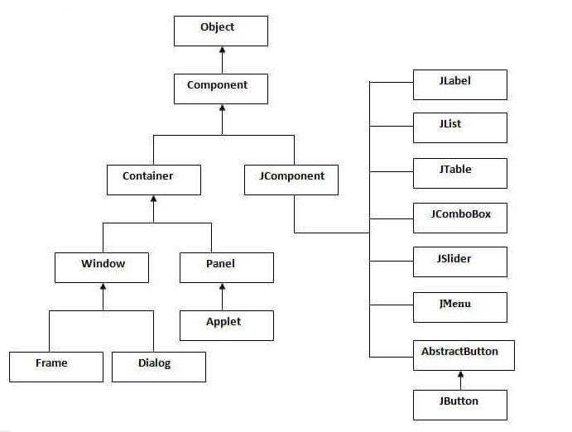
Hierarchy of Java Swing classes

Slide 47
Features of Swing
Swing components are Lightweight
Having a number of built in controls
We can change the look and feel of the GUI
Swing is not thread safe

Slide 48
import javax.swing.*;
f.setSize(400,500);//400 width and 500 height
A simple swing example where we are creating one button and adding it on the JFrame object inside the main() method.
public class FirstSwingExample
f.setLayout(null);//using no layout managers
{
f.setVisible(true);//making the frame visible
public static void main(String[] args)
}
{
}
JFrame f=new JFrame();//creating instance of JFrame
JButton b=new JButton("click");//creating instance of JButton
javac FirstSwingExample .java
b.setBounds(130,100,100, 40);//x axis, y axis, width, height
java FirstSwingExample
f.add(b);//adding button in JFrame

Slide 49
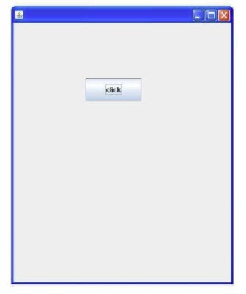

Slide 50
Java JRadioButton
The JRadioButton class is used to create a radio button.
It is used to choose one option from multiple options.
It is widely used in exam systems or quiz.
It should be added in ButtonGroup to select one radio button only.

Slide 51
import javax.swing.*;
public class RadioButtonExample {
bg.add(r1);bg.add(r2);
JFrame f;
f.add(r1);f.add(r2);
RadioButtonExample(){
f.setSize(300,300);
f=new JFrame();
f.setLayout(null);
JRadioButton r1=new JRadioButton("A) Male");
f.setVisible(true);
JRadioButton r2=new JRadioButton("B) Female");
}
r1.setBounds(75,50,100,30);
public static void main(String[] args)
r2.setBounds(75,100,100,30);
{
ButtonGroup bg=new ButtonGroup();
new RadioButtonExample();
}
}

Slide 52
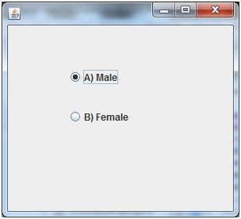

Slide 53
Java JComboBox
The object of Choice class is used to show popup menu of choices.
Choice selected by user is shown on the top of a menu.
It inherits JComponent class.

Slide 54
import javax.swing.*;
public class ComboBoxExample {
f.setLayout(null);
JFrame f;
f.setSize(400,500);
ComboBoxExample(){
f.setVisible(true);
f=new JFrame("ComboBox Example");
}
String
country[]={"India","Aus","U.S.A","England","Newzealand"};
public static void main(String[] args)
{
JComboBox cb=new JComboBox(country);
new ComboBoxExample();
cb.setBounds(50, 50,90,20);
}
f.add(cb);
}

Slide 55
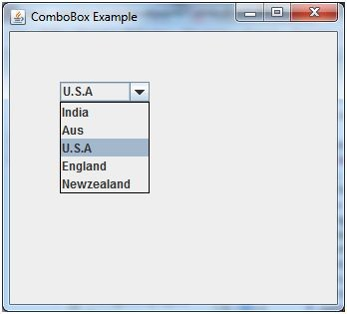

Slide 56
Java JTable
The JTable class is used to display data in tabular form.
It is composed of rows and columns.
Let's see the declaration for javax.swing.JTable class.

Slide 57
JTable jt=new JTable(data,column);
import javax.swing.*;
jt.setBounds(30,40,200,300);
public class TableExample {
JScrollPane sp=new JScrollPane(jt);
JFrame f;
f.add(sp);
TableExample(){
f.setSize(300,400);
f=new JFrame();
f.setVisible(true);
String data[][]={ {"101","Amit","670000"},
}
{"102","Jai","780000"},
public static void main(String[] args) {
{"101","Sachin","700000"}};
new TableExample();
String column[]={"ID","NAME","SALARY"};
}
}

Slide 58
