Slide 1
Threads
JAVA

Slide 2
What is Thread in java
A thread is a lightweight subprocess, the smallest unit of processing.
It is a separate path of execution.
Threads are independent.
If there occurs exception in one thread, it doesn't affect other threads.
It uses a shared memory area.

Slide 3
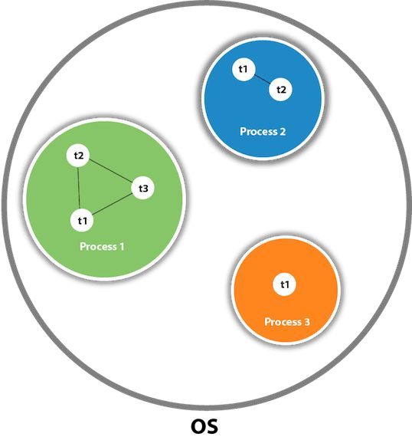

Slide 4
Java Thread class
Java provides Thread class to achieve thread programming.
Thread class provides constructors and methods to create and perform operations on a thread.
Thread class extends Object class and implements Runnable interface

Slide 5
Life cycle of a Thread (Thread States)
A thread can be in one of the five states.
According to sun, there is only 4 states in thread life cycle in java new, runnable, non-runnable and terminated.
There is no running state.
But for better understanding the threads, we are explaining it in the 5 states.
The life cycle of the thread in java is controlled by JVM.
The java thread states are as follows:

Slide 6
New
Runnable
Running
Non-Runnable (Blocked)
Terminated

Slide 7
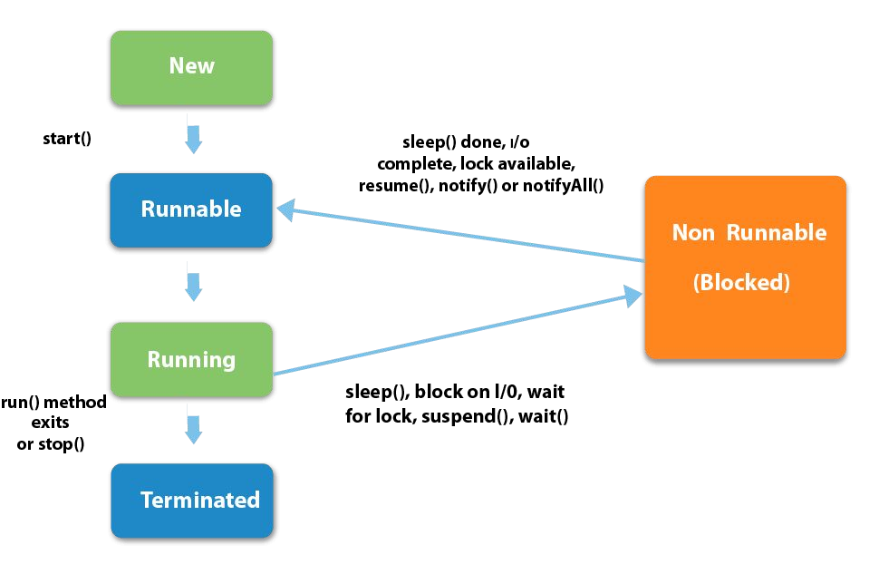

Slide 8
1) New
The thread is in new state if you create an instance of Thread class but before the invocation of start() method.
2) Runnable
The thread is in runnable state after invocation of start() method, but the thread scheduler has not selected it to be the running thread.
3) Running
The thread is in running state if the thread scheduler has selected it.

Slide 9
4) Non-Runnable (Blocked)
This is the state when the thread is still alive, but is currently not eligible to run.
5) Terminated
A thread is in terminated or dead state when its run() method exits

Slide 10
How to create thread
There are two ways to create a thread:
By extending Thread class
By implementing Runnable interface.

Slide 11
Thread class
Thread class provide constructors and methods to create and perform operations on a thread.
Thread class extends Object class and implements Runnable interface.
Commonly used Constructors of Thread class:
Thread()
Thread(String name)
Thread(Runnable r)
Thread(Runnable r,String name)

Slide 12
Commonly used methods of Thread class
public void run(): is used to perform action for a thread.
public void start(): starts the execution of the thread.JVM calls the run() method on the thread.
public void sleep(long miliseconds): Causes the currently executing thread to sleep (temporarily cease execution) for the specified number of milliseconds.
public void join(): waits for a thread to die.
public void join(long miliseconds): waits for a thread to die for the specified miliseconds.
public int getPriority(): returns the priority of the thread.
public int setPriority(int priority): changes the priority of the thread.
public String getName(): returns the name of the thread.
public void setName(String name): changes the name of the thread

Slide 13
Runnable interface:
The Runnable interface should be implemented by any class whose instances are intended to be executed by a thread.
Runnable interface have only one method named run().
1. public void run(): is used to perform action for a thread.

Slide 14
Starting a thread:
start() method of Thread class is used to start a newly created thread.
It performs following tasks:
A new thread starts(with new callstack).
The thread moves from New state to the Runnable state.
When the thread gets a chance to execute, its target run() method will run

Slide 15
Thread Example by extending Thread class
class Multi extends Thread
{
public void run()
{
System.out.println("thread is running...");
}
public static void main(String args[])
{
Multi t1=new Multi(); t1.start();
}
}
Output:
thread is running..

Slide 16
Thread Example by implementing Runnable interface
class Multi implements Runnable
{
public void run()
{
System.out.println("thread is running...");
}
public static void main(String args[])
{
Multi m1=new Multi(); Thread t1 =new Thread(m1); t1.start();
}
}
Output : thread is running...

Slide 17
Sleep method in java
The sleep() method of Thread class is used to sleep a thread for the specified amount of time.
Syntax of sleep() method in java
The Thread class provides two methods for sleeping a thread:
public static void sleep(long miliseconds)throws InterruptedException
public static void sleep(long miliseconds, int nanos)throws InterruptedException

Slide 18
class TestSleepMethod1 extends Thread
{
public void run()
{
for(int i=1;i<5;i++)
{
try{
Thread.sleep(500);
}
catch(InterruptedException e)
{
System.out.println(e);
}
System.out.println(i);
}
}

Slide 19
public static void main(String args[])
{
TestSleepMethod1 t1=new TestSleepMethod1(); TestSleepMethod1 t2=new TestSleepMethod1(); t1.start();
t2.start();
}
}

Slide 20
Output :
1
1
As you know well that at a time only one thread is executed.
2
If you sleep a thread for the specified time,the thread scheduler picks up another thread and so on.
2
3
3
4
4

Slide 21
Naming Thread and Current Thread
Naming Thread
The Thread class provides methods to change and get the name of a thread. By default, each thread has a name i.e. thread-0, thread-1 and so on.
By we can change the name of the thread by using setName() method.
The syntax of setName() and getName() methods are given below:
public String getName(): is used to return the name of a thread.
public void setName(String name): is used to change the name of a thread.

Slide 22
class TestMultiNaming1 extends Thread{
public void run()
{
System.out.println("running...");
}
public static void main(String args[]){ TestMultiNaming1 t1=new TestMultiNaming1(); TestMultiNaming1 t2=new TestMultiNaming1(); System.out.println("Name of t1:"+t1.getName()); System.out.println("Name of t2:"+t2.getName()); t1.start();
t2.start(); t1.setName("Sonoo Jaiswal");
System.out.println("After changing name of t1:"+t1.getName());
}
}

Slide 23
Output:
Name of t1:Thread-0
Name of t2:Thread-1 id of t1:8
running...
After changeling name of t1:Sonoo Jaiswal running...

Slide 24
Priority of a Thread (Thread Priority):
Each thread have a priority.
Priorities are represented by a number between 1 and 10.
In most cases, thread schedular schedules the threads according to their priority (known as preemptive scheduling).
But it is not guaranteed because it depends on JVM specification that which scheduling it chooses.
3 constants defined in Thread class:
public static int MIN_PRIORITY
public static int NORM_PRIORITY
public static int MAX_PRIORITY
Default priority of a thread is 5 (NORM_PRIORITY).
The value of MIN_PRIORITY is 1 and the value of MAX_PRIORITY is 10.

Slide 25
{
public void run()
{
System.out.println("running thread name is:"+Thread.currentThread().getName()); System.out.println("running thread priority is:"+Thread.currentThread().getPriority());
}
public static void main(String args[])
{
TestMultiPriority1 m1=new TestMultiPriority1(); TestMultiPriority1 m2=new TestMultiPriority1(); m1.setPriority(Thread.MIN_PRIORITY); m2.setPriority(Thread.MAX_PRIORITY); m1.start();
m2.start();
}
}

Slide 26
Output:
running thread name is:Thread-0
running thread priority is:10 running thread name is:Thread-1 running thread priority is:1

