Slide 1

Contents
JAVA Swings

Slide 2
JAVA Swings
Swing in Java is a lightweight GUI toolkit which has a wide variety of widgets for building optimized window based applications.
lightweight and platform independent
It includes components like button, scroll bar, text field etc. Putting together all these components makes a graphical user interface.

Slide 3
Java AWT(abstract window toolkit) | Java Swing
Java AWT is an API to develop GUI applications in Java. | Swing is a part of Java Foundation Classes and is used to create various applications.
Components of AWT are heavy weighted. | The components of Java Swing are lightweight.
Components are platform dependent. | Components are platform independent.
Execution Time is more than Swing. | Execution Time is less than AWT.
AWT components require java.awt package. | Swing components requires javax.swing package.

Slide 4
Container Class
Any class which has other components in it is called as a container class. For building GUI applications at least one container class is necessary.
Three types of container classes:
Panel – It is used to organize components on to a window
Frame – A fully functioning window with icons and titles
Dialog – It is like a pop up window but not fully functional like the frame

Slide 5
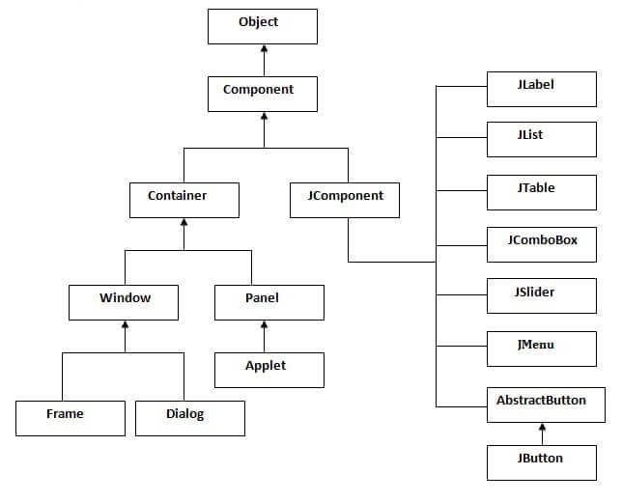

Slide 6
Method | Description
public void add(Component c) | add a component on another component.
public void setSize(int width,int height) | sets size of the component.
public void setLayout(LayoutManager m) | sets the layout manager for the component.
public void setVisible(boolean b) | sets the visibility of the component. It is by default false.

Slide 7
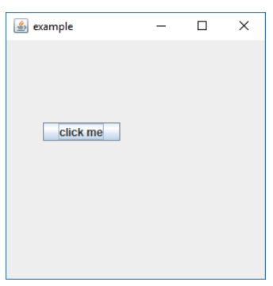
Example – Jbutton Class
import javax.swing.*;
public class example{
public static void main(String args[]) {
JFrame a = new JFrame("example");
JButton b = new JButton("click me");
b.setBounds(40,90,85,20);
a.add(b);
a.setSize(300,300);
a.setLayout(null);
a.setVisible(true);
}
}

Slide 8
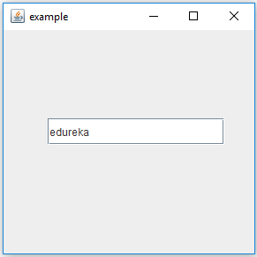
Example – JTextField Class
import javax.swing.*;
public class example{
public static void main(String args[]) {
JFrame a = new JFrame("example");
JTextField b = new JTextField(“Hello");
b.setBounds(50,100,200,30);
a.add(b);
a.setSize(300,300);
a.setLayout(null);
a.setVisible(true);
}
}
Hello

Slide 9
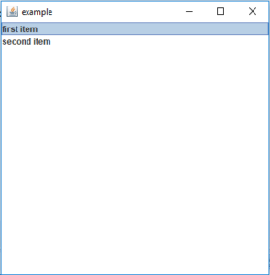
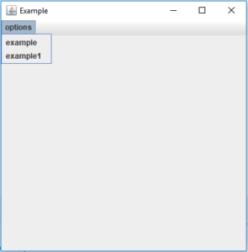
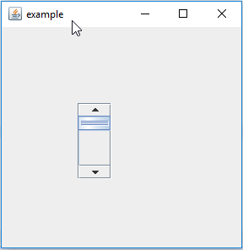
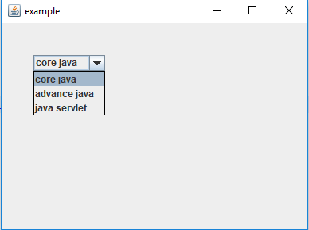
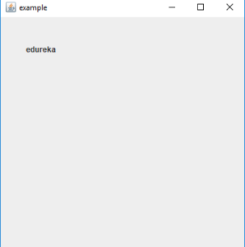
JList Class
JMenu Class
JScrollBar Class
JLabel Class
JComboBox Class

Slide 10
Layout Manager
To arrange the components inside a container we use the layout manager.
Border layout: The borderlayout arranges the components to fit in the five regions: east, west, north, south, and center.
Flow layout: The FlowLayout is the default layout. It layout the components in a directional flow.
GridBag layout: The GridLayout manages the components in the form of a rectangular grid.

Slide 11
https://cse.iitkgp.ac.in/~dsamanta/java/ch10.htm

