Slide 1
CS 4320 / 7320 Software Engineering
Design
Notes:
Write down 3 things about the design of this classroom that you would change.
Design an application for ranking developer awesomeness.

Slide 2
What is the SDLC? Where does Design fit?
Requirements
Analysis
Design
Requirements
Analysis
Requirements
Analysis
Design
Requirements
Analysis
Design
Problem
Design
Problem
Problem
Problem
Release
Testing
Implementation
Release
Testing
Testing
Implementation
Implementation
Maintenance
Problem

Slide 3
Software Design Process
Two-step Process:
Architectural design describes how software is organized into components
Detailed design describes the desired behavior of these components

Slide 4
Architectural Design
System Architecture
High level physical systems involved
Connections between systems
Identify dependencies
Data Architecture
High level (Entity) descriptions of data
Show the data structure (conceptual) at the entity level
Illustrate critical data flows
Process Architecture
Integrate business or user process practices into the architecture
Show the touchpoints between process and technology
Software Architecture
Software components
Connections between components
Key Software Subsystems (i.e., messaging hubs, databases, software components)
Some of these components may also show up in the system architecture

Slide 5
Detailed Design
Software components
Connections between them
Describe behavior down to methods
Possibly stub methods out
Could include writing test cases for methods

Slide 6
Software Design Principles
Key notions
that are the basis for many different
software design approaches and concepts.

Slide 7
Software Design Principles
Abstraction
By Parameterization
By Specification
Procedural Abstraction
Data Abstraction
Control (Iteration) Abstraction

Slide 8
Software Design Principles
Coupling and Cohesion Aiming for Appropriate Coupling and High Cohesion
Decomposition and Modularization Separate functionalities and responsibilities Well defined interfaces

Slide 9
Software Design Principles
Encapsulation and Information Hiding Packaging implementation details together Restricting direct access to a component’s details
Separation of Interface and Implementation Public interface separate from implementation details

Slide 10
Software Design Principles
Sufficiency, Completeness, and Primitiveness All important abstraction characteristics but nothing more Design based on patterns that are easy to implement
Separation of Concerns Architectural views specific to a group of stakeholders

Slide 11
Key Issues in Software Design
Important issues that cut across the whole system
Concurrency Think about order, sequence of actions Concerns: efficiency, atomicity, synchronization, scheduling.

Slide 12
Key Issues in Software Design
Control and Handling of Events Organize data and control flow Handle reactive and temporal events
Data Persistence How to handle long-lived data

Slide 13
Key Issues in Software Design
Distribution of Components How to distribute software across hardware (computer and network) How components communicate How middleware deals with heterogeneous software

Slide 14
Key Issues in Software Design
Error and Exception Handling and Fault Tolerance Prevent, tolerate, and process errors Deal with exceptional conditions
Interaction and Presentation Structure and organize user interaction How to present information

Slide 15
Key Issues in Software Design
Security Prevent unauthorized disclosure, creation, change, deletion of information Avoid denial of access to authorized users How to respond to attacks Access control and proper use of cryptography

Slide 16
Software Structure and Architecture: Architectural Design:
A problem-solving, creative process with decisions involving trade-offs, often on quality attributes

Slide 17
Software Structure and Architecture: Architectural Styles
General structures: layers, pipes, filters Distributed systems: client-server, 3-tiered, broker Interactive systems: Model-View-Controller, Presentation-Abstraction-Control Others…

Slide 18
Software Structure and Architecture: Architectural Styles
What do you know about architecture styles for a typical web application?

Slide 19
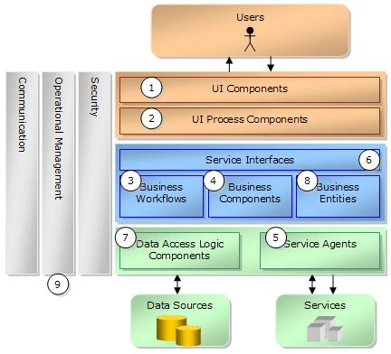
Typical Layered Design
Source: https://msdn.microsoft.com/en-us/library/ms954601.aspx

Slide 20
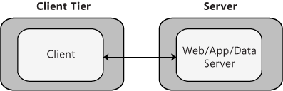
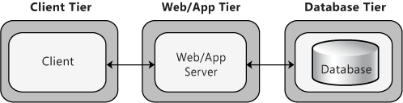
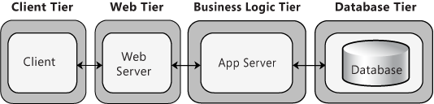
Distributed Deployment Patterns
Client-Server
3-tier
4-tier
Source: https://msdn.microsoft.com/en-us/library/ee658120.aspx

Slide 21

Software Structure and Architecture: Architectural Styles
Microsoft Application Architecture Guide, 2nd Edition by Microsoft Patterns & Practices Team
ISBN-13: 978-0735627109 ISBN-10: 073562710X
Publisher: Microsoft Press (November 22, 2009)
Online Book: https://msdn.microsoft.com/en-us/library/ff650706.aspx
Chapter 3: Architectural Patterns and Styles

Slide 22
Software Structure and Architecture: Design Patterns
Common solutions to a common problem
Object-oriented design patterns Creational: builder, factory, prototype, singleton Structural: adapter, bridge, composite, façade, proxy Behavioral: command, interpreter, iterator, observer

Slide 23
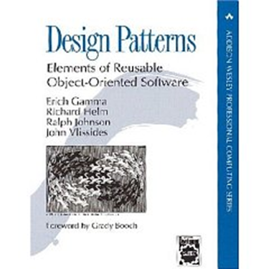
Software Structure and Architecture: Design Patterns
Design Patterns: Elements of Reusable Object-Oriented Software by ErichGamma, RichardHelm, RalphJohnson, and JohnVlissides (the GangOfFour) ISBN 978-0201633610, ISBN 0-201-63361-2 Publisher: AddisonWesley Professional (November 10, 1994)
http://wiki.c2.com/?DesignPatternsBook

Slide 24
Software Structure and Architecture: Frameworks
Framework: A software system providing some generic functionality to facilitate development of software solutions.
Examples: Sprint MVC (java), .Net Framework (Microsoft), Django (python), Bootstrap (html, css, js), many, many, more….

Slide 25
User Interface Design: General Principles
First, know your users. Then consider…
Learnability User familiarity Consistency Minimal surprise Recoverability (from errors) User guidance (feedback) User diversity (accessibility)

Slide 26


User Interface Design:
https://www.usability.gov/what-and-why/user-interface-design.html
https://www.w3.org/WAI/intro/accessibility.php

Slide 27
References
P. Bourque and R. E. Fairley, Eds., SWEBOK v3.0: Guide to the Software Engineering Body of Knowledge, IEEE, 2014.

