Slide 1
CS 4320 / 7320 Software Engineering
Week 3 – Design: UML and Data Models

Slide 2
Design: UML and Data Models
Requirements:
Use Cases and Use Case Diagrams
Design:
Entity-Relationship Modeling Diagrams
Class Diagrams
Activity Diagrams
Sequence Diagrams
State Machines

Slide 3
Use Case Diagrams
Gives a top down perspective of the system
Shows and describes the functional requirements of the system
Does not show the steps to each function or the code
Does not give an order to the system
Describes the typical interactions between the actors and the system

Slide 4
Use Case Diagrams : Basic Symbols
Actors – key players to the system
Use Cases – key functions to the system
Included Functions – required functions
Extended Functions – optional functions
Use Case Descriptions
Overall description of the system
Possible situations of the system

Slide 5
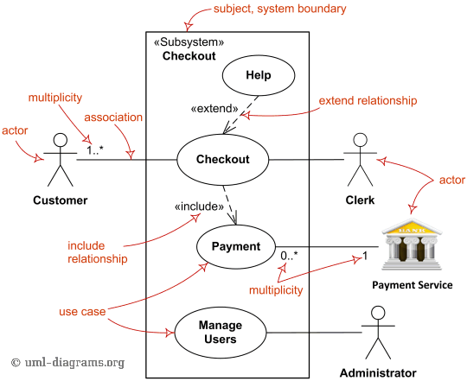
Use Case Diagrams
Notes:
df

Slide 6
Use Case Descriptions: Typical Elements
Title (active verb phrase, states main goal)
Description
Triggers
Actors
Preconditions
Main Success Scenario (Goals)
Failed End Condition
Extensions
Steps of Execution (Requirements)

Slide 7
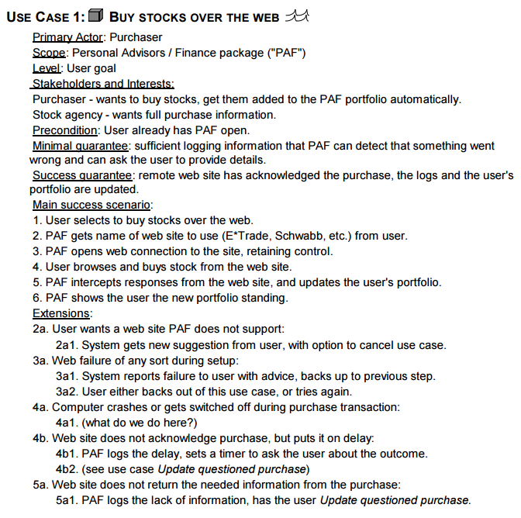
Use Case Example
Writing Effective use Cases by Alistair Cockburn ISBN-13: 978-0201702255 ISBN-10: 0201702258 Publisher: Addison-Wesley Professional; (October 15, 2000)
From the pre-publication draft online: http://alistair.cockburn.us/get/2465

Slide 8
Data Modeling
What are the data entities of the system?
What are the attributes of each entity?
What are the constraints on the attributes of the entities?
What can be used to uniquely identify entities in the system?
How are the different entities related?

Slide 9
Data Modeling
Entity: a person, place, or thing about which we want to collect and store multiple instances of data
Attribute: data that describes the entity
Constraints: specific rules like not null, unique, check constraints (value < 10), default values
Unique identifiers: primary or surrogate key (be careful!)

Slide 10
Data Modeling
Relationships: associations between entities
In logical and physical models, requires foreign keys
Cardinality constraints
zero or more; one or more; one and only one; zero or one

Slide 11
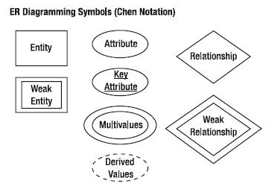
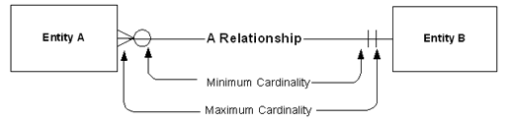
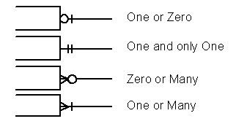


ERD: Chen vs. Crow’s Foot

Slide 12
Object Oriented Design
What
Representing the components of a system as objects, which have a strong correlation to real-world entities
Modeling the attributes and actions of these entities
Modeling their inter-relationships and associations
Why
Clear approach to capturing the real-world needs in the model
Straight-forward conversion from model to components

Slide 13
Object Oriented Design What is an Object?
Some entity that models a real-world concept that is either:
Actor
Environment
Entity
Objects are defined by a Class definition
Attributes / Fields / Members / State
Actions / Methods
An instantiated Class is an Object
The class is the blueprint!

Slide 14
Object Oriented Design
Other topics in OOD:
Encapsulation (information hiding)
Abstraction
Inheritance
Polymorphism

Slide 15
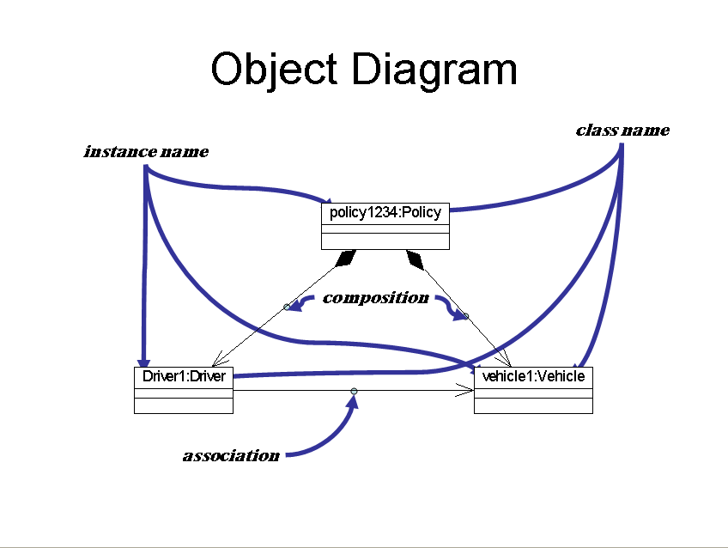

Slide 16
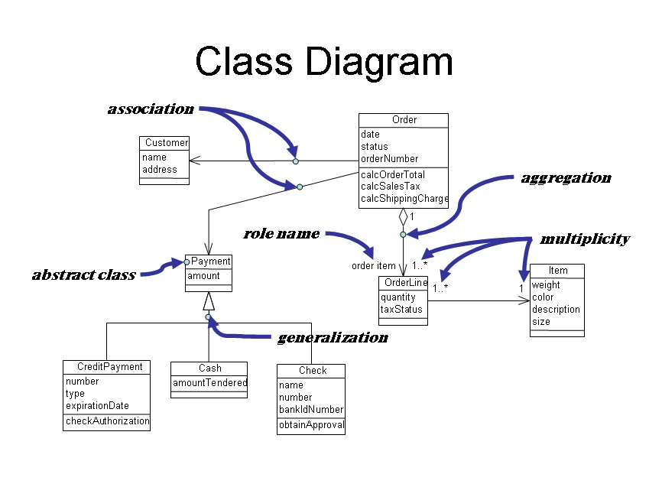

Slide 17
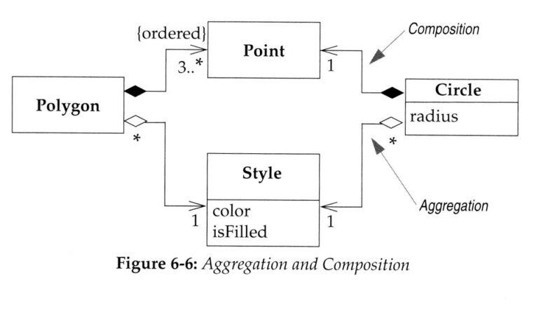
UML Class Diagram: HasA

Slide 18
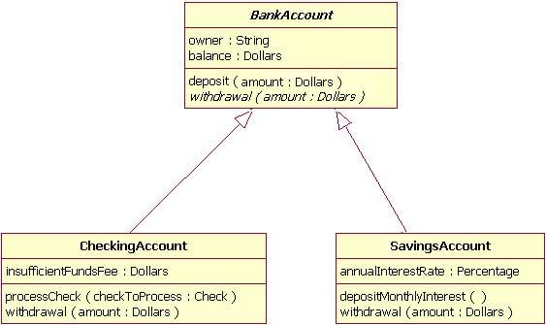
UML Class Diagram: Inheritance

Slide 19
UML Activity Diagrams
Used to describe procedural logic and work flow
Similar to a flowchart
Sometimes used to describe a Use Case
Shows the procedures needed for each Use Case
Supports parallel behavior

Slide 20
UML Activity Diagrams: Symbols
Action
Initial function to describe
Fork / Join
Parallel processes not needed to run in order
Decision / Merge
Conditional statements
If-then-else statements
Flow / Edges

Slide 21
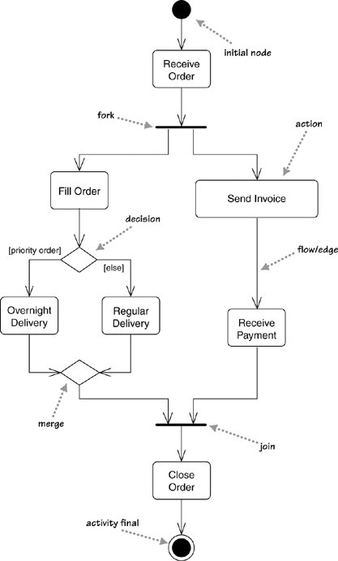
UML Activity Diagram

Slide 22
UML Sequence Diagram
Interactive Design
Passes messages between participants (objects)
Shows the process of a single scenario
Shows how long each participant is active
Shows what each participant contributes to the process

Slide 23
UML Sequence Diagram: Symbols
Object
Timeline
How long each object is active
Active Object
Method Call
Reaching the next object with a call
Messages

Slide 24
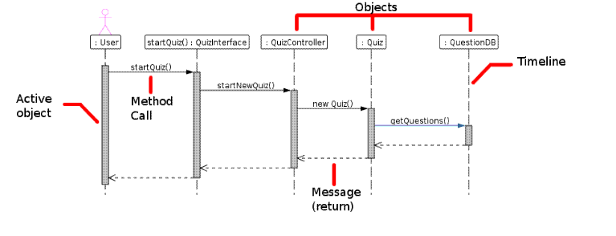
UML Sequence Diagrams:

Slide 25
UML Sequence Diagram: Advanced Symbols
Creating and Deleting Objects
Objects only last while as an active object
Loops, Conditional Statements
if – then statements
Synchronous and Asynchronous Calls
Sending several messages in parallel
Common Operators for Interaction Frames

Slide 26
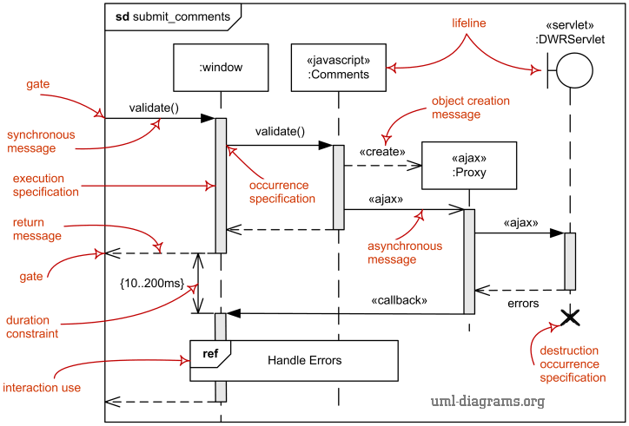
UML Sequence Diagrams

Slide 27
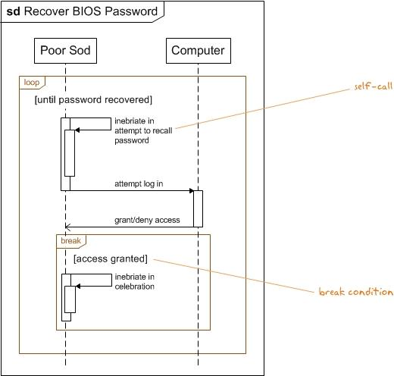
UML Sequence Diagram: Loops

Slide 28
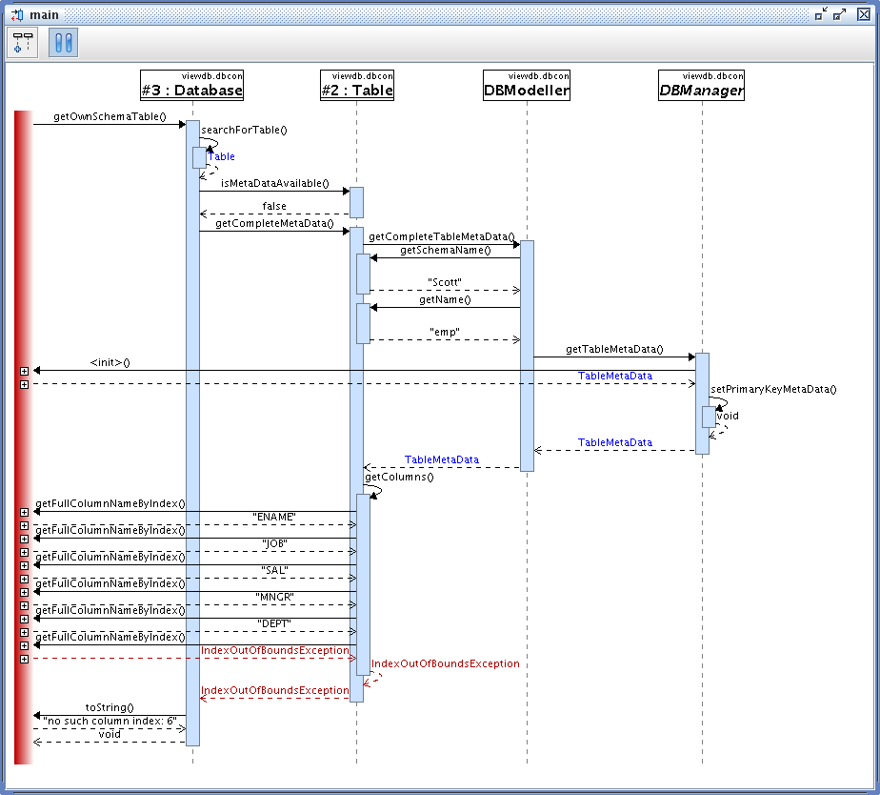
UML Sequence Diagram: Threads

Slide 29
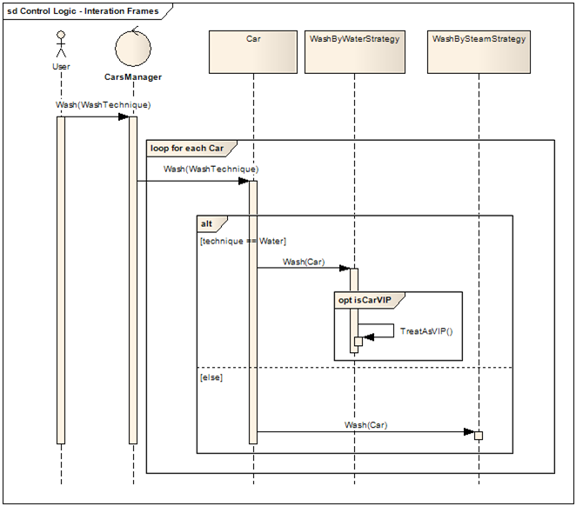
UML Sequence Diagram: Loop/Interaction

Slide 30
UML State Machines
Another way to describe the behavior of a system
Similar style to the Activity Diagrams
Closest diagram that represents the code
In Object-oriented approaches, the state machine diagram shows the lifetime behavior of a single object
State Machines are good at describing the behavior across several use cases.

Slide 31
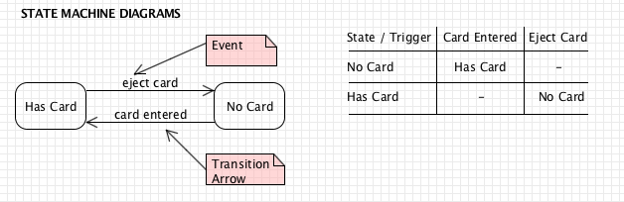
UML State Machines: Description/Tables
State Machines model the change of states and the events that cause them

Slide 32
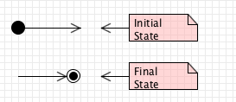
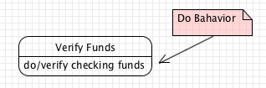
UML State Machines: Basic Symbols
Initial State – Starting Position
Final State – Ending Position
Do Behavior

Slide 33
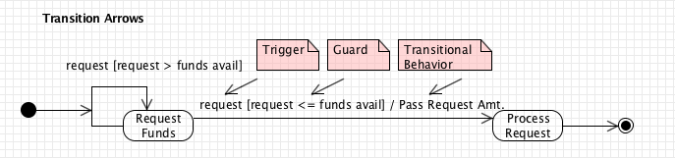
UML State Machines: Basic Symbols
Event / Transition
Transitions from one state to another
Trigger-signature – trigger to change the state
[guard] – Boolean Condition for transition to occur
Activity – Event that happens during transition

Slide 34
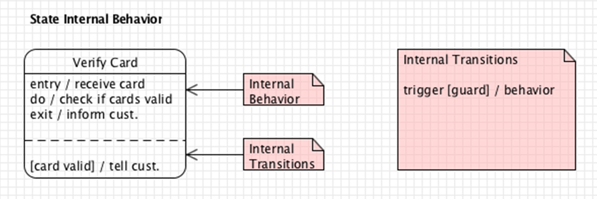
UML State Machines: Advanced Symbols
State Internal Behavior
Internal Behavior
Entry Behavior / Exit Behavior
Internal Events / Do Behaviors
Internal Transitions
Transition Label

Slide 35
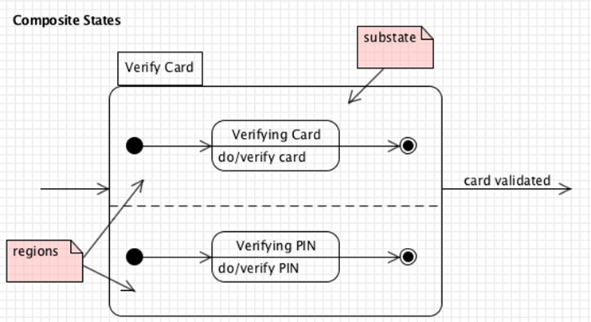
UML State Machines: Advanced Symbols
Concurrent States
Fork / Join
Concurrent Boundary
Choice Pseudostates (Boolean decisions)

