Slide 1
CS 4320 / 7320 Software Engineering
Models and Methods:
METHODS (and some review)

Slide 2
What is the SDLC?
Requirements
Analysis
Design
Requirements
Analysis
Requirements
Analysis
Design
Requirements
Analysis
Design
Problem
Design
Problem
Problem
Problem
Release
Testing
Implementation
Release
Testing
Testing
Implementation
Implementation
Maintenance
Problem
Notes:
n

Slide 3
… and back to the beginning…
What are the key factors for a
DEFINITION
of Software Engineering?

Slide 4
Software Engineering is…
“…the application of a systematic, disciplined, quantifiable approach
to the development, operation, and maintenance of software;
that is, the application of engineering to software.”
ISO/IEC/IEEE Systems and Software Engineering Vocabulary

Slide 5
Goals of Software Engineering
What are the key items to include in a
LIST OF GOALS
for Software Engineering?

Slide 6
Goals of Software Engineering:
Dependability
Maintainability
Efficiency
Acceptability
Security
Ian Sommerville, Software Engineering 9th ed.

Slide 7
Software Engineering Methods
Organized and systematic approaches
to developing software
As an engineer, you choose
an appropriate method or methods
** See SWEBOK Chapter 9

Slide 8
Software Engineering Methods
Types:
Heuristic
Formal
Prototyping
Agile

Slide 9
Heuristic Methods
Structured Analysis and Design Methods
Data Modeling Methods
Object Oriented Analysis and Design Methods

Slide 10
Heuristic Methods: Structured Analysis and Design
Input
Output
Mechanisms
Control
Data
Notes:
Functional
Behavioral

Slide 11
Heuristic Methods: Data Modeling
Data Model
Creature
Skill
Achievement
Notes:
Data driven
What are the relations
How is information related?

Slide 12
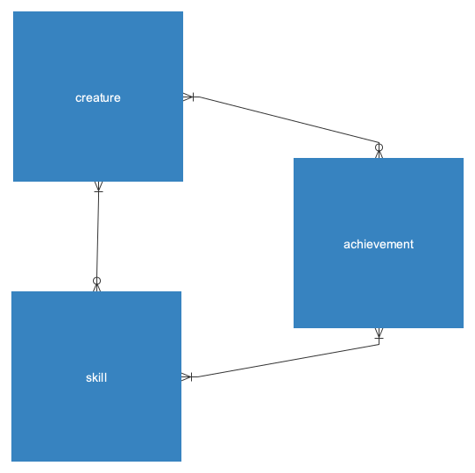
Conceptual Model

Slide 13
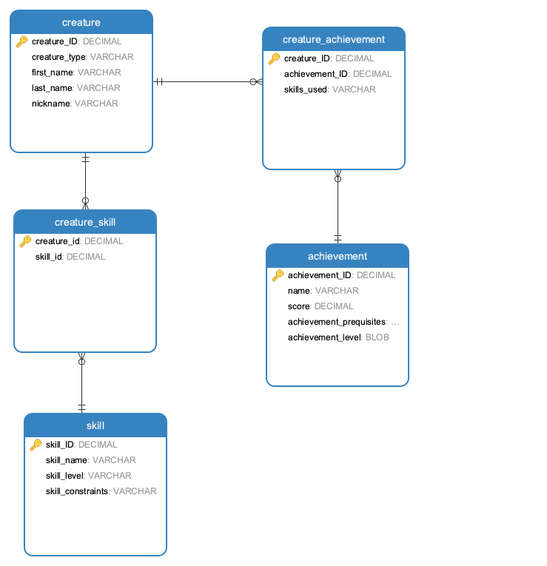

Slide 14
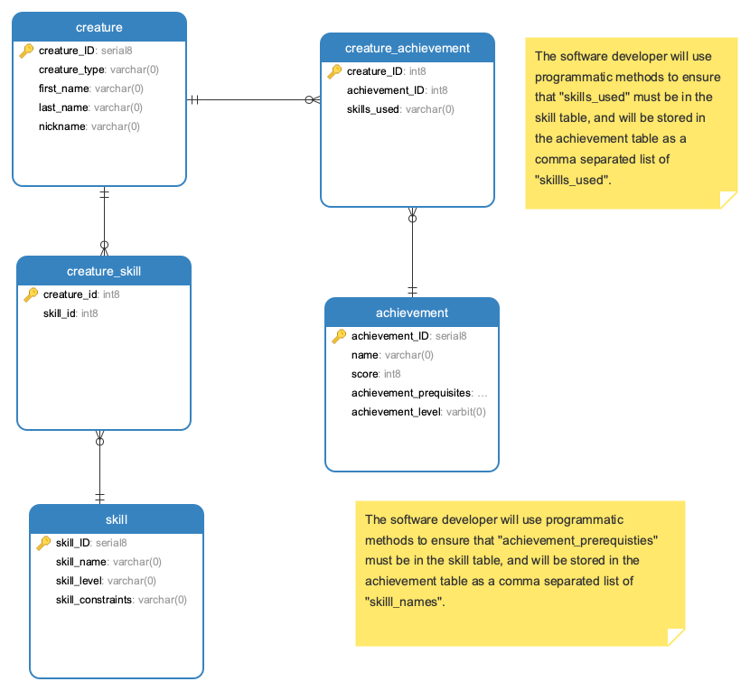

Slide 15
Heuristic Methods: Object Oriented Analysis and Design
State and Behavior
Data
Code / Methods
Integration / Cohesion & Coupling

Slide 16
Formal Methods
Safety Critical Systems
Systems that must be maximally deterministic
Mathematically verifiable

Slide 17
Prototyping Methods
What is a prototype?
Styles:
Throwaway
Evolutionary
Executable Specification
Notes:
Discuss value systems associated with each

Slide 18
Prototyping Methods
Examples of prototyping targets:
Requirements specification
Architectural design element
Human-machine user interface

Slide 19
Prototyping Methods
Evaluation techniques:
(Depends on the reason for prototyping)
Evaluated against implemented software
Evaluated against target set of requirements
Serve as a model for software development

Slide 20
Agile Methods in Historical Context
1990’s
From a desire to reduce overhead associated with plan-based methods (“waterfall”) **readings
Agile founders were concerned with values and principles rather than rigid, codified methodologies **readings
** Also Historical and comparative readings

Slide 21
Agile Methods
Typical characteristics of agile methodologies:
Short, iterative development cycles
Working product each iteration
Self-organizing teams
Refactoring
Test-driven development
Close customer involvement

Slide 22
Agile Methods: Rapid Application Development (RAD)
Notes:
Data

Slide 23
Agile Methods: eXtreme Programming (XP)
Notes:
Plan
Build
Test
USEr stories

Slide 24
Agile Methods: Scrum
Notes:
User stories with a manager

Slide 25
Agile Methods: Feature-Driven Development

Slide 26

Done!

