Slide 1
CS 4320 / 7320 Software Engineering
Models and Methods:
MODELS

Slide 2
What is the SDLC?
Requirements
Analysis
Design
Requirements
Analysis
Requirements
Analysis
Design
Requirements
Analysis
Design
Problem
Design
Problem
Problem
Problem
Release
Testing
Implementation
Release
Testing
Testing
Implementation
Implementation
Maintenance
Problem
Notes:
This again!

Slide 3
Modeling…
… is an organized and systematic approach for representing significant aspects of the software under consideration.
…facilitates decision-making about the software
…communicates those decisions to various stakeholders

Slide 4
Modeling Principles: Abstraction
Model the essentials…

Slide 5
Modeling Principles: Restricted Views
Provide specific (rule-based) views
Views: Structural view, behavioral view, temporal view,
organizational view, etc…
Rules: notation, vocabulary, methods, tools

Slide 6
Modeling Principles: Communication
Modeling enables effective communication
Application domain vocabulary
Modeling language
Semantic expression (meaning within context)

Slide 7
Caution…
False confidence
Be aware a model or models do not yield complete understanding
Models are abstractions (stuff is missing)
Syntax
Understand and adhere to the precise meanings of syntax
Changes
Be aware of changing context and assumptions (more on that later)

Slide 8
Beware Assumptions
“Abstraction leads to a set of assumptions
about the context in which the model is placed
that should also be captured in the model.”
SWEBOK 9-3
Preconditions
Postconditions
Invariants

Slide 9
Beware Assumptions
“Abstraction leads to a set of assumptions
about the context in which the model is placed
that should also be captured in the model.”
SWEBOK 9-3

Slide 10
Unified Modeling Language (UML)
1994-1995
Developed by Grady Booch, Ivar Jacobson, and James Rumbaugh at Rational Software to standardize notation in Software Engineering
1997
Adopted by Object Management Group (OMG)
2005
Adopted by International Organization for Standardization (ISO)

Slide 11
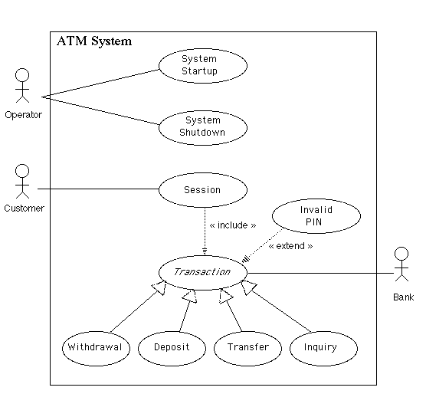
A Special Case: Use Cases
For Modeling Requirements

Slide 12
Types of Models
Information Modeling
Conceptual, logical, and physical data models
Behavioral Modeling
State machine, control-flow, and data-flow models
Structure Modeling
Class, component, object, deployment, and packaging models

Slide 13
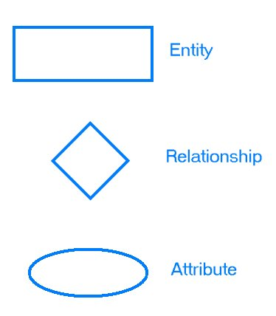

Informational Modeling
Entity
Relationship
Attribute

Slide 14
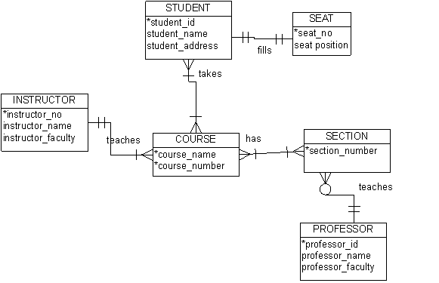
Informational Modeling
Entity
Relationship
Attribute

Slide 15
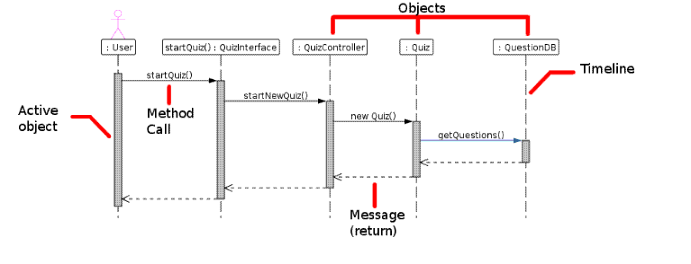
Behavioral Modeling

Slide 16
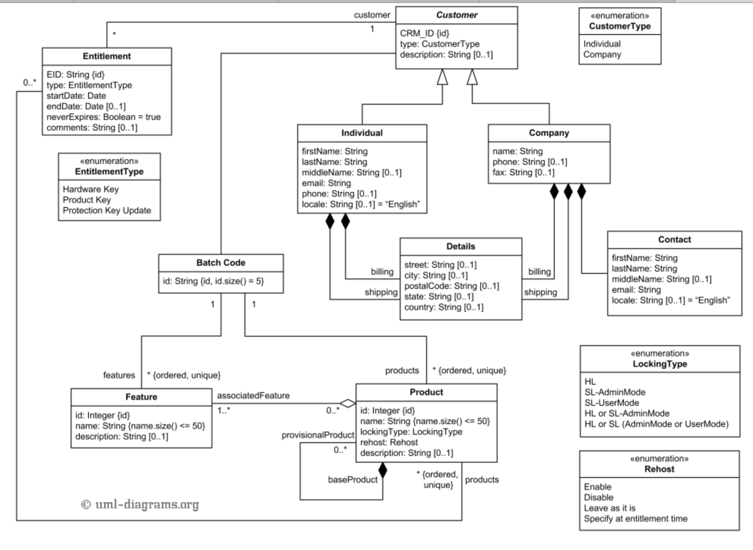
Structure Modeling
Notes:
----- Meeting Notes (1/26/17 15:13) -----
This model does not have methods. So, its a bad choice! (ugh)
Change to a model with methods in it.
In Class, had them analyze for consistency, completeness and correctness of the customer/individaul/detail classes

Slide 17
Analysis of Models
Analyzing for Completeness
Are all requirements implemented and verified?
Analyzing for Consistency
Do the models conflict?
Analyzing for Correctness
Is the model syntactically and semantically correct?

Slide 18
Analysis of Models
Traceability
Can the requirements, models, and code be connected up?
Can changes be traced?
Interaction Analysis
Does the control flow between parts of the system work as intended?

Slide 19
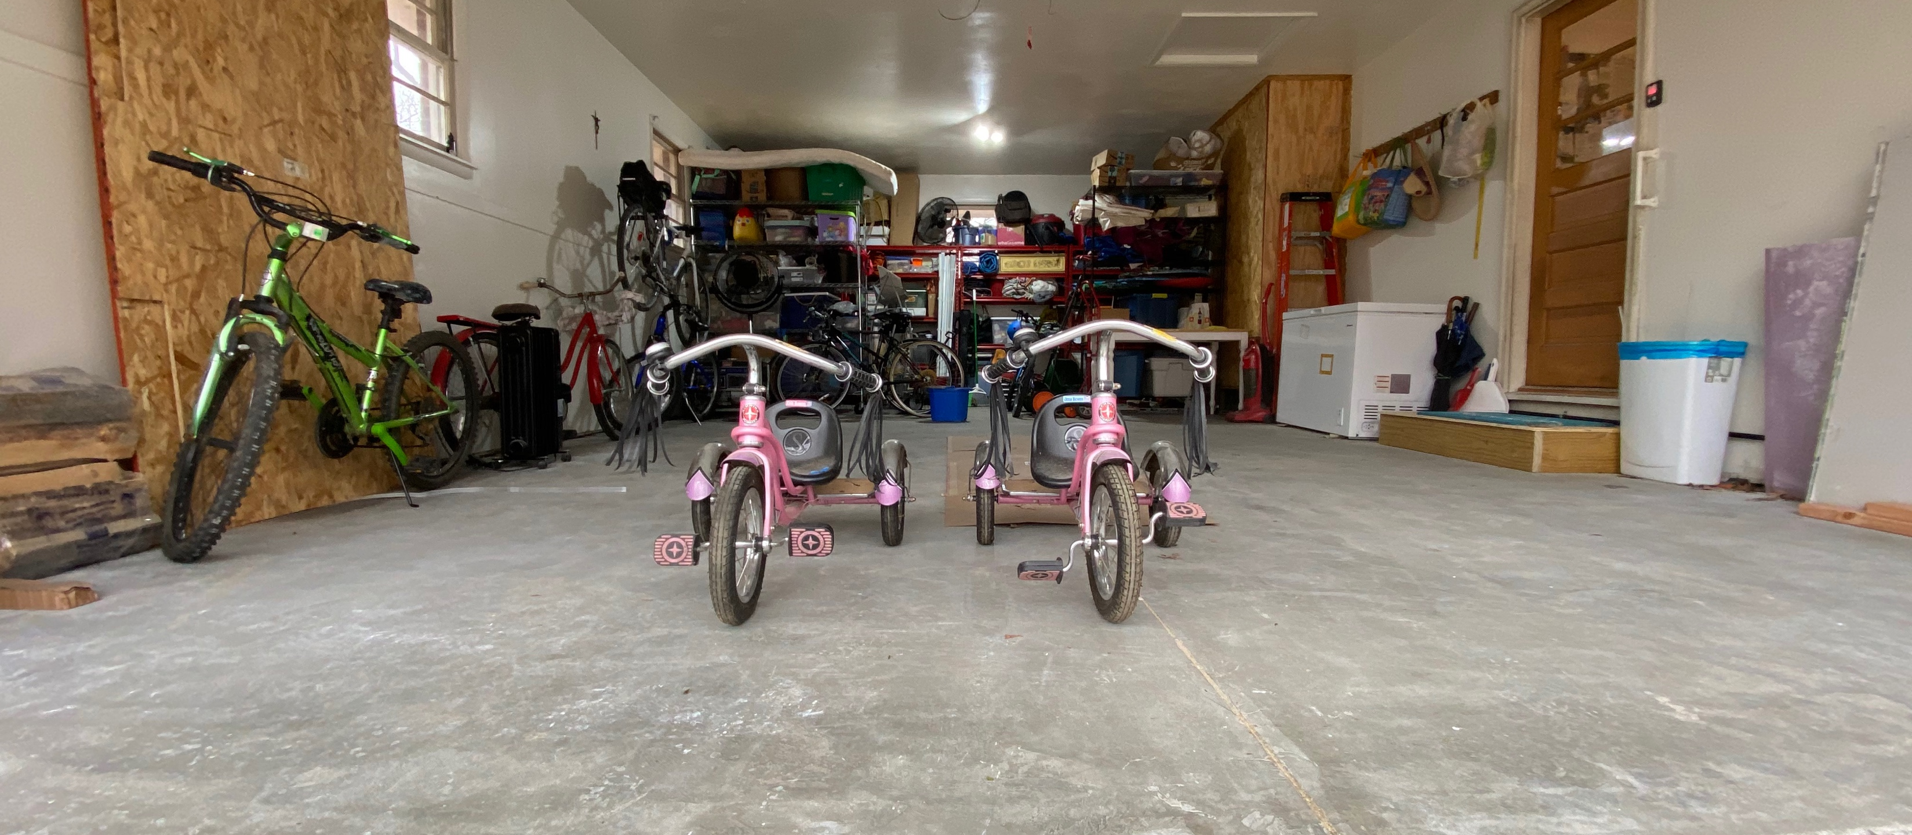
Done!

