Slide 1
CS 4320 / 7320 Software Engineering
Use Cases

Slide 2
What is the SDLC? Where does Requirements Analysis fit?
Requirements
Analysis
Design
Requirements
Analysis
Requirements
Analysis
Design
Requirements
Analysis
Design
Problem
Design
Problem
Problem
Problem
Release
Testing
Implementation
Release
Testing
Testing
Implementation
Implementation
Maintenance
Problem

Slide 3
What is a software requirement?
A requirement is a property that must be exhibited by the software system in question in order to solve some problem in the real world.
Each requirement must be verifiable within available resource constraints.

Slide 4
Use Case Components
Each use case should contain the following elements:
Title (active verb phrase, states main goal)
Description (This may be several paragraphs. Context is important. You are describing the use case in some detail, and since many of the use cases will involve users changing parameters on data visualizations, you should be exceedingly clear about this type of thing.)
Triggers (What prompts the use case to start?)
Actors (Who is involved?)
Preconditions (This includes things like “data loaded”. Or, project is flagged as “of interest”; etc.)
Main Success Scenario (Goals) (What does it look like when the user’s work is successful in the system?)
Alternate Success Scenarios (For a data analysis and “data playing” focused project like this one, there could be several different success scenarios for each use case. “Sees visualization” is not a success scenario. “Compares four different projects on “indicator X” and saves “project trackers” for each one could be a success scenario.)
Failed End Condition (“crashes” is not a failed end condition. “User is unable to discern the difference between two projects because they are similar on the available indicators” might be).
Extensions
Steps of Execution (Requirements)
A use case diagram, following the UML Standard for expressing use cases.

Slide 5
Use Case Example
Each use case should contain the following elements:
Title (active verb phrase, states main goal)
Description (This may be several paragraphs. Context is important. You are describing the use case in some detail, and since many of the use cases will involve users changing parameters on data visualizations, you should be exceedingly clear about this type of thing.)
Triggers (What prompts the use case to start?)
Actors (Who is involved?)
Preconditions (This includes things like “data loaded”. Or, project is flagged as “of interest”; etc.)
Main Success Scenario (Goals) (What does it look like when the user’s work is successful in the system?)
Alternate Success Scenarios (For a data analysis and “data playing” focused project like this one, there could be several different success scenarios for each use case. “Sees visualization” is not a success scenario. “Compares four different projects on “indicator X” and saves “project trackers” for each one could be a success scenario.)
Failed End Condition (“crashes” is not a failed end condition. “User is unable to discern the difference between two projects because they are similar on the available indicators” might be).
Extensions
Steps of Execution (Requirements) (Functional and Technical)
A use case diagram, following the UML Standard for expressing use cases.
https://github.com/OCDX/OCDX-Engine/blob/master/use-cases/Contribute-to-Existing-Dataset.md

Slide 7
Product requirements may be…
Functional
Capabilities, features, or functions the software will execute
Finite test steps can be written for it
A description of a behavior that a system will exhibit under specific conditions. [Wiegers]
Non-functional
Constraints on the solution
Quality attributes
Performance Security
Maintainability Interoperability
Reliability Etc…
A description of a property or characteristic that a system must exhibit or a constraint that it must respect. [Wiegers]

Slide 8
System Requirements
A system is an interacting combination of elements to accomplish a defined objective. These include hardware, software, firmware, people, information, techniques, facilities, services, and other support elements.
System requirements are requirements for the system as a whole.
Software requirements are derived from system requirements. [SWEBOK 1.6]
A system requirements is a top-level requirement for a product that contains multiple subsystems, which could be all software or software and hardware. [Wiegers]

Slide 9
System Requirements
Pre-requisites that often define the operating environment
Architecture
Hardware
Storage
Memory
CPU
Connectivity etc.
Notes:
----- Meeting Notes (2/2/17 15:06) -----
this slide needs ot have some of the sociotechnical elements from the previous slide.

Slide 10
User Requirements
Identify the different classes of user in your system
What are the goals of that user? What do they want to be able to do?
A prospective customer shall be able to add items to a shopping cart.
A customer shall be able to check out.

Slide 11
Example: User Requirements to Functional Requirements
User Requirement for a Web Browser:
The user shall be able to edit bookmarks.
Functional Requirements for a Web Browser:
The system shall display bookmarks as a collapsible and expandable hierarchical tree.
The user shall be able to resequence bookmarks.
The system shall display bookmark properties.
The user shall be able to modify a bookmark’s name, URL, and description. [Wiegers]

Slide 12
A few practical properties…
Priority rating
to enable trade-offs when faced with finite resources
Status value
to enable project progress tracking
Unique identifier
to enable tracking and configuration management
Proposed
Approved
Imple-mented
Verified
1.2a

Slide 13
Requirements Process
Elicitation
Analysis
Specification
Validation
Confirm and Correct
Re-evaluate
Clarify
Close Gaps
Rewrite

Slide 14
Requirements Elicitation Sources
Goals (Business Requirements)
Domain Knowledge
Stakeholders
Business Rules
Operational Environment
Organizational Environment

Slide 15
Requirements Elicitation Techniques
Interviews
Scenarios (use cases)
Prototypes
Facilitated meetings
Observation
User Stories
Analyzing competitor products
Analyzing existing system being replaced

Slide 16
Requirements Analysis – Why?
Detect and resolve conflicts
Discover the bounds of the software and how it must interact with its organizational and operational environment
Elaborate system requirements to derive software requirements

Slide 17
Requirements Analysis – How?
Classify requirements
to help think about them in an organized way
Functional vs non-functional
Derived from stakeholder or emergent
Product or process
Priority
Scope
Volatility/stability

Slide 18
Requirements Analysis – How?
Organize requirements
to help track them and look for interactions
By Business Process? Features? Subsystems?
Leave room in your identifiers for additions and changes
Conceptual modeling to understand the problem
Use Case diagrams, data models, others as deemed useful

Slide 19
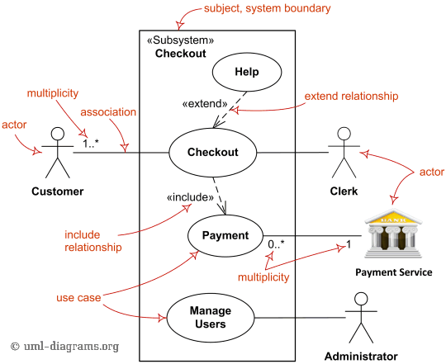
Use Case Diagram
Actors
Use cases (functions)
Included functions (required)
Extended functions (optional)

Slide 20
Requirements Validation
Clear? –unambiguous; one possible meaning to all readers
Correct? – accurately states a user or external need
Consistent? – no conflicts or contradictions
Complete? – nothing missing
Feasible? – can be implemented within resource constraints
Verifiable? – we can tell if the requirement has been achieved

Slide 21
Requirements Validation
Requirements reviews
Include a customer representative
Prototyping
Espec. for dynamic behaviors, user interfaces, critical features
Use low-quality prototypes to keep focus on topic
Model Validation
Acceptance Tests
Identifying and designing acceptance tests

Slide 22
Requirements Management
What to manage:
Documentation
Tracing - connecting up requirements, design, code, testing
Change Management
How to manage:
Specialized tools
Simpler, cheaper, but less satisfactory: spreadsheets

