Slide 1
CS 4320 / 7320 Software Engineering
Construction and Testing

Slide 2
What is the SDLC? Where does Testing fit?
Requirements
Analysis
Design
Requirements
Analysis
Requirements
Analysis
Design
Requirements
Analysis
Design
Problem
Design
Problem
Problem
Problem
Release
Testing
Implementation
Release
Testing
Testing
Implementation
Implementation
Maintenance
Problem

Slide 3
Testing is….
… dynamic verification (or validation) that a program provides expected behaviors on a finite set of test cases, suitably selected from the (usually) infinite execution domain.

Slide 4
Software is designed to produce desired output from a set of inputs, based on the instructions you think you have implemented
Specific Input (and State?)
Test Target
Expected Result
The Test Target can vary in granularity: a unit, a combinations of components, a sub-system, the whole system

Slide 5
Testing Goals
Demonstrate the software meets the requirements
Discover failures in the software
Faults cause failures
Testing reveals failures
The cause, the fault, may be hard to find

Slide 6
Test Levels
Unit Testing
Integration Testing
System Testing

Slide 7
Unit Testing: What is it?
Testing program components at the smallest functional unit
Unit tests are organized into test suites of related tests, for example…
For OOP, a class should have its own test suite(s) that exhaustively cover every method, with multiple tests!
In MVC design, models and controllers can be unit tested.
DB stored procedures can be unit tested.

Slide 8
Unit Testing: How to do it?
Units must be de-coupled to do unit testing.
A driver is a program that feeds test data to the test target and prints results.
A stub replaces modules that are invoked by the component to be tested, substituting dummy results for the test target to use
Good interfaces are essential
Units with High Cohesion are easier to test. (Why?)

Slide 9
Test Driven Development
Identify new functionality needed in software / component
Write tests for new functionality
Functionality tests, unit tests
Run tests, which should ALL FAIL
Implement functionality in proper components and re-factor as necessary
Repeat step 3 and 4 until all tests pass

Slide 10
Integration Testing
Testing if program components integrate & interact as expected
Stubs are replaced with actual components
Can include UI events driving behavior, database calls
These tests begin to represent test-cases of the requirements
As software/system complexity increases, more opportunities for components to interact
Each interaction between components may affect the state of the system or components

Slide 11
System Testing
All components of the system are functioning together
For testing:
Non-functional requirements – security, speed, accuracy, reliability.
System configurations
External interfaces

Slide 12
Oops, we failed a test….
What do you do?
If coding is “done” - create an issue/bug
Is it a design or code issue?
Fix the design and/or fix the code
Then what?
Regression testing
If tests pass.. close the issue/bug

Slide 13
When are we done with testing?
Does it do what it is supposed to do?
Who is the ultimate authority on this?
Client product: client representative(s)
Consumer product: selected target user(s)
User Acceptance Testing
Not automated, typically scenario or story-board driven

Slide 14

Validation vs Verification
Verification: Does it meet the detailed specifications?
Validation: Does it do what it is supposed to do?
If it meets specifications, how could it
not do what it is supposed to do?

Slide 15
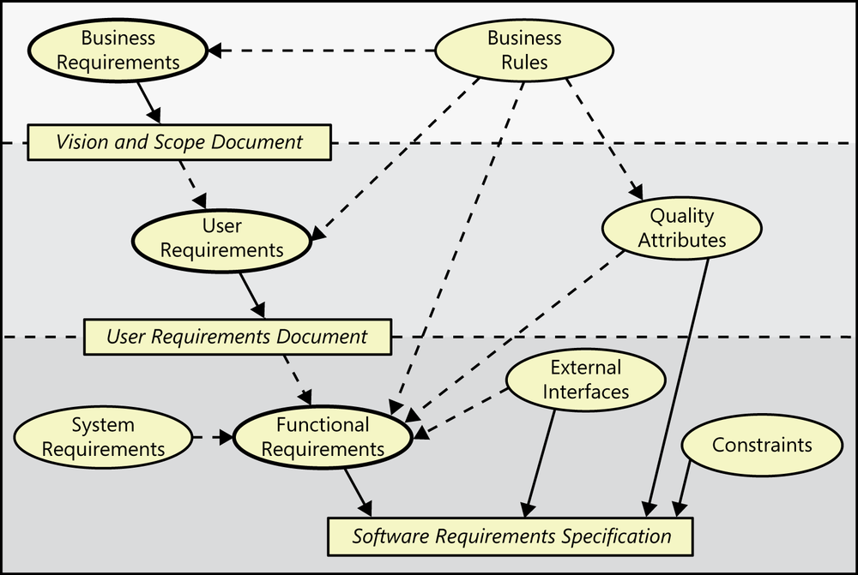
Non-functional Requirements
Represented with Use Cases
Are the origin of
Influence
Figure 1-1. Relationships among several types of requirements information. Solid arrows mean “are stored in”; dotted arrows mean “are the origin of” or “influence.” Source: K. E. Wiegers and J. Beatty, Software Requirements, 3rd ed., Redmond, Washington: Microsoft Press, 2013.

Slide 16
Validation vs Verification
Which test(s) are validation?
Which test(s) are verification?
Test levels and objectives we’ve covered:
Unit tests, integration tests, system tests,
regression tests, user acceptance tests
Notes:
----- Meeting Notes (2/21/17 15:06) -----
validation: user acceptance
Verification: Everything else

Slide 17
Other testing objectives
Performance testing
Security testing**
Stress testing
Interface testing
Configuration testing
Usability and Human Computer Interaction Testing

Slide 18
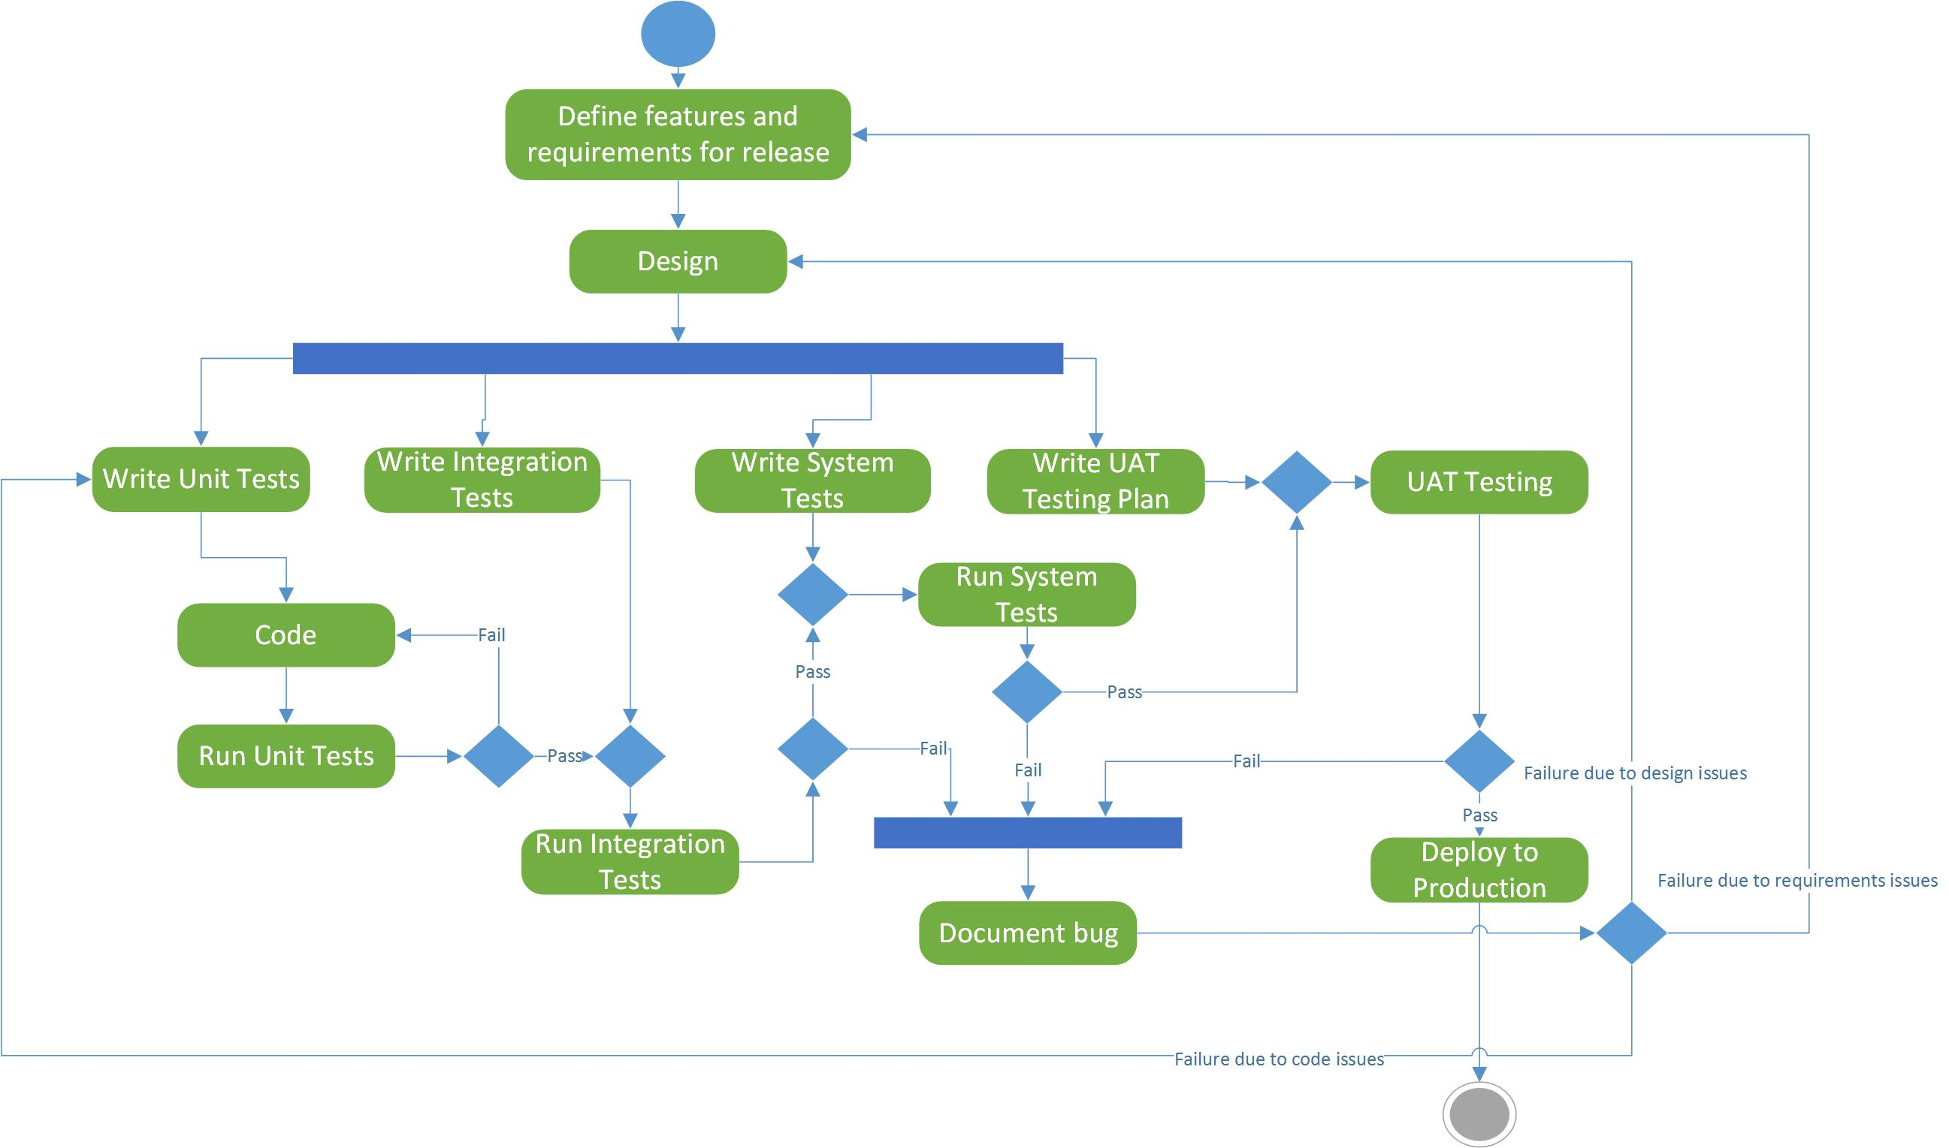
One view of a testing process
Question: where is regression testing?

Slide 19
Limitations of tests
Program testing can be used to show the presence of bugs,
but never to show their absence.
Edsger Dijkstra
Testing is dynamic verification that a program provides expected behaviors on a finite set of test cases, suitably selected from the (usually) infinite execution domain.
SWEBOK Chapter 4

Slide 20
Designing Tests: Black Box vs. White Box
Black Box Testing:
Tests are designed based on input / output only
White Box (or Clear Box) Testing:
Tests are designed based on the software design and coding

Slide 21
Designing Tests: Input-based techniques
Equivalence Partitioning: Divide the input into logical subsets and take a sample from each subset
Pairwise Testing: Combine interesting values of input variables (rather than all combinations)
Boundary-Value Analysis: Choose input values on or near boundaries of the variable domains. Also choose values outside the boundaries.
Random Testing: Random input values from the domain

Slide 22
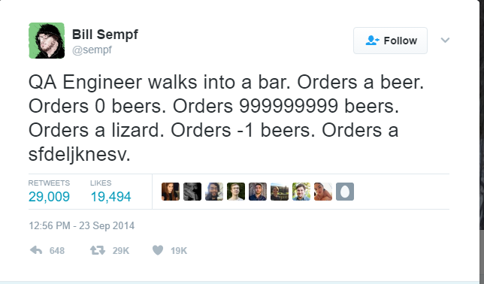
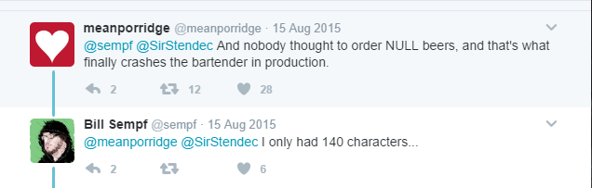

Slide 23
Designing Tests: Code-based techniques
Control flow-based criteria: Cover all statements, or statement blocks, or some combinations of statements.
Path testing: test all entry-to-exit control flow paths
All is usually not feasible – limit loops, aim for a % coverage

Slide 24
Designing Tests: Code-based techniques
Data flow-based criteria: Select paths to explore the sequence of events related to variable status. When do variables receive values? When are these values used?
Helps find:
Variables that are declared but never used
Variables that are used but never declared
Variables that are defined multiple times before being used
Variables that are deallocated before being used

Slide 25
Designing Tests: Test the unhappy path
Don’t just think about what the code is supposed to do, but the error and exception handling that should happen if something goes wrong.

Slide 26
Automated Testing
Advantages of automated testing
Once tests have been developed, can be run quickly and repeatedly
Allows easy regression testing
Easy -> testing more likely to get done -> defects more likely to be found
Kinds of automated testing
Graphical User Interface testing – a testing framework records or generates UI events
API driven testing –tests using a programming interface to the application (whole application, classes, modules, or libraries) , might use a framework

Slide 27
What is “Done”?
Done:
With coding… but what if a test fails?
Done, Done:
With coding and testing.. But is it ready to be used?
Done, Done, Done:
With code, testing, and deployment… In production! DONE!

