Slide 1
CS 4320 / 7320 Software Engineering
Construction and Testing

Slide 2
What is the SDLC? Where does Construction fit?
Requirements
Analysis
Design
Requirements
Analysis
Requirements
Analysis
Design
Requirements
Analysis
Design
Problem
Design
Problem
Problem
Problem
Release
Testing
Implementation
Release
Testing
Testing
Implementation
Implementation
Maintenance
Problem

Slide 3

Construction Fundamentals
Psst…here’s a secret.
A lot of this also occurs in design.

Slide 4
Construction Fundamentals
Minimize Complexity
Anticipate Change
Construct for Verification
Reuse
Standards

Slide 5
Construction Fundamentals: Minimize Complexity
Make it readable
Keep it simple
Don’t be clever
Follow standards
Use modular design
For Python, here is a good reference:
http://docs.python-guide.org/en/latest/writing/style/#code-style

Slide 6
Construction Fundamentals: Anticipate Change
Modularity and Cohesion
Interfaces
Organization: put things that change together, together
“Loose coupling” vs. Appropriate coupling
Things that change often: fewer dependencies
Things that rarely change: more dependencies ok

Slide 7
Construction Fundamentals: Construct for Verification
Build it so that faults are easily found and diagnosed
during development, testing and operations.
Follow standards to support code reviews & unit testing
Organize code to support automated unit testing
Restrict use of complex, hard-to-understand code

Slide 8
Construction Fundamentals: Reuse
Libraries, modules, components, source code, COTS….
Construction FOR reuse
Construction WITH reuse
When does it make sense? What are trade offs?
Vendor support, code dependencies, …

Slide 9
Construction Fundamentals: Standards
Well thought out standards help achieve non-functional objectives such as efficiency, quality, and cost.
Communication methods (document or message formats)
Programming language
Coding standards (naming conventions, layout, indentation…)
Platforms (interface standards)
Tools (notations like Crow’s foot, UML)

Slide 10
Secure Coding
Input validation
Output Encoding
Authentication and Password Management
Access Control
Error Handling and Logging
See.. OWASP Secure Coding Practices Quick Reference Guide
https://www.owasp.org/images/0/08/OWASP_SCP_Quick_Reference_Guide_v2.pdf

Slide 11
Error Handling
Anticipate errors
A few error handling techniques:
Return neutral value
Logging a warning message
Return an error code
Shutting down
What makes sense in this situation?

Slide 12
Exception Handling
Detect and gracefully process errors & exceptional events
Implemented with a Try-Catch block of code
May process the exception or return to the calling block
Include all relevant info in the message (*but not to the user)
No empty catch blocks (!!!!)
Know your library exceptions
Standardize exception handling

Slide 13
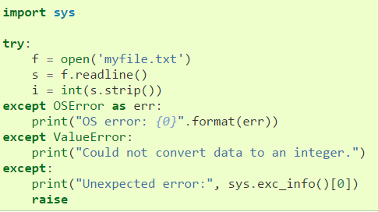
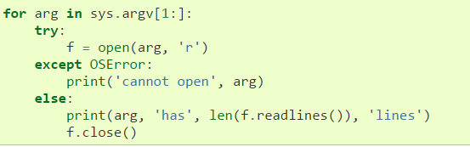
Python Exception Handling

Slide 14
Test-First Programming
Unit test cases are written before writing the code
Advantages:
Detect and correct defects earlier
Forces careful consideration of requirements and design
Reference for Python Test Driven Development:
http://www.obeythetestinggoat.com/pages/book.html

