Slide 1
Vechical Speed Detection
Using OpenCV

Slide 2
Introduction
Objective: Detect and measure the speed of vehicles in a video.
Tools Used: Python, OpenCV, NumPy, and Math libraries.
Key Features: Speed calculation, speed limit checks, and penalty image saving.

Slide 3
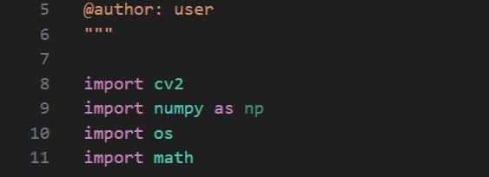
Importing Libraries
cv2 for computer vision tasks.
numpy for numerical operations.
os for file system operations.
math for mathematical calculations.

Slide 4
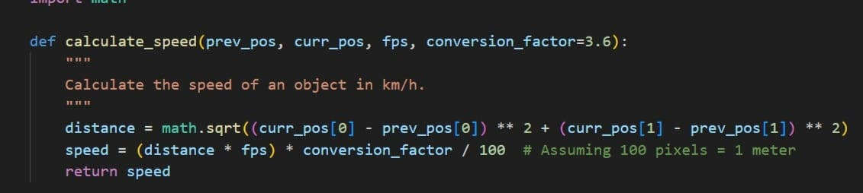
Calculating Speed
Calculates the speed of an object between two positions in km/h.
Uses Euclidean distance formula and converts speed to km/h.

Slide 5
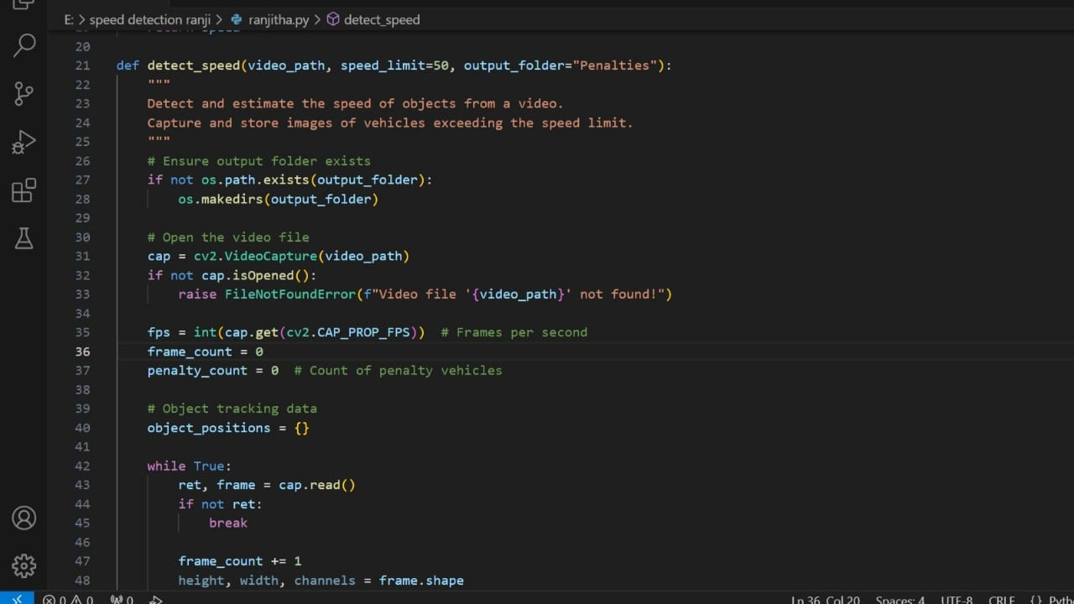
Detect Speed Function
Opens video file and processes each frame.
Detects motion using frame differencing.
Calculates speed and checks for speed limit violations.
Saves images of vehicles exceeding the speed limit.

Slide 6
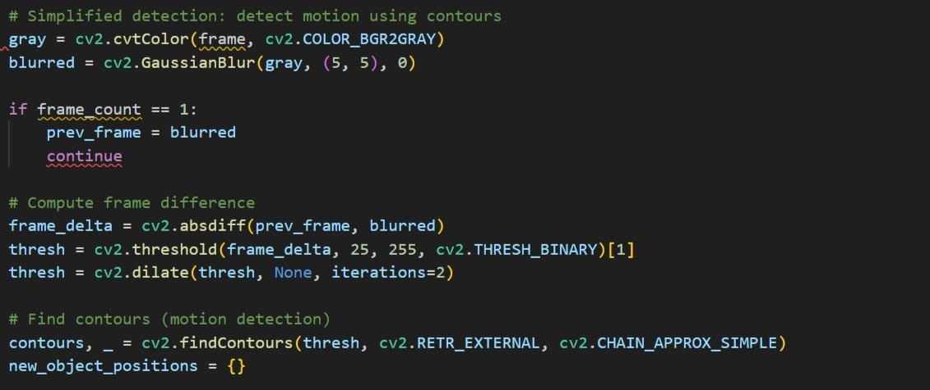
Motion Detection
Converts frames to grayscale and applies Gaussian blur.
Computes frame difference and applies thresholding and dilation.
Detects contours for motion detection.

Slide 7
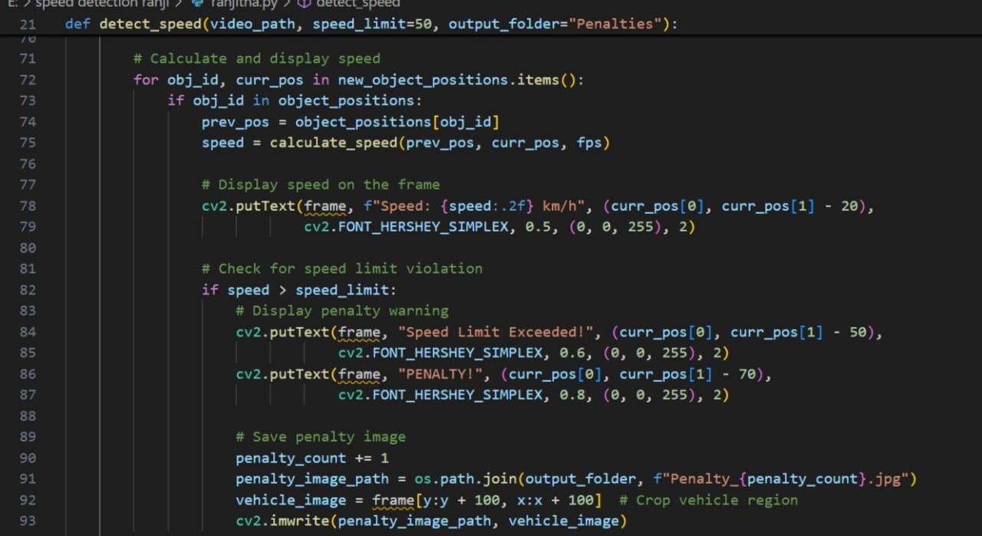
Speed Calculation and Penalty Handling
Calculates speed for detected objects.
Displays speed on the frame.
Checks for speed limit violations and handles penalties.

Slide 8
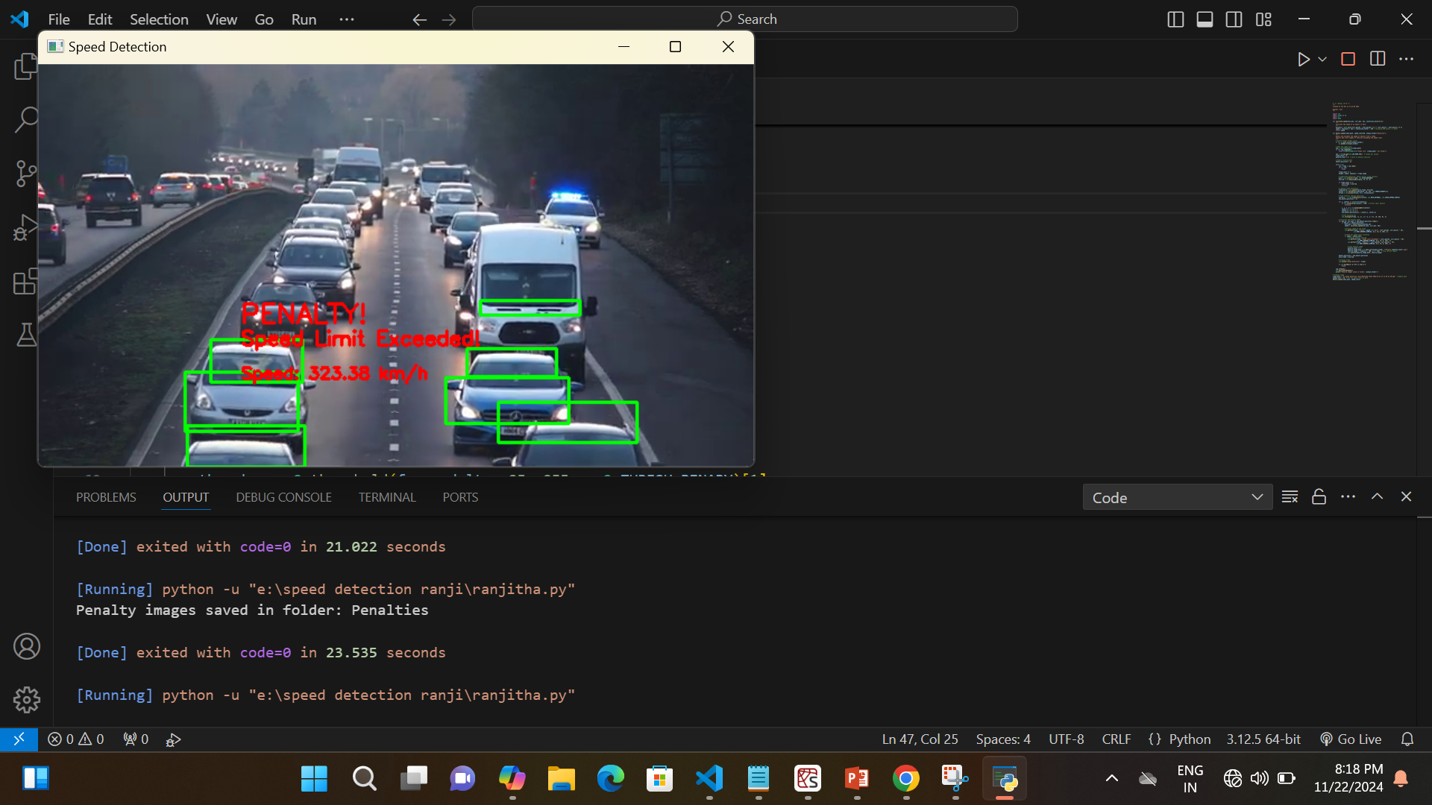
Penalty Vechicles are captured

Slide 9
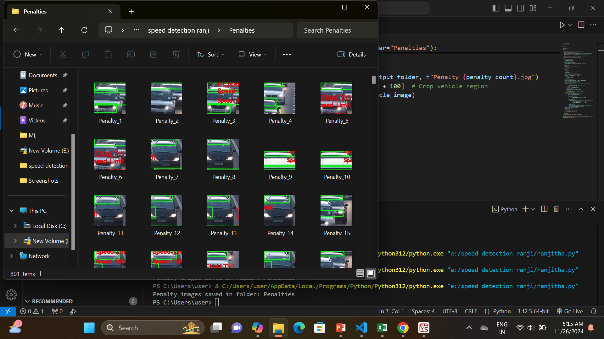
Finally it will store the captured image

